Slide 1


Tutorial: Decision Making
BME 121, Fall 2016
Rasoul Nasiri

Slide 2
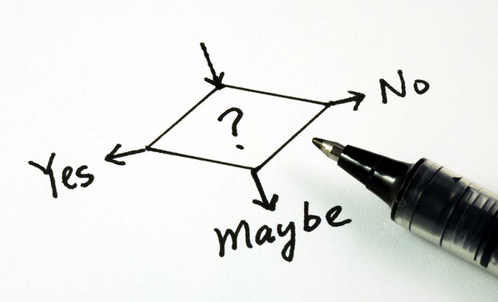

Topics
Making a decision
Logical Variables and comparisons
If-statement
If-else
Logical Operation
&&, ||, !=

Slide 3
Decision statement
How should this cat decide?
Owns:
Litter box
Fake mouse
Does not own?
Your laptop
Your bag
…

Slide 4
Boolean Variables
If something is true
Boolean variable can have two values
true
false
Boolean variables can reflect the status of a concept
The cat has litter box: true
It is very warm in Canada: false
See: 1.booleanVar.cs

Slide 5
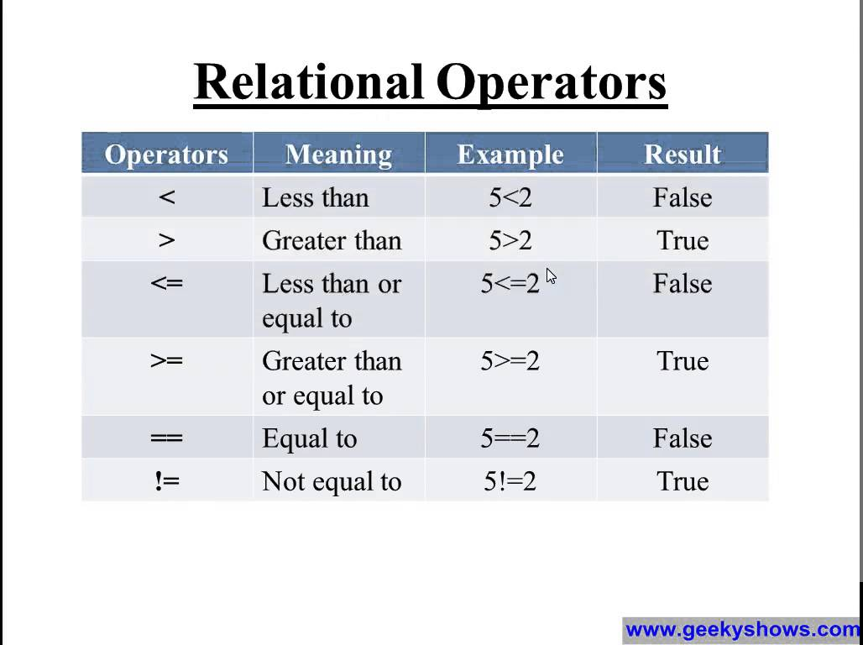
Boolean values from comparisons
Comparing two values of the same type to see their relation and use as a Boolean value/variable
The result of comparison
true
false
We can assign the result to
a boolean variable
See: 2.Comparisons
See: 3.RelationalwithParse

Slide 6
Note on string comparisons
Equality of two strings
word1 == word2: is true if they are exactly same
word1 != word2: is true if the words are different
Comparison of strings is case sensitive
E.g.:
Sarah == Sarah : true
Sarah != sarah : true
Sarah == Saraah: false
Sarah != Sarah1: true
If for some case you can accept both capital and small letter: use TOUpper() and ToLower() functions.
See: 4.StringComparison.cs

Slide 7
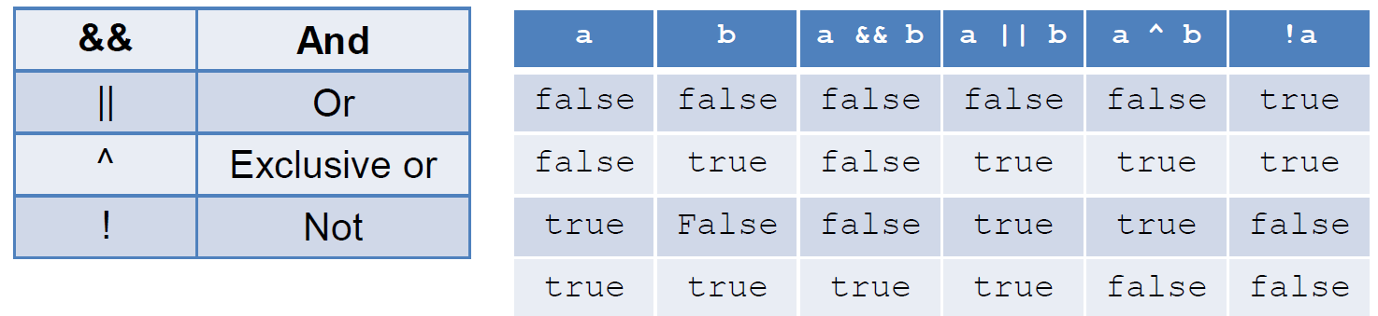
Logical Operators
Simple Logical statement
Single Boolean variable or comparison of values
It can be evaluated to true/false
Complex statement
Combination of simple logical statements
It can be evaluated to true/false
Combination is made by logical operators
See: 5.LogicalOperators

Slide 8
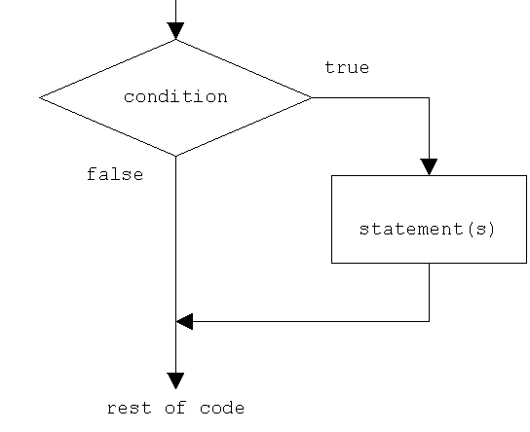
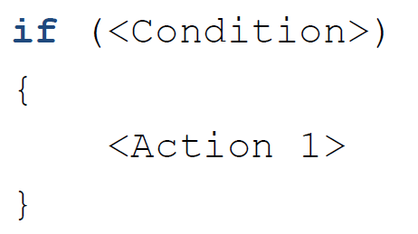
If statement
E.g.:
See: 6.IfStatement.cs
Bool isOddNumber = (a %2 != 0);
if( isOddNumber== true)
{
…
}
Bool isOddNumber = (a %2 != 0);
if( isOddNumber)
{
…
}
if(a %2 != 0)
{
…
}

Slide 9
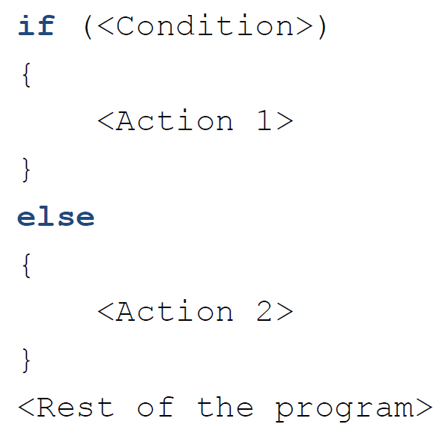
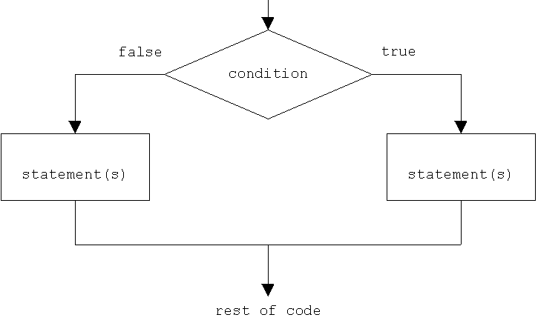
If-else statement
See: 7.IfElse.cs

Slide 10
If-else-if
Detect input values from

Slide 11
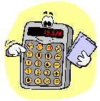
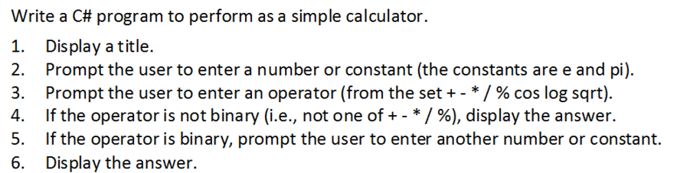
WA2
See: WA2.cs,

