Slide 1
Results and observations for pure structural MMTO See MMTO_main.py

Slide 2
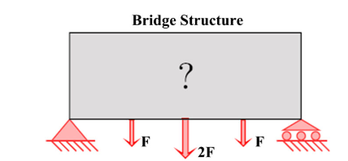
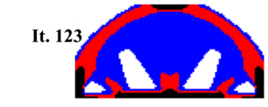
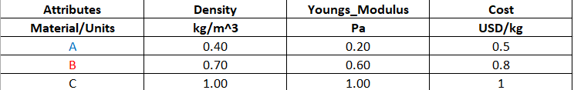
Bridge Problem
2D; 5000 elements
Final compliance: 238
Zuo, W. and Saitou, K., 2017. Multi-material topology optimization using ordered SIMP interpolation. Structural and Multidisciplinary Optimization, 55(2), pp.477-491

Slide 3
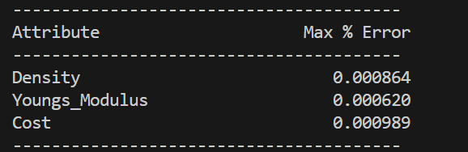
Materials: DataConstantTemperature/3MaterialsBridge.xlsx
3 materials
3 attributes
Training takes about 3 mins. All attributes reconstruction errors are within 0.001%

Slide 4
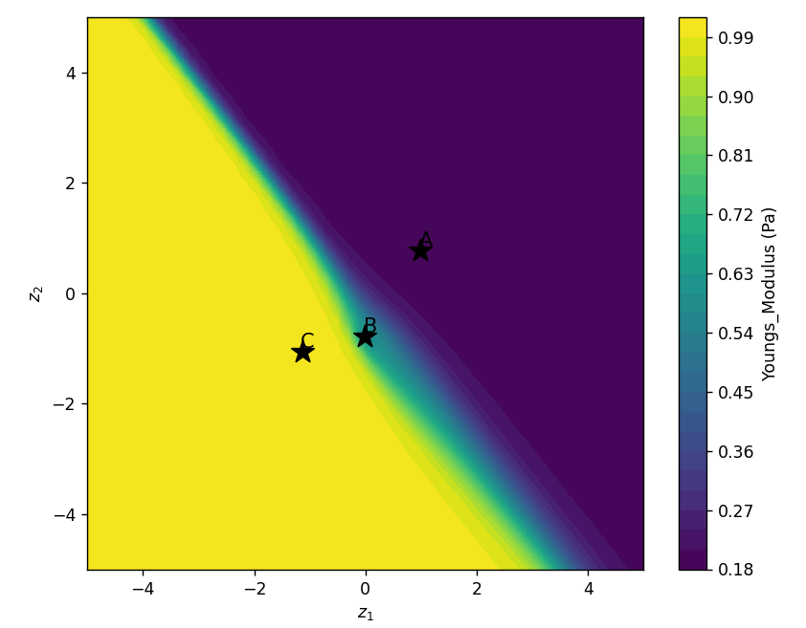
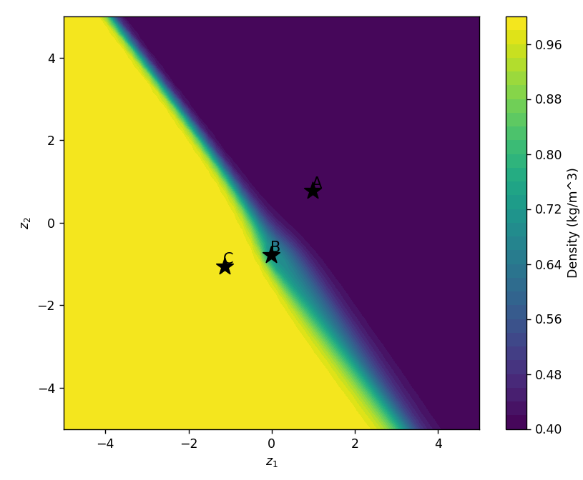
Sample Latent Spaces
Young’s Modulus
Density

Slide 5
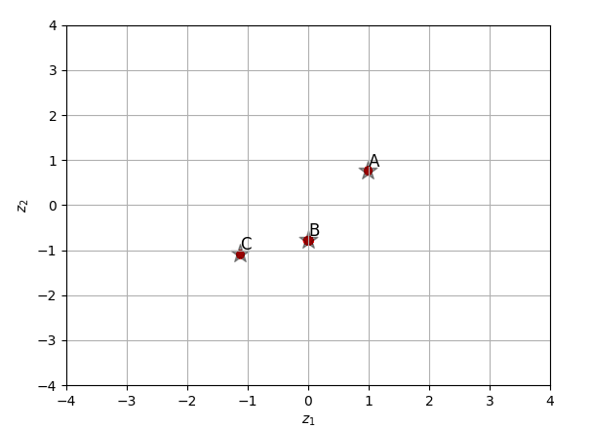
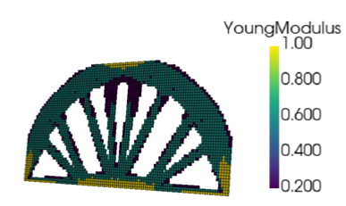
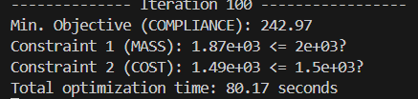
Example 1
MMTOExamples.BridgeProblem_Compliance_MassCost
Our compliance: 243
Our 3D solution is within 2% of the 2D benchmark solution.
Reference compliance: 238

Slide 6
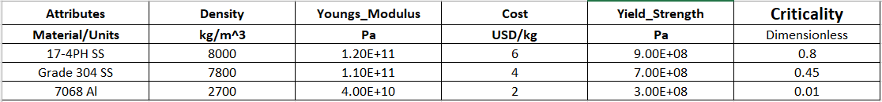
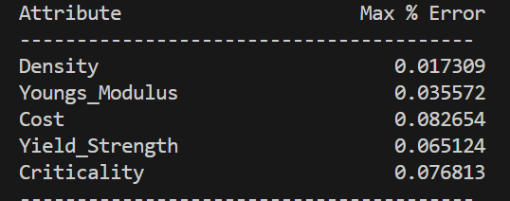

Materials: DataConstantTemperature/3Materials.xlsx
3 materials
5 attributes
Training takes about 4 mins. This is usually negligible for large scale TO problems
All attributes reconstruction errors are within 0.1%

Slide 7
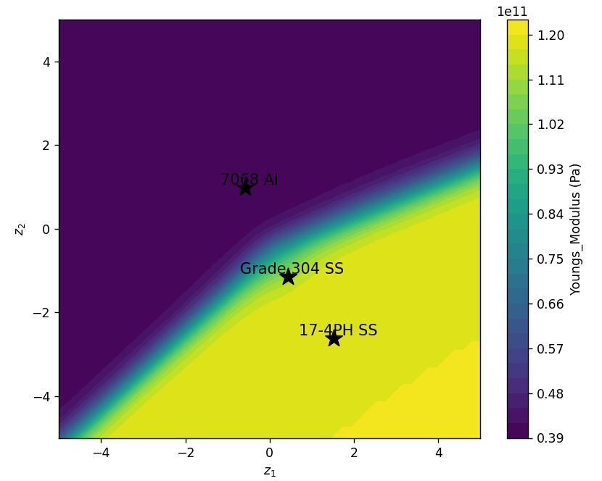
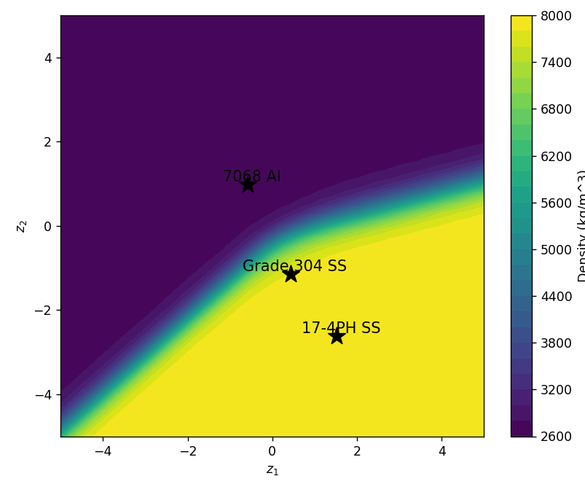
Sample Latent Spaces
Young’s Modulus
Density

Slide 8
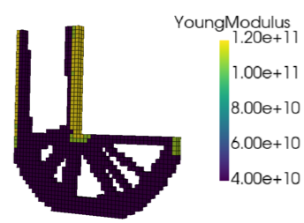
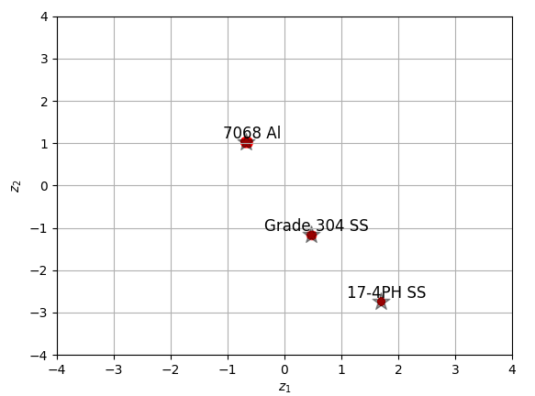

Example 2
MMTOExamples.LBracketTopLoad_Compliance_Mass
Stiff materials are added where expected.
Constraints are satisfied

Slide 9
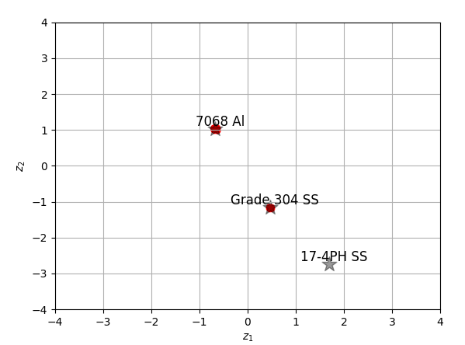
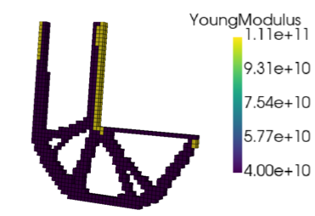
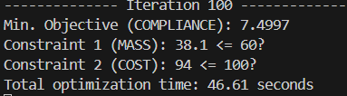
Example 3
MMTOExamples.LBracketTopLoad_Compliance_MassCost
Adding more constraints does not significantly increase computational cost

Slide 10
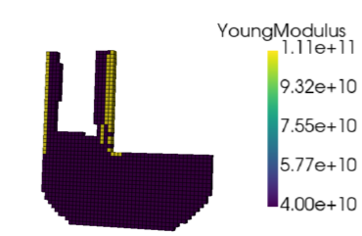

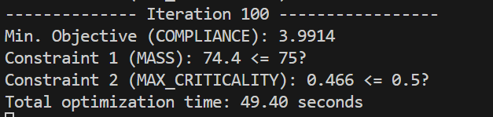
Example 4
MMTOExamples.LBracketTopLoad_Compliance_MassCriticality
Max criticality constraint ensures that materials of high criticality are avoided.

Slide 11
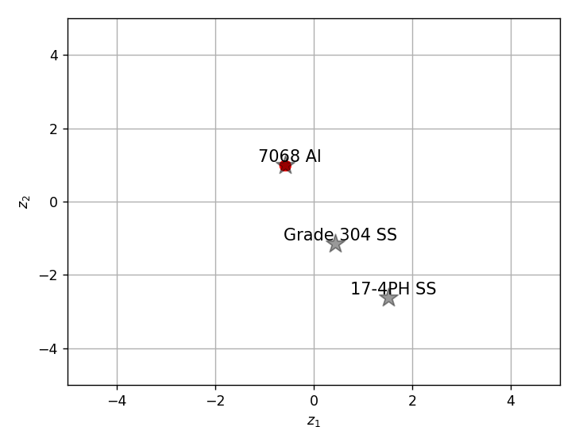
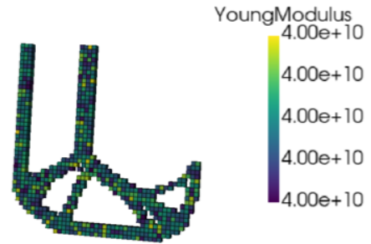
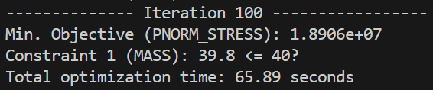
Example 5
MMTOExamples.LBracketTopLoad_Stress_Compliance
Optimizer seems to prefer a single material (?!)

Slide 12
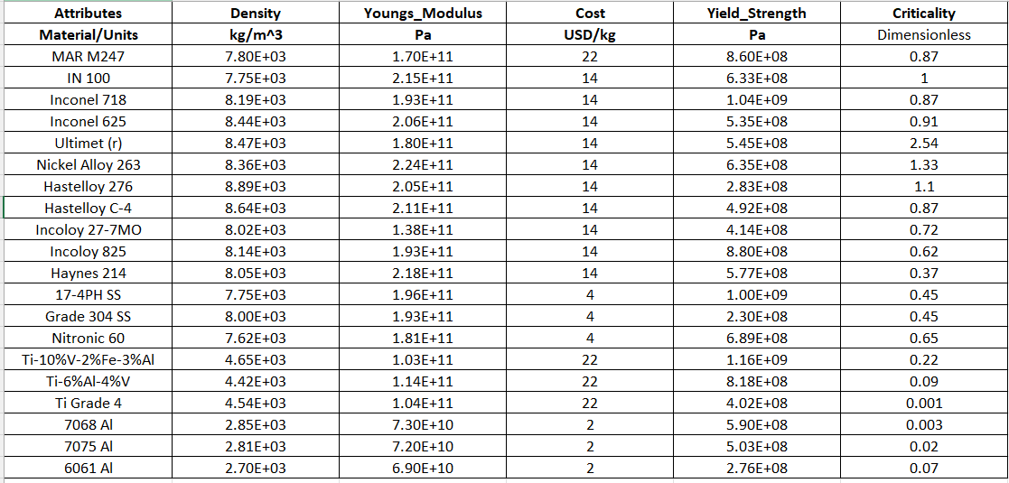
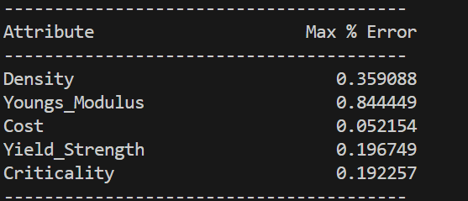

Materials: DataConstantTemperature/20MaterialsTeledyne.xlsx
20 materials
5 attributes
All attributes reconstruction errors are within 1%
Training takes about 6 mins.

Slide 13
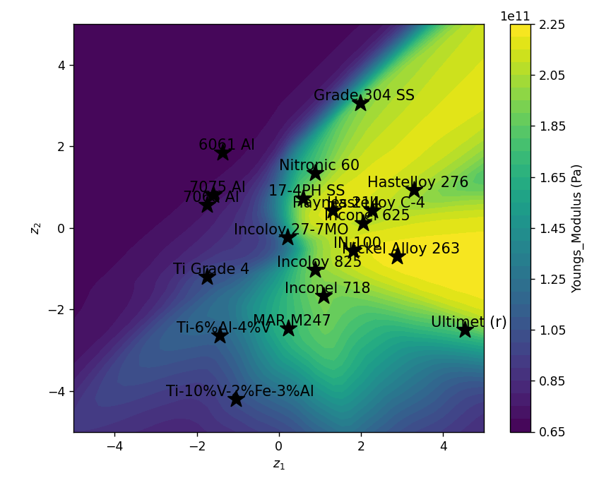
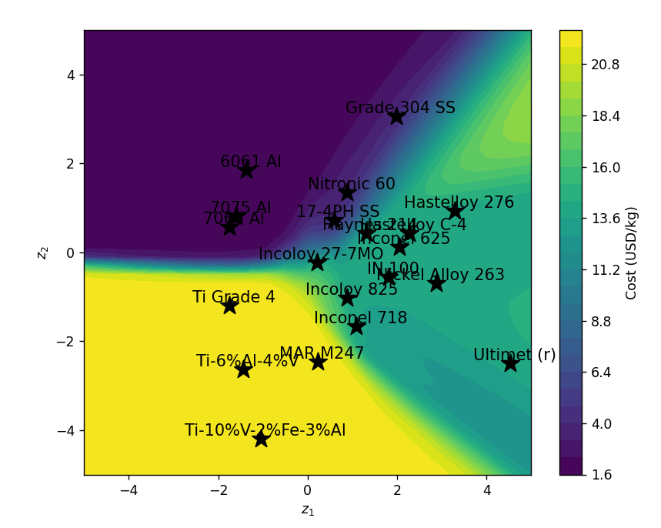
Materials: Sample Latent Space
Young’s Modulus
Cost
Highly non-linear latent space

Slide 14
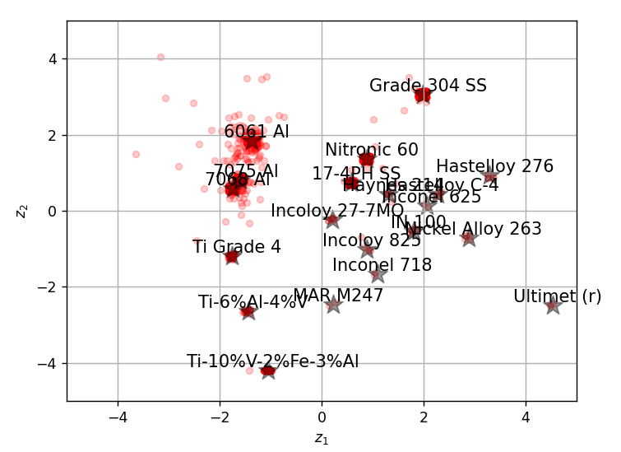
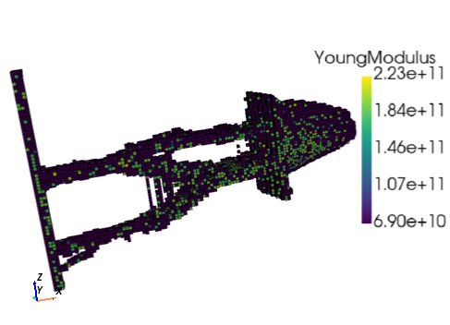
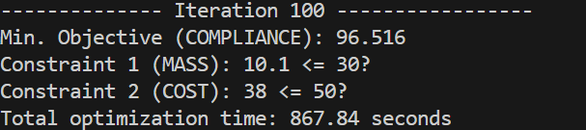
Example 6
MMTOExamples.BliskSection_Compliance_MassCost
Additional iterations needed for convergence. Stopped at 100 iterations for all examples.

Slide 15
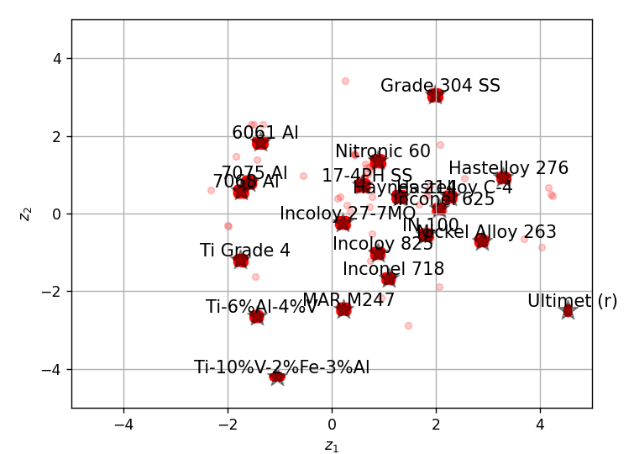
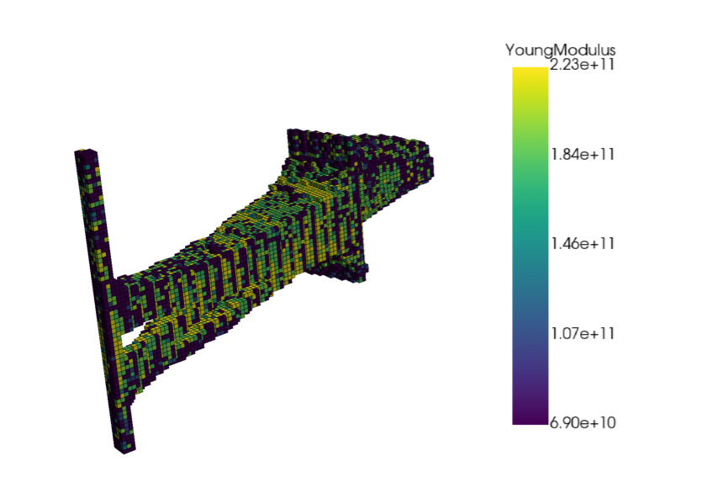
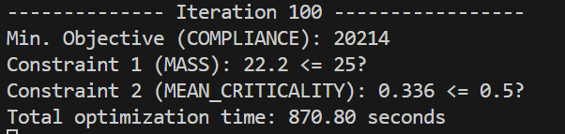
Example 7
MMTOExamples.BliskSection_Compliance_MassCriticality
We can also enforce mean criticality (as opposed to max criticality).

Slide 16
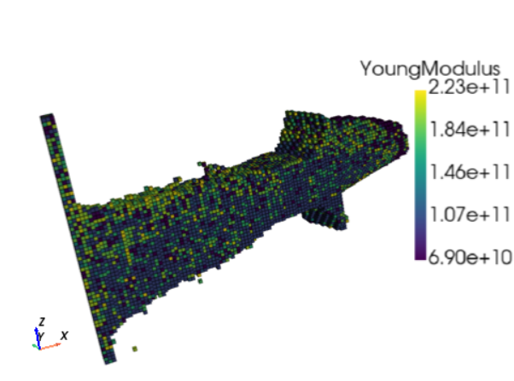
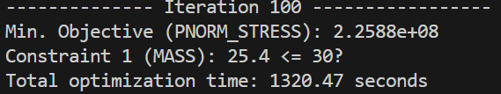
Example 8
MMTOExamples.BliskSection_Stress_Mass
Additional iterations are needed for convergence.

