Slide 1
Results and observations for temperature-dependent MMTO (both linear and non-linear thermal scenarios) See MMTO_TempDependent_main.py

Slide 2



Material-Temperature Interpolation Schemes
Scheme | Cubic | Hermite polynomial | Bezier Curve | Log Bezier Curve
Description
Advantages
Drawbacks
M$=M_{0}H_{1}\left(t\right)+M_{1}H_{2}\left(t\right)+M_{3}H_{3}\left(t\right)+M_{4}H_{4}(t)$
$$t=\frac{T−T_{min}}{T_{max}−T_{min}}$$
$$H_{1}\left(t\right)={\left(1−t\right)}^{3}$$
Smooth cubic Bézier curve in log₁₀-space.
Input: $\log_{10}{M_{0}}.\log_{10}{M_{1}} etc.$
Output: ${10}^{logBezier\left(T\right)}$
$$E\left(T\right)=aT^{3}+bT^{2}+cT+d$$
Most simple interpolation scheme
Coefficients represent real physical quantities
4 parameters
Can avoid local minima
Coefficients represent real physical quantities
4 parameters
Can avoid local minima
Best for large gradients and hence max use temp
4 parameters
Can avoid local minima
Can model use-temperature
Leads to local minima
Enforcing max use temperature implicitly is difficult due to coefficient scaling
Cannot effectively capture large gradients of elastic modulus and yield strength with respect to temperature
Non-physical parameters (slopes etc)
Coefficients vary by large orders of magnitude for large gradient with respect to temperature.
Hence: Best for thermal conductivity
Not suited for small gradients with respect to temperature
Hence: Best for elastic modulus and yield strength

Slide 3
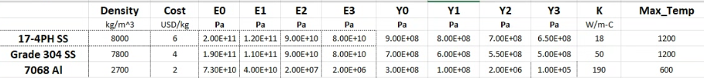
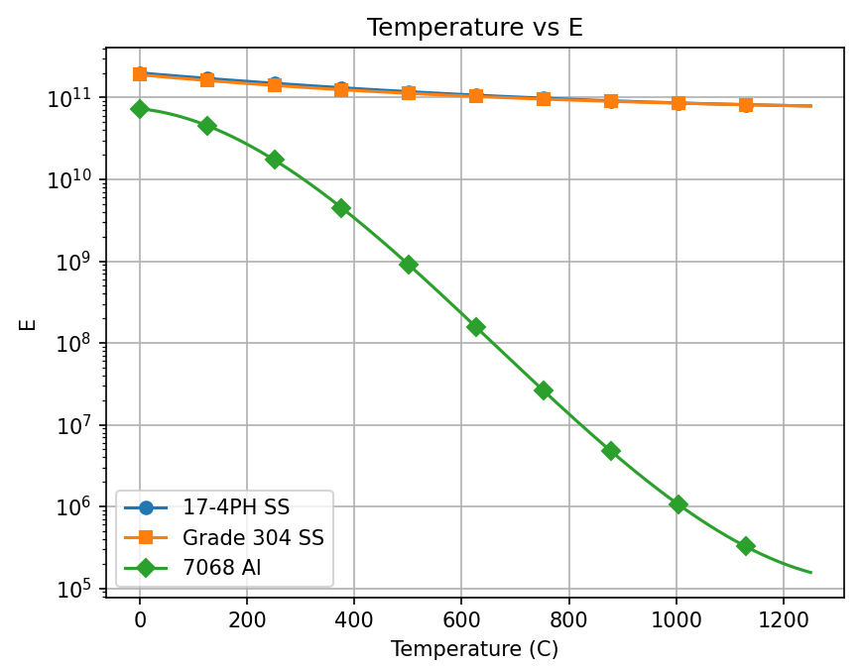
Fitting log-Bezier curve
E(7068 Al): 3 orders of magnitude drop at 600. Discourages use at high temperatures

Slide 4
Summary
Use standard (cubic) Bezier for material properties such as conductivity (K) , that do not vary by orders of magnitude over working temperature
Use (cubic) Log-Bezier for material properties such as E and Y, that vary by orders of magnitude over working temperature
For both, provide 4 parameters: M0, M1, M2, M3, that best match the data using the Bezier or log-Bezier curve, as appropriate

Slide 5
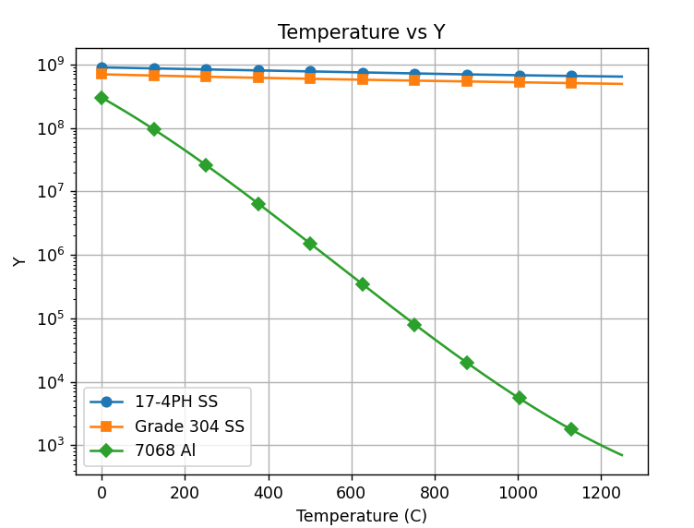
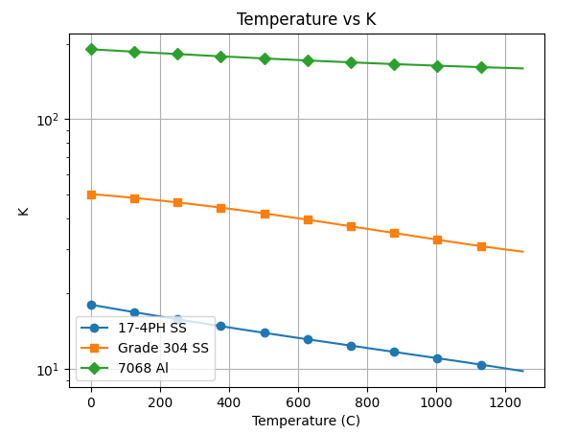
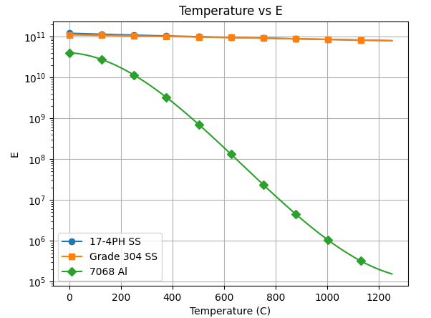
Material: DataVaryingTemperature/3MaterialsTempDependent.xlsx
3 materials
16 attributes
Captures E(T)
Captures Y(T)
Captures K(T)
Max use temp
E(T)
Y(T)
K(T)
A steep drop in E and Y dissuades the optimizer from using 7068 Al at high temperatures

Slide 6
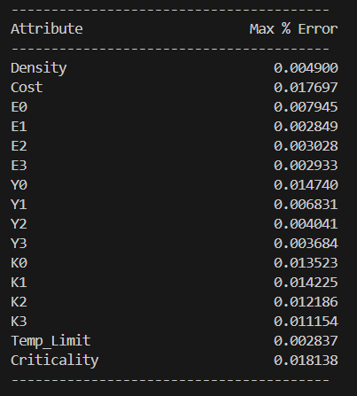
Latent Space Accuracy and Computational Time
All attribute reconstruction errors are less than 0.02%

Slide 7
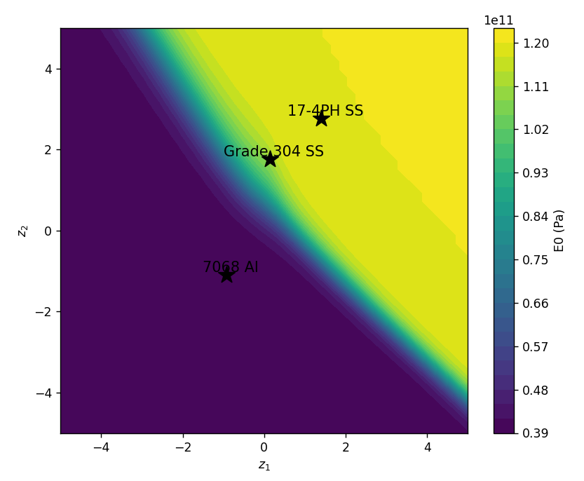
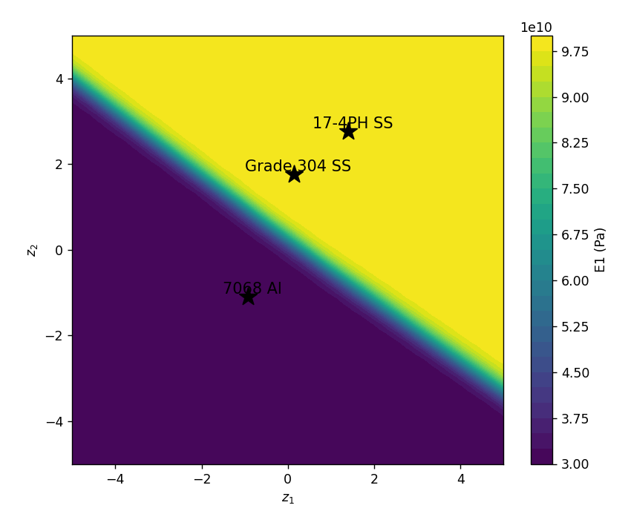
Sample Latent Spaces
E0 Latent Space
E1 Latent Space

Slide 8
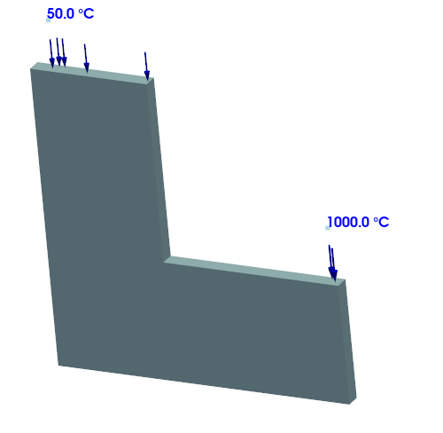
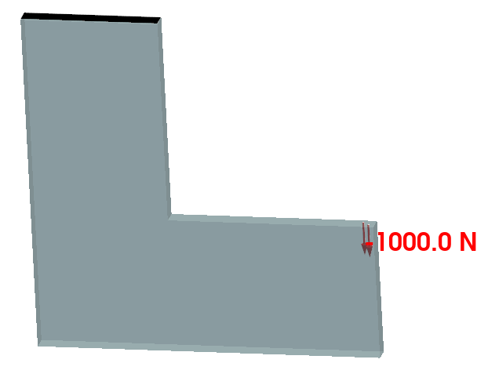
Lbracket Structural and Thermal Problems
50 C
1000 C

Slide 9
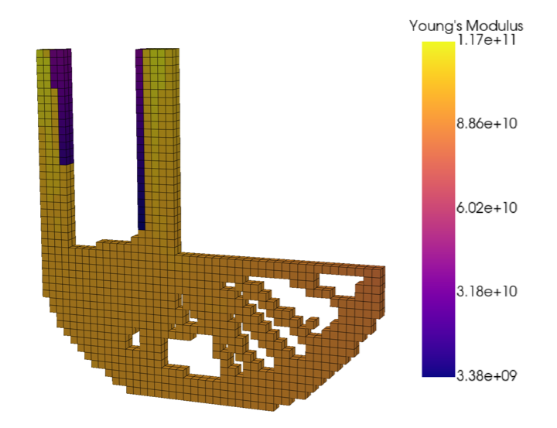
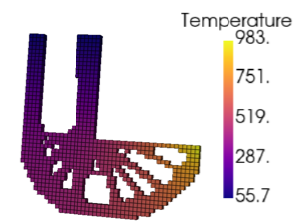
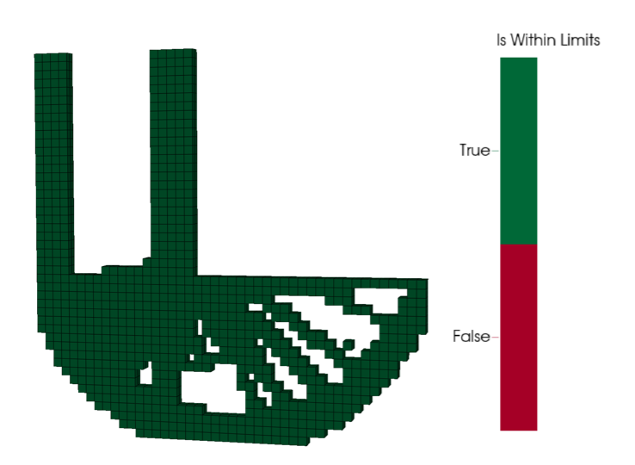
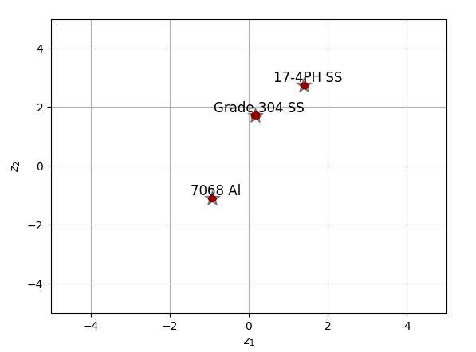
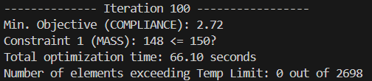
Example 1a
MMTOTempDependentExamples.LBracket_Compliance_Mass
Linear thermal (i.e., conductivity is assumed to be constant = K0)
0 elements exceed temperature limit

Slide 10
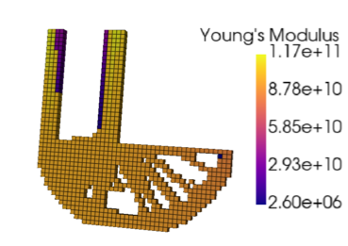
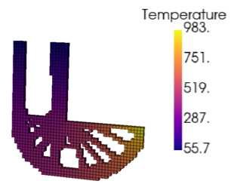
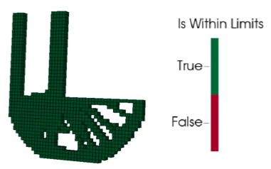
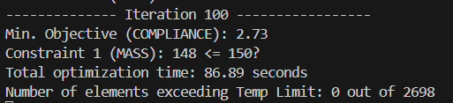
Example 1b
MMTOTempDependentExamples.LBracket_Compliance_Mass
Non-Linear thermal (i.e., conductivity is also temp dependent)
0 elements exceed temperature limit
Non-linear adds 30% to computational time

Slide 11
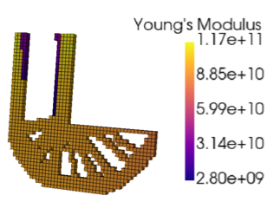
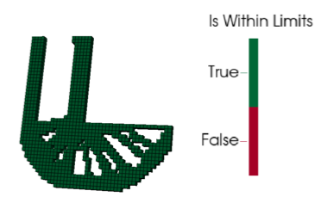
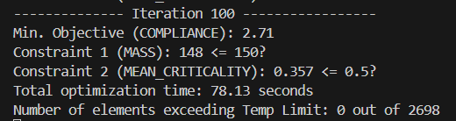
Example 2a
MMTOTempDependentExamples.LBracket_Compliance_MassCriticality
Linear thermal (i.e., conductivity is assumed to be constant = K0)
0 elements exceed temperature limit

Slide 12
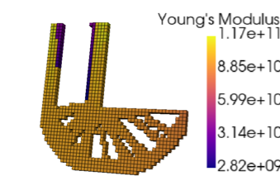
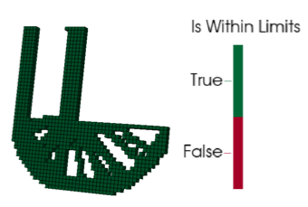
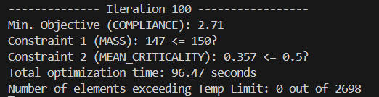
Example 2b
MMTOTempDependentExamples.LBracket_Compliance_MassCriticality
Non-Linear thermal (i.e., conductivity is also temp dependent)
0 elements exceed temperature limit

Slide 13
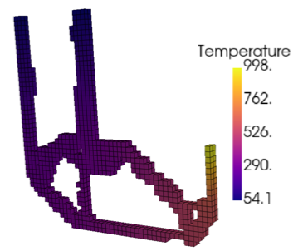
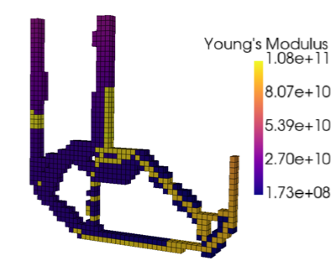
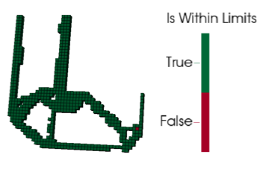
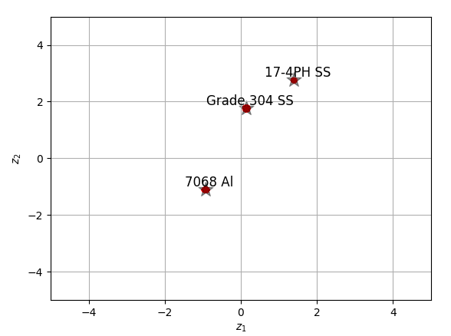
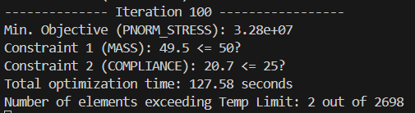
Example 3
MMTOTempDependentExamples.LBracket_Stress_MassCompliance
0.1% elements exceed temperature limit (needs additional filtering)
Optimizer avoid aluminum in high temperature regions

Slide 14
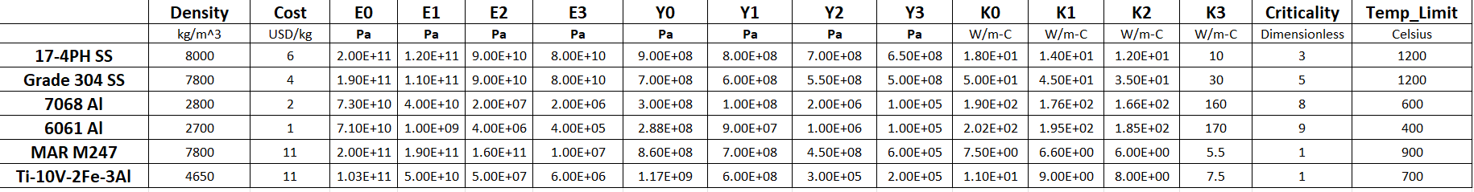
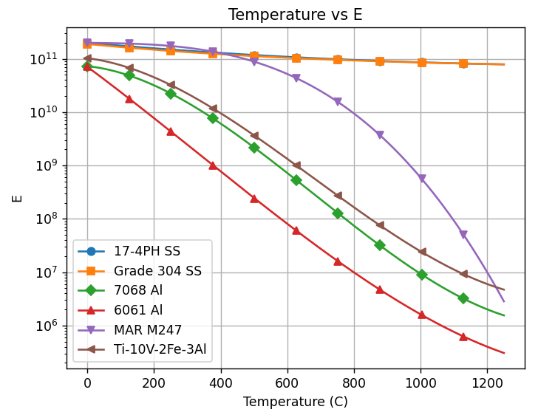
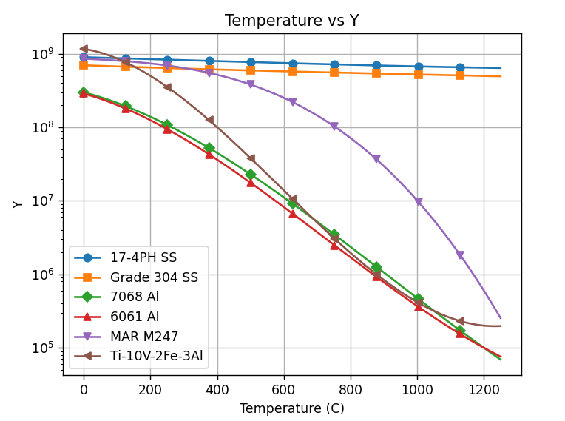
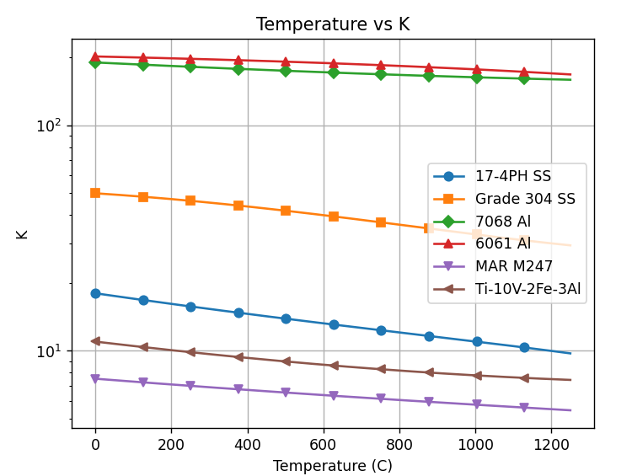
Material: DataVaryingTemperature/6MaterialsTempDependent.xlsx
6 materials
16 attributes
Captures E(T)
Captures Y(T)
Captures K(T)
Max use temp
Y(T)
K(T)
E(T)
Captures E(T)
Captures Y(T)
Captures K(T)
A steep drop in E and Y dissuades the optimizer from using some materials at high temperatures

Slide 15
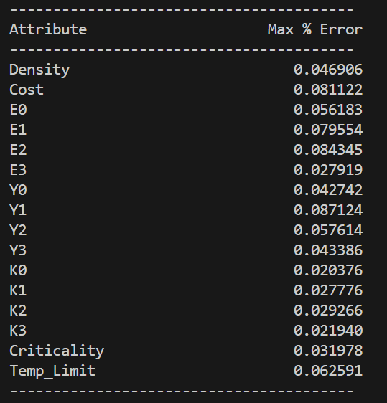
Latent Space Accuracy
All attribute reconstruction errors are less than 0.1%
Training takes about 4 minutes.

Slide 16
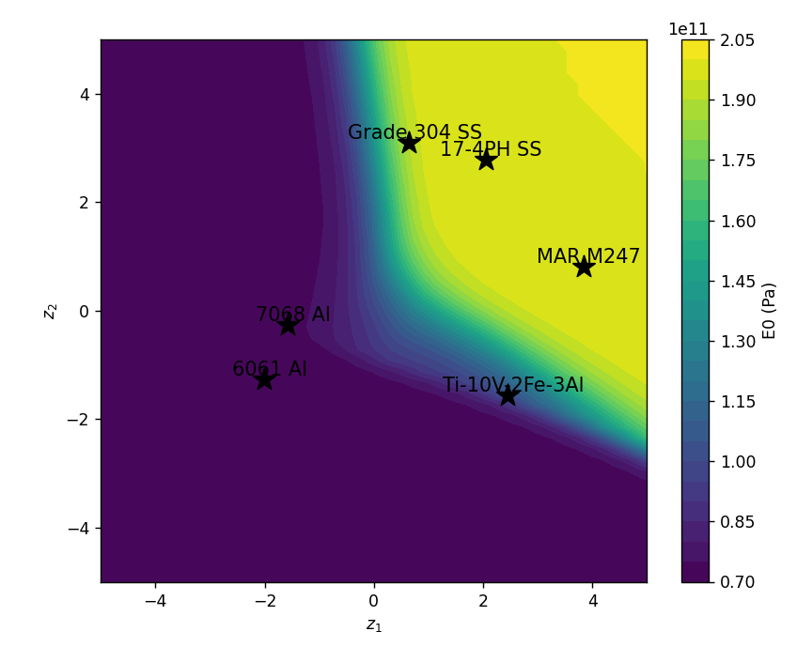
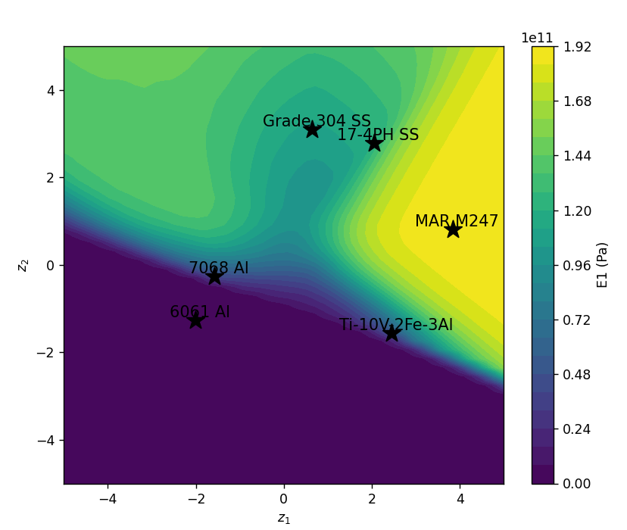
Sample Latent Spaces
E0
E1

Slide 17
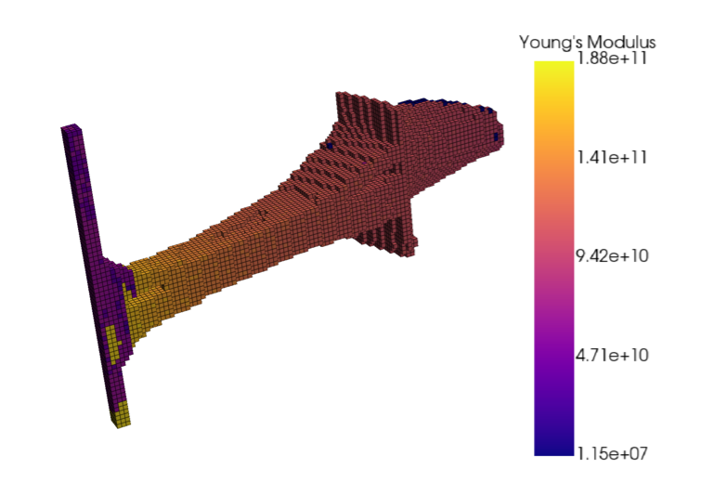
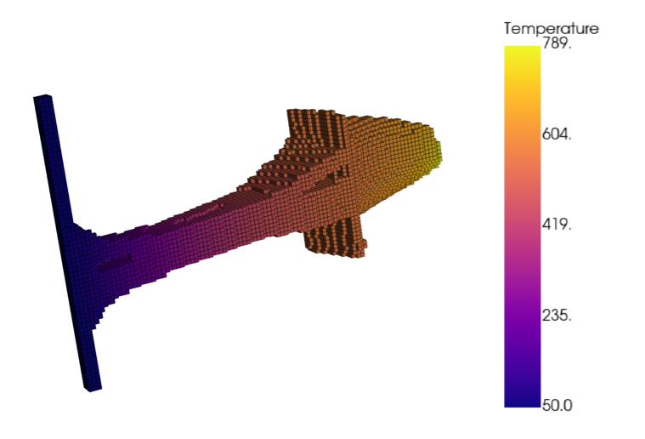
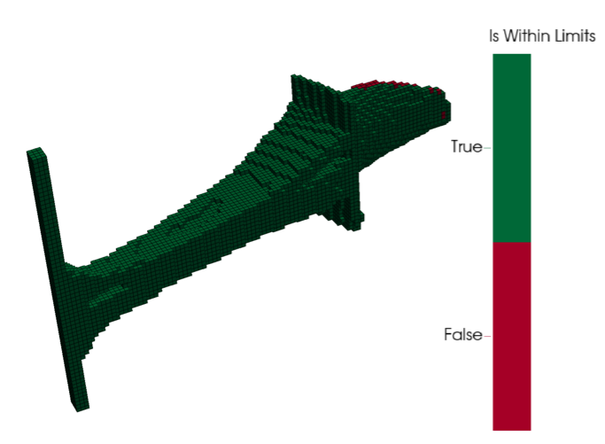
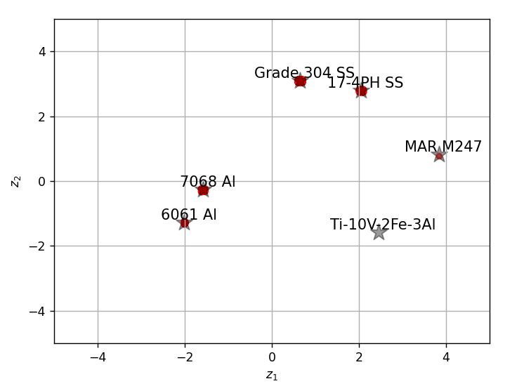
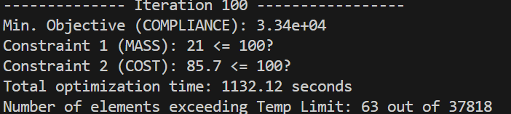
Example 4a
MMTOTempDependentExamples.BliskSection_Compliance_MassCost
Linear thermal
Young’s modulus
Temperature
Max Use Temp
0.2% elements exceed temperature limit (additional filtering needed)

Slide 18
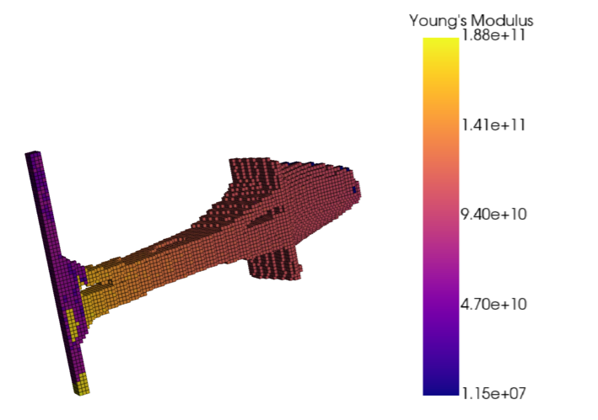
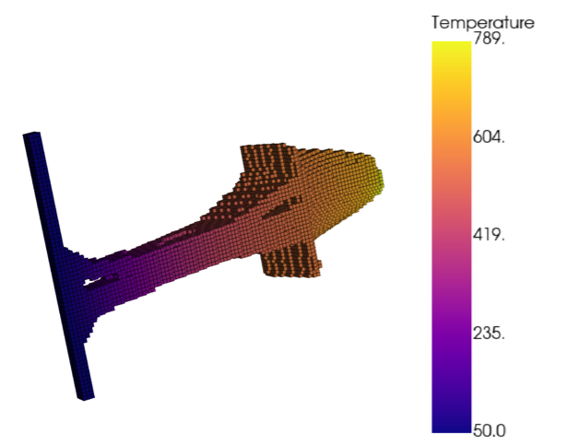
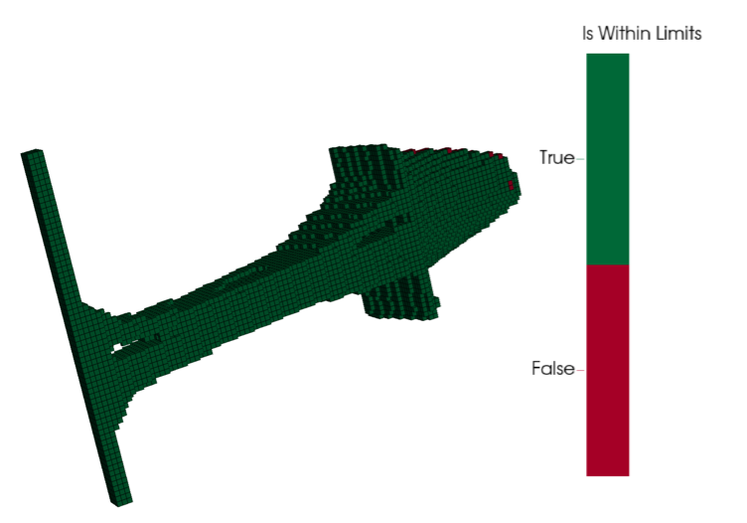
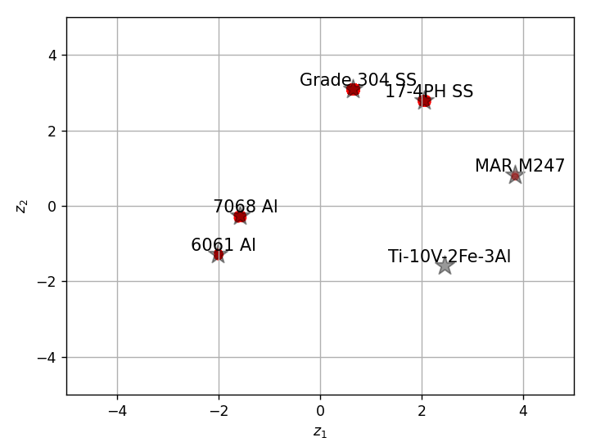
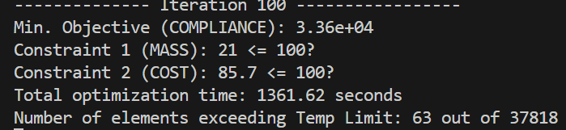
Example 4b
MMTOTempDependentExamples.BliskSection_Compliance_MassCost
0.2% elements exceed temperature limit (additional filtering needed)
NonLinear thermal
Young’s modulus
Temperature
Max Use Temp
Non-linear MMTO with 130,000 degrees of freedom in 22 mins

Slide 19
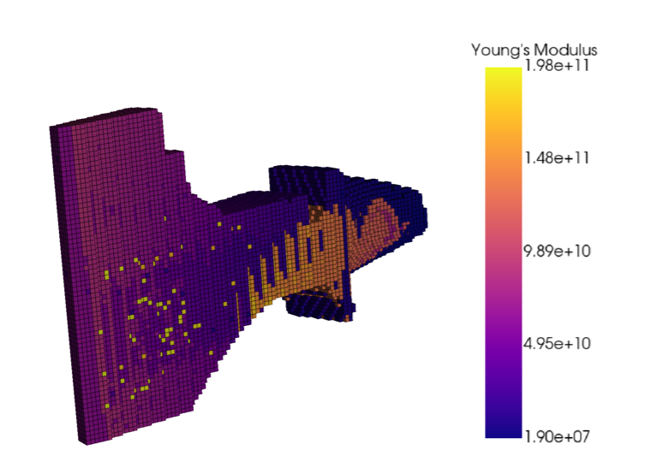




Example 5
MMTOTempDependentExamples.BliskSection_Stress_MassComplianceCriticality
NonLinear thermal with Stress, Mass, Compliance and Criticality
1% elements exceed temperature limit (additional filtering needed)
Young’s modulus
Temperature
Max Use Temp
Non-linear MMTO with 130,000 DOF in 34 mins. Additional iterations needed for convergence

