Slide 1
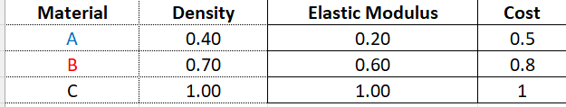
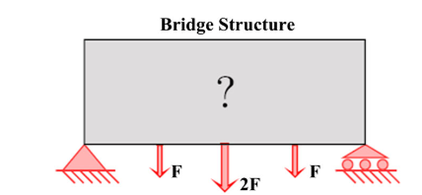
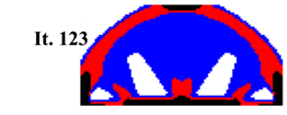
Benchmark Problem: 3 Materials, 3 Attributes
Minimize Compliance
Mass fraction < 0.4
Cost fraction < 0.3
2D; 5000 elements
Final compliance: 238
Zuo, W. and Saitou, K., 2017. Multi-material topology optimization using ordered SIMP interpolation. Structural and Multidisciplinary Optimization, 55(2), pp.477-491

Slide 2
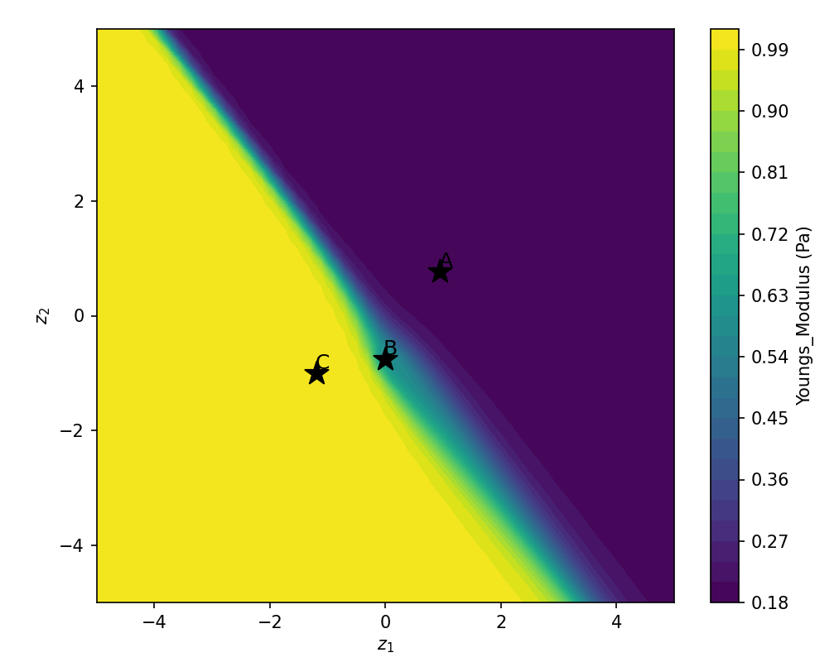
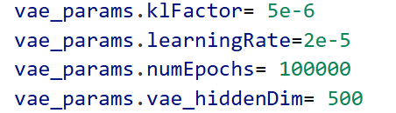
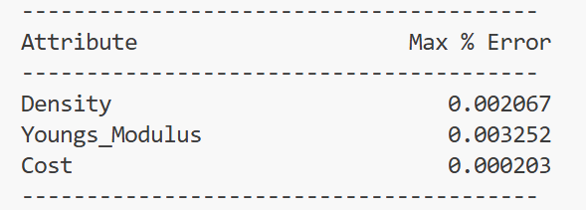
NN Training Parameters
2 mins

Slide 3

Optimization Parameters
3D; 10,000 elements

Slide 4
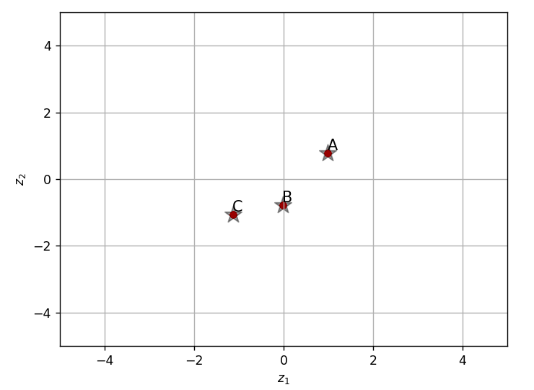
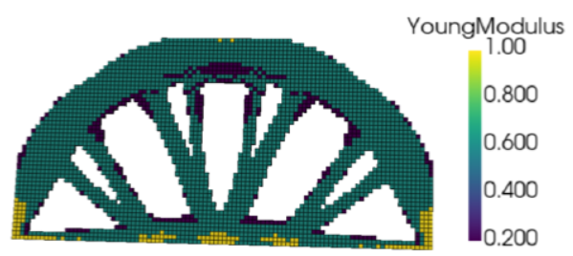
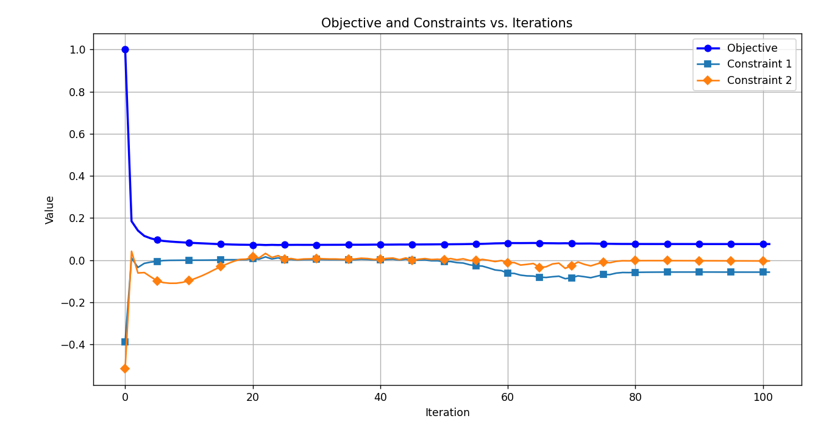
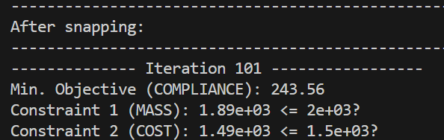
Optimal Topology
to_params.RelativeFilterRadius = 1.5
Compliance: 243.56

Slide 5
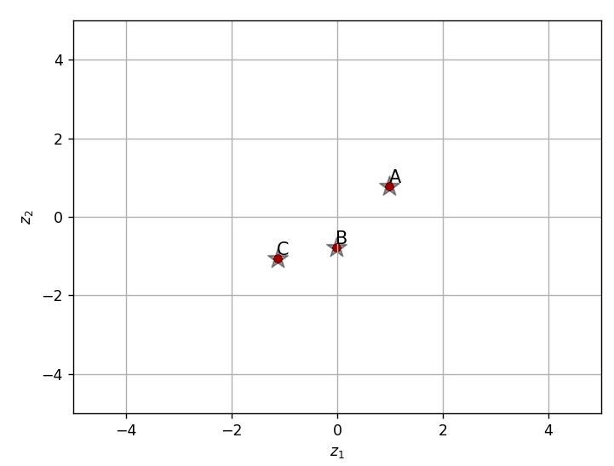
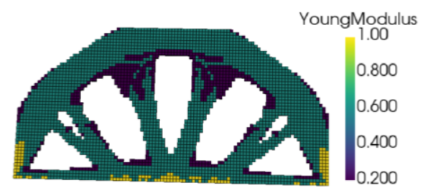
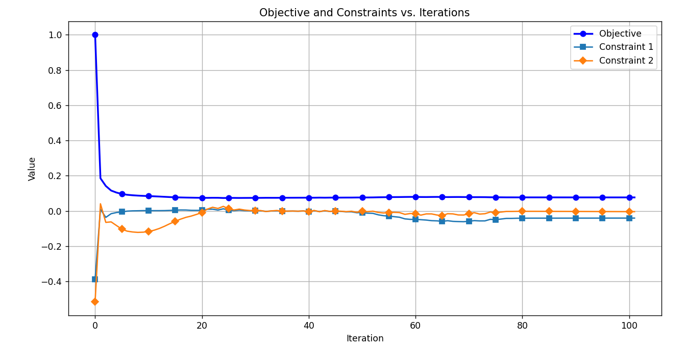
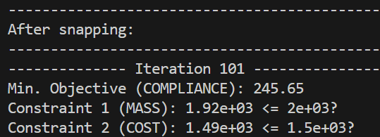
Optimal Topology
to_params.RelativeFilterRadius = 3
Compliance: 245.65

Slide 6
Discussion Topics
Concerns:
Can we reduce NN training time?
The impact of NN parameters on the latent space and optimal design is hard to understand (Ex: Are these parameters applicable for all material tables?)
Filtering after penalization is not working (bug in backward prop).
Termination criteria?
To Do:
Non-monotonic material database
Impact of material initialization: ORIGIN to UNIFORM?
Filter radius impact?
Pure mass constraint?
Add more materials?
Additional benchmark studies?
Impact of NN training parameters?

