Slide 1
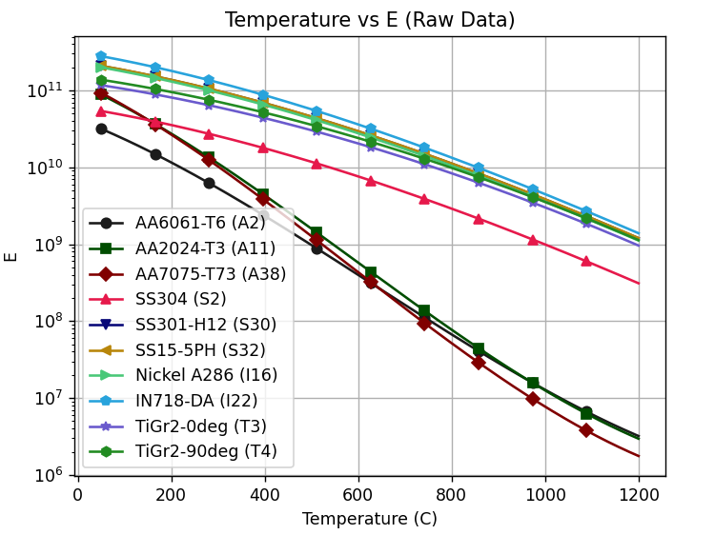
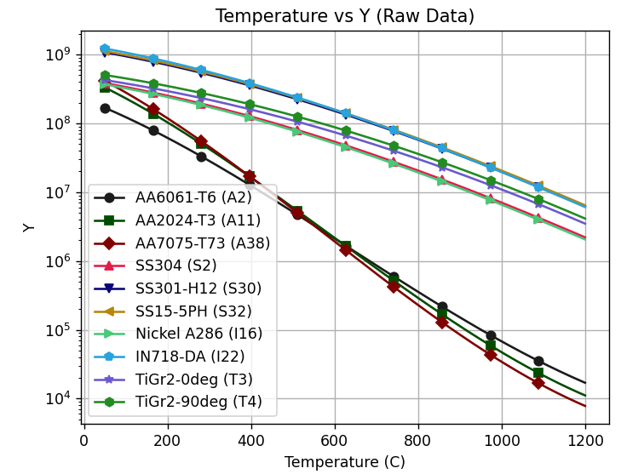
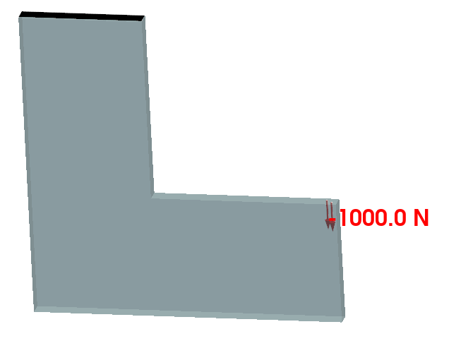
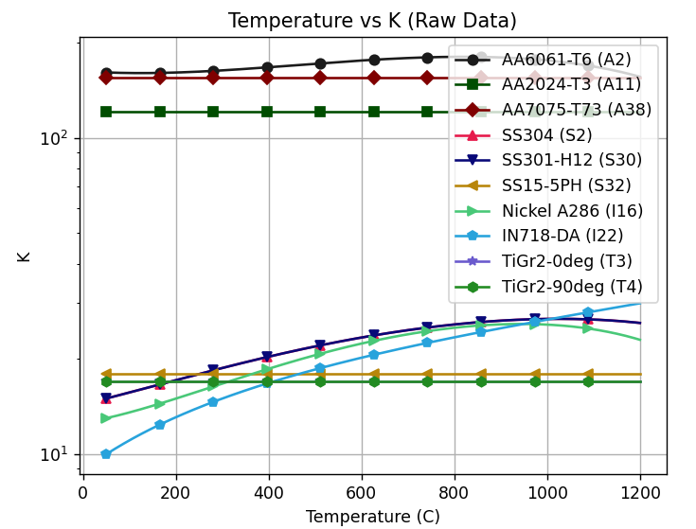
Topology Optimization: All Materials
E(T)
Y(T)
T = 50
T_{max} = 1000
F = 5000N
Min Mass
Stress Limit SF > 1.25
Fatigue Limit SF > 1
Temp Limit SF > 1
Mean Criticality < 1
PBR < 1.8
Compliance < 2.5
K(T)

Slide 2
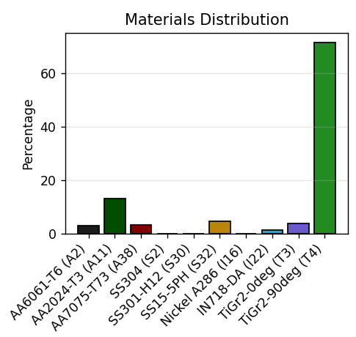
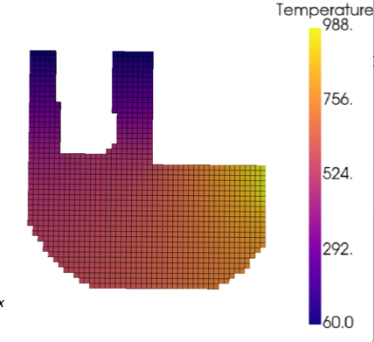
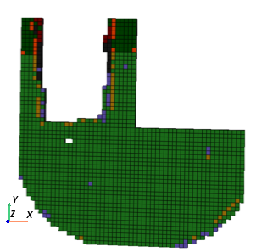
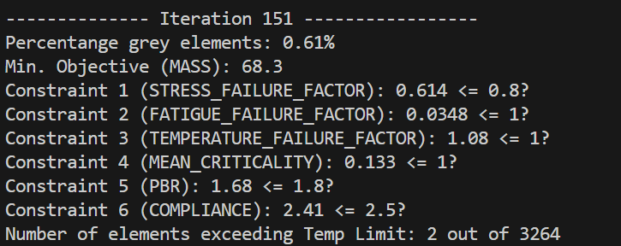
Topology Optimization: All Materials; higher temperature
Min Mass
Stress Limit SF > 1.25
Fatigue Limit SF > 1
Temp Limit SF > 1
Mean Criticality < 1
PBR < 1.8
Compliance < 2.5

