Slide 1
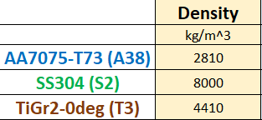
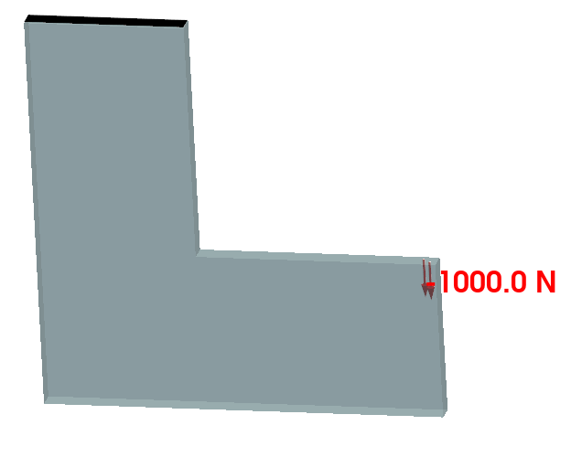
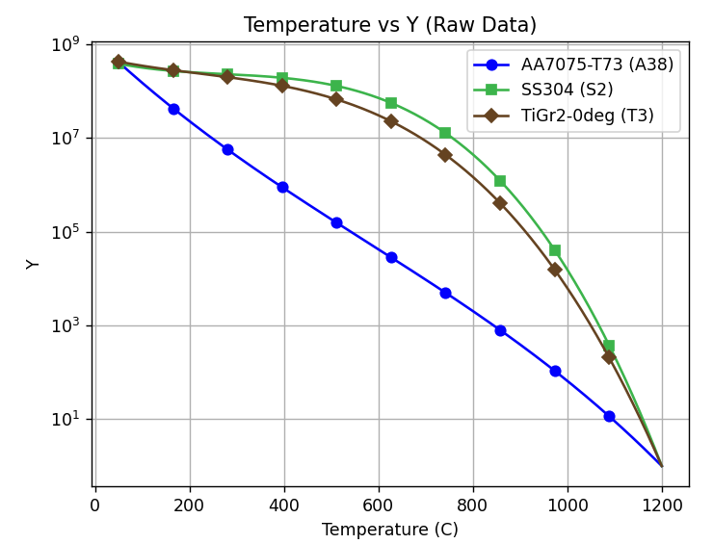
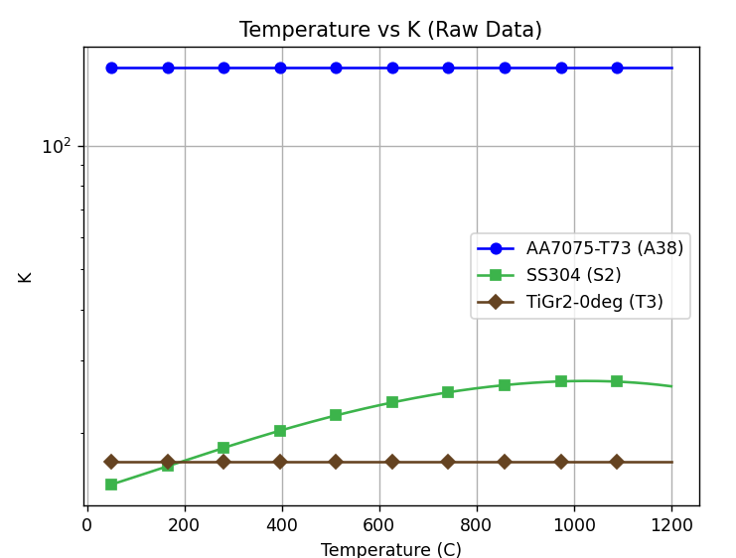
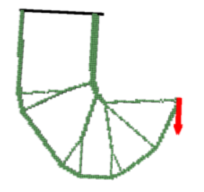
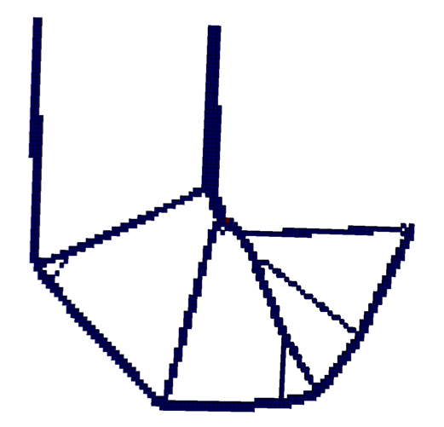
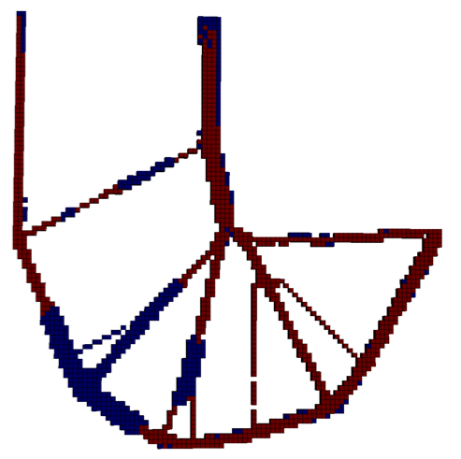
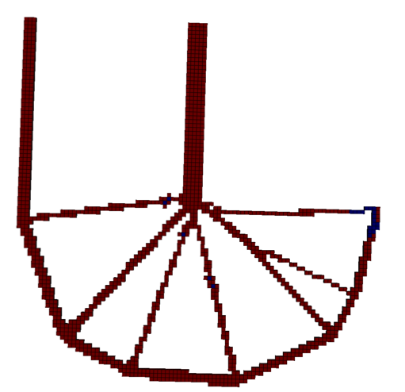
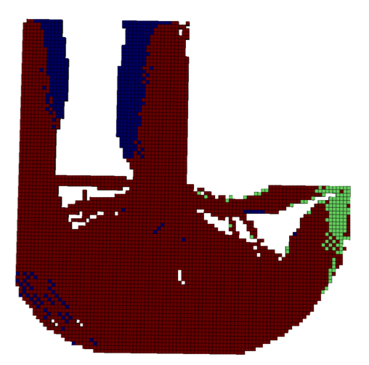
Topology Optimization: Validation Example
T = 50
Y(T)
K(T)
Ref: SMTO SS304
Temp
T_{max} = X
F = 50000N
Min Mass
Stress SF > 2
M* = 24.4
T_{max}= 50
T_{max}= 150
T_{max}= 250
T_{max}= 400
T_{max}= 800
TiGr
AA7075
X
AA7075
No design can meet
stress safety factor for given load and
temperature
M* = 6.5
M* = 11.9
M* = 14.0
M* = 62.5

Slide 2
Topology Optimization: Validation Example
T = 50
Y(T)
K(T)
Min Mass
Stress SF > 2
T_{max} = X
F = 50000N
M* = 24.4
T_{max}= 50
T_{max}= 150
T_{max}= 250
T_{max}= 400
T_{max}= 800

Slide 3
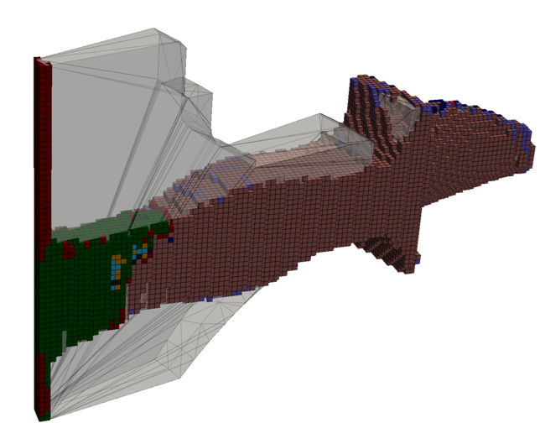
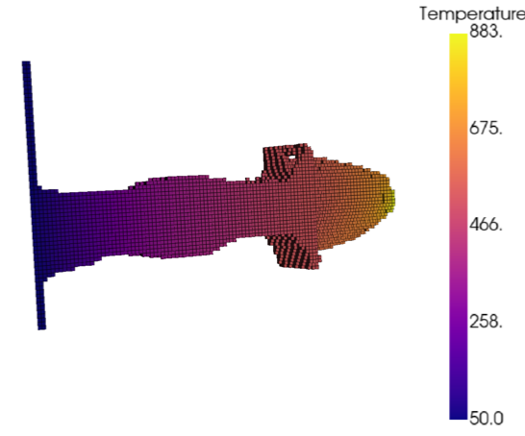
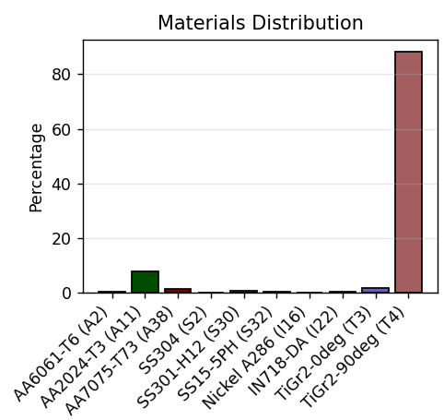
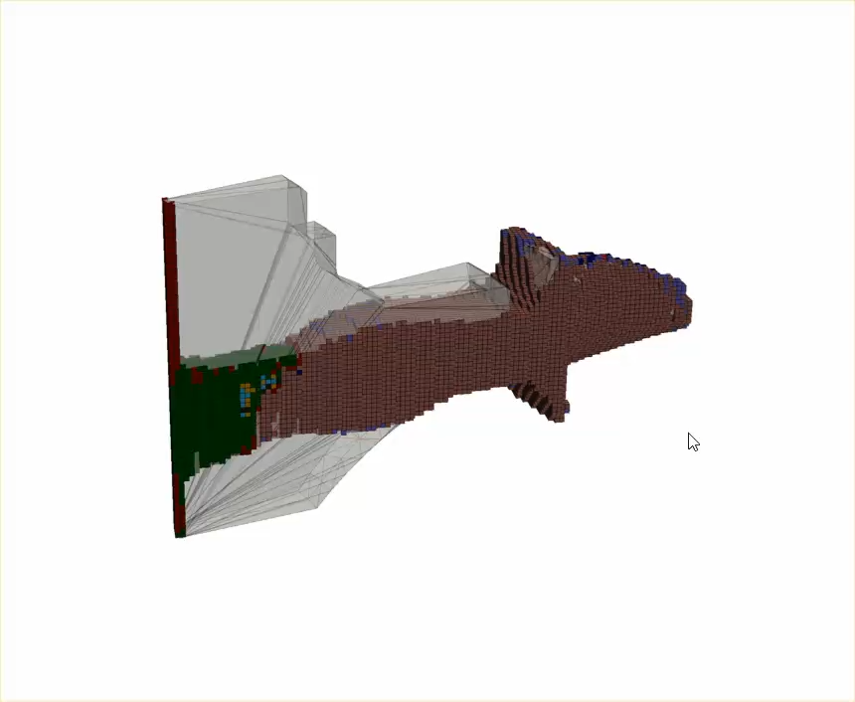
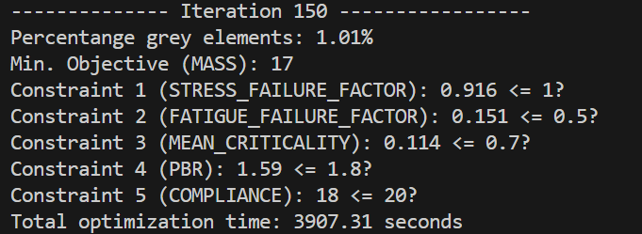
Topology Optimization: Blisk Example
Min Mass
Stress Limit SF > 1
Fatigue Limit SF > 2
Mean Criticality < 0.7
PBR < 1.8
Compliance < 20
10 materials
16 attributes
6-D latent space
100K DOF
1 hour, 5 mins
150 MMA iterations
Penalization

