Slide 1
19th Nov 2025
Version 1

Slide 2
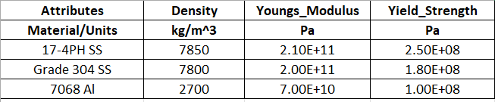
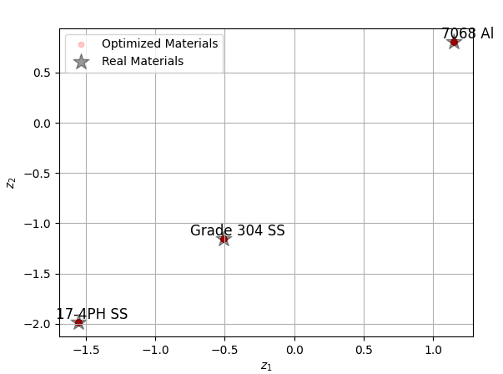
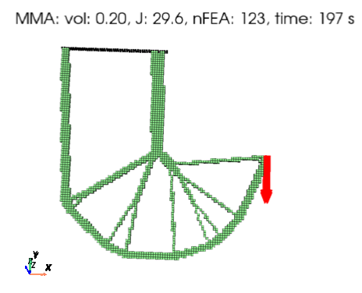
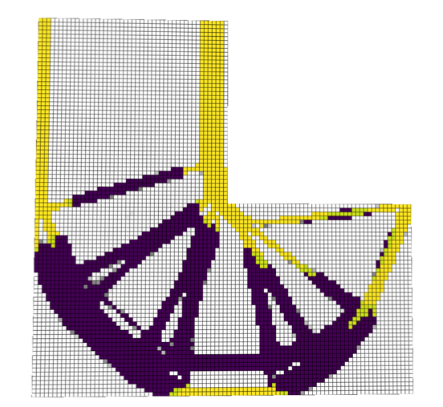
Multiple materials (No thermal)
Single material
E = 2.1e11
Y = 2.5e8
ρ = 7850
2D latent space
Init: Heaviest
M* = 29.7
σ*= 0.5
M* = 29.5
σ*= 0.48

Slide 3
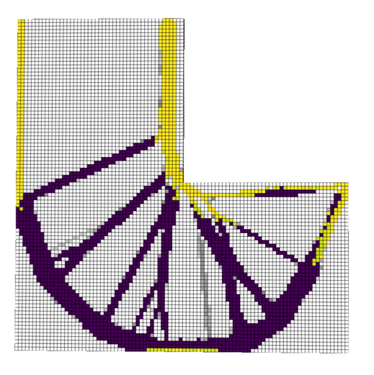
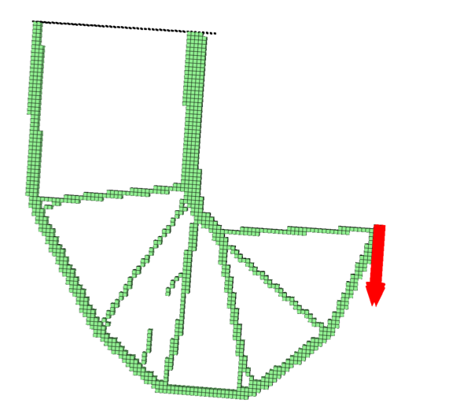
Multiple materials (No thermal)
Single material
E = 2.1e11
Y = 2.5e8
ρ = 7850
2D latent space
Init: Heaviest
M* = 24.5
σ*= 0.76
M* = 20.4
σ*= 0.77

Slide 4
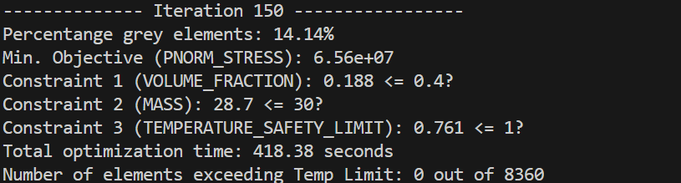
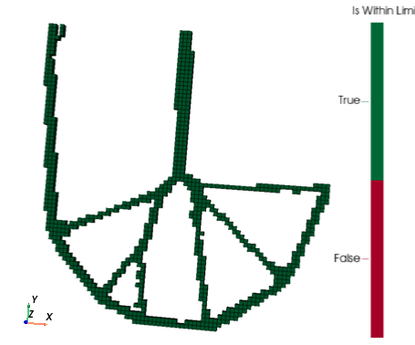
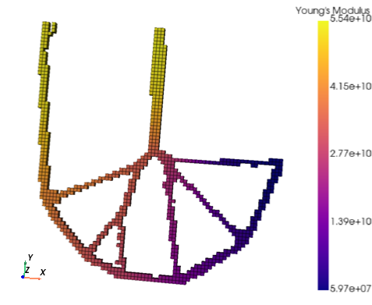
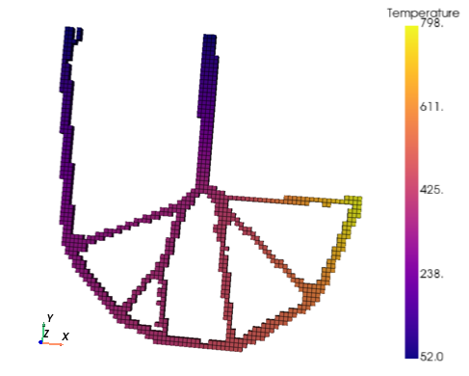

Slide 5
