Slide 1

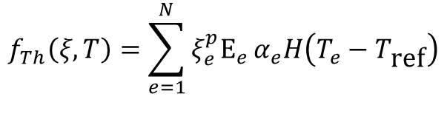


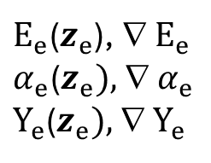








LSR-MMTO Thermo-Elastic Compliance
Latent variables
Topology variables
$κ_{e}$($z_{e})$
Assemble
$$z_{e}$$
$$ξ_{e}$$
$$k_{T,e};f_{T,e}$$
$$K_{T},f_{ext}$$
T$={\left(K_{T}\right)}^{−1}f_{ext}$
Variational
Encoder
$$f_{Th}\left(ξ,T\right)=\sum_{e=1}^{N}{ξ_{e}^{p}E_{e}}α_{e}H\left(T_{e}−T_{\text{ref}}\right)$$
$E_{e}$($z_{e}$), ∇ $E_{e}$
$α_{e}$($z_{e}),$ ∇ $α_{e}$
$Y_{e}$($z_{e}),$ ∇ $Y_{e}$
Structural Compliance
Assemble
$$k_{S,e};f_{ext,e}$$
$$K_{S},f_{ext}$$
$$d=K_{S}^{−1}f_{S}$$
$$J=d^{T}K_{S}d$$
Material
Properties
$${f_{S}=f_{exi}+ f}_{Th}$$

Slide 2




LSR-MMTO Thermo-Elastic Compliance
Latent variables
Topology variables
$κ_{e}$($z_{e})$
Assemble
$$z_{e}$$
$$ξ_{e}$$
$$k_{T,e};f_{T,e}$$
$$K_{T},f_{ext}$$
T$={\left(K_{T}\right)}^{−1}f_{ext}$
Variational
Encoder
$E_{e}$($z_{e}$), ∇ $E_{e}$
$α_{e}$($z_{e}),$ ∇ $α_{e}$
$Y_{e}$($z_{e}),$ ∇ $Y_{e}$
Assemble
$$k_{S,e};f_{ext,e}$$
$$K_{S},f_{ext}$$
$$d=K_{S}^{−1}f_{S}$$
$$σ_{e}$$
$$σ_{VM}$$
Material
Properties
$$σ_{FF}={\left(\sum{{\left(σ_{e}^{VM}/Y_{e}\right)}^{P}}\right)}^{1/P}$$

Slide 3
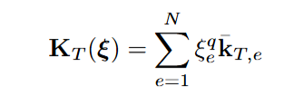






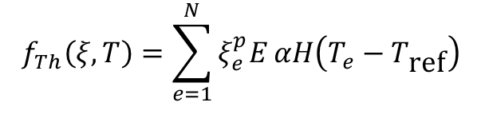




SMTO Thermo-Elastic Compliance
Topology variables
$$ξ_{e}$$
$$k_{T,e};q_{T,e}$$
$$K_{T},q_{ext}$$
T$={\left(K_{T}\right)}^{−1}q_{ext}$
$$f_{Th}\left(ξ,T\right)=\sum_{e=1}^{N}{ξ_{e}^{p}E}αH\left(T_{e}−T_{\text{ref}}\right)$$
$$k_{S,e};f_{ext,e}$$
$$K_{S},f_{ext}$$
$$d=K_{S}^{−1}f_{S}$$
$$J=d^{T}K_{S}d$$
$${f_{S}=f_{exi}+ f}_{Th}$$
Structural Compliance

Slide 4










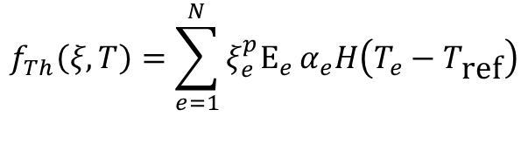




LSR-MMTO Thermo-Elastic Compliance
Latent variables
$$z_{e}$$
Topology variables
$κ_{e}$($z_{e})$
$E_{e}$($z_{e}$)
$α_{e}$($z_{e})$
Assemble
Solve
$$ξ_{e}$$
$$k_{T,e};f_{T,e}$$
$$K_{T},f_{ext}$$
T$={\left(K_{T}\right)}^{−1}f_{ext}$
$$f_{Th}\left(ξ,T\right)=\sum_{e=1}^{N}{ξ_{e}^{p}E_{e}}α_{e}H\left(T_{e}−T_{\text{ref}}\right)$$
$$f_{Th}$$
Assemble
Solve
$$k_{S,e};f_{ext,e}$$
$$K_{S},f_{ext}$$
$$d=K_{S}^{−1}f_{S}$$
$$J=d^{T}K_{S}d$$
$E_{e}$($z_{e})$
$${f_{S}=f_{exi}+ f}_{Th}$$
Structural Compliance

Slide 5





LSR-MMTO Thermo-Elastic Compliance
Latent variables
$$z_{e}$$
Topology variables
$κ_{e}$($z_{e})$
$E_{e}$($z_{e}$)
$$ξ_{e}$$
$$k_{T,e};q_{T,e}$$
$α_{e}$($z_{e})$
$$K_{T},q_{ext}$$
T$={\left(K_{T}\right)}^{−1}q_{ext}$
$$f_{Th}\left(ξ,T\right)=\sum_{e=1}^{N}{ξ_{e}^{p}E_{e}}α_{e}H\left(T_{e}−T_{\text{ref}}\right)$$
$$f_{Th}$$
$$k_{S,e};f_{ext,e}$$
$$K_{S},f_{ext}$$
$$d=K_{S}^{−1}f_{S}$$
$$J=d^{T}K_{S}d$$
$E_{e}$($z_{e})$
Structural Compliance

Slide 6


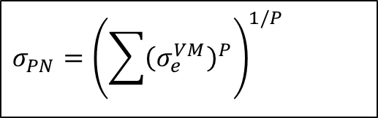


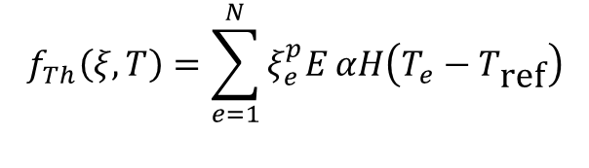
SMTO Thermo-Elastic P-Norm Stress
Topology variables
$$ξ_{e}$$
$$k_{T,e};q_{T,e}$$
$$K_{T},q_{ext}$$
T$={\left(K_{T}\right)}^{−1}q_{ext}$
$$f_{Th}\left(ξ,T\right)=\sum_{e=1}^{N}{ξ_{e}^{p}E}αH\left(T_{e}−T_{\text{ref}}\right)$$
$$k_{S,e};f_{ext,e}$$
$$K_{S},f_{ext}$$
$$d=K_{S}^{−1}f_{S}$$
Displacement
$$σ_{PN}={\left(\sum{{\left(σ_{e}^{VM}\right)}^{P}}\right)}^{1/P}$$
$$σ_{e}$$
$$σ_{e}^{VM}$$
P-Norm von Mises

Slide 7

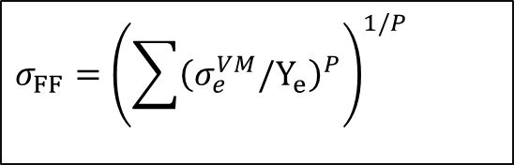















LR-MMTO Thermo-Elastic P-Norm Stress (constant mat properties)
Latent variables
$$z_{e}^{d}$$
Topology variables
$$κ_{e}$$
$$E_{e}$$
$$Y_{e}$$
$$ξ_{e}$$
$$k_{T,e};q_{T,e}$$
$$α_{e}$$
$$K_{T},q_{ext}$$
T$={\left(K_{T}\right)}^{−1}q_{ext}$
$$f_{Th}$$
$$k_{S,e};f_{ext,e}$$
$$K_{S},f_{ext}$$
$$d=K_{S}^{−1}f_{S}$$
$$E_{e}$$
$$σ_{FF}={\left(\sum{{\left(σ_{e}^{VM}/Y_{e}\right)}^{P}}\right)}^{1/P}$$
$$σ_{e}^{ij}$$
$$σ_{e}^{VM}$$
$$E_{e}$$
Stress Failure Factor

Slide 8







MMTO Thermal Analysis
Topology variables
$$ξ_{e}$$
Temperature
Conductivity
$$k_{eT},f_{eT}$$
$$K_{T},f_{T}$$
T$={\left(K_{T}\right)}^{−1}f_{T}$
$$z_{e}^{d}$$
$$D$$
$$κ_{e}$$
Element
Thermal Matrix
Global
Thermal Matrix
Material variables
Decoder
Non-linear thermal

Slide 9



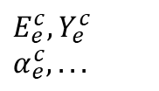








MMTO Structural Analysis
Topology variables
$$ξ_{e}$$
$$f_{b}$$
Body force
Displacement
Material Controls
$$k_{eS},f_{es}$$
Stress
$$K_{S},f_{S}$$
$$d=K_{S}^{−1}f_{S}$$
$$σ_{e}^{ij}$$
Decoder
Element
Structural Matrix and force
$$z_{e}^{d}$$
$$E_{e}^{c},Y_{e}^{c} \\ α_{e}^{c},...$$
$$D$$
$$σ_{e}^{VM}$$
Material variables
$$E_{e},Y_{e} \\ α_{e},ρ_{e}$$
T
Element von Mises
$$f_{Th}$$
Thermo-Structural force

Slide 10
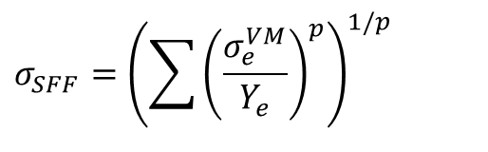
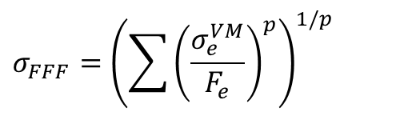


Quantities of Interest
Thermal Compliance
$$J_{T}=T′K_{T}T$$
Structural Compliance
$$J_{S}=d^{T}K_{S}d$$
$$σ_{SFF}={\left(\sum{{\left(\frac{σ_{e}^{VM}}{Y_{e}}\right)}^{p}}\right)}^{1/p}$$
Stress Failure Factor
$$σ_{FFF}={\left(\sum{{\left(\frac{σ_{e}^{VM}}{F_{e}}\right)}^{p}}\right)}^{1/p}$$
Fatigue Failure Factor

Slide 11
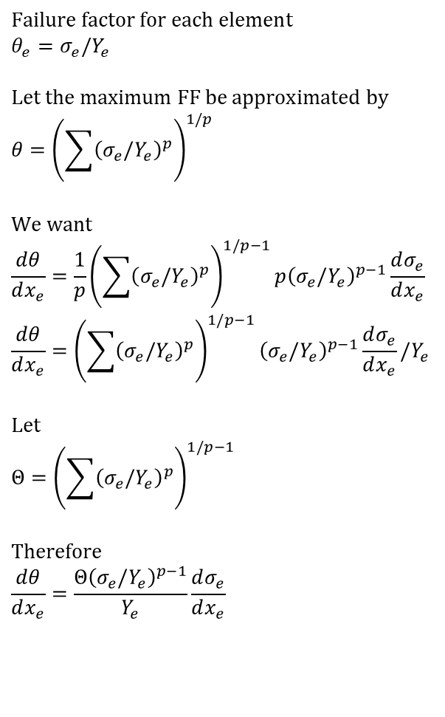
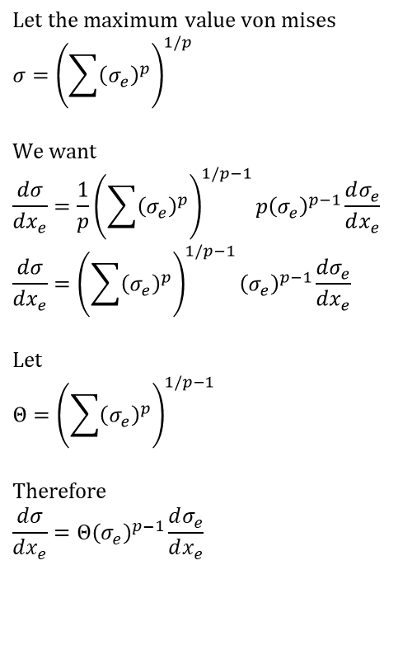
Sensitivity of stress failure factor to density variable
$$\text{Failure} \text{factor} \text{for} \text{each} \text{element} \\ θ_{e}=σ_{e}/Y_{e}$$ $$\text{Let} \text{the} \text{maximum} \text{FF} \text{be} \text{approximated} \text{by} \\ θ={\left(\sum{{\left(σ_{e}/Y_{e}\right)}^{p}}\right)}^{1/p}$$ $$\text{We} \text{want} \\ \frac{dθ}{dx_{e}}=\frac{1}{p}{\left(\sum{{\left(σ_{e}/Y_{e}\right)}^{p}}\right)}^{1/p−1}p{\left(σ_{e}/Y_{e}\right)}^{p−1}\frac{dσ_{e}}{dx_{e}} \\ \frac{dθ}{dx_{e}}={\left(\sum{{\left(σ_{e}/Y_{e}\right)}^{p}}\right)}^{1/p−1}{\left(σ_{e}/Y_{e}\right)}^{p−1}\frac{dσ_{e}}{dx_{e}}/Y_{e}$$ $$\text{Let} \\ Θ={\left(\sum{{\left(σ_{e}/Y_{e}\right)}^{p}}\right)}^{1/p−1}$$ $$\text{Therefore} \\ \frac{dθ}{dx_{e}}=\frac{Θ{\left(σ_{e}/Y_{e}\right)}^{p−1}}{Y_{e}}\frac{dσ_{e}}{dx_{e}}$$
$$\text{Let} \text{the} \text{maximum} \text{value} \text{von} \text{mises} \\ σ={\left(\sum{{\left(σ_{e}\right)}^{p}}\right)}^{1/p}$$ $$\text{We} \text{want} \\ \frac{dσ}{dx_{e}}=\frac{1}{p}{\left(\sum{{\left(σ_{e}\right)}^{p}}\right)}^{1/p−1}p{\left(σ_{e}\right)}^{p−1}\frac{dσ_{e}}{dx_{e}} \\ \frac{dσ}{dx_{e}}={\left(\sum{{\left(σ_{e}\right)}^{p}}\right)}^{1/p−1}{\left(σ_{e}\right)}^{p−1}\frac{dσ_{e}}{dx_{e}}$$ $$\text{Let} \\ Θ={\left(\sum{{\left(σ_{e}\right)}^{p}}\right)}^{1/p−1}$$ $$\text{Therefore} \\ \frac{dσ}{dx_{e}}=Θ{\left(σ_{e}\right)}^{p−1}\frac{dσ_{e}}{dx_{e}}$$

Slide 12
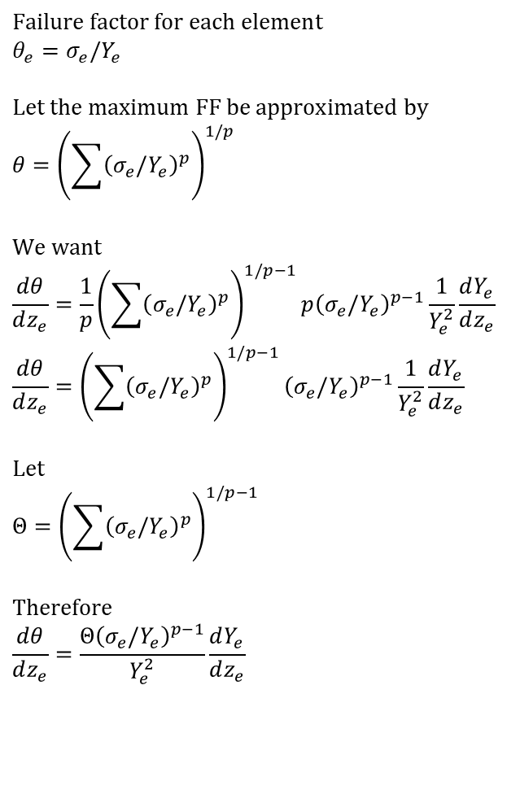
Sensitivity of stress failure factor to latent variable
$$\text{Failure} \text{factor} \text{for} \text{each} \text{element} \\ θ_{e}=σ_{e}/Y_{e}$$ $$\text{Let} \text{the} \text{maximum} \text{FF} \text{be} \text{approximated} \text{by} \\ θ={\left(\sum{{\left(σ_{e}/Y_{e}\right)}^{p}}\right)}^{1/p}$$ $$\text{We} \text{want} \\ \frac{dθ}{dz_{e}}=\frac{1}{p}{\left(\sum{{\left(σ_{e}/Y_{e}\right)}^{p}}\right)}^{1/p−1}p{\left(σ_{e}/Y_{e}\right)}^{p−1}\frac{1}{Y_{e}^{2}}\frac{dY_{e}}{dz_{e}} \\ \frac{dθ}{dz_{e}}={\left(\sum{{\left(σ_{e}/Y_{e}\right)}^{p}}\right)}^{1/p−1}{\left(σ_{e}/Y_{e}\right)}^{p−1}\frac{1}{Y_{e}^{2}}\frac{dY_{e}}{dz_{e}}$$ $$\text{Let} \\ Θ={\left(\sum{{\left(σ_{e}/Y_{e}\right)}^{p}}\right)}^{1/p−1}$$ $$\text{Therefore} \\ \frac{dθ}{dz_{e}}=\frac{Θ{\left(σ_{e}/Y_{e}\right)}^{p−1}}{Y_{e}^{2}}\frac{dY_{e}}{dz_{e}}$$

