Slide 1
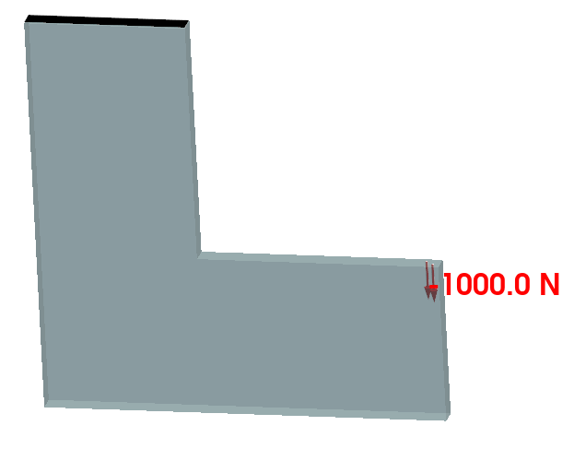
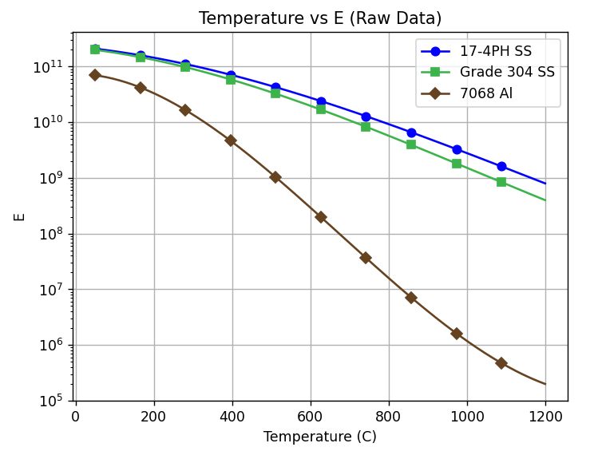
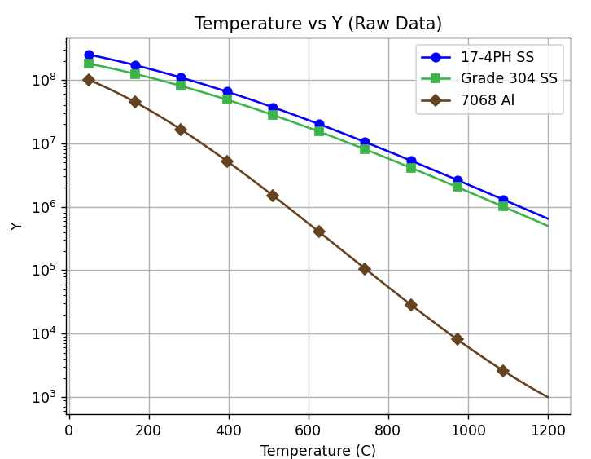
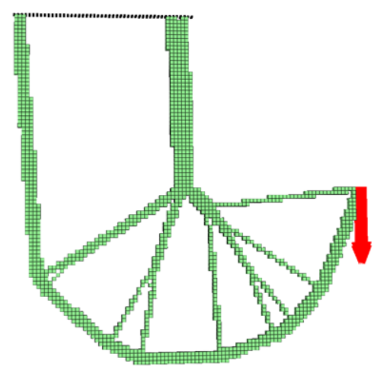
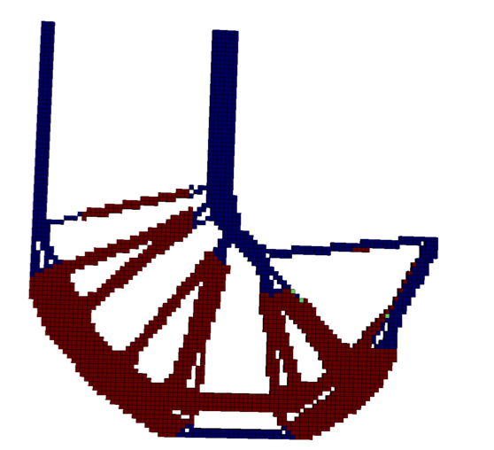
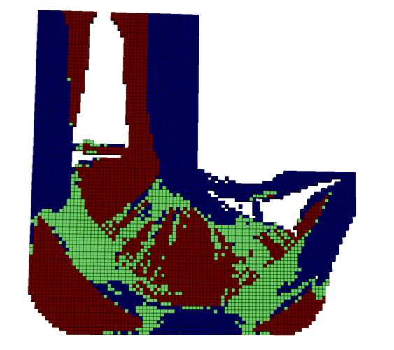
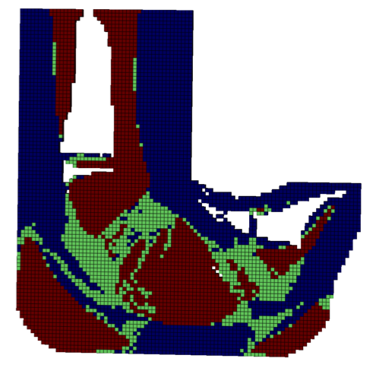
Topology Optimization: Validation Example
T = 50
3 Materials
17-4PH-SS
304 SS
7068 Al
E(T)
Y(T)
Min Mass
Stress SF > 1.25
T_{max} = X
Ref: 17-4PH-SS; Temp
T_{max}= 50
T_{max}= 75
T_{max}= 100
T_{max}= 250
17-4PH-SS
X
7068-Al
304-SS
No design
can meet
stress safety
factor
M* = 29.8
M* = 29.7
M* = 94.1
M* = 93.4

Slide 2
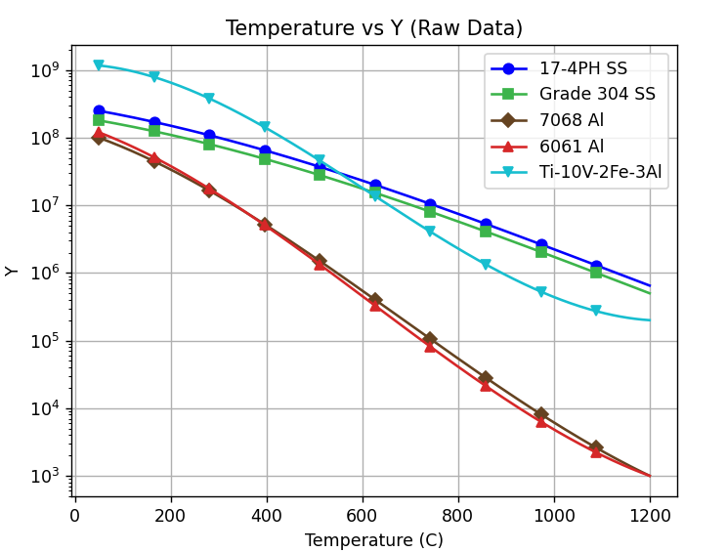
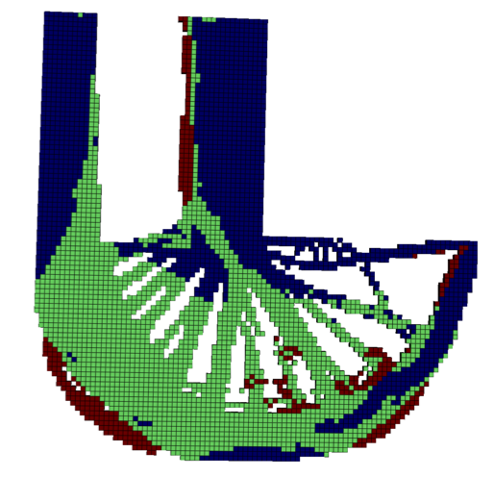
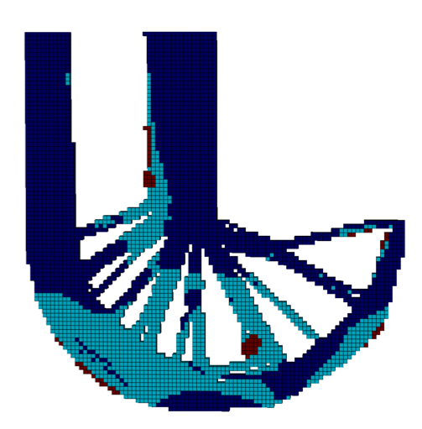
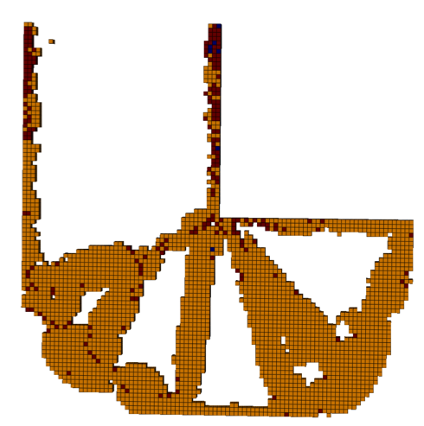
L Bracket: Materials
T_{max}= 250
16 attributes
4D LSR
Did not converge in 150 iterations
3 Materials
4 Materials
5 Materials
M* = 114
M* = 82.6
Yield strength cross-over at high temperature?
Min Mass
Stress SF > 2
Min Mass
Stress SF > 2
Min Mass
Stress SF > 2

Slide 3
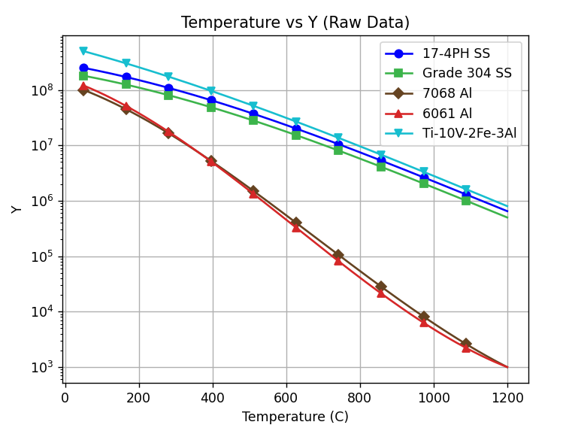
L Bracket: Materials
Yield strength cross-over
No cross-over

Slide 4
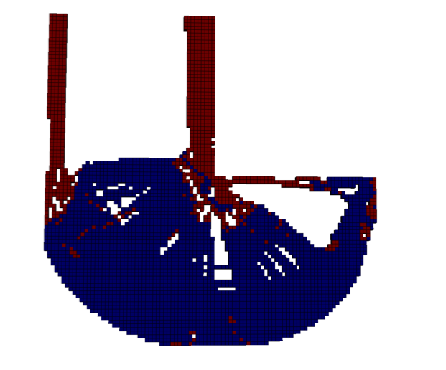
L Bracket: Materials
T_{max}= 250
16 attributes
4D LSR
3 Materials
4 Materials
5 Materials
M* = 114
M* = 82.6
M* = 35
Min Mass
Stress SF > 2
Min Mass
Stress SF > 2
Min Mass
Stress SF > 2

Slide 5
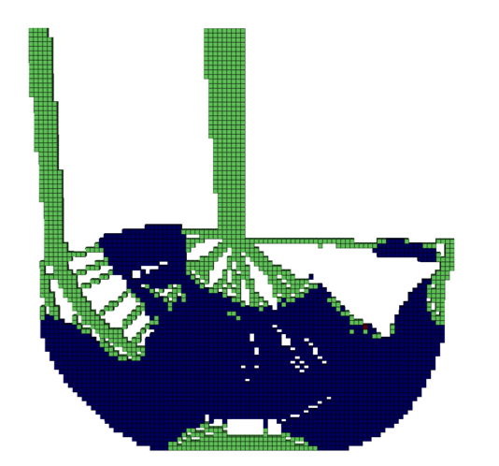
L Bracket: Materials
T_{max}= 250
16 attributes
4D LSR
Snapping leads to issues
3 Materials
4 Materials
5 Materials
6 Materials
M* = 114
M* = 82.6
M* = 35
M* = 33.2
Min Mass
Stress SF > 2
Min Mass
Stress SF > 2
Min Mass
Stress SF > 2
Min Mass
Stress SF > 2

Slide 6
L Bracket: Materials
4D LSR
~0.2% error
6D LSR
~0.2% error
6 Materials
6 Materials
M* = 33.2
M* = 33.2
Min Mass
Stress SF > 2
Min Mass
Stress SF > 2

