Slide 1
Default Settings
Solver: Pardiso
 | DENSITY (MMA, SIMP) | DENSITY (OC, SIMP) | Pareto
 | maxIterations = 500, penal= 3, move= 0.2, kkt_tol= 1.e-6, step_tol= 0.025, rel_conv_tol= 1.e-4, | maxIterations= 500, penal= 3, move= 0.2, step_tol= 0.025, rel_conv_tol= 1.e-4, | rel_err= 0.025, vol_decr_max= 0.05, vol_decr_min= 0.0025, min_local_iters= 2, max_local_iters= 10, rhoVoid= 0,

Slide 2
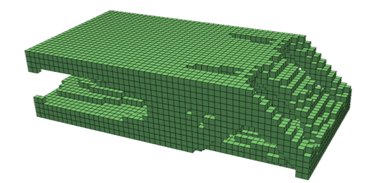
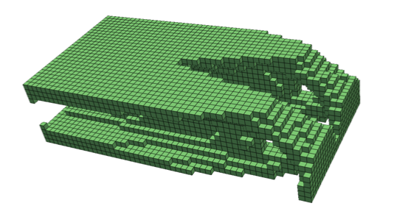
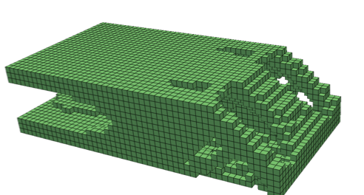
Ex 1a: Edge-loaded Cantilever
 | DENSITY (MMA, SIMP) | DENSITY (OC, SIMP) | Pareto
J* | 0.911 | 0.899 | 0.891
Time (s) | 122 | 66 | 113
Comments |  | Fastest Most optimal

Slide 3
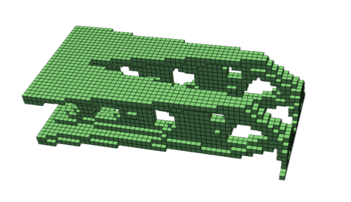
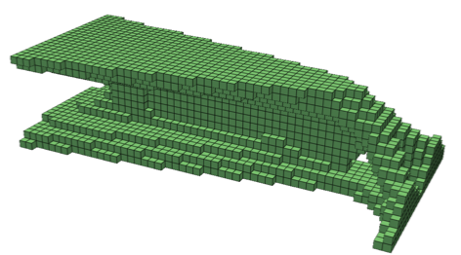
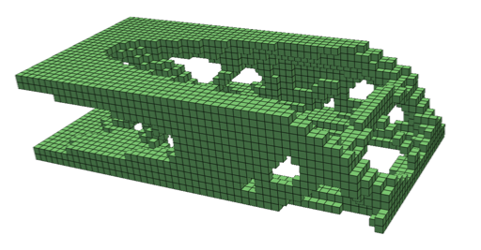
Ex 1b: Edge-loaded Cantilever
 | MMA (SIMP) | OC | Pareto
J* | 1.73 | 1.95 | 1.66
Time (s) | 157 | 76 | 313
Comments |  | Sub-optimal design | Most optimal Slowest

Slide 4
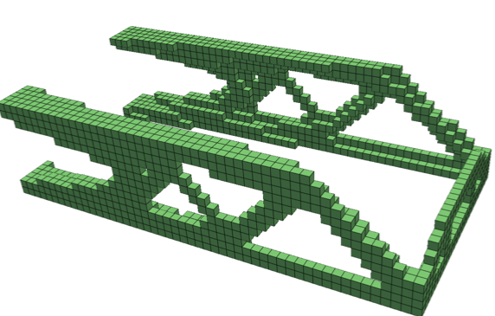
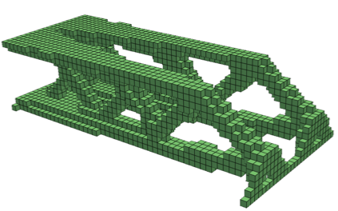
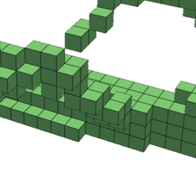
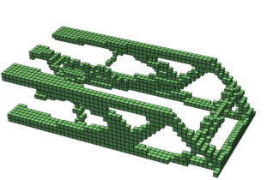
Ex 1c: Edge-loaded Cantilever
 | MMA (SIMP) | OC | Pareto
J* | 5.28 | 6.62 | 2.66 (v = 0.16)
Time (s) | 450 | 67 | 518
Comments | Most optimal | Sub-optimal design Hanging elements | Could not reach 0.1

Slide 5
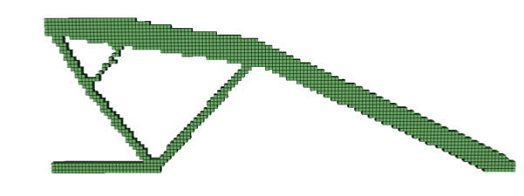
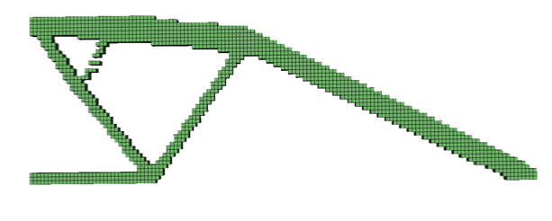
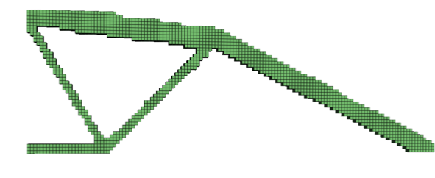
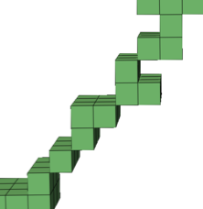
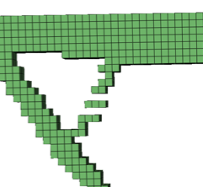
Ex 2: MBB
 | MMA | OC | Pareto
J* | 10.2 | 10.3 | 10.7
Time (s) | 116 | 49 | 162
Comments | Hanging elements | Fastest Hanging elements | Connected Slowest

Slide 6
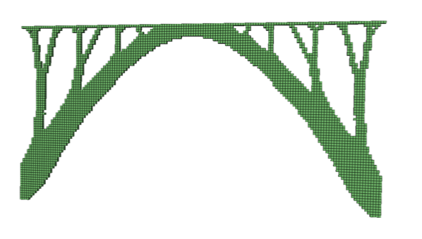
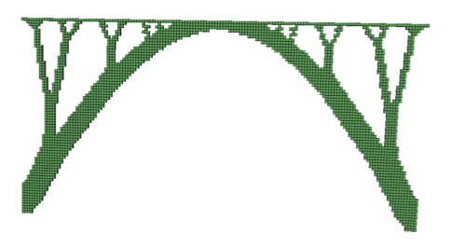
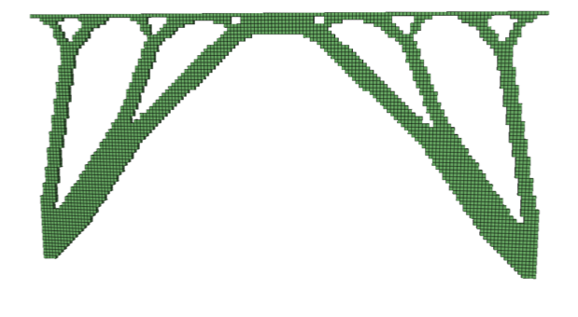
Ex 3: Distributed Load
 | MMA | OC | Pareto
J* | 0.323 | 0.323 | 0.349
Time (s) | 328 | 135 | 81
Comments |  | Fast | Best performance

Slide 7
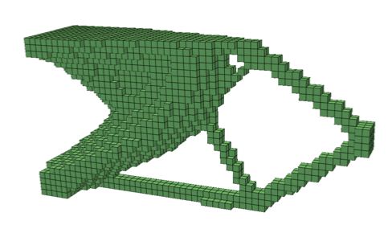
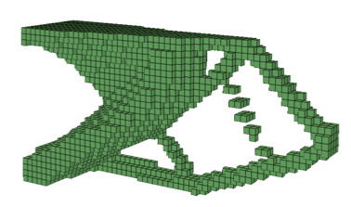
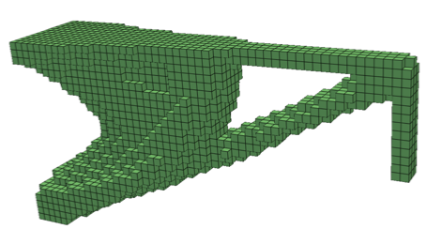
Ex 4: Multiload
 | MMA | OC | Pareto
J* | 0.22 | 0.227 | 0.235
Time (s) | 167 | 79 | 148
Comments |  | Disconnected

Slide 8
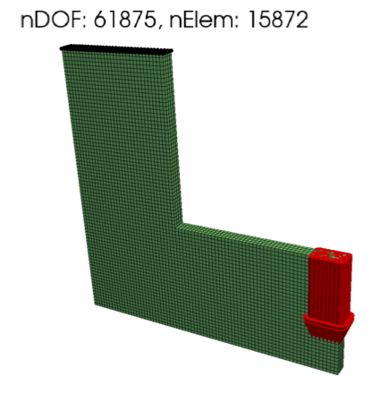
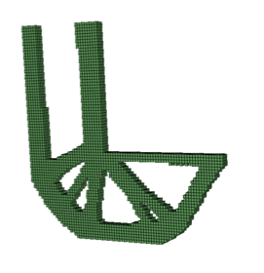
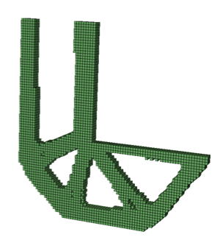
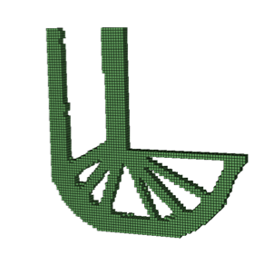
L-Bracket
 | MMA | OC | Pareto
J* | 0.13 | 0.128 | 0.127
Time (s) | 140 | 111 | 72
Comments |  |  | Most optimal Fastest

Slide 9
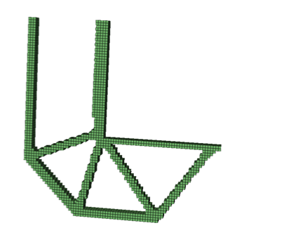
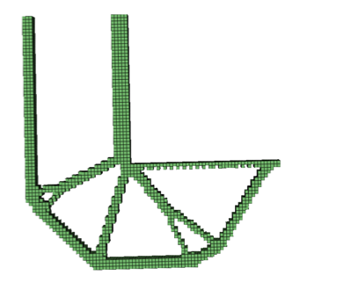
L-Bracket
 | MMA | OC | Pareto
J* | 0.239 | 0.238 | 0.127
Time (s) | 512 | 436 | 72
Comments |  |  | Most optimal Fastest

Slide 10
Ex 7: Distributed Load
 | MMA | OC | Pareto
J* | 0.396 | 0.395 | 0.349
Time (s) | 120 | 44 | 81
Comments |  | Fast | Best performance

Slide 11
Ex 7: Blisk Quarter Model
 | MMA | OC | Pareto
J* | 0.396 | 0.395 | 0.349
Time (s) | 120 | 44 | 81
Comments |  | Fast | Best performance

Slide 12
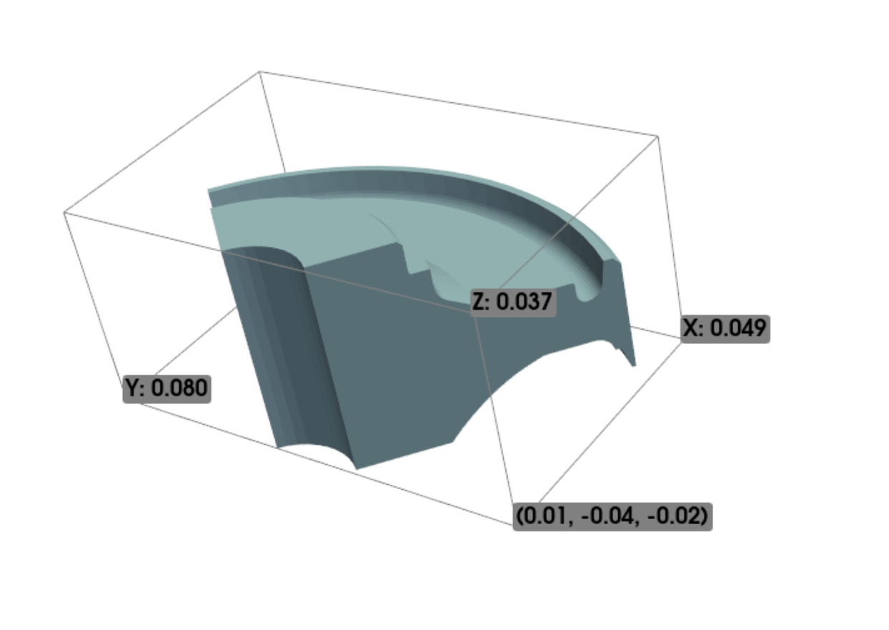

Slide 13
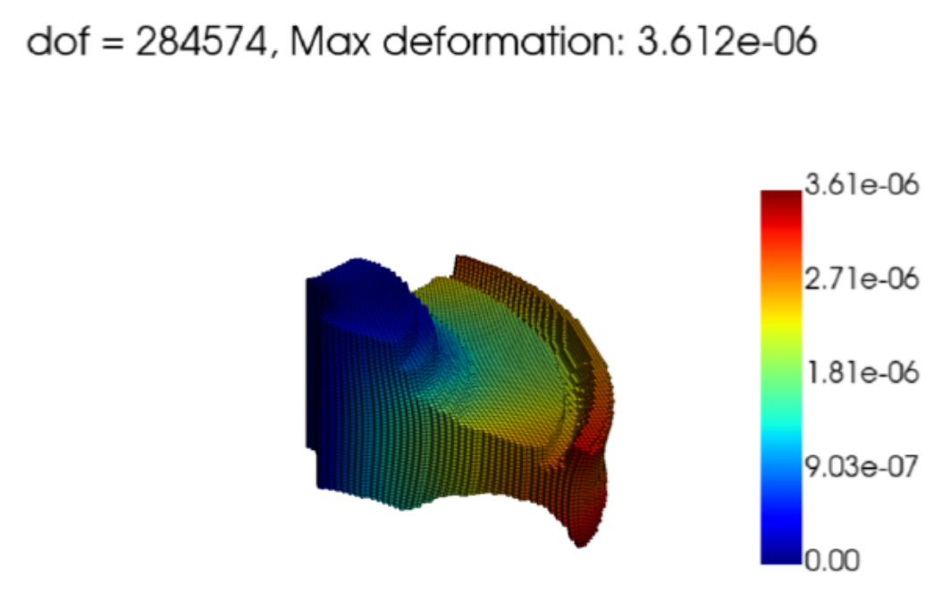

Slide 14
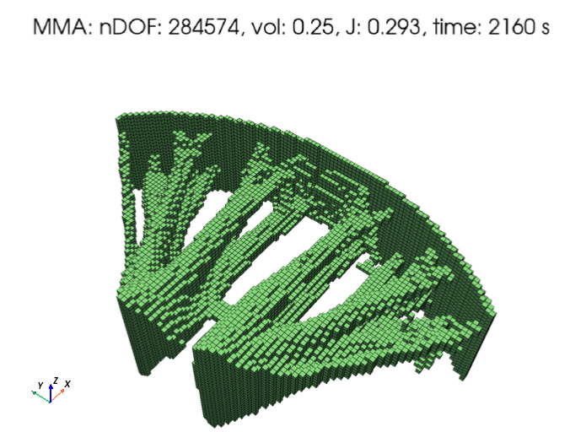


Slide 15
