Slide 1

Git Internals
OR: How I Learned To Stop Worrying And Love The Rebase
Andrew Wildman
May 10, 2019

Slide 2
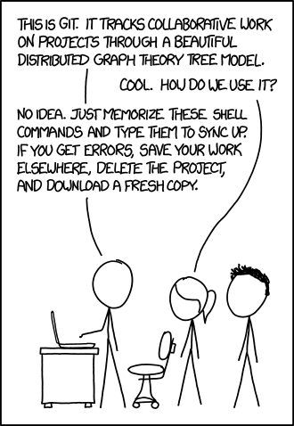
Goals
https://xkcd.com/1597/

Slide 3
Goals
Better mental model
Where and how does git store data files?
What makes up a commit? How do commits form a history?
Why does git rebase create new commits?
https://xkcd.com/1597/

Slide 4
Goals
Better mental model
Where and how does git store data files?
What makes up a commit? How do commits form a history?
Why does git rebase create new commits?
Git Book – https://git-scm.com/book/en/v2
A Plumber’s Guide to Git – https://alexwlchan.net/a-plumbers-guide-to-git/
A Hacker’s Guide to Git – https://wildlyinaccurate.com/a-hackers-guide-to-git/
https://xkcd.com/1597/

Slide 5
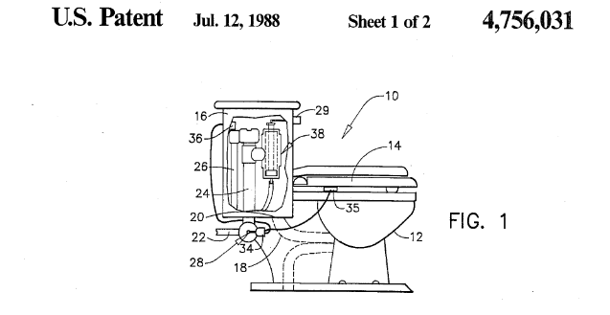
Plumbing vs. Porcelain
Our focus today
git add
git commit
git push

Slide 6
Plumbing vs. Porcelain
Not covering
Basics of git, such as:
git add/commit/push
Git hooks
Internet git repositories (GitHub, GitLab, Bitbucket)
Diffs and packfiles
Communication protocols (behind git pull)
Git tools, such as:
git bisect/rerere/stash
Our focus today
git add
git commit
git push

Slide 7
Agenda
Git Object Store
Blobs and Trees
Commits
References
Attendees’ Choice(?)

Slide 8
Git Object Store

Slide 9
Exercises

Slide 10
Solutions

Slide 11
Blobs and Trees

Slide 12
Directory structure
Blob
echo “Hello world”
File name?
Path?
Permissions?
Blob
#!/bin/python
print(“Hello world”)

Slide 13
Directory structure
Tree
hello.sh
Blob
echo “Hello world”
src
Blob
#!/bin/python
print(“Hello world”)
Tree
hello.py
Executable!

Slide 14
Exercises

Slide 15
Solutions

Slide 16
Commits

Slide 17
Linear history
Commit
Initial commit
Tree
hello.sh
Blob
echo “Hello world”
Blob
#!/bin/python
print(“Hello world”)
src
Tree
hello.py
Executable!

Slide 18
Linear history
Commit
Moved src
Tree
src_moved
Tree
hello.sh
hello.py
Executable!
Commit
Initial commit
Blob
echo “Hello world”
Blob
#!/bin/python
print(“Hello world”)

Slide 19
Linear history
Commit
Moved src
Tree
src_moved
Tree
hello.sh
hello.py
Executable!
Commit
Initial commit
Tree
hello.sh
Blob
echo “Hello world”
Blob
#!/bin/python
print(“Hello world”)
src
Tree
hello.py
Executable!

Slide 20
Merging histories
Commit
Merged histories
Tree
...
...
Tree
Commit
Renamed hello.sh
Commit
Moved src
Tree
...
Commit
Initial commit
Tree
...

Slide 21
Exercises

Slide 22
Solutions

Slide 23
References

Slide 24
Human accessible history
Commit
Merged histories
Tag
v0.0.1
master
Commit
Renamed hello.sh
Commit
Moved src
dev
v0.0.1_rc1
Commit
Initial commit

Slide 25
Permanent human accessible history
Commit
Merged histories
Tag
v0.0.1
master
Commit
Renamed hello.sh
Commit
Moved src
dev
v0.0.1_rc1
Commit
Initial commit

Slide 26
Exercises

Slide 27
Solutions

