Slide 1

Git Internals
OR: How I Learned To Stop Worrying And Love The Rebase
Andrew Wildman
May 10, 2019

Slide 2
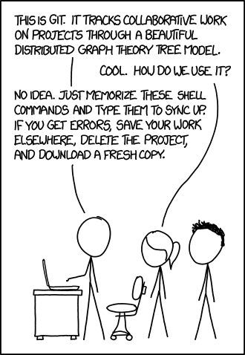
Goals
https://xkcd.com/1597/

Slide 3
Goals
Better mental model
Where and how does git store data files?
What makes up a commit? How do commits form a history?
Why does git rebase create new commits?
https://xkcd.com/1597/

Slide 4
Goals
Better mental model
Where and how does git store data files?
What makes up a commit? How do commits form a history?
Why does git rebase create new commits?
Git Book – https://git-scm.com/book/en/v2
A Plumber’s Guide to Git – https://alexwlchan.net/a-plumbers-guide-to-git/
A Hacker’s Guide to Git – https://wildlyinaccurate.com/a-hackers-guide-to-git/
https://xkcd.com/1597/

Slide 5
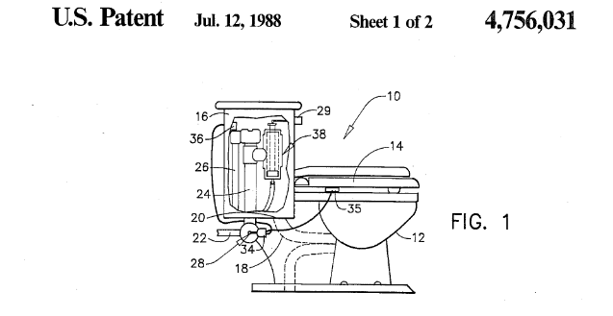
Plumbing vs. Porcelain
Our focus today
git add
git commit
git push

Slide 6
Plumbing vs. Porcelain
Not covering
Basics of git, such as:
git add/commit/push
Git hooks
Internet git repositories (GitHub, GitLab, Bitbucket)
Diffs and packfiles
Communication protocols (behind git pull)
Git tools, such as:
git bisect/rerere/stash
Our focus today
git add
git commit
git push

Slide 7
Agenda
Git Object Store
Blobs and Trees
Commits
References
Attendees’ Choice(?)

Slide 8
Git Object Store

Slide 9
Exercises
Create a new directory, and initialize git
Look inside the .git folder. Make sure you understand its contents.
Create a file, and put some contents in it.
Save that file to the Git object store. Find it in the Git object database.
Use a plumbing command to see the contents of the object you just saved.
Make a change to a file. Save the changed file to the object database.
What do you expect to see in .git/objects?
Were you right?
Bonus: Delete a file, and recreate it from the Git object database.
Bonus: Change the name of a file, and save it to the object database.
What do you expect to see in .git/objects?
Were you right?
2 x

Slide 10
Blobs and Trees

Slide 11
Directory structure
Blob
echo “Hello world”
File name?
Path?
Permissions?
Blob
#!/usr/bin/env python
print(“Hello world”)

Slide 12
Directory structure
Tree
hello.sh
Blob
echo “Hello world”
src
Blob
#!/usr/bin/env python
print(“Hello world”)
Tree
hello.py
Executable!

Slide 13
Exercises
Add a file from part 1 to the index.
Look inside the .git folder. Find the index file.
Check the contents of the index with a plumbing command.
Use git status to confirm the contents of the index.
Save the index as a tree in the object database. Find the file in the database.
Look at the contents of the tree object. Make sure you understand each line.
Repeat 1-5 until you are comfortable saving trees to the database
Change a file and add it to the index. Save the tree to the object database.
What do you expect to be the contents of the tree?
Inspect the object file. Were you right?
Save a subdirectory with files to your database. Inspect both the root tree and subtree. Make sure you understand each of the trees’ contents.

Slide 14
Commits

Slide 15
Linear history
Commit
Initial commit
Tree
hello.sh
Blob
echo “Hello world”
Blob
#!/usr/bin/env python
print(“Hello world”)
src
Tree
hello.py
Executable!

Slide 16
Linear history
Commit
Moved src
Tree
src_moved
Tree
hello.sh
hello.py
Executable!
Commit
Initial commit
Blob
echo “Hello world”
Blob
#!/usr/bin/env python
print(“Hello world”)

Slide 17
Linear history
Commit
Moved src
Tree
src_moved
Tree
hello.sh
hello.py
Executable!
Commit
Initial commit
Tree
hello.sh
Blob
echo “Hello world”
Blob
#!/usr/bin/env python
print(“Hello world”)
src
Tree
hello.py
Executable!

Slide 18
Merging histories
Commit
Merged histories
Tree
...
...
Tree
Commit
Renamed hello.sh
Commit
Moved src
Tree
...
Commit
Initial commit
Tree
...

Slide 19
Exercises
Create a commit from a tree from part 2.
Find your commit object in the object database.
Check the contents of the commit you created
Repeat the above to create a linear history
Check the commit history with git log
Bonus: Create a second commit off of your initial commit. Create a merge commit from your two “branches.”

Slide 20
References

Slide 21
Human accessible history
HEAD
Commit
Merged histories
master
Commit
Renamed hello.sh
Commit
Moved src
dev
Commit
Initial commit

Slide 22
Permanent human accessible history
HEAD
Commit
Merged histories
Tag
v0.0.1
master
Commit
Renamed hello.sh
Commit
Moved src
dev
v0.0.1_rc1
Commit
Initial commit

Slide 23
Exercises
Look inside your .git/refs directory. Check that there are two subdirectories.
Look inside the .git folder. Find the index file.
Check the contents of the index with a plumbing command.
Use git status to confirm the contents of the index.
Save the index as a tree in the object database. Find the file in the database.
Look at the contents of the tree object. Make sure you understand each line.
Repeat 1-5 until you are comfortable saving trees to the database
Change a file and add it to the index. Save the tree to the object database.
What do you expect to be the contents of the tree?
Inspect the object file. Were you right?
Save a subdirectory with files to your database. Inspect both the root tree and subtree. Make sure you understand each of the trees’ contents.

Slide 24
Example: Rebase

Slide 25
Recap

