Slide 1
Camera Electrical and Network Info
Simulated Phonomicrosurgery Station

Slide 2
Camera Wiring
04/05/2011
Signals
Low : 0 V
High: > 2.2 V (5-15 mA)
HW Trigger
Camera 1
Gigabit Ethernet
PC
POE Switch
Digital
Camera 2
Physical Connections
Signal Generator
Signal Splitter
Camera 1*
Ethernet
PC
POE Switch
BNC
Camera 2*
BNC/DIN
*Cameras must be connected to powered ports on POE Switch

Slide 3
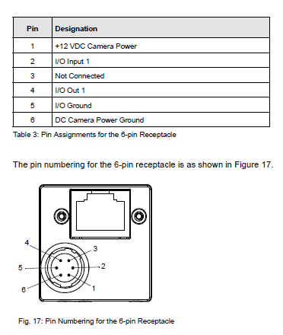
Splitter Box
Schematic
Low : 0 V
High: 3.3 V
Sig Gen
1
MAX627CP+
8
2
C1
2
7
5
3
6
+5V
4
5
2
C2
5
Basler acA640-100gc Pin Diagram
Splitter Box Diagram
To Camera Trigger Signals
BNC @ Splitter Box
Mini-DIN @ Camera
+5V Power Source
Barrel Connector
From Sig. Gen 3.3V Trigger Source
BNC @ Splitter Box
BNC @ Signal Generator

Slide 4
Camera Network Configuration
04/23/2011
Network Adapter
Realtek PCIe GBE Family Controller (Motherboard).
IP Configuration : Fixed IP (TCP/IPv4)
IPv4 Address 172.16.0.1
IPv4 Subnet Mask 255.255.0.0
Camera IP Configuration
Left Camera
S/N: 21058246
MAC: 00:30:53:10:25:C6
IP Configuration: Fixed IP (TCP/IPv4)
Config Name LEFT_CAM
IPv4 Address 172.16.0.2
IPv4 Subnet Mask 255.255.0.0
Right Camera
S/N: 21058262
MAC: 00:30:53:10:25:D6
IP Configuration: Fixed IP (TCP/IPv4)
Config Name RIGHT_CAM
IPv4 Address 172.16.0.3
IPv4 Subnet Mask 255.255.0.0

