Slide 1
Political Fake News Characterization Using Twitter Replication
Andy De La Fuente
Anmol Srivastava
Juan Solorio
Maggie Weatherly
Matthew Rhodes

Slide 2
Target Paper
“Characterizing Political Fake News in Twitter by its Meta-Data”
Amador et. al. of Cornell University
Provides a unique and timely analysis of social media data
Tackles the “pervasive” issue of fake news, at its popularity peak near the 2016 election
Uses Natural Language Processing to apply ‘fake’ label based on:
Political polarization of tweet content
Level of fabrication of tweet content
Virality, or exposure, of tweets
Provides professionally curated data for fake/not fake labels

Slide 3
Target Paper
Specifically tests for significant differences in curated accounts’:
hashtags, mentions, URLs from fake and legitimate accounts
proportion of ‘favorites’ and ‘retweets’ from fake and legitimate accounts
proportion of “followed” vs. “following” accounts from authors of fake or real accounts
verified status of tweet authors
Relies on the Kolmogorov-Smirnoff to test the difference in distributions
Makes a few subsequent conclusions:
Retweets, favorites, and hashtags are not differently-distributed in fake tweets
Verified accounts are less likely to disseminate fake news
Accounts with fake content have different followage proportions than legitimate ones
Fake (vs. real) tweets are seen to have a different mean number of URLs

Slide 4
Scientific Claims of Interest
Figures were replicated for distribution claims regarding:
Number of URLs
‘Friends’ count
‘Followers’ count
‘Friends’ vs. ‘Followers’ ratio
Number of hashtags
Kolmogorov-Smirnoff p-values were replicated for difference-tests involving all original attributes

Slide 5
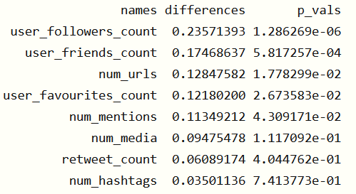
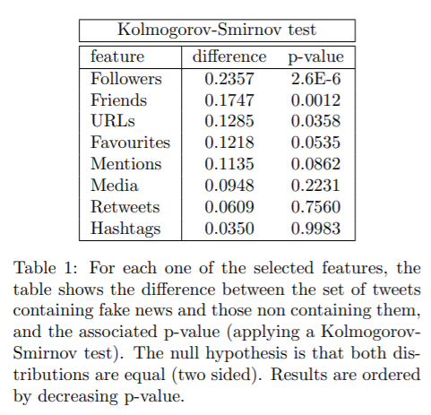
Replication Efforts – P-values Table

Slide 6
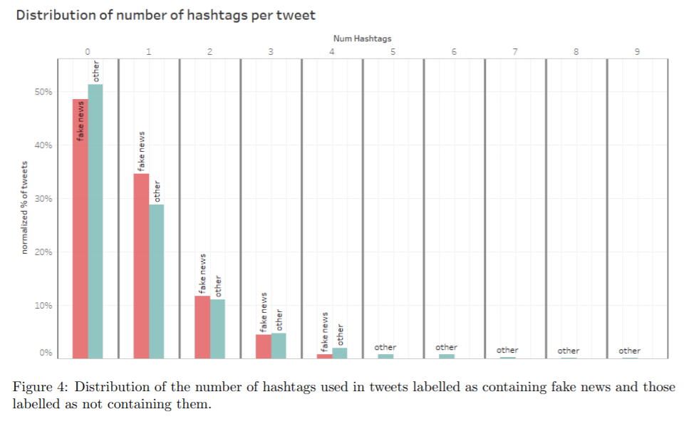
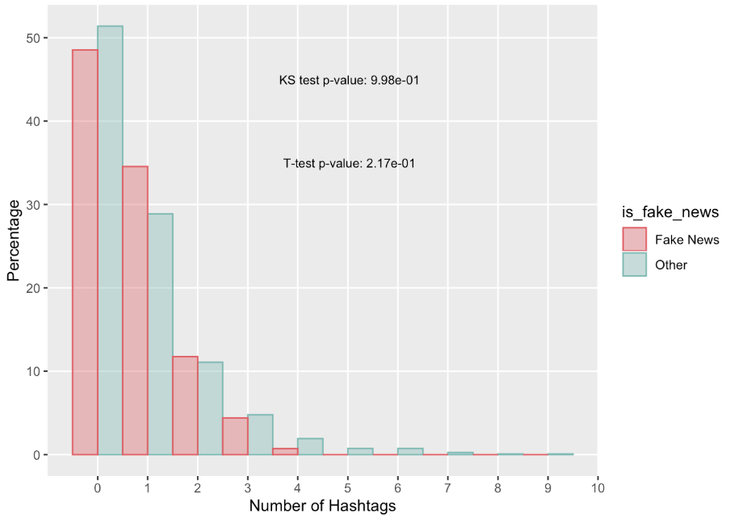
Replication Efforts – Figure 4

Slide 7
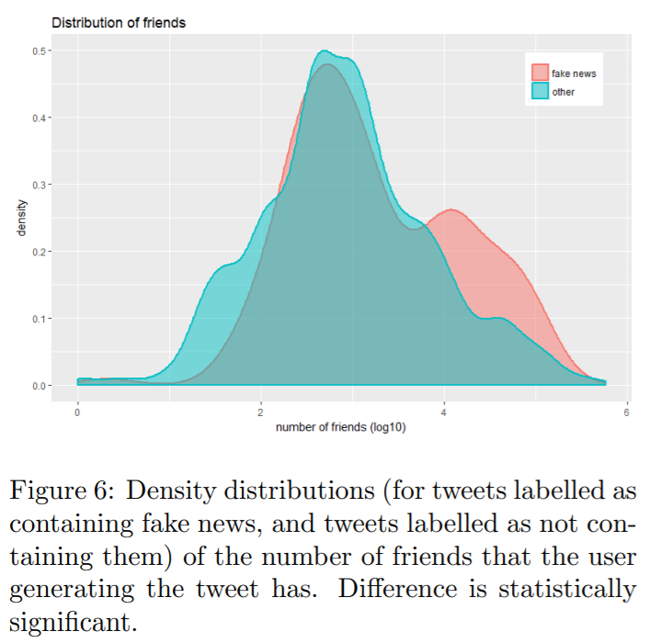
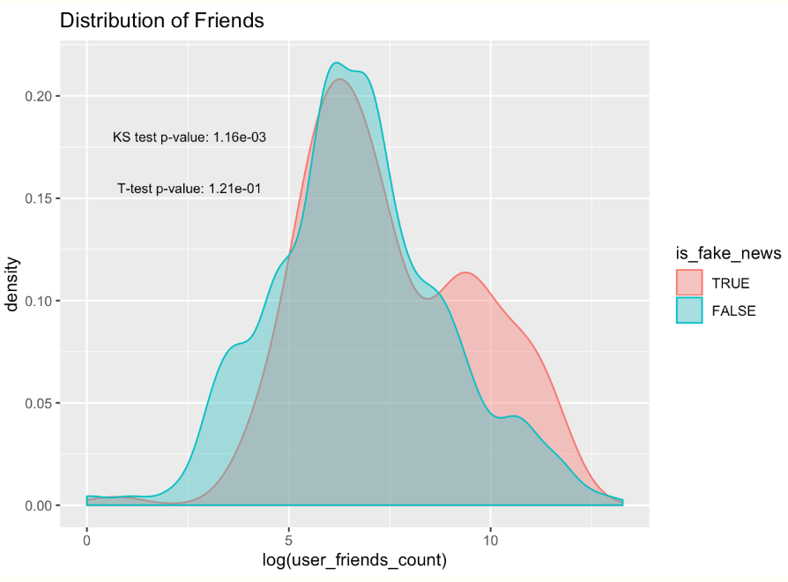
Replication Efforts – Figure 6

Slide 8
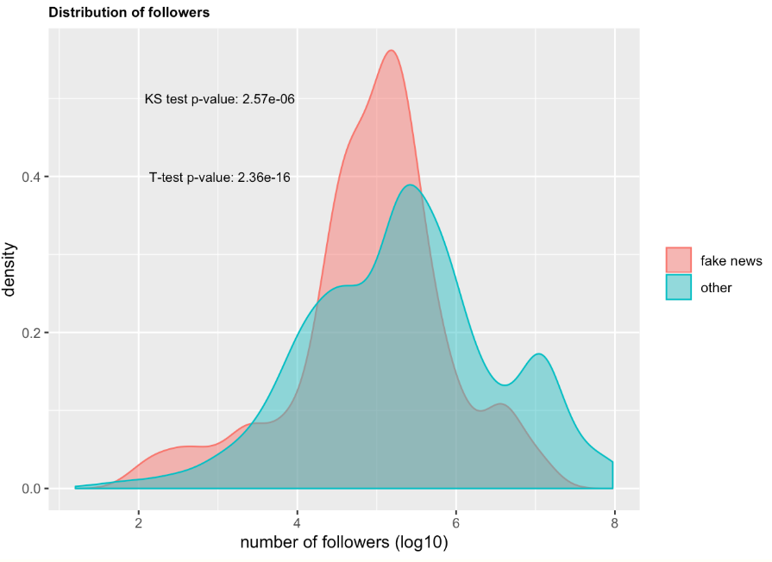
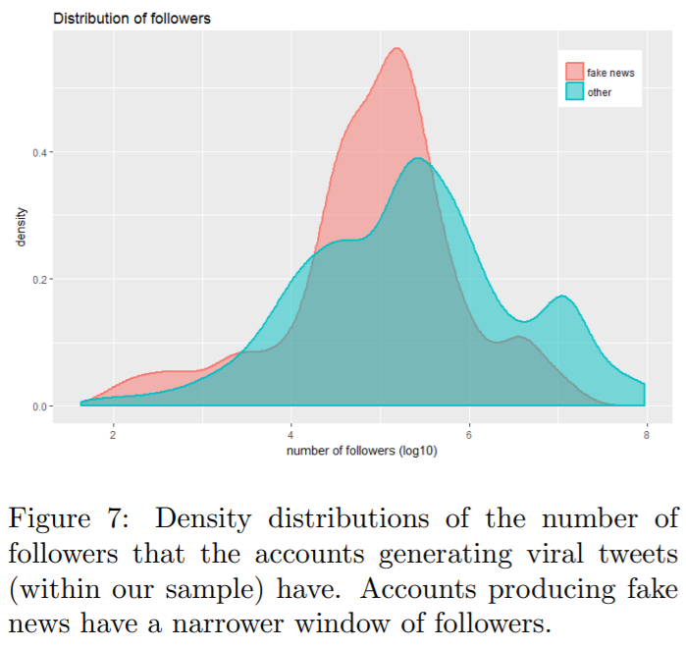
Replication Efforts – Figure 7

Slide 9
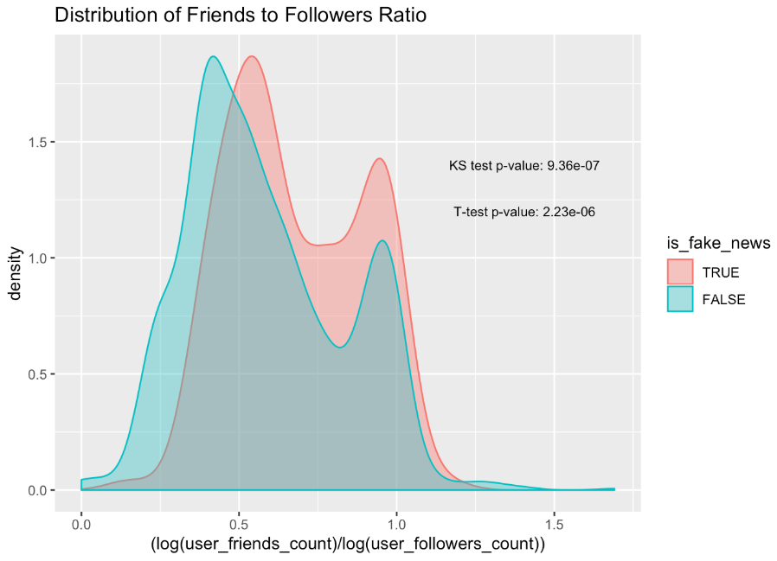
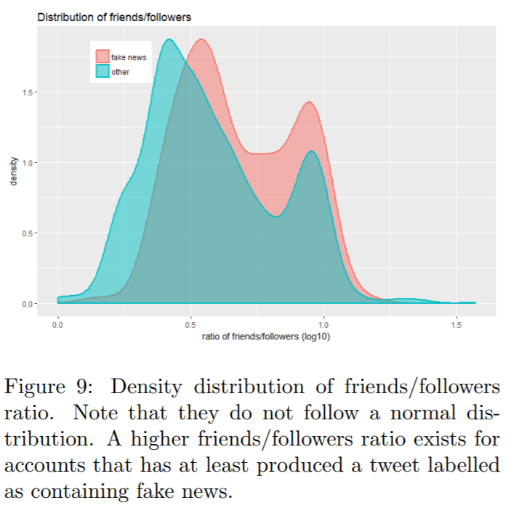
Replication Efforts – Figure 9

Slide 10
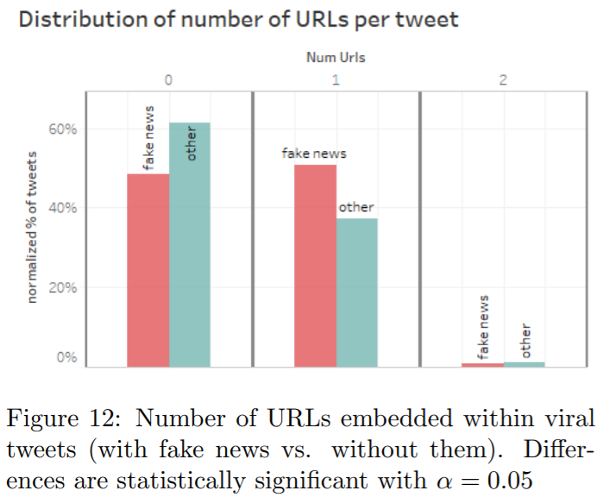
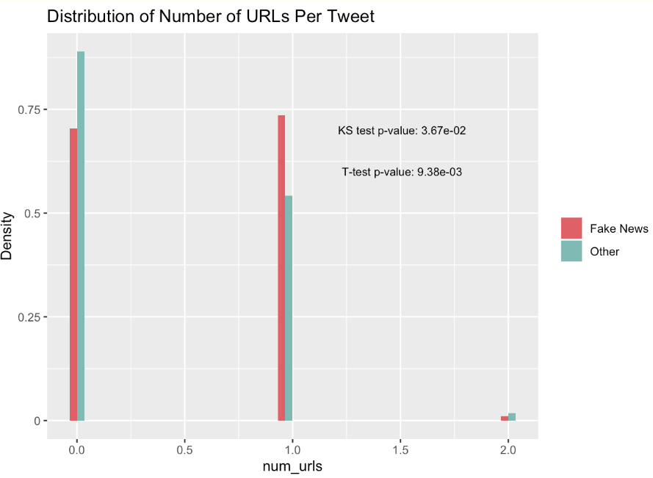
Replication Efforts – Figure 12

Slide 11
Reflections
We were able to collaborate on (and share) much of the code related to:
styling plot content, labels, overlays
providing accompanying calculations (like p-values) for Kolmogorov-Smirnoff and other tests
Still, there were some minor hurdles in reproducing this work seamlessly:
aesthetic discrepancies in object shape and size
scaling discrepancies in axes and corresponding units
lack of complete codebase from original project (human curated labeling)
obfuscated statistical methods from original paper

