Slide 1

What Can I Do With Git/Github?

Slide 2
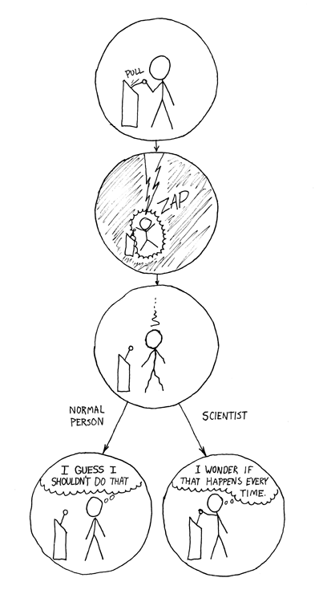
“Non-reproducible single occurrences are of no significance to science.” —Karl Popper
Popper, K. R. 1959. The logic of scientific discovery. Hutchinson, London, United Kingdom.

Slide 3
Software carpentry
Write software for people not computers
Automate repetitive tasks
Use the computer to record history
Make incremental changes
Use version control
Don’t repeat yourself
Plan for mistakes
First make it correct, then make it fast
Document design & purpose not mechanics
Conduct code reviews
Wilson et al. (2014) Best practices for scientific computing. PLoS Biology 12: e1001745

Slide 4
What is version control?
What does git do?
Keeps track of changes made to files
Lets you go back to old versions
Only one version in your directory
+ Github
  Keep files synced at multiple locations
  Work with other people
  Publish your code
Notes:
Also mention then you can play with things without worry – as lauren mentioned yesterday

Slide 5
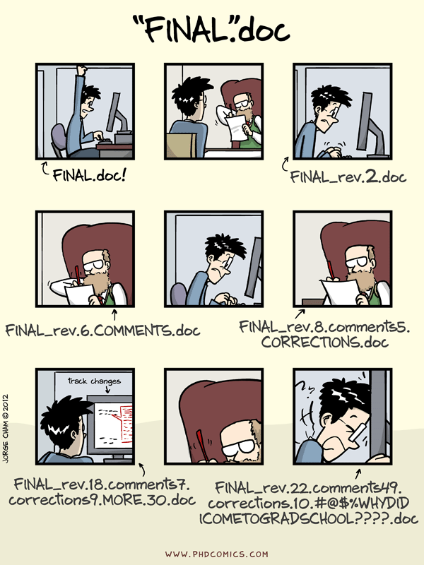
“Piled Higher and Deeper” by Jorge Cham, http://www.phdcomics.com

Slide 6
More Realistically
script_v1.py
script_v2.py
file-04-05-2015.docx
file-06-08-2016.docx
2015-05-04-file.docx
2016-06-07file_PI.docx
2016-06-08-file.docx
“Piled Higher and Deeper” by Jorge Cham, http://www.phdcomics.com

Slide 7
Why Learn Git?
Reproducible Research
  For you
    Your closest collaborator is you 6 months ago, and you don't respond to emails.
  For publishing your analysis
For collaboration
  Code review
  Working together on a project

Slide 8
Other Resources
http://kbroman.org/Tools4RR/
https://software-carpentry.org/
http://www.datacarpentry.org/
ComBEE - https://sites.google.com/a/wisc.edu/combee/
http://blog.mothur.org/2016/01/04/Suck-until-you-dont/

Slide 9
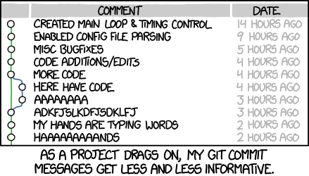
https://xkcd.com/1296/

Slide 10
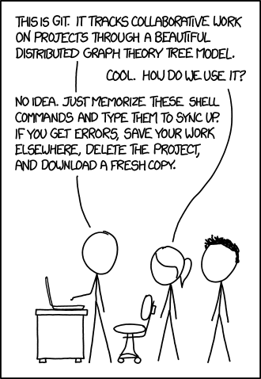
https://xkcd.com/1597/

