Slide 1
Welcome to the Workshop!
Workshop Website
https://uw-madison-aci.github.io/2017-01-12-uwmadison/
Make sure you’ve completed the Setup!!
Etherpad (for collaborative notes)
http://pad.software-carpentry.org/2017-06-28-uwmadison-swc
Pre-Workshop Survey (1/2 of your entry fee!)
https://www.surveymonkey.com/r/swc_pre_workshop_v1
Notes:
SHOW SCHEDULE AND ETHERPAD, Introductions to neighbors.

Slide 2
Check your setup!
Open Terminal or GitBash (Windows), and type the following:
python –-version
Raise your hand if you DON’T have version 3.5.x (where x can vary).
python –c “import numpy”
Raise your hand if you get an error.
git –-version
Raise your hand if you get an error.
nano --version
Raise your hand if you get an error.
Notes:
SHOW SCHEDULE AND ETHERPAD, Introductions to neighbors.

Slide 3

Welcome to Software Carpentry!
June 28-29, 2017
Instructors:
Carolyn Voter
Patrick Shriwise
Kalin Kiesling
Host:
Advanced Computing
Initiative
Notes:
3
INTRODUCE SELF + OTHER INSTRUCTORS + HELPERS + HOSTS

Slide 4
What is ‘Software Carpentry’??
Non-profit, international organization
Teaches workshops to help researchers adopt reproducible computational practices
Instructors are all volunteers
Materials developed by open science community
Code-along learning model

Slide 5
Code of Conduct
http://software-carpentry.org/conduct/
Harassment includes offensive verbal comments related to gender, sexual orientation, disability, physical appearance, body size, race, religion, sexual images in public spaces, deliberate intimidation, stalking, following, harassing photography or recording, sustained disruption of talks or other events, inappropriate physical contact, and unwelcome sexual attention.
All communication should be appropriate for a professional audience including people of many different backgrounds. Sexual language and imagery is not appropriate for any event.
Be kind to others. Do not insult or put down other attendees.
Behave professionally. Remember that harassment and sexist, racist, or exclusionary jokes are not appropriate.
Notes:
In essence, Be nice, we are all here to learn. (Give them a minute to read on the board)

Slide 6
Workshop Logistics:
Where Stuff Is
Restrooms
Across the hall
Beverages
Drinking fountain: across the hall
Coffee/tea: front left corner of room, all day
Lunch
On your own.
Need a fridge? Let us know.

Slide 7
If You Can’t Reproduce It,
Is It Still Science?
And how long will it take?
Inspired by Greg Wilson,
Software Carpentry
Notes:
7

Slide 8
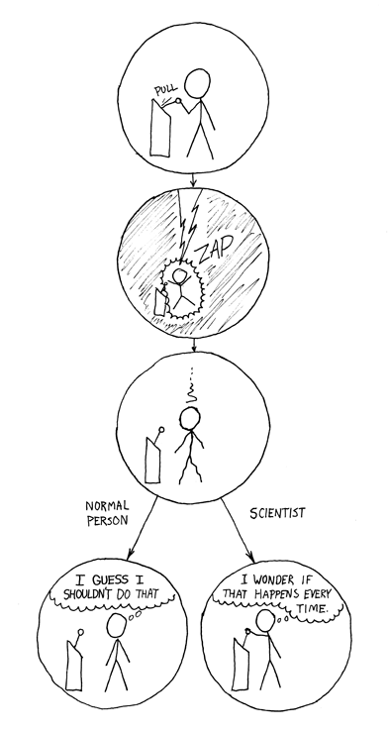
https://xkcd.com/242/

Slide 9
Reality of Research Computing
Many scientists spend most of their time developing, maintaining, or running software
Most don’t consider themselves software engineers
Few have ever been taught how

Slide 10
So what?
Most results take longer to produce than they need to
Difficult to assess quality

Slide 11
Software Carpentry to the Rescue
Best practices used by the best software engineers whose business is development of quality software
They don’t always have formal training
They don’t always follow all the practices
Growing evidence supported by empirical studies

Slide 12
Software Carpentry Practices
Write software for people, not computers
Automate repetitive tasks
Use the computer to record history
Make incremental changes
Use version control
Don’t repeat yourself
Plan for mistakes
First make it correct, then make it fast
Document design & purpose, not just mechanics
Conduct code reviews
Wilson et al. (2014) Best practices for scientific computing. PLoS Biology 12: e1001745
Notes:
Readable by humans (fixing bugs, trying to extend): meaningful names, clear style, modular
Modular code so that

Slide 13
Good Enough Practices
Data management - saving both raw and intermediate forms, documenting all steps, creating tidy data amenable to analysis
Software - writing, organizing, and sharing scripts and programs used in an analysis
Collaboration - making it easy for existing and new collaborators to understand and contribute to a project
Project organization - organizing the digital artifacts of a project to ease discovery and understanding
Tracking changes - recording how various components of your project change over time
Manuscripts - writing manuscripts in a way that leaves an audit trail and minimizes manual merging of conflicts
Wilson et al. (2017) Good enough practices in scientific computing. PLoS Comput Biol 13(6): e1005510

Slide 14
Thoughts on Productivity and Automation
Cumulative Effort
Time

Slide 15
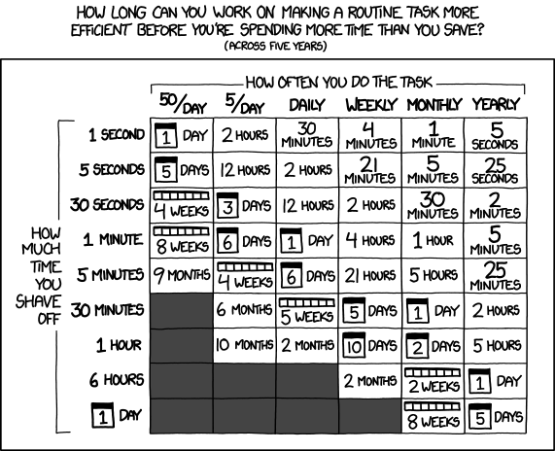
Thoughts on Productivity and Automation
https://xkcd.com/1205/

Slide 16
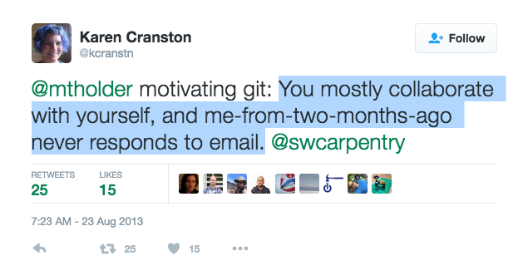
http://bit.ly/motivate_git)
Notes:
– Mark Holder (see http://bit.ly/motivate_git)

Slide 17
Make Incremental Changes Redux
Choose one practice
Implement it in your work
Share it with your lab group
Allow it to sink in
Repeat

Slide 18
Where to Start?
Depends on the nature of your work
Consider the purpose:
Improve productivity
Improve quality
Need help after the workshop?
Follow up meeting
Email our local Software Carpentry Community! @ swc-dc-help@lists.wisc.edu

Slide 19
Workshop Logistics:
Continuous Feedback
Nametags
green side up – exercise completed
red side up – exercise in progress; HELP!
nametag down – all is okay
Post-Its
At each break, indicate something that was good and something that could be better.
Post-Workshop Survey (1/2 of your entry fee!)
You’ll receive a link from us after the workshop.

Slide 20
Welcome to the Workshop!
Workshop Website
http://uw-madison-aci.github.io/2016-08-29-uwmadison/
Make sure you’ve completed the “Setup”!!
Etherpad (for collaborative notes)
http://pad.software-carpentry.org/2016-08-29-uwmadison
Pre-Workshop Survey (1/2 of your entry fee!)
https://www.surveymonkey.com/r/swc_pre_workshop_v1
Notes:
SHOW SCHEDULE AND ETHERPAD, Introductions to neighbors.

