Slide 1
Follow Up Sessions
Dates/times:
July 6th 2-4PM
July 13th 2-4PM
Purpose:
some extended lessons on each topic
custom workflows using the shell, Git, and Python
any questions you might have

Slide 2
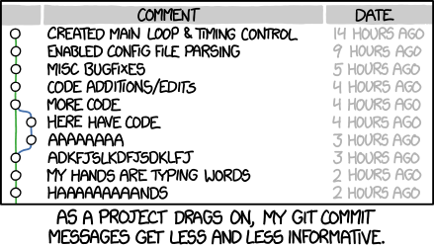
https://xkcd.com/1296/

Slide 3
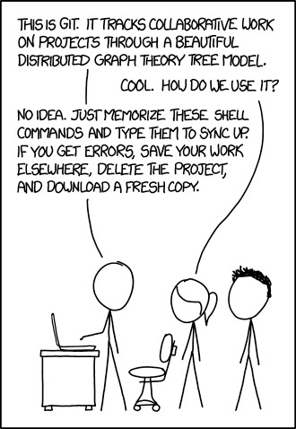
https://xkcd.com/1597/

