Slide 1
Welcome to the Workshop!
Find a seat with a nametag, and plug in!
Make sure you’ve completed the “Setup” steps:
https://uw-madison-aci.github.io/2018-01-08-uwmadison-dc/
Get to know the people at your table.
Let Lauren know if you have food you need to store in a fridge.
Restrooms are across the hall; coffee at the front of the room.

Slide 2


Welcome to
@
https://github.com/UW-Madison-ACI/2018-01-08-uwmadison-dc

Slide 3
Introductions

Slide 4
Workshop Impetus and Content

Slide 5
Data Problems*
"Where did this data file come from?!”
"Can you repeat the analysis, omitting subject X?”
“You used the wrong data- the full dataset has more subjects.”
“The color-coding in this spreadsheet was off.”
*modified from Karl Broman’s intro to Tools for Reproducible Research

Slide 6
Our Goals: Reproducibility
Learn data analysis tools and best practices for organizing your data “studio”
Two themes:
Make yourself a road map: take time to organize and document
Avoid doing things “by hand”: use tools that parse and analyze data, rather than editing data directly
Take away something immediately useful

Slide 7
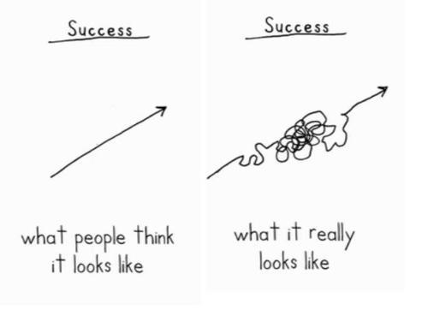

Slide 8
Reproducibility vs. Replicability?

Slide 9
What We’ll Learn
Data Organization and Formatting in Spreadsheets
Data Cleaning/Reformatting
(Meta: Tips for Data Entry/Creation)
Data Management using a Database
Automated Data Analysis
Automated Data Visualization and Reporting

Slide 10
Tools We’ll Use
Spreadsheet Program (Excel, or other)
OpenRefine
SQL
R w/packages:
dplyr
ggplot2
knitr

Slide 11
Workshop Logistics

Slide 12
Workshop Format
Hands-on, working with real data.
Be prepared to:
(almost) always, follow along with the instructor on your own computer
work on exercises by yourself or with people near you
Ask questions!
Share notes in the etherpad:
http://pad.software-carpentry.org/2018-01-08-uwmadison-dc

Slide 13
Nametags
Your nametags are a visual feedback tool for instructors
If you are lost, confused, or need help, put the red side up.
If all is well, put up the green side up.

Slide 14
Code of Conduct
In order to facilitate the best learning for everyone, we expect everyone to abide by the Data Carpentry Code of Conduct: http://www.datacarpentry.org/code-of-conduct/ If you have any concerns, email Christina at ckoch5@wisc.edu or Lauren at lmichael@wisc.edu, or contact the Data Carpentry staff listed on the CoC above.

Slide 15
Workshop Logistics
We will have breaks during the morning, afternoon and for lunch.
Coffee, tea, and a morning snack are provided. Lunch is on your own.
We can provide a refrigerator / microwaves for food.
Restrooms (and drinking fountains) are across the hall or on the first floor.

Slide 16
Meet your neighbors!
Talk to 1-2 people around you:
summarize your research/work in three words (and then briefly describe it)
share one thing you hope to learn at this workshop

Slide 17
Important Links
Workshop Website (schedule, materials):
https://uw-madison-aci.github.io/2018-01-08-uwmadison-dc/
Etherpad (links, online notes + live chat):
http://pad.software-carpentry.org/2018-01-08-uwmadison-dc
Twitter: @datacarpentry, #dcuwm
All-Data Shortcut: (most useful after the workshop)
kbroman.org/datacarp

