Slide 1
Welcome to the Workshop!
Workshop Website
https://uw-madison-aci.github.io/2018-01-10-uwmadison-swc/
Make sure you’ve completed the Setup!!
Etherpad (for collaborative notes)
http://pad.software-carpentry.org/2018-01-10-uwmadison-swc
Pre-Workshop Survey (1/2 of your entry fee!)
https://www.surveymonkey.com/r/swc_pre_workshop_v1
Notes:
SHOW SCHEDULE AND ETHERPAD, Introductions to neighbors.

Slide 2
Check your setup!
Open Terminal or GitBash (Windows), and type the following:
python –-version
Raise your hand if you DON’T have version 3.5.x (where x can vary).
python –c “import pandas”
Raise your hand if you get an error.
git –-version
Raise your hand if you get an error.
nano --version
Raise your hand if you get an error.
Notes:
SHOW SCHEDULE AND ETHERPAD, Introductions to neighbors.

Slide 3
Workshop Logistics:
Where Stuff Is
Restrooms
Across the hall
Beverages
Drinking fountain: across the hall
Coffee/tea: front left corner of room, all day
Lunch
On your own.
Need a fridge? Let us know.

Slide 4

Welcome to Software Carpentry!
January 10-11, 2018
Instructors:
Carolyn Voter
Christina Koch
Patrick Shriwise
Sarah Stevens
Host:
Advanced Computing
Initiative
Notes:
4
INTRODUCE SELF + OTHER INSTRUCTORS + HELPERS + HOSTS

Slide 5
Briefly….
What is Software Carpentry? What are our goals?
Expectations
What you should expect from us
What we expect from you
What you should expect from yourselves
Notes:
In essence, Be nice, we are all here to learn. (Give them a minute to read on the board)

Slide 6
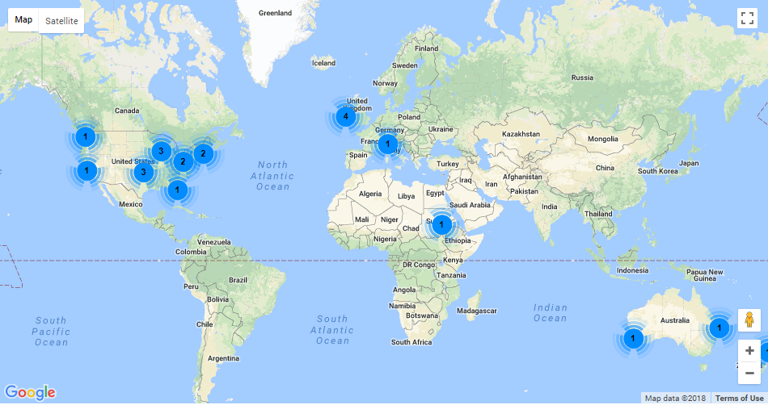
What is ‘Software Carpentry’??
Non-profit, international organization
Workshops = our way to help scientists
Notes:
Start by telling you a little more about what this workshop is

Slide 7
What is ‘Software Carpentry’??
Non-profit, international organization
Workshops = our way to help scientists
Code-along learning model
Instructors are all volunteers
Materials developed by open science community
Notes:
Start by telling you a little more about what this workshop is

Slide 8
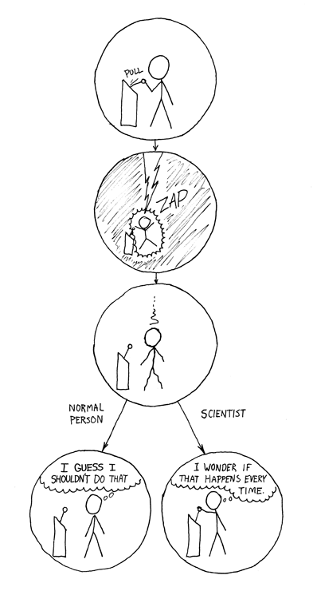
If you can’t reproduce it, is it still science?
https://xkcd.com/242/
Notes:
Need Popper’s if it isn’t reproducible it isn’t science quote

Slide 9
Reality of Research Computing
Many scientists spend most of their time developing, maintaining, or running software
Most don’t consider themselves software engineers
Few have ever been taught how

Slide 10
So what?
Most results take longer to produce than they need to
Difficult to assess quality

Slide 11
Thoughts on Productivity and Automation
Cumulative Effort
Time
Notes:
Conceptually, if you put in a bit more effort at the start to figure out how to automate tasks – like you’re doing right here, in this workshop – over time it pays off

Slide 12
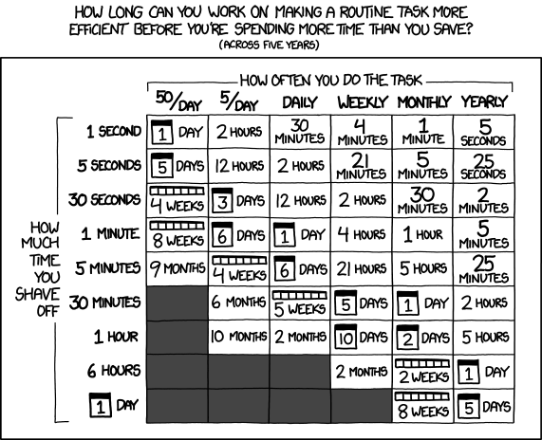
Thoughts on Productivity and Automation
https://xkcd.com/1205/
Notes:
XKCD took this even further and actually quantified for us how much time you can take to figure out how to automate a task based on how often you do it and how much time you shave off.

Slide 13
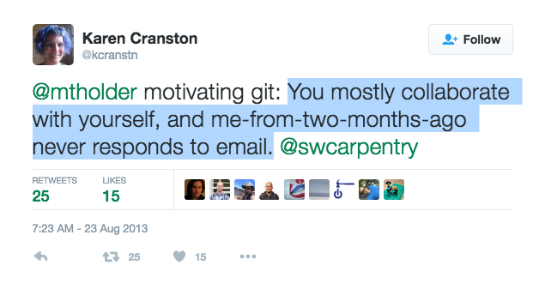
http://bit.ly/motivate_git)
Notes:
Another reason to improve the reproducibility of your scientific computing is that often, it’s YOU who’s doing the reproducing.
– Mark Holder (see http://bit.ly/motivate_git)

Slide 14
Software Carpentry to the Rescue! SWC Best Practices
Write software for people, not computers
Automate repetitive tasks
Use the computer to record history
Make incremental changes
Use version control
Don’t repeat yourself
Plan for mistakes
First make it correct, then make it fast
Document design & purpose, not just mechanics
Conduct code reviews
Wilson et al. (2014) Best practices for scientific computing. PLoS Biology 12: e1001745
Notes:
SWC wants to come to your rescue! Help you be kind to yourself…and your colleagues around you…by sharing best practices from the software engineering community (the people who actually do get formal training in this stuff). Readable by humans (fixing bugs, trying to extend): meaningful names, clear style, modular
Modular code so that

Slide 15
What you can expect from us
We’ll go at your pace (code-along)
We’re here to help
Nametags (green = done; red = not done/help!)
Helpers
Etherpad (chat/notes)
http://pad.software-carpentry.org/2018-01-10-uwmadison
We’ll incorporate feedback from you at the end of each section
Post-its (green = good thing; red = could be better)
We might not get to everything
Notes:
Readable by humans (fixing bugs, trying to extend): meaningful names, clear style, modular
Modular code so that

Slide 16
What we expect from you
Active participants
Code-along, respond to questions
Ask for help when needed
Help your neighbors if you can
Code of Conduct http://software-carpentry.org/conduct/
Harassment includes offensive verbal comments related to gender, sexual orientation, disability, physical appearance, body size, race, religion, sexual images in public spaces, deliberate intimidation, stalking, following, harassing photography or recording, sustained disruption of talks or other events, inappropriate physical contact, and unwelcome sexual attention.
All communication should be appropriate for a professional audience including people of many different backgrounds. Sexual language and imagery is not appropriate for any event.
Be kind to others. Do not insult or put down other attendees.
Behave professionally. Remember that harassment and sexist, racist, or exclusionary jokes are not appropriate.

Slide 17
What you should expect of yourself
You don’t need to absorb & implement everything at once
Choose one practice
Implement it in your work
Share it with your lab group
Allow it to sink in
Repeat

Slide 18
Where to Start?
Depends on the nature of your work.
Consider the purpose:
Improve productivity
Improve quality
Need help after the workshop?
Post-workshop follow-up sessions
Email our local Software Carpentry Community! swc-dc-help@lists.wisc.edu

