Slide 1
Before we begin
Make sure you have installed:
R
The “tidyverse” suite of R packages
RStudio
Have RStudio OPEN
Download this file and put it in your project “Clean” folder (link also on line 302 of etherpad):
https://ndownloader.figshare.com/files/10717186

Slide 2
Data Carpentry: Day 2
UW Madison - Data Science Hub
January 17, 2019

Slide 3
Same as yesterday
Logistics
Workshop
Similar schedule -- 3 breaks
Bathrooms outside the door
If you need a kitchen, lactation room, lockers, let us know.
Hands-on!
Work with your neighbors
Use red/green tents to indicate if you need help
Helpers are nearby
Abide by the Code of Conduct
etherpad link: https://pad.carpentries.org/2019-01-16-uwmadison-dc
workshop page: https://uw-madison-datascience.github.io/2019-01-16-uwmadison-dc/

Slide 4
Goal: Productivity
Perform accurate data analysis
Leverage appropriate tools
Prepare for the future
Your closest collaborator is you six months ago, but you don't reply to email.
– (paraphrasing) Mark Holder

Slide 5
Recap from yesterday
Early stages of data analysis
Format
Clean
Basic selection, combination, summarization
Focus on reproducibility
Track steps of data change
Organize using a folder structure
Use tools that you can repeat

Slide 6
Organization
Create a directory for each project
Separate things (data, scripts, reports)
File names: meaningful, sortable, consistent
File organization and naming are powerful weapons against chaos.
– Jenny Bryan

Slide 7
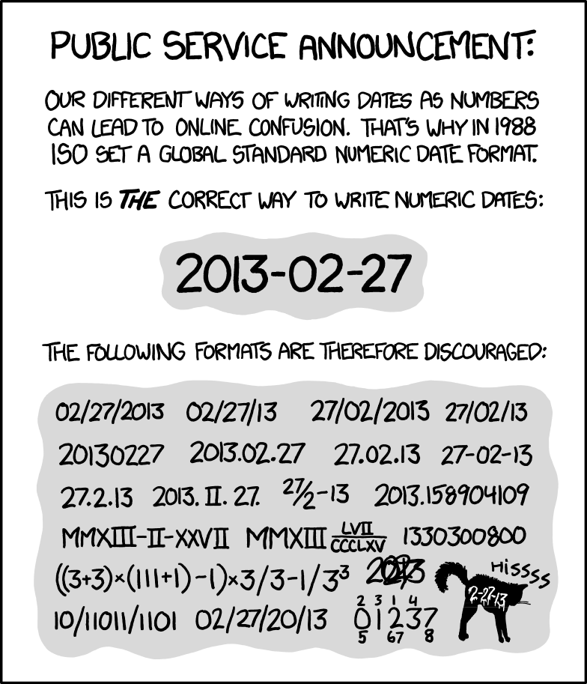
Dates
https://xkcd.com/1179/

Slide 8
Format (spreadsheets)
Goal: rectangle of information
rows = observations, columns = variables
one thing per cell
headers for the columns
don't use font color or highlighting as data
Watch out for dates (3 separate columns?)
Never edit raw data
Plain text formats

Slide 9
Clean (spreadsheets/Open Refine)
cleaning & exploration
faceting / filtering
splitting a column
remove trailing/ending text
cluster categories (to find typos)
identify outliers
all actions are reproducible

Slide 10
Subset and Summarize (Open Refine + SQL)
Access rows (usually by a filter) and columns of data
Summarize data in total or in groups
Combine related data

Slide 11
TODAY
Pick up where we left off:
Select and summarize data
Visualize data
Reports, final presentations
Using R
Still with a focus on self-documentation, organization, reproducibility

Slide 12
Why R?
Facilitates reproducibility
Flexible / extensible
Data-oriented, good graphics packages
Free
Actively developed
Community support

