Slide 1

Bitstream Computing Hackathon @ UW 11/12 – 11/26/2023
https://uw-pharm.github.io/bitstream-hackathon/
Organized by PHARM Research Lab – http://pharm.ece.wisc.edu

Slide 2
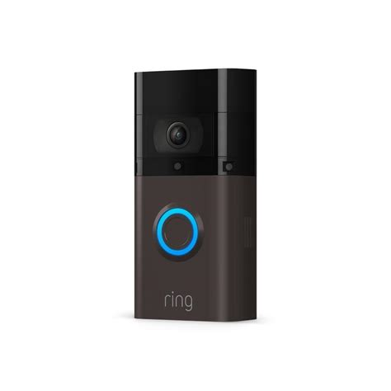
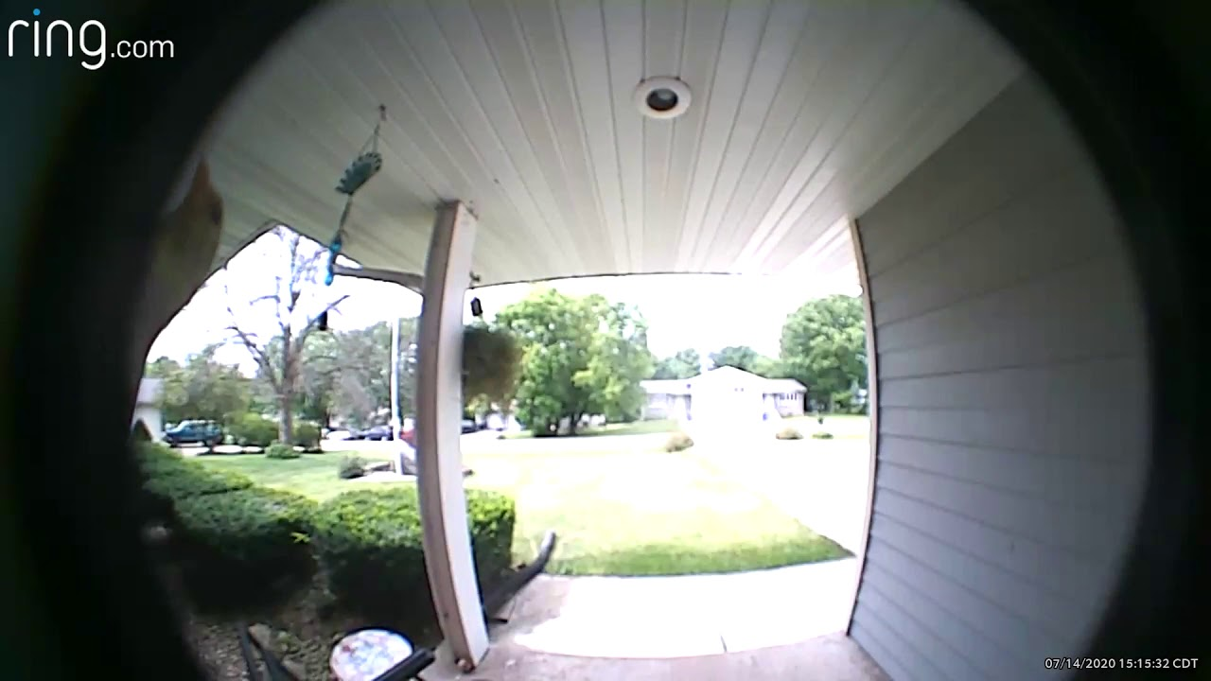

Motivation
Is someone at the door?
Did you ever wonder:
How edge IoT devices sense and interpret the world?
How they minimize power use/maximize battery life?
How we program/train/design them?

Slide 3
Edge/IoT Devices
Smart sensing at the edge of the internet
aka. Internet of Things (IoT)
Main design objectives
Cost reduction
Power and energy efficiency
Accuracy/functionality
Most powerful algorithms based on neural networks
Power-hungry, millions of MAC operations/inference
Large memory footprint
Poor fit for IoT constraints

Slide 4
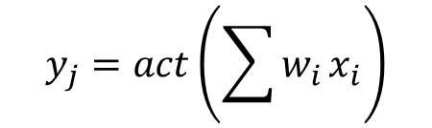
Neural Networks 101
$$y_{j}=act\left(\sum{w_{i}}x_{i}\right)$$
Training Data
Error/Loss
Label
Input
Hidden Layer
Output
Mimics neurons in the brain, learns y=f(x)
Trained using gradient descent
Adjust each w_{i} to reduce output error, repeat

Slide 5
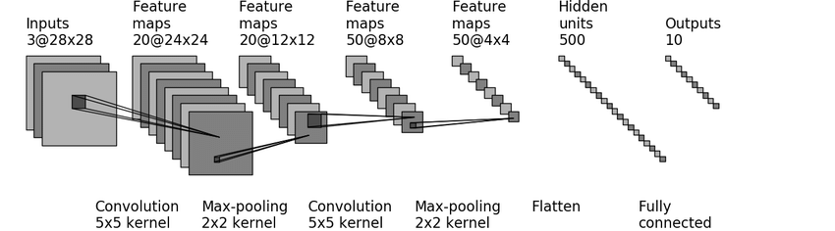
Convolutional Neural Networks
[Zhou, Y et al., On classification of Distorted Images with Deep Convolutional Neural Networks, 2017]
Proposed by LeCun in 1989
3D convolution learns image features at each x,y
Non-unit stride increases receptive field
Final fully connected layer decodes to label

Slide 6
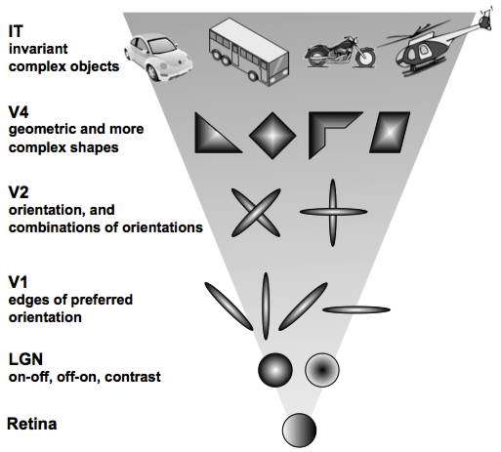
Mammalian Visual Cortex
Complexity of Features

Slide 7
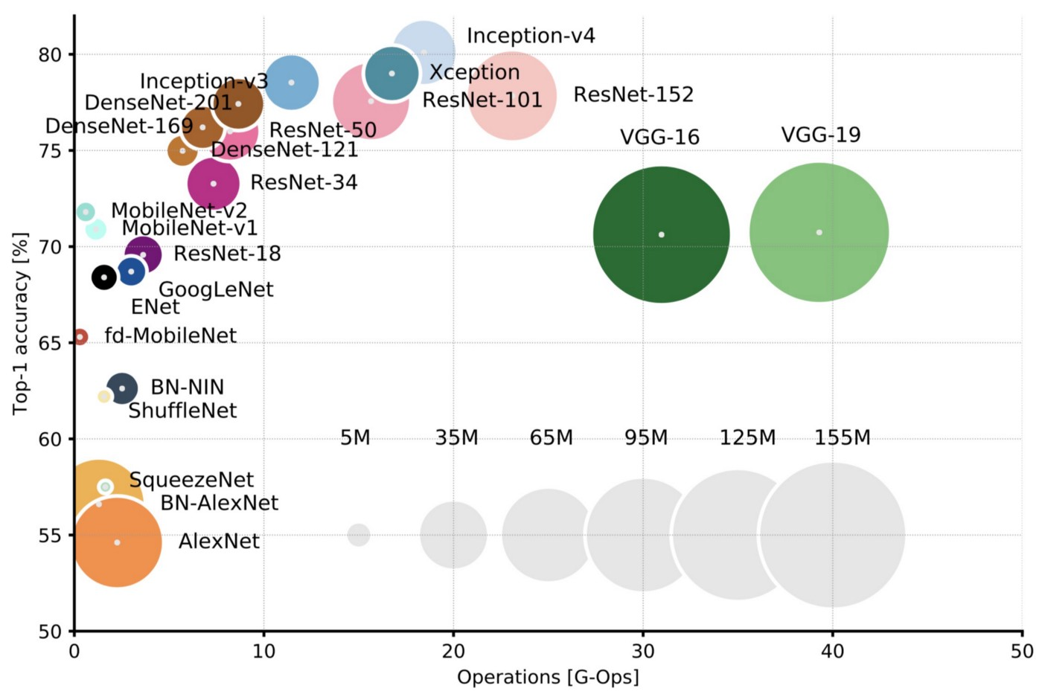
Deep Neural Network Size
https://towardsdatascience.com/neural-network-architectures-156e5bad51ba
Accuracy vs. cost (model size/compute requirement)
Each synapse requires multiply-accumulate
Concerted effort to reduce cost without compromising accuracy

Slide 8
Reducing DeepNN Cost
How to deploy NN algorithms onto constrained IoT platforms
TinyML project https://tinyml.seas.harvard.edu/
Approaches considered here
Redesign networks to reduce cost [Mobilenet]
Quantize networks to simplify datapaths, reduce memory footprint
Prune networks to reduce memory & compute

Slide 9
Redesigning Networks
Mobilenet v1 from Google
[Howard, A. et al. Mobilenets: Efficient Convolutional Neural Networks for Mobile Vision Applications, https://arxiv.org/abs/1704.04861]
Optimize number and type of layers
Provide scaling factor for channel depth
We use 0.25x scaling for the hackathon
Replace 3D convolution with depthwise separable convolution

Slide 10
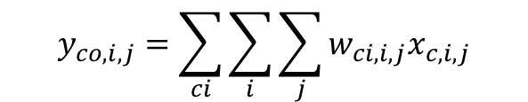
3D Convolution
x
y
i
dim(x) | dim(y) | ci | co | Wts | 3x3 MACs
96 | 96 | 16 | 32 | 4.6K | 42M
228 | 228 | 64 | 64 | 37K | 1.9B
228 | 228 | 512 | 1024 | 4.7M | 245B
ci
j
$$y_{co,i,j}=\sum_{ci}{\sum_{i}{\sum_{j}{w_{ci,i,j}x_{c,i,j}}}}$$
co
Requires co×ci×i×j parameters (weights) and dim(x) × dim(y) × ci×co×i×j MACs
Both training and inference are costly

Slide 11

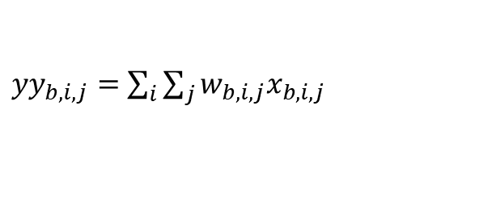
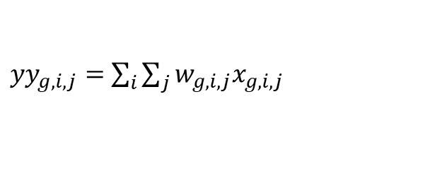
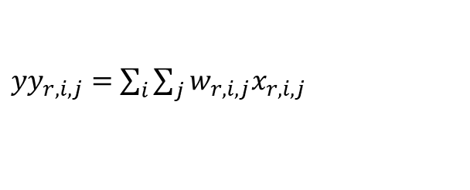
Depthwise Separable Convolution
i
dim(x) | dim(y) | ci | co | Wts | 3x3 MACs
96 | 96 | 16 | 32 | 0.7K | 6M
228 | 228 | 64 | 64 | 4.6K | 243M
228 | 228 | 512 | 1024 | 0.5M | 27.5B
ci
j
${yy}_{r,i,j}=$ $\sum_{i}{\sum_{j}{w_{r,i,j}x_{r,i,j}}}$
${yy}_{g,i,j}=$ $\sum_{i}{\sum_{j}{w_{g,i,j}x_{g,i,j}}}$
co
${yy}_{b,i,j}=$ $\sum_{i}{\sum_{j}{w_{b,i,j}x_{b,i,j}}}$
$$y_{co,i,j}=\sum_{ci}{w_{co,ci}{yy}_{c,i,j}}$$
Requires (ci×i×j + ci×co) parameters (weights) and dim(x) × dim(y) × (ci×i×j + ci×co) MACs
Faster/cheaper training, cheaper inference

Slide 12
Quantization: Fixed-point
8b
Driven by DNN inference
16b
32b
64b fixed-pt
Short vector
…
Wider was considered better
Better precision, larger range (e.g. addresses)
Narrower is considered better
Memory, datapath, energy
8b weights & activations [VanHoucke 2011]
How narrow?
Notes:
Addressability drove increased bit widths; in 90s short vectors introduced to accommodate narrow data types (media), DNNs driving push back

Slide 13
Bitstreams
The least amount of information we can convey in a digital system is one bit
A stream of bits convey greater precision and range over time
Origins in three related areas:
Rate coding in biological spiking networks
Pulse-density modulation in audio applications
Stochastic computing

Slide 14
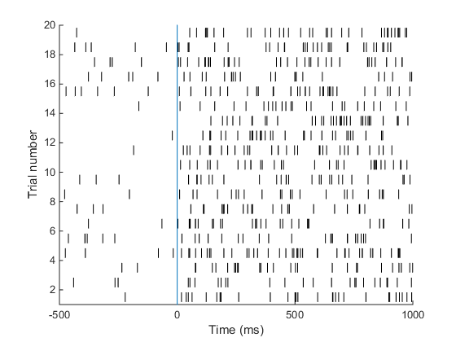
Rate Coding in Neurons
From: https://praneethnamburi.wordpress.com/
Quantity represented as overall firing rate of neuron or population of neurons

Slide 15
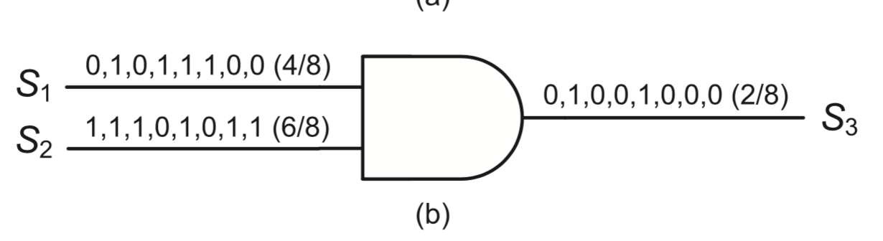
Stochastic Computing
E[S₃] = E[S₁S₂] = E[S₁]E[S₂]
Introduced by von Neumann, digital realization by Gaines in 1967
A bit represents a probability in time
Uniform weight per bit, inherently fault tolerant
Arithmetic functions are usually trivial
Variable (low) precision increases with length

Slide 16
Why Bitstreams?
Flexible representation
Very low cost datapaths
Preferred representation for sensors, actuators
Audio: PDM microphones, class D amplifiers
Other sensing modalities: multi-bit ADC an expensive component; single-bit SDM preferred
PWM for motor, actuator control

Slide 17
Why Not Bitstreams?
Inefficient representation: linear vs. logarithmic
Inefficient computation (in time)
Algorithmic issues
Not all operators available/known
Pipelined/streaming computations serialized for unknown operations
Analytical tools (e.g. z-domain analysis) may not work
Range, precision, scaling are tricky [Shukla, FoNS, 2018]
Practical issues
Previously, limited software tools
Notes:
FIXME; rerecord

Slide 18
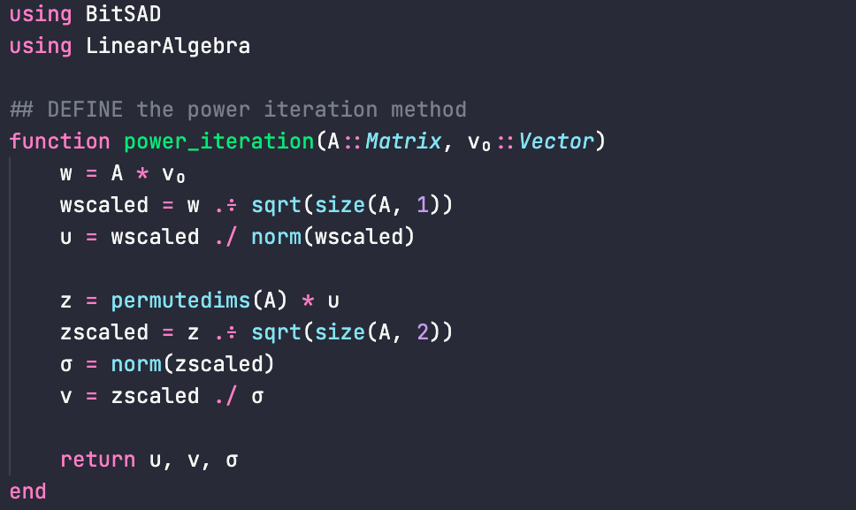
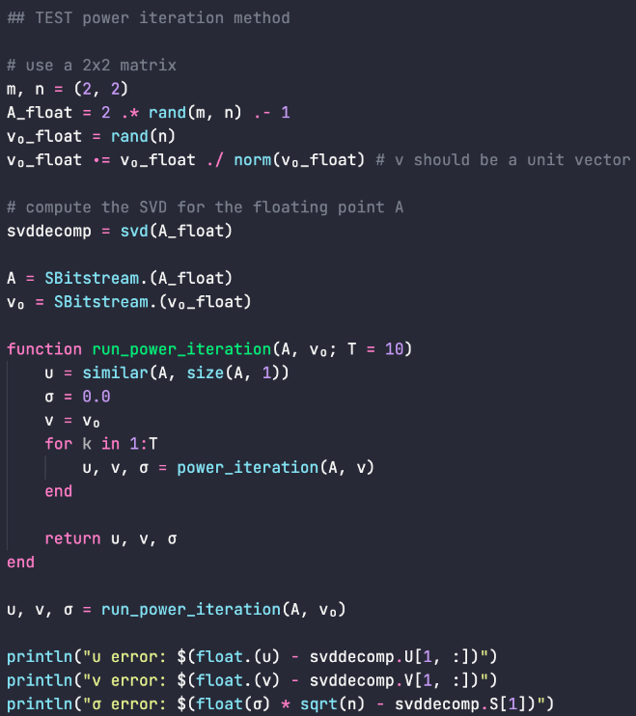
Development Tools
[Kyle Daruwalla, Rohit Shukla, Heng Zhuo]
Julia-based DSL
Support for a broad variety of bitstream constructs
Algorithm development in FP
Validation in emulated bitstream mode
Automatic synthesis of bitstream datapath in Verilog
https://github.com/UW-PHARM/BitSAD.jl

Slide 19
Bitstream Dot Product
SNG
SNG
Add
…
…
SNG
Input and weight encoding: SNG (LFSR)
Stochastic number generator
Multiply: AND gate
Add: bit count circuit
Replicate for each layer, channel, x-y location
Length of bitstream ~ accuracy

Slide 20
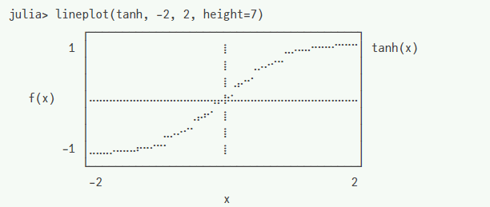
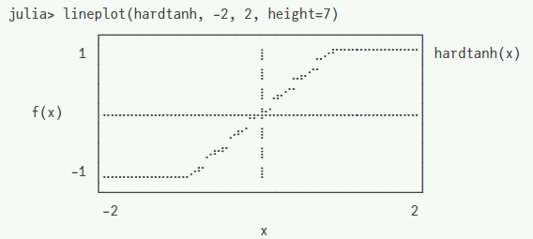
Activation Function
Bitstream range limited to [-1,+1]
Popular activation functions (e.g. ReLU) exceed this range
Traditional tanh function is a good fit
Hardware cost of tanh is high: arithmetic approximation or lookup table
Hard tanh is a very good fit for bitstreams

Slide 21
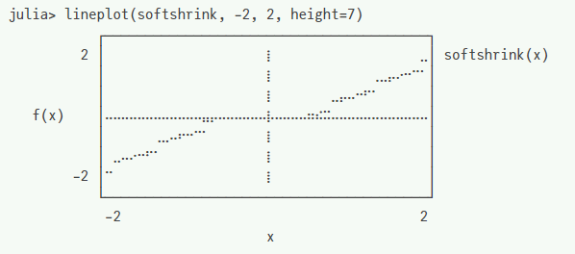
Quantizing Weights
Conv Layer
Conv Layer
Batch Norm
Batch Norm
Parameters (weights) also have range [-1,+1]
Add loss function term to limit to this range
Softshrink function: linear penalty if outside range
During training, weights converge to [-1,+1] range
Effective, but does not restrict batch normalization layers
Batch norm (BN) needed to solve vanishing gradient
Folded with Conv weights after training (not needed for inference)
After folding weights can exceed range [-1,+1]
Solution: fold BN, then fine tune a few epochs
Weights quickly converge to [-1,+1] range
Note: need to reinsert BN layers after pruning to avoid vanishing gradient

Slide 22
Pruning Neural Networks
Input
Hidden Layer
Output
Proposed in 1980s [LeCun, Optimal Brain Damage]
Remove ineffectual (low weight) synapses
Remove disconnected nodes
Fine-tune (train a few more iterations)

Slide 23
Pruning Impact on Hardware
SNG
SNG
Add
…
…
SNG
Pruned synapse: eliminate SNG + AND gate
Pruned channel: eliminate entire dot product
Structured pruning: targets channels
Unstructured pruning: targets synapses

Slide 24
Hackathon Flow
[TinyMLPerf Visual wake words from https://github.com/mlcommons/tiny]
Train from scratch
Training & Validation Data
Test Data
Pre-trained Mobilenet
Prune
Fine Tune
Remove Batch Norm
Fine Tune
Evaluate
Iterate
Iterate
Submit
HW requirement
Decently-fast CPU will suffice for required tasks
Train from scratch (optional)
Fast GPU (GTX1080 ~1.5 hours)

Slide 25
Evaluation
Accuracy is determined with test images
Set of 100, not included in training or validation
Julia script uses BitSAD to estimate accuracy
Accuracy drops from pruning, quantization
Cost is measured as relative silicon area
We provide Julia script for this
Energy is measured per inference (image)
We also provide a script for this

Slide 26
Hackathon Logistics
Getting started/help session Sun 11/12 1-4pm
Evaluation metrics
Accuracy on test set
Area cost (based on pruning)
Energy cost (based on pruning and bitstream length)
Compound: accuracy/area (higher is better)
Compound: accuracy/energy (higher is better)
Submit report, model, and results via web site

Slide 27
Report Format
Describe
Choices, changes to pruning/fine-tuning flow
Choices for bitstream length
Any design tradeoffs
Any further parameters changed/tweaked
Resulting area, energy estimates from tools
Resulting accuracy for test set
Lessons learned, conclusions
Include pointer to final BSON model file

Slide 28
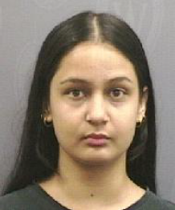

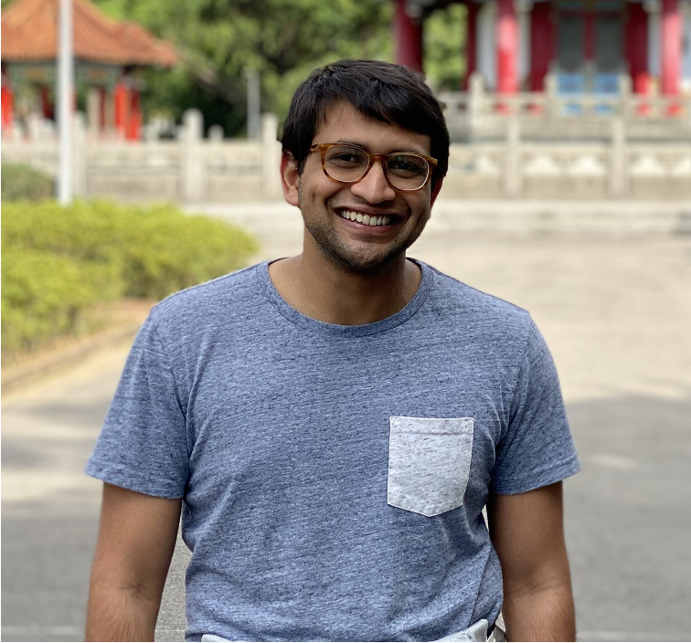
Acknowledgments
Nitya Joshi
Quantization, script & tutorial updates
PHARM Research Lab
http://pharm.ece.wisc.edu
Funding
AFRL Award FA9550-18-1-0166
NSF Award CCF-2010830
Prior students
Rohit Shukla (now at Nvidia)
Michael Mishkin (now at AMD)
TinyML project at Harvard
Kyle Daruwalla
Bitstreams, Julia, scripts, tutorials
Ravi Raju
Pruning, training, scripts, tutorials

Slide 29
Conclusion
Come and learn all about leading-edge UW research into ultra low-power neural networks!
Learn a new programming language (Julia)
Learn about computing with bitstreams
Learn to train a powerful neural network (Mobilenet)
Prune it/tune it/quantize it to make it energy efficient
Submit your results & win valuable prizes
BCH@UW Hackathon kicks off on Sun 11/12 at 1pm in EH2261
Web site is already live – get started with tutorials & tools

