Slide 1
ESS 411/511 Geophysical Continuum Mechanics Class #2
Highlights from Class #1 – Jason Ott
Today’s highlights on Monday? – Jensen DeGrande
Warm-up question (break-out with 1 or 2 partners, 4 minutes)
You are a DOT traffic engineer, and you want to treat traffic on Interstate 5 as a continuum problem
suggest a value for averaging length r
Why?

Slide 2
Your Class-prep answers for today (break-out groups, 6 minutes)
Read Raymond Notes Ch 1 (class web site, https://courses.washington.edu/ess511/NOTES/notes.shtml (Links to an external site.)), Read Mase, Smelser and Mase, Ch 1 Read Raymond Notes Ch 2, (2.1 and 2.2, also on class web site).
Then In a prose sentence for each, discuss what you see as the key feature of a spring, and of a dash pot.
and
In a prose sentence for each, discuss what you consider to be the essential nature of each of stress, strain, and elastic behavior.

Slide 3
ESS 411/511 Geophysical Continuum Mechanics Class #2
For Monday Oct 4, Class_03
Please read Raymond Chapter 2 through Section 2.9.
(Focus on the 1-D model descriptions, not the Earth properties yet)
It's time to start Homework Problem Set No.1 under the HOMEWORK tab.
https://courses.washington.edu/ess511/ASSIGNMENTS/assignments.shtml (Links to an external site.)
It’s a good idea to have some initial ideas formed so that you can contribute to discussions in Problem Lab on Thursday.
This week, also check out “EDW_notes_about_1-D_models” under the READING & NOTES tab
https://courses.washington.edu/ess511/NOTES/notes.shtml (Links to an external site.)

Slide 4
ESS 411/511 Geophysical Continuum Mechanics Class #2
Class-prep writing assignment Class_03, due in Canvas before class on Monday:
Viscoelasticity You are working in a mechanics lab, and your lab boss has asked you to perform a creep test on a rock sample. In general terms, what are you going to do?
The lab boss has now asked you to perform a relaxation test on an identical rock sample. In general terms, what will you do differently this time?
I would expect you can answer each question in a few sentences for each, for something like half a page total.

Slide 5
ESS 411/511 Geophysical Continuum Mechanics Class #2
Dealing with a continuum
Environment
Temperature T
Pressure P
Force F
Electromagnetic H,B,E
The continuum
Material properties
density ρ
charge state E
magnetization state
How it responds
Constitutive properties
thermal conductivity
electrical conductivity
elastic constants
Viscosity
magnetic permeability

Slide 6
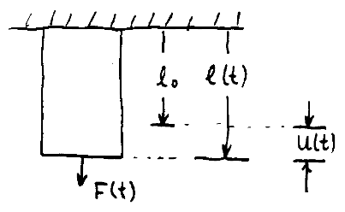
ESS 411/511 Geophysical Continuum Mechanics Class #2
Force vs stress in 1-D
F(t) applied force
l₀ initial length
l(t) deformed length
u(t) elongation
A cross-sectional area
A
We want to discover a relationship between force and response (shape change) independent of the geometry.
Stress is force per unit area σ(t) = F/A
Strain is fractional elongation e(t) = u(t)/l₀
Goal is to relate σ and e independent of geometry

Slide 7
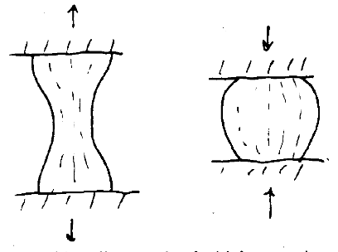
ESS 411/511 Geophysical Continuum Mechanics Class #2
Issues
Large strains – necking (no, not that necking)
Silly-putty demo
What happens to total force in the neck?
What happens to stress in the neck?
Necking instability
Barrel instability

Slide 8
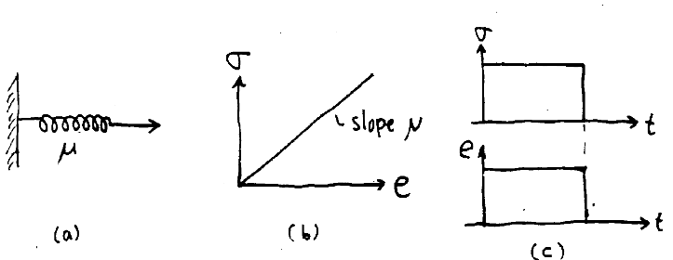
ESS 411/511 Geophysical Continuum Mechanics Class #2
Linear Elastic Behavior – Hookean solid (an idealization)
σ(t) = μ e(t)

Slide 9
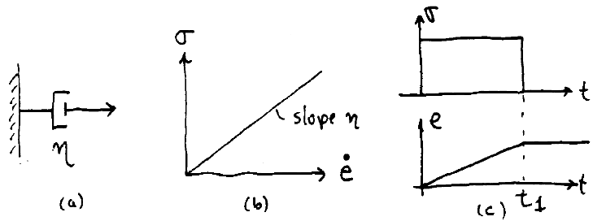
ESS 411/511 Geophysical Continuum Mechanics Class #2
Linear viscous Behavior – Newtonian fluid (an idealization)
.
.
σ(t) = η e(t)
The dot indicates a time derivative
.
e is a strain rate
η is a viscosity

Slide 10
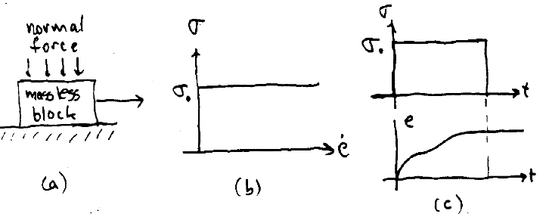
ESS 411/511 Geophysical Continuum Mechanics Class #2
Failure (an idealization)
.
There is a critical stress σ₀ called the yield stress
Below σ₀ there is no deformation
At σ₀ the deformation can be anything
Can be brittle failure, or perfect plasticity, or work hardening

Slide 11
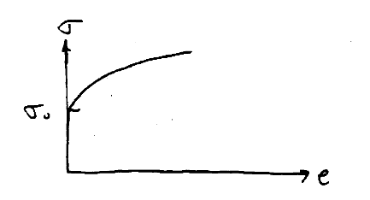
ESS 411/511 Geophysical Continuum Mechanics Class #2
.
Failure – A work-hardening plastic material
No strain until stress reaches σ₀.
For straining to continue, applied stress must continue to rise.
The more strain that has occurred, the greater the stress must be to cause further strain.

Slide 12
ESS 411/511 Geophysical Continuum Mechanics Class #2
.
Brittle vs ductile behavior
The difference is rate of loss of strength
Brittle material loses strength immediately
Ductile material loses strength slowly as strain increases

Slide 13
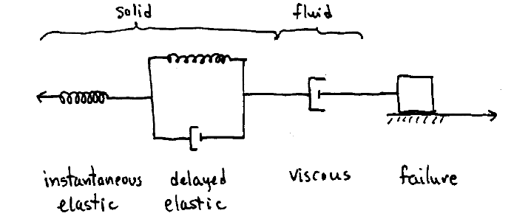
ESS 411/511 Geophysical Continuum Mechanics Class #2
A more realistic model for real materials
.
The importance of each element depends on time scale, pressure, temperature, and state of stress

