Slide 1
ESS 411/511 Geophysical Continuum Mechanics Class #3
Highlights from Class #2 – Jensen DeGrande
Today’s highlights on Wednesday – Alysa Fintel
Warm-up question (break-out) – Units
What are the SI units for stress σ?
For strain e?
For elasticity μ?
For strain rate de/dt?
For viscosity η?
Can you suggest a time constant for a visco-elastic material?
Class-prep answers (break-out)
Creep tests
Relaxation tests

Slide 2
ESS 411/511 Geophysical Continuum Mechanics Class #3
For each class, I am assigning a short CR/NC writing assignment (1 point) in Canvas
Assignments > Pre-class prep > Class_xx
It will be due in Canvas at the start of class.
I anticipate the whole thing will be around ~half a page.
The goal to help us get into the topic, and the points from this and similar exercises will contribute to class participation grades.
The writing assignment should help you to be prepared to discuss the key features in each class.

Slide 3
ESS 411/511 Geophysical Continuum Mechanics Class #3
Prep for Wednesday class #4
Read Raymond Notes Ch 2, through 2.9 (energy and energy loss).
(Focus on the 1-D model descriptions and section 2.9, not the Earth properties yet.)
Energy and dissipation If you manually compress a perfect spring and then release it back to its initial state (a strain cycle), no energy gets converted into heat, but if you manually drive a perfect dash-pot through a similar strain cycle, some energy is always converted to heat.
Without resorting to any equations, explain to a nonscientific family member why this has to be true, based your efforts expended in the two experiments.

Slide 4
ESS 411/511 Geophysical Continuum Mechanics Class #3
Broad Outline for the Quarter
Continuum mechanics in 1-D
1-D models with springs, dashpots, sliding blocks
Mathematical tools – vectors, tensors, coordinate changes
Stress – principal values, Mohr’s circles for 3-D stress
Coulomb failure, pore pressure, crustal strength
Measuring stress in the Earth
Strain – Finite strain; infinitesimal strains
Moments – lithosphere bending; Earthquake moment magnitude
Conservation laws
Constitutive relations for elastic and viscous materials
Elastic waves; kinematic waves

Slide 5
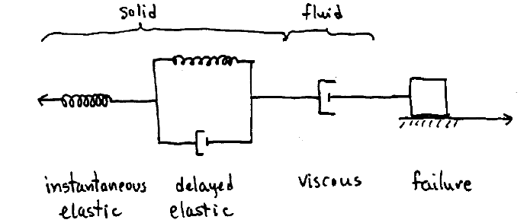
ESS 411/511 Geophysical Continuum Mechanics Class #3
A model for idealized real materials
.
-F
F
Forces are balanced
Each element feels the same force F

Slide 6
Rheological tests
Creep tests
Apply a constant stress σ
e.g. put a weight on top of a sample
Measure strain e(t) or strain rate
Relaxation tests
Apply an abrupt strain e, then hold it constant
e.g. abrupt shortening in a vice.
Measure stress σ(t) as sample adjusts.
Constant strain-rate tests
Apply a constant strain rate
e.g. with a motor-driven vice
Measure stress σ(t)

Slide 7
Models for linear solids
Those springs and dashpots …

Slide 8
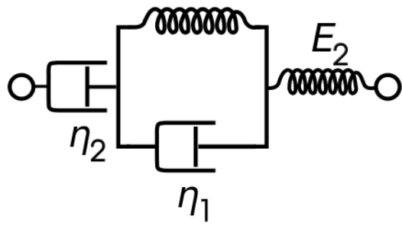
Viscoelastic model
μ₁
μ₂
Elastic
Viscous
Delayed Elastic
Called Maxwell Solid, if η₁ = ∞, μ₁ = ∞
Called Kelvin-Voigt Solid, if η₂ = ∞, μ₂ = ∞
Called Standard Linear Solid, if η₂ = ∞

Slide 9
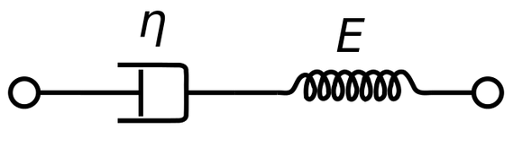
Maxwell solid
μ
σ
Also Homework set #1
e
?
time

Slide 10
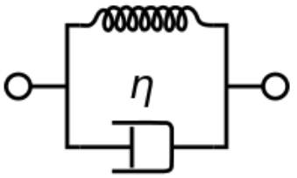
Kelvin-Voigt solid
μ
σ
e
?
time
Notes:
Project onto white board, invite students to sketch response

Slide 11
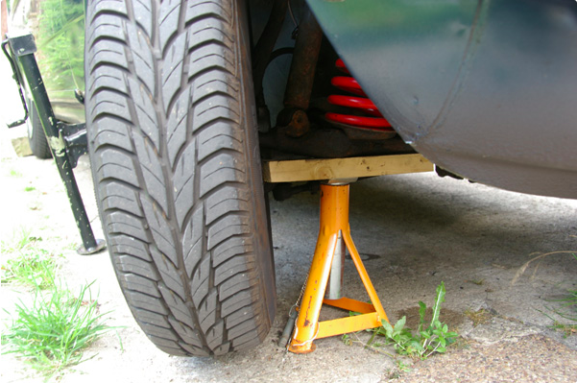

Slide 12
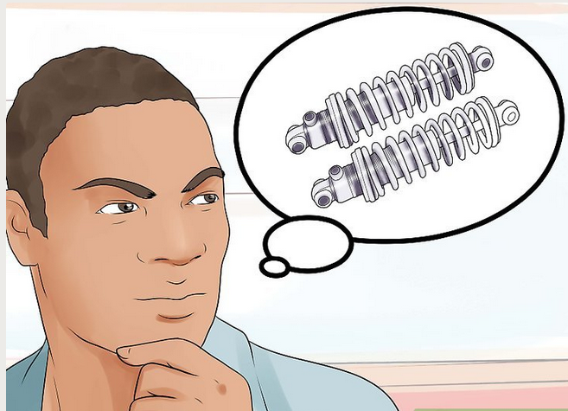

Slide 13
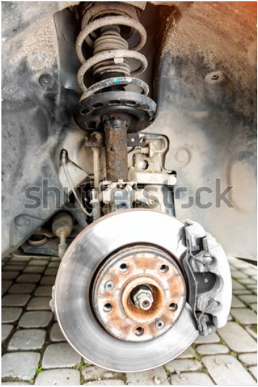
Kelvin-Voigt element - delayed elasticity
the shock absorber in my car?!

Slide 14
Kelvin-Voigt solid
μ
σ
Let’s figure out how this solid responds to constant load σ …
What are units of elasticity μ and viscosity η?
Is there a characteristic time for the material?
e
?
time
Notes:
Project onto white board, invite students to sketch response.
Eta/mu has units of time. It must control the rate of delayed response to loading

Slide 15
Kelvin-Voigt Response
μ
Spring and dashpot together support stress σ
At t = 0, spring hasn’t shortened; dashpot supports all the stress σ , so
e(0) = 0 (∗)
At t = ∞, dashpot has stopped; spring supports all the stress σ, so
e(∞) = σ/μ (∗∗)
The transition is probably a decaying exponential.
τ=η/μ must be the time constant defining the transition.
With the boundary conditions (*) and (**), A can be found, and solution is …

Slide 16

Viscoelastic Response to constant loading σ
μ₁
μ₂
Viscous
Elastic
Delayed Elastic

Slide 17
How did we get that?!
μ₁
μ₂
Viscous
Elastic
Delayed Elastic
Each element feels the same stress σ,
We just added up the strains in each element

Slide 18
Energy and Work
Work for point particles: W = F d
In Continuum – work per unit volume:
W/V = F d/V
= (F d) / (A l)
= (F/A) (d/l)
= σ e
= stress x strain

