Slide 1
ESS 411/511 Geophysical Continuum Mechanics Class #4
Highlights from Class #3 – Alysa Fintel
Today’s highlights on Friday – Anna Ledeczi
Warm-up question (break-out) –
What is a creep function?
What is a relaxation function?

Slide 2
Announcements
When I set up the sign-up schedule for class highlights, I hadn't properly accounted for the November 11 Veteran's Day holiday. It should be correct now. If you had signed up to highlight a class around Nov 11 or later, please check that the revised schedule still works for you. Thanks.
On the Canvas home page, I have added
a link to a calendar showing daily topics
links to FILES folders where you can find the slides from past lectures, and your Highlights reports from those lectures.
Homework #1 is live on Canvas. Please check it out and bring questions to our HW Lab on Thursday.

Slide 3
ESS 411/511 Geophysical Continuum Mechanics Class #3
Broad Outline for the Quarter
Continuum mechanics in 1-D
1-D models with springs, dashpots, sliding blocks
Mathematical tools – vectors, tensors, coordinate changes
Stress – principal values, Mohr’s circles for 3-D stress
Coulomb failure, pore pressure, crustal strength
Measuring stress in the Earth
Strain – Finite strain; infinitesimal strains
Moments – lithosphere bending; Earthquake moment magnitude
Conservation laws
Constitutive relations for elastic and viscous materials
Elastic waves; kinematic waves

Slide 4
ESS 411/511 Geophysical Continuum Mechanics Class #4
Class-prep answers (break-out)
This was the assignment:
Energy and dissipation If you manually compress a perfect spring and then release it back to its initial state (a strain cycle), no energy gets converted into heat, but if you manually drive a perfect dash-pot through a similar strain cycle, some energy is always converted to heat.
Without resorting to any equations, explain to a nonscientific family member why this has to be true, based your efforts expended in the two experiments.
Share with partners your explanations of energy dissipation (or not) in cyclical springs and dash-pots.

Slide 5
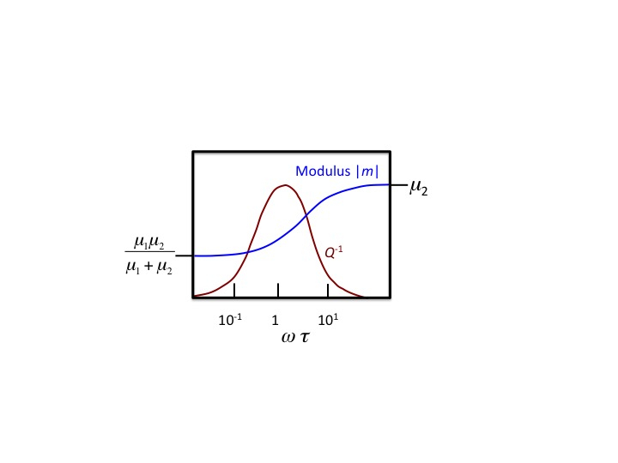
ESS 411/511 Geophysical Continuum Mechanics Class #4
For Friday (class #5)
Please review the section in Raymond Ch 2, Section 2.9 on harmonic loading, and start reading Mase, Smelser, and Mase, Ch.2, through Section 2.3.
Your class-prep assignment on frequency-dependent attenuation
When a viscoelastic material is loaded harmonically at a frequency ω, the attenuation (Q⁻¹) of that sinusoidal signal depends on the relation between ω and a characteristic time τ of the material.
With reference to the Standard Linear Solid model, please explain in words why energy loss (attenuation Q⁻¹) is minimal at high and low frequencies, but is high at mid-range.

Slide 6
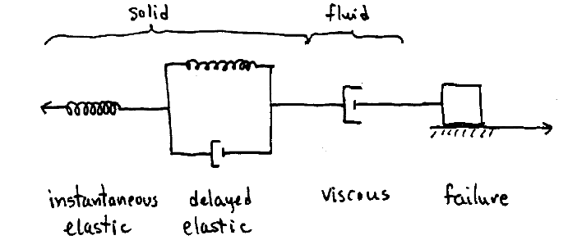
ESS 411/511 Geophysical Continuum Mechanics Class #3
A model for idealized real materials
.
-F
F
Forces are balanced
Each element feels the same force F

Slide 7
Rheological tests
Creep tests
Apply a constant stress σ
e.g. put a weight on top of a sample
Measure strain e(t) or strain rate
Relaxation tests
Apply an abrupt strain e, then hold it constant
e.g. abrupt shortening in a vice.
Measure stress σ(t) as sample adjusts.
Constant strain-rate tests
Apply a constant strain rate
e.g. with a motor-driven vice
Measure stress σ(t)

Slide 8
Models for linear solids
Those springs and dashpots …

Slide 9
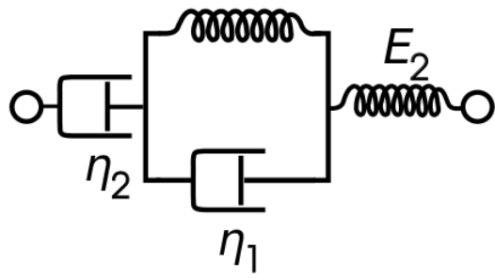
Viscoelastic model
μ₁
μ₂
Elastic
Viscous
Delayed Elastic
Called Maxwell Solid, if η₁ = ∞, μ₁ = ∞
Called Kelvin-Voigt Solid, if η₂ = ∞, μ₂ = ∞
Called Standard Linear Solid, if η₂ = ∞

Slide 10
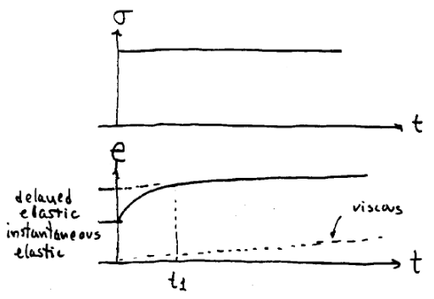
Creep Test with Viscoelastic model

Slide 11
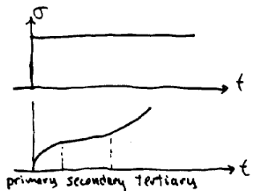
Viscoelastic behavior in real materials
Stress
e
Strain
Changes in the microstructure at the crystal level inside the sample can alter the effective viscosity after significant strain as the test progresses.
e.g. crystal basal planes align for easy glide
microcracks may develop, allowing internal slip

Slide 12
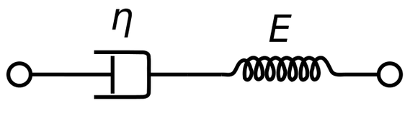
Maxwell solid
μ
Also Homework set #1
σ
Is there a characteristic time for the material?
η/μ ?
e
?
time

Slide 13
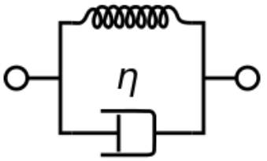
Kelvin-Voigt solid
μ
σ
Is there a characteristic time for the material?
η/μ ?
e
?
time
Notes:
Project onto white board, invite students to sketch response

Slide 14

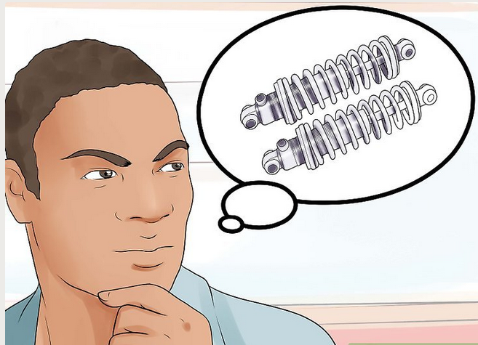

μ
A shock absorber can be modeled as a delayed elasticity Kelvin-Voigt solid.

Slide 15
Kelvin-Voigt Response
μ
Spring and dashpot together support stress σ
At t = 0, spring hasn’t shortened; dashpot supports all the stress σ , so
e(0) = 0 (∗)
At t = ∞, dashpot has stopped; spring supports all the stress σ, so
e(∞) = σ/μ (∗∗)
The transition is probably a decaying exponential. (Let’s try it …)
τ=η/μ must be the time constant defining the transition.
With the boundary conditions (*) and (**), A can be found, and solution is …

Slide 16

Response to constant loading σ
Generalized linear viscoelastic solid
μ₁
μ₂
Viscous
Elastic
Delayed Elastic

Slide 17
How did we get that?!
μ₁
μ₂
Viscous
Elastic
Delayed Elastic
Each element feels the same stress σ,
We just added up the strains in each element

Slide 18
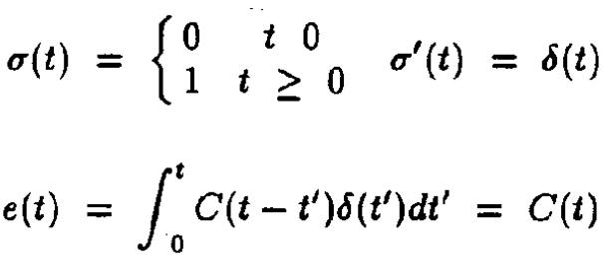
The Raymond notes also give creep functions and relaxation functions for step changes in stress or strain
=
Applied stress σ
Creep test
C(t-t’) is the creep function
e
=
Applied strain σ
e
Relaxation test
σ
k
k
k(t-t’) is the relaxation function

Slide 19
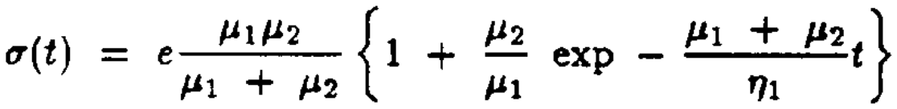
Relaxation Function in Standard Linear Solid (η₂ = ∞)
μ₁
e = constant (after t=0)
X
μ₂
(
)
(*)
At t=0 :
The spring μ₁ in the K-V element is prevented from deforming, due to η₁.
All applied strain e is taken up initially in the spring μ₂. So σ(0) =μ₂e
(Do you agree that (*) shows this?)
Stress σ(0) also acts on the K-V element, so it also begins to strain.
For a K-V element, (strain e(0) = 0 ✓).
μ = μ₁
η = η₁
By differentiating with respect to time t,
At t=0, the strain rate in the K-V element is

Slide 20
Relaxation Function in Standard Linear Solid (η₂ = ∞)
μ₁
e = constant
X
μ₂
(
)
(*)
At t > 0
The K-V element is starting to strain at the rate ,
K-V begins to take over some of the strain from the spring μ₂.
Strain e₁ increases in spring μ₁ and η₁, and strain e₂ decreases in spring μ₂
e₁ + e₂ = e
Because strain is decreasing in spring μ₂, stress σ(t) must be decreasing.
Strain e₁ in spring μ₁ cannot exceed σ∞/μ₁
Dash-pot η₁ must eventually stop moving.
This means there is no stress in the dash-pot at t=t∞
There will be a time constant τ
that depends on μ_{2,} μ₁ and η₁

Slide 21
Relaxation Function in Standard Linear Solid (η₂ = ∞)
μ₁
e = constant
X
μ₂
(
)
(*)
At t = ∞
Strain e₁ in spring μ₁ cannot exceed σ∞/μ₁
Dash-pot η₁ must eventually stop moving.
This means there is no stress in the dash-pot at t=t∞
Both springs μ₁ and μ₂ then support the same stress σ∞, so
or
is the limiting stress at t=t∞

Slide 22
Relaxation Function in Standard Linear Solid (η₂ = ∞)
μ₁
e = constant
X
μ₂
(
)
(*)
Strain e
μ₂
Stress σ(t)/e
0
Time t

Slide 23
Energy and Work
Work W is force F acting through a distance d
Work for point particles: W = F d
In Continuum – work done per unit volume:
= stress × strain
Rate of doing work per unit volume
= stress × strain rate
(overdots indicate time derivatives)

Slide 24
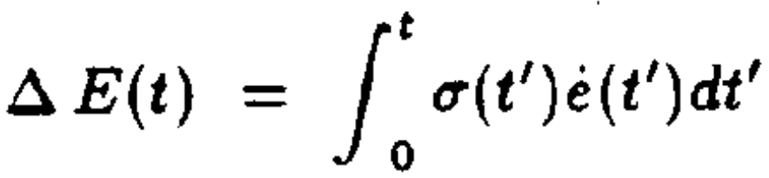
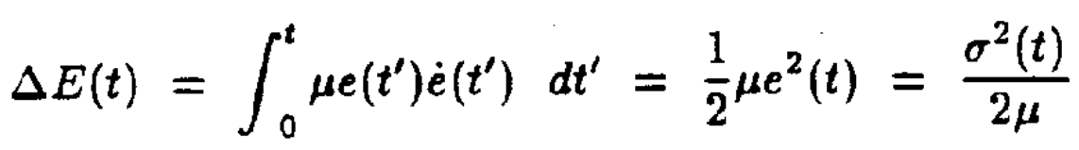
Energy and Work
Total energy input between from time 0 to t
For elastic material, substitute: σ(t) = μe(t)
ΔE(t) returns to zero whenever σ returns to zero.
All energy is recovered

Slide 25
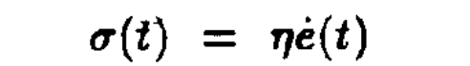
Energy and Work
Total energy input between from time 0 to t
For viscous material:
The integrand is always positive.
ΔE(t) can never return to zero if strain rate is ever nonzero
energy is always lost if any strain has occurred.

