Slide 1
ESS 411/511 Geophysical Continuum Mechanics Class #5
Highlights from Class #4 – Anna Ledeczi
Today’s highlights on Monday – Peter Lindquist
Remember we are looking for just 2 or 3 highlights, not a transcript of the entire class. (What did you think was most important?)
Warm-up question (break-out)
Ground displacements (and initial wave amplitudes at the epicenter of an earthquake) can be a meter or more.
Why are amplitudes only cm or mm (or less) when the waves arrive at Seattle? (at least two reasons)

Slide 2
ESS 411/511 Geophysical Continuum Mechanics Class #5
Class-prep answers (break-out)
In a visco-elastic material subjected to oscillatory stress at frequency ω, why is attenuation low at “high” and “low” frequencies, but higher at mid-range (ωτ ~ 1)
What is τ?

Slide 3
ESS 411/511 Geophysical Continuum Mechanics
For Monday class
Please read Mase, Smelser, and Mase, CH 2 through Section 2.3
Class-prep assignment Class_06: Second-order tensors
A force can be represented by a vector, with a magnitude and a direction. However, a stress (which is the continuum analog) cannot be represented by a vector. Explain in a few qualitative sentences (maximum) why not.

Slide 4
ESS 411/511 Geophysical Continuum Mechanics
Broad Outline for the Quarter
Continuum mechanics in 1-D
1-D models with springs, dashpots, sliding blocks
Attenuation
Mathematical tools – vectors, tensors, coordinate changes
Stress – principal values, Mohr’s circles for 3-D stress
Coulomb failure, pore pressure, crustal strength
Measuring stress in the Earth
Strain – Finite strain; infinitesimal strains
Moments – lithosphere bending; Earthquake moment magnitude
Conservation laws
Constitutive relations for elastic and viscous materials
Elastic waves; kinematic waves

Slide 5
Problem Set #1
How did it go yesterday?
Questions about the actual problems?
Suggestions to make the sessions better?

Slide 6
Energy and Work
Work W is force F acting through a distance d
Work for point particles: W = F d
In Continuum – work done per unit volume:
= stress × strain
Rate of doing work per unit volume
= stress × strain rate
(overdots indicate time derivatives)

Slide 7
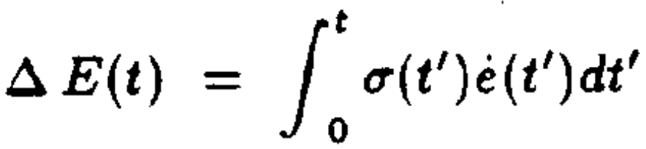
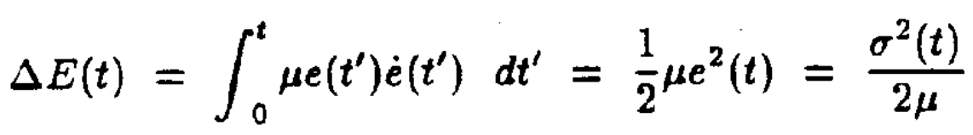
Energy and Work
Total energy input between from time 0 to t
For elastic material, substitute: σ(t) = μe(t)
ΔE(t) returns to zero whenever σ returns to zero.
All energy is recovered

Slide 8
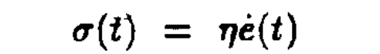
Energy and Work
Total energy input between from time 0 to t
For viscous material:
The integrand is always positive
ΔE(t) can never return to zero if strain rate is ever nonzero
energy is always lost if any strain has occurred.

Slide 9
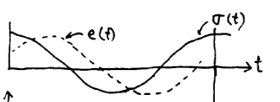
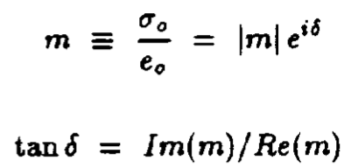
Harmonic stress loading
Stress:
σ(t) = σ₀ e ^{iωt} (σ₀ is real)
Response is also harmonic (but δ is a phase lag)*
e(t) = e₀ e ^{iωt} = (|e₀|e ^{iδ} )e ^{iωt}
Complex modulus
δ
*Notation challenge –
be aware that e can be either strain or natural base

Slide 10
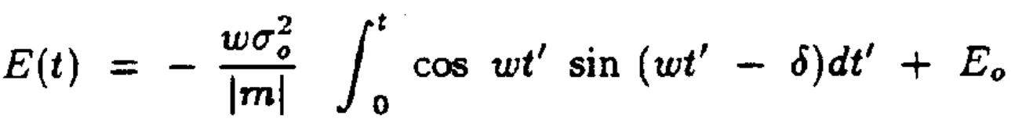
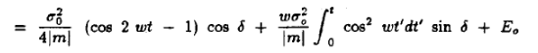
Energy in harmonically driven material
E(t) = E₀ +ΔE(t)
Energy input from time 0 to t
After breaking exponentials into cos and sin
σ e=|e₀|e ^{iδ}
Oscillatory,
storage
Monotonic, dissipation

Slide 11
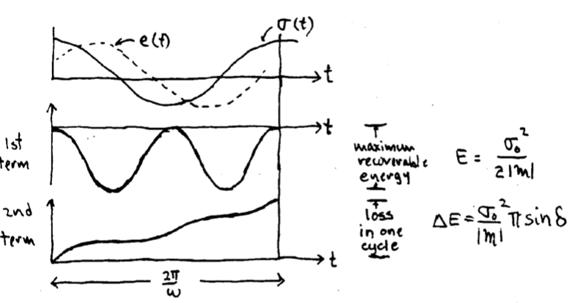
Energy change over time

Slide 12
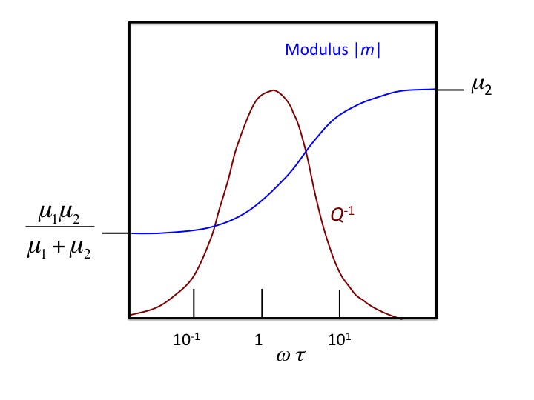
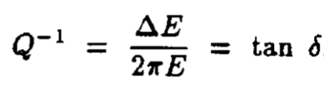
Debye Dispersion in Harmonic loading
Elastic wave speed is proportional to elastic modulus |m|
When different frequencies in a wave packet travel at different speeds, the packet breaks up or disperses
Fast
Fast
Dispersing
Dispersing
slow
slow

Slide 13

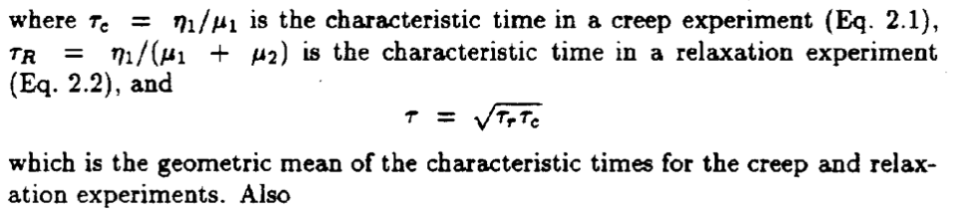
What is τ?

Slide 14
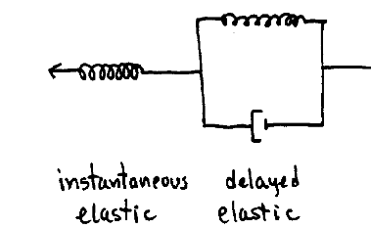
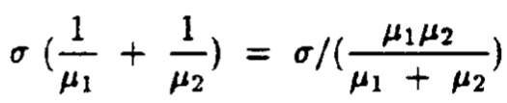
Why is there a maximum in dispersion?
What happens at low frequency ωτ << 1?
What happens at high frequency ωτ >> 1?
σ/μ₂
What happens in the middle range ωτ ~ 1?
Strain response
Strain response

Slide 15
Attenuation in real rocks
There is a broad plateau of low Q over several decades of frequency ω
Probably a sum of various dissipative processes centered on different frequencies.
Dislocations inside crystals
Interactions among adjacent crystals
Pore fluids
ω

Slide 16
Earthquake waves
Peak-to-peak amplitude and energy density decrease with distance from source, due to 2 processes.
Geometrical spreading with distance r from source
In body waves (p & s) energy is spread over expanding spherical wave front, so wave-front area increases as r² for
Energy decreases as 1/r²
In surface waves (Love, Rayleigh, etc) energy is spread over expanding cylindrical wave front, so wave-front area increases as r .
Energy decreases as 1/r

Slide 17
Earthquake waves
Peak-to-peak amplitude and energy density decrease with distance from source, due to 2 processes.
(2) Intrinsic attenuation quantified by Quality factor Q
Q⁻¹ is fractional energy lost per cycle of the wave.
For most rocks, Q >> 1 (~30 - 80 is typical)
Amplitude A(r) of a seismic wave:
c is wave speed (e.g. 8 km/s for mantle p-waves)
ω is angular frequency (ω = 2πf )
Let’s use Q=75, r = 100 km, and f=1 & 10 Hz
Results:
f = 1 Hz: A = 0.59 A₀
So a 1 Hz wave loses 40% of its amplitude for every 100 km it travels, while a 10 Hz wave loses 99.5% of its amplitude every 100 km
We don’t see much energy at 10 Hz from teleseisms!
f = 10 Hz: A = 0.0053 A₀

