Slide 1

ESS 411/511 Geophysical Continuum Mechanics Class #6
Highlights from Class #5 – Peter Lindquist
Today’s highlights on Wednesday – John-Morgan Manos
Remember we are looking for just 2 or 3 highlights, not a summary of the entire class. (What did you think was most important?)
https://www.earthsciweek.org/
Since October 1998, the American Geosciences Institute has organized this national and international event to help the public gain a better understanding and appreciation for the Earth sciences and to encourage stewardship of the Earth. This year's Earth Science Week will be held from October 10 - 16, 2021 and will celebrate the theme "Water Today and for the Future." The coming year's event will focus on the importance of learning how to understand, conserve, and protect water, perhaps Earth's most vital resource.

Slide 2

ESS 411/511 Geophysical Continuum Mechanics
Prep for Wednesday class #7
Please read Mase, Smelser, and Mase, CH 2 through Section 2.6
Class_07 assignment on Vector products
Equation 2.12, vector cross product
u × v = - v × u
= |u| |v| sin(θ) $\hat{e}$
= e_{ijk} u_{i} v_{j} ${\hat{e}}_{k}$
What is θ?
Where does the vector $\hat{e}$ point?
Can you give a simple geometric interpretation for u × v ?

Slide 3
ESS 411/511 Geophysical Continuum Mechanics
Broad Outline for the Quarter
Continuum mechanics in 1-D
1-D models with springs, dashpots, sliding blocks
Attenuation
Mathematical tools – vectors, tensors, coordinate changes
Stress – principal values, Mohr’s circles for 3-D stress
Coulomb failure, pore pressure, crustal strength
Measuring stress in the Earth
Strain – Finite strain; infinitesimal strains
Moments – lithosphere bending; Earthquake moment magnitude
Conservation laws
Constitutive relations for elastic and viscous materials
Elastic waves; kinematic waves

Slide 4
Problem Sets
Problem Set #1 – due in Canvas on Wednesday
Problem Set #2 – in Lab on Thursday

Slide 5
ESS 411/511 Geophysical Continuum Mechanics Class #6
Warm-up question (break-out) –
The Summation Convention is your Best Friend in Continuum
Expand according to the summation convention.
What is the tensor rank of the result?
How would you interpret the result?
Class-prep answers (break-out)
Expressing stress as vector? Why or why not?

Slide 6
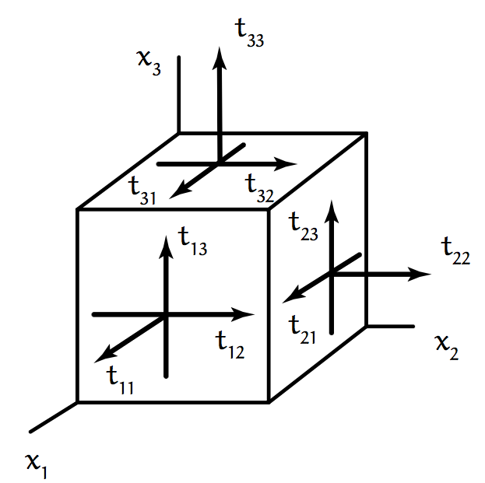
Why stress has 9 components

Slide 7
Scalars, vectors, and tensors
Scalar (zero-order tensor)
α, β, γ, θ, a, b, r, etc. lower-case italic greek or roman letters.
Temperature, pressure, density, …
Vector (first-order tensor)
u, v, w, x, y, z etc. Bold italic lower-case roman letters.
Velocity, force, geothermal flux, …
Higher-order tensor
A, T, S, σ, ε, Ε, etc. Bold letters, often upper-case roman, but many exceptions.
Stress, strain rate, anisotropic material properties, …

Slide 8
Scalars, vectors, and tensors
Symbolic notation:
A tensor, or linear transformation T, assigns any vector v to another vector Tv such that
T (v + w) = T v + T w (distributive property)
T (αv) = αT v (associative property)
(T+S)v = Tv + Sv
(αT) v = α (Tv)
for all v and w.
Not necessarily commutative though …
Things like Tv and vT get messier.
May not be equal
May not even exist …

Slide 9
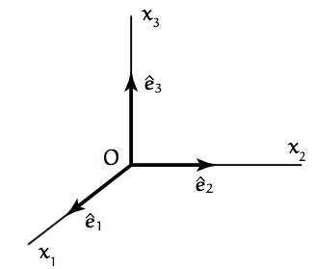
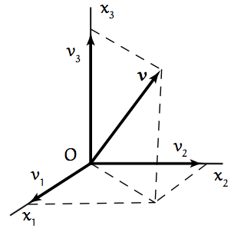
Cartesian coordinates
Basis vectors and coordinate axes
A vector v exists independent of a particular coordinate system.
However, after we choose a coordinate system, v can be expressed through its components in that coordinate system.
v = (v₁, v₂, v₃)

Slide 10
Index notation
u_{i} (u₁,u₂,u₃) vector (3 elements)
u_{ij} (u₁₁,u₁₂,u₁₃,u₂₁,u₂₂,u₂₃,u₃₁,u₃₂,u₃₃ )
Second-order tensor (9 elements)
u_{ijk} (u₁₁₁,u₁₁₂,u₁₁₃, u₁₂₁,u₁₂₂,u₁₂₃, … u₃₃₁,u₃₃₂,u₃₃₃,).
Third-order tensor (27 elements)
u_{ijkl} (u₁₁₁₁,u₁₁₁₂,u₁₁₁₃, … u₃₃₃₁,u₃₃₃₂,u₃₃₃₃,).
Fourth-order tensor (81 elements)

Slide 11
Summation Convention
Whenever an index i is repeated in a term, a summation is implied, in which i takes the values 1, 2 ,3.
In an implied summation, index i is a dummy index, i.e.
or

Slide 12
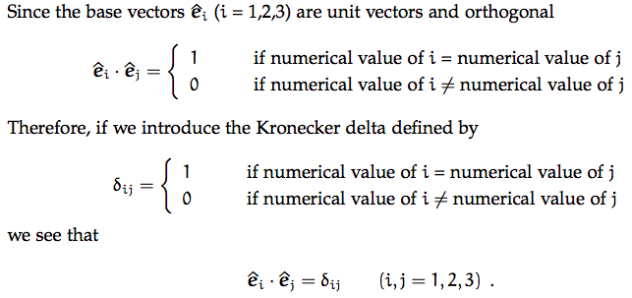
Kronecker delta
Note that δ_{ij} is like a 3x3 identity matrix
What is the value of δ_{jj} ?

Slide 13
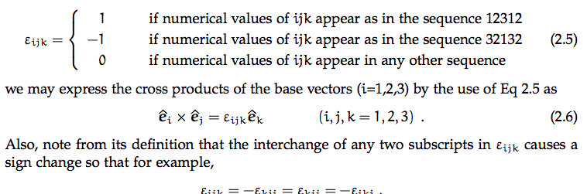

Permutation symbol
1
Imagine the numbers 1, 2, 3 are written clock-wise around the circumference of a wheel
3
2
if the numerical values of i,j,k are in clockwise order
if the numerical values of i,j,k are anti-click-wise order
if the numerical values of i,j,k are in any other order
Cross products of basis vectors
Switching indices

Slide 14
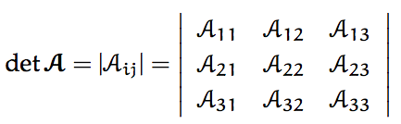
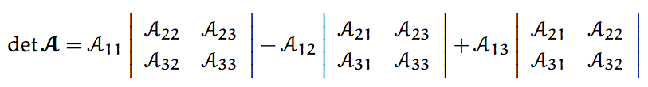


Determinants

Slide 15

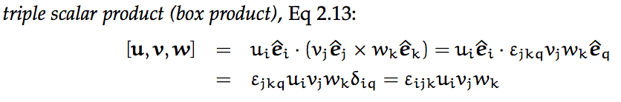
Box product
u×v
v
What does u×v measure?
u
w
v
What does [u,v,w] measure?
u

Slide 16
Vector algebra

