Slide 1

ESS 411/511 Geophysical Continuum Mechanics Class #7
Highlights from Class #6 – Madeline Mamer
Today’s highlights on Friday – Abigail Thienes
Not just AGI
https://sci.scientific-direct.net/view_online.asp?1651331&bd53762d1b456a39&18

Slide 2


Slide 3

Class-prep – Vector product
u×v
What does u×v measure?
v
u

Slide 4
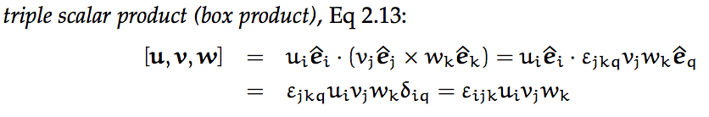
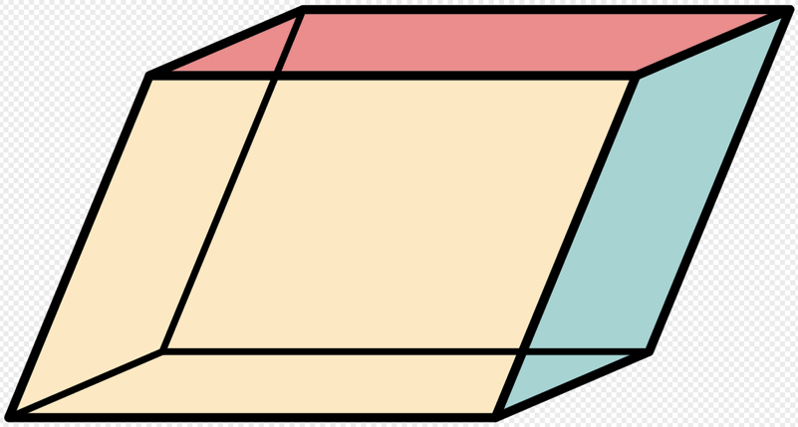
Warm-up question – Box product
What does [u,v,w] measure?
w
v
u
https://en.wikipedia.org/wiki/Parallelepiped

Slide 5
ESS 411/511 Geophysical Continuum Mechanics
For Friday class
Please read Mase, Smelser, and Mase, CH 2 through Section 2.6
Your short CR/NC Pre-class prep writing assignment (1 point) in Canvas
It will be due in Canvas at the start of class.
I will send another message when it is posted in Canvas.

Slide 6
ESS 411/511 Geophysical Continuum Mechanics
Broad Outline for the Quarter
Continuum mechanics in 1-D
1-D models with springs, dashpots, sliding blocks
Attenuation
Mathematical tools – vectors, tensors, coordinate changes
Stress – principal values, Mohr’s circles for 3-D stress
Coulomb failure, pore pressure, crustal strength
Measuring stress in the Earth
Strain – Finite strain; infinitesimal strains
Moments – lithosphere bending; Earthquake moment magnitude
Conservation laws
Constitutive relations for elastic and viscous materials
Elastic waves; kinematic waves

Slide 7
Problem Sets
Problem Set #1 – due today
Problem Set #2 – work in Lab on Thursday

Slide 8
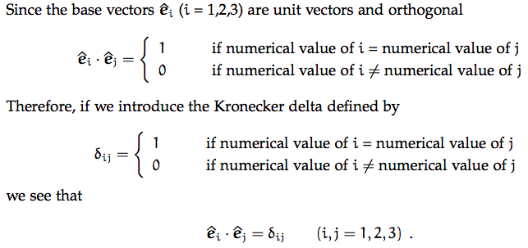
Kronecker delta
Note that δ_{ij} is like a 3x3 identity matrix
What is the value of δ_{jj} ?

Slide 9



Permutation symbol
1
Imagine the numbers 1, 2, 3 are written clock-wise around the circumference of a wheel
3
2
if the numerical values of i,j,k are in clockwise order
if the numerical values of i,j,k are anti-click-wise order
if the numerical values of i,j,k are in any other order
Cross products of basis vectors
Switching indices

Slide 10
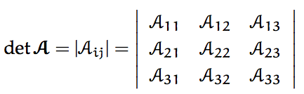
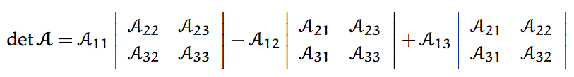


Determinants

Slide 11
Vector algebra
Lots of details in CH 2
Are there points that are unclear?
Please let me know if there are things you would like us to look at specifically.

Slide 12
Coordinate Systems
ê₃
ê₃
Right-handed
Left-handed
ê₂
ê₁
ê₁
ê₂
Thumb = 1
Index = 2
Middle = 3

Slide 13
Transformation of Cartesian Coordinates
An object such as vector v is represented as v_{j} in coordinate system Ox₁x₂x₃ with unit coordinate vectors ê_{j}
The same object (e.g. v) is represented as v_{j}‘ in coordinate system Ox₁’x₂’x₃’ with unit coordinate vectors ê’_{j}
ê₃
ê’₃
v
v
ê₂
O
O
ê’₂
ê₁
v is not rotated –
its coordinates are just expressed in a different coordinate system
ê’₁

Slide 14
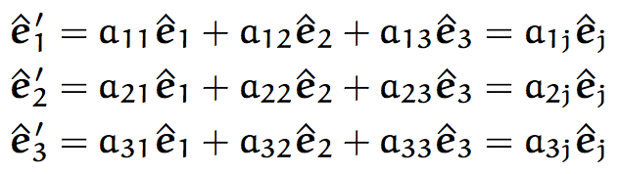

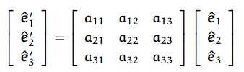
Transformation matrix
The new coordinate vectors ê’_{j} can be expressed in terms of the old coordinate vectors ê_{j}
or,
A is the transformation matrix

Slide 15
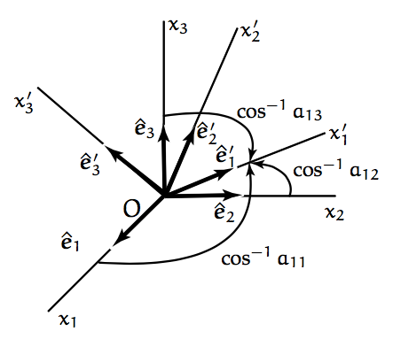
Meaning of a_{ij}
The matrix elements a_{ij} are the direction cosines between ê‘_{i} and ê_{j}.

Slide 16

Transformation matrix
Orthogonality
a_{iq}a_{jq} = δ_{ij} or A A^{T} = I
a_{ij}a_{ik} = δ_{jk} or A^{T} A = I

Slide 17
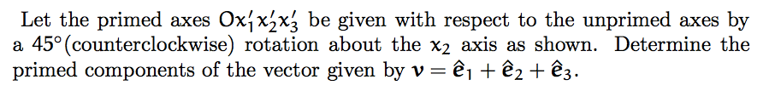
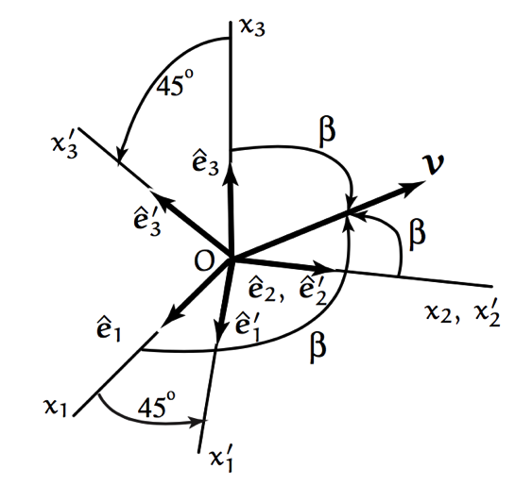
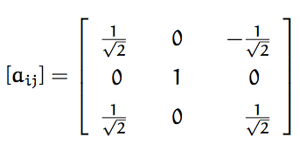
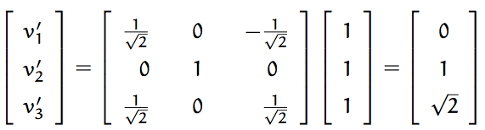
Example 2.12

Slide 18
Change of coordinates for a scalar
θ’ = θ

Slide 19

Change of coordinates for a vector
Or without the unit vectors
v’_{j}= a_{ji}v_{i}

Slide 20
Change of coordinates for a 2nd order tensor
An example of second order tensor w_{ij} is
w_{ij} = u_{i} v_{j}
= a_{qi} u’_{q} a_{mj} v’_{m}
= a_{qi}a_{mj} u’_{q}v’_{m}
= a_{qi}a_{mj}w’_{ij}
Or symbolically
W = A^{T}W’A and W’ = AWA^{T}

Slide 21

Change of coordinates for any order tensor R_{qm…n}
Multiply by transformation matrix A once for each order in the tensor R_{qm…n}

Slide 22
Proper and Improper changes of coordinates
det(A) = 1 is a rotation (proper)
det(A) = -1 is a reflection (improper)
(right-handed coordinate system becomes a left-handed coordinate system (generally not good …)

