Slide 1
ESS 411/511 Geophysical Continuum Mechanics Class #8
Warm-up
Show that a_{ik} b_{kj} is the same as multiplying two 3x3 matrices A and B together.
Class- prep questions
Q_{ij} = A_{ij} + B_{ij} (1)
What property of A_{ij} makes it symmetric?
How can you make A_{ij} from Q_{ij} ?
What property of B_{ij} makes it anti-symmetric?
How can you make B_{ij} from Q_{ij} ?
Show that Equation (1) holds with your A_{ij} and B_{ij} .

Slide 2
ESS 411/511 Geophysical Continuum Mechanics
For Monday class
Please read Mase, Smelser, and Mase, CH 2 through Section 2.8
(tensor fields; Gauss’ theorem)
Please also read Mase, Smelser, and Mase, CH 3 through Section 3.3
Your short CR/NC Pre-class prep writing assignment (1 point) in Canvas
It will be due in Canvas at the start of class.
I will send another message when it is posted in Canvas.

Slide 3
ESS 411/511 Geophysical Continuum Mechanics
Broad Outline for the Quarter
Continuum mechanics in 1-D
1-D models with springs, dashpots, sliding blocks
Attenuation
Mathematical tools – vectors, tensors, coordinate changes
Stress – principal values, Mohr’s circles for 3-D stress
Coulomb failure, pore pressure, crustal strength
Measuring stress in the Earth
Strain – Finite strain; infinitesimal strains
Moments – lithosphere bending; Earthquake moment magnitude
Conservation laws
Constitutive relations for elastic and viscous materials
Elastic waves; kinematic waves

Slide 4
Problem Sets
You are working on Problem Set #2
Due in Canvas on Wednesday

Slide 5
Vector algebra
Lots of details in CH 2
Are there points that are unclear?
Please let me know if there are things you would like us to look at specifically.

Slide 6
Transformation of Cartesian Coordinates
An object such as vector v is represented as v_{j} in coordinate system Ox₁x₂x₃ with unit coordinate vectors ê_{j}
The same object (e.g. v) is represented as v_{j}‘ in coordinate system Ox₁’x₂’x₃’ with unit coordinate vectors ê’_{j}
ê₃
ê’₃
v
v
ê₂
O
O
ê’₂
ê₁
v is not rotated –
its coordinates are just expressed in a different coordinate system
ê’₁

Slide 7
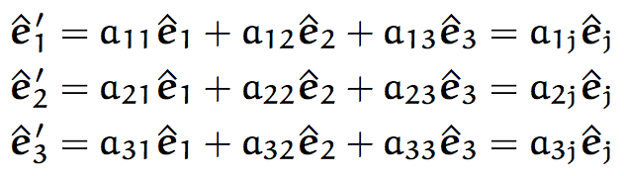

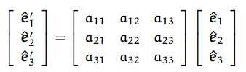
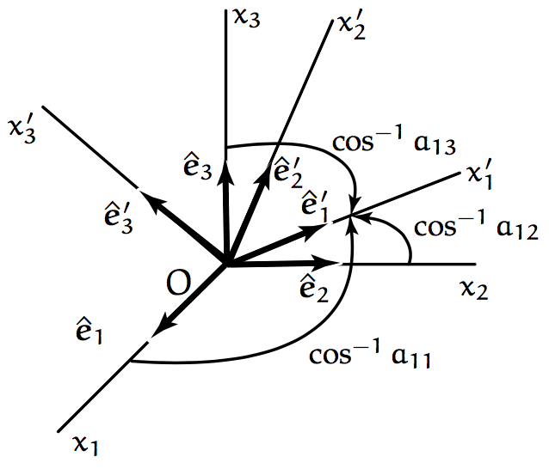
Transformation matrix
The new coordinate vectors ê’_{j} can be expressed in terms of the old coordinate vectors ê_{j}
or,
A is the transformation matrix
a_{ij} is just the projection of the i^{th} new axis unit vector ê’_{i} onto the j^{th} old axis unit vector ê_{j}
through their dot product ê’_{i} • ê_{j}

Slide 8

Change of coordinate system for any order tensor R_{qm…n}
Multiply by transformation matrix A once for each order in the tensor R_{qm…n}
Examples
0th order tensor (scalar) – no a_{pq} factors θ’ = θ
1st order tensor (vector) – 1 a_{pq} factor u’_{i} = a_{ij} u_{j}
2nd order tensor – 2 a_{pq} factors t’_{ij} = a_{im} a_{jn}t’_{mn}

Slide 9
Proper and Improper changes of coordinates
det(A) = 1 is a rotation (proper)
det(A) = -1 is a reflection (improper)
(right-handed coordinate system becomes a left-handed coordinate system (generally not good …)
We will use only right-handed coordinates

Slide 10
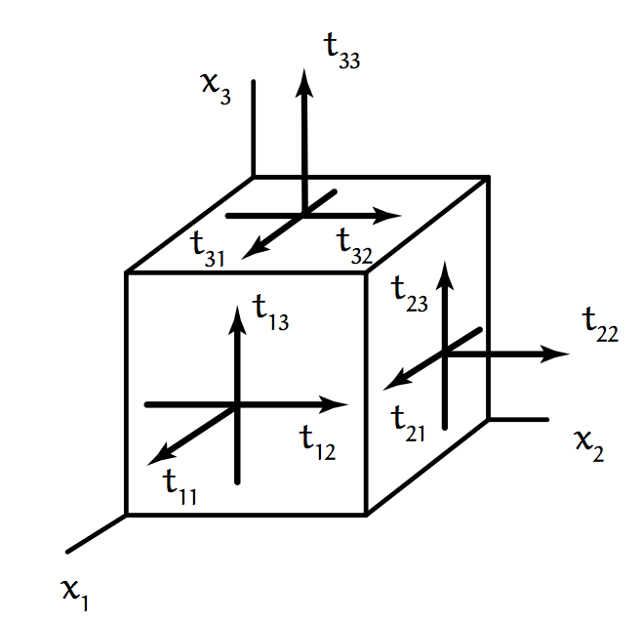
Principal values and directions (Eigenvalues and eigenvectors)
A 2nd order tensor s_{ij} maps a vector u_{j} onto another vector v_{i}
s_{ij}u_{j} = v_{i}
In general u_{j} and v_{i} point in different directions.
It would be nice if we could find some special vectors u_{j} that mapped onto vectors v_{i} that were parallel to u_{j}.
That could help us to find a coordinate system in which s_{ij} could be expressed more simply.
For example, stress in the rocks on a mountain side.
We know that there is no shear stress on the sloping surface.
Maybe the stress tensor would be simpler using a coordinate system aligned with the mountain surface.

Slide 11
Finding eigenvectors
When t_{ij} is symmetric with real components, there will be some vectors n_{j} that do map onto a parallel vector.
When n_{j} is a unit vector, it defines a principal direction or eigenvector of the tensor t_{ij}, and λ is called a principal value or eigenvalue of t_{ij}.
t_{ij} n_{j} – λ n_{i} = 0
Since n_{i} = δ_{ij} n_{j}
t_{ij} n_{j} – λ δ_{ij} n_{j} = 0
or
(t_{ij} – λ δ_{ij}) n_{j} = 0 or in symbolic form, (T – λΙ)• n = 0

Slide 12
Can you find the eigenvalue?
Source: Wikipedia (no Copyright)

Slide 13
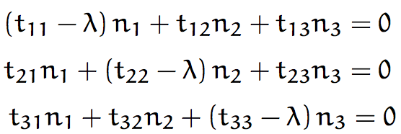


Finding eigenvectors
(t_{ij} – λ δ_{ij}) n_{j} = 0 or in symbolic form, (T – λΙ)• n = 0
Obviously these equations are satisfied if n₁= n₂= n₃= 0.
But that is no help because we said n_{j} is a unit vector
Nontrivial solutions can exist
(the equations are not independent)
if the determinant = 0
Evaluating the determinant produces a cubic equation in λ
This is called the Characteristic Equation, and the 3 coefficients are the first, second, and third invariants of the tensor t_{ij}.

Slide 14
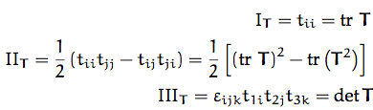
Finding eigenvectors
This is called the Characteristic Equation, and the 3 coefficients are the first, second, and third invariants of the tensor t_{ij}.
No matter what coordinate system we use to express the tensor T, these 3 special quantities always have the same 3 values.

Slide 15

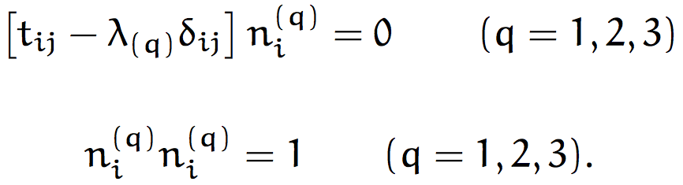
Finding eigenvectors
This is called the Characteristic Equation, and the 3 coefficients are the first, second, and third invariants of the tensor t_{ij}.
The cubic equation has 3 solutions λ₍₁₎, λ₍₂₎, and λ₍₃₎, which are all real for a symmetric tensor T whose elements are real.
There is a direction associated with each eigenvalue λ_{(q)}.
We can find by solving
To see how to do this, check out MSM Example 2.14 on page 32.

