Slide 1
ESS 411/511 Geophysical Continuum Mechanics
Broad Outline for the Quarter
Continuum mechanics in 1-D
1-D models with springs, dashpots, sliding blocks
Attenuation
Mathematical tools – vectors, tensors, coordinate changes
Stress – principal values, Mohr’s circles for 3-D stress
Coulomb failure, pore pressure, crustal strength
Measuring stress in the Earth
Strain – Finite strain; infinitesimal strains
Moments – lithosphere bending; Earthquake moment magnitude
Conservation laws
Constitutive relations for elastic and viscous materials
Elastic waves; kinematic waves

Slide 2
ESS 411/511 Geophysical Continuum Mechanics Class #9
For Wednesday
Please read Mase, Smelser, and Mase, Ch 3 through Section 3.6
For Friday
ESS 511 Students will give a 1 minute presentation about their class projects on Friday.
Your short CR/NC Pre-class prep writing assignment (1 point) in Canvas
It will be due in Canvas at the start of class.
I will send another message when it is posted in Canvas.
Problem Sets
Problem Set #2 due in Canvas on Wednesday
Problem Set #3 in Thursday session

Slide 3
ESS 411/511 Geophysical Continuum Mechanics Class #9
Warm-up Finding the eigenvalues and eigenvectors of a 3x3 tensor is complicated and “mathy”.
Explain in words why anyone would want to find the eigenvalues and eigenvectors of a 3x3 tensor. Why bother?
Class-prep questions
We said earlier this week that stress s_{ij} can’t be represented by a vector, it is a second-order tensor, because there are two directions involved in defining stress.
Yet our text (page 55) talks about a “stress vector”! Something strange is going on here!
In math, and in words, what exactly is this vector t_{i}^{(n)}?
Hint – what is n?

Slide 4
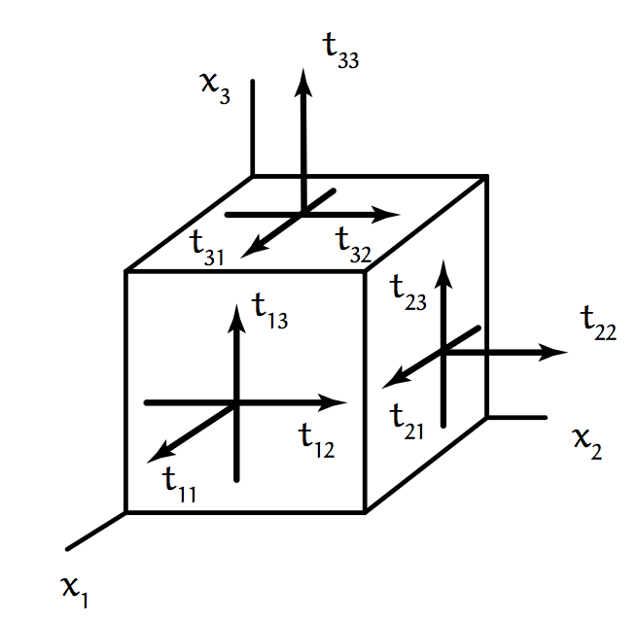
Principal values and directions (Eigenvalues and eigenvectors)
A 2nd order tensor s_{ij} maps a vector u_{j} onto another vector v_{i}
s_{ij}u_{j} = v_{i}
In general u_{j} and v_{i} point in different directions.
It would be nice if we could find some special vectors u_{j} that mapped onto vectors v_{i} that were parallel to u_{j}.
That could help us to find a coordinate system in which s_{ij} could be expressed more simply.
For example, stress in the rocks on a mountain side.
We know that there is no shear stress on the sloping surface.
Maybe the stress tensor would be simpler using a coordinate system aligned with the mountain surface.

Slide 5
Finding eigenvectors
When t_{ij} is symmetric with real components, there will be some vectors n_{j} that do map onto a parallel vector.
When n_{j} is a unit vector, it defines a principal direction or eigenvector of the tensor t_{ij}, and λ is called a principal value or eigenvalue of t_{ij}.
t_{ij} n_{j} – λ n_{i} = 0
Since n_{i} = δ_{ij} n_{j}
t_{ij} n_{j} – λ δ_{ij} n_{j} = 0
or
(t_{ij} – λ δ_{ij}) n_{j} = 0 or in symbolic form, (T – λΙ)• n = 0

Slide 6
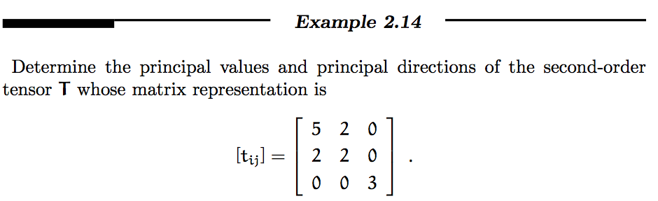
Let’s work through an example

Slide 7
Let’s work through an example
In order for n_{i} to be an eigenvector, n_{i} and t_{ij} n_{j} must be parallel
t_{ij} n_{j} – λ n_{i} = 0
Since n_{i} = δ_{ij} n_{j}
t_{ij} n_{j} – λ δ_{ij} n_{j} = 0
Factor out n_{j}: (t_{ij} – λ δ_{ij}) n_{j} = 0

Slide 8
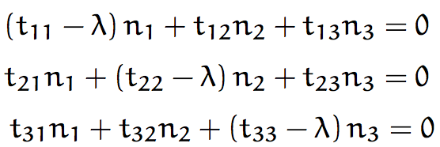

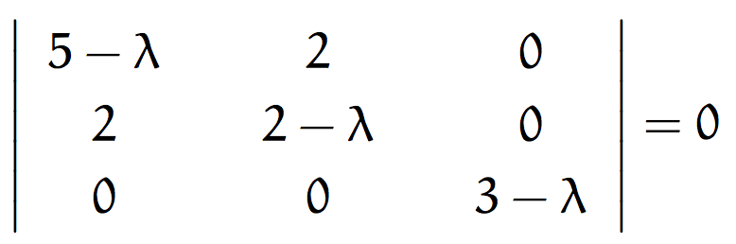


Let’s work through an example
Obviously these equations are satisfied if n₁= n₂= n₃= 0.
But that is no help because we said n_{j} is a unit vector
Nontrivial solutions can exist
(the equations are not independent)
if the determinant = 0
So, expanding on the third row,
which factors into

Slide 9

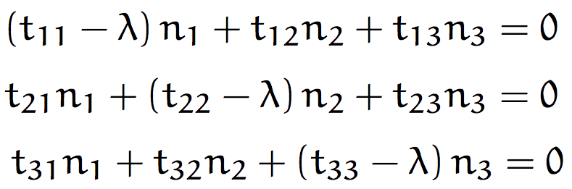
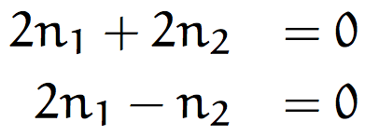

Let’s work through an example
So, the eigenvalues are:
Now, find the 3 corresponding eigenvectors n_{j} by solving the equations (t_{ij} – λ δ_{ij}) n_{j} = 0 with each value of λ in turn:
and
With λ₍₁₎=3:
The solution is:
and since n_{j} must be a unit vector, n₃ = 1
and the first eigenvector is: (0, 0, ±1), i.e. ê’₃= ê₃
So the new axes are just the old axes rotated about ê₃

Slide 10
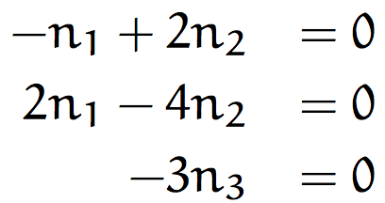



Let’s work through an example
Similarly, using λ₍₂₎=6,
And the unit-vector criterion gives
and
So, the second eigenvector is: ( , 0)

Slide 11
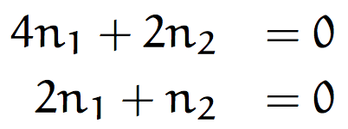
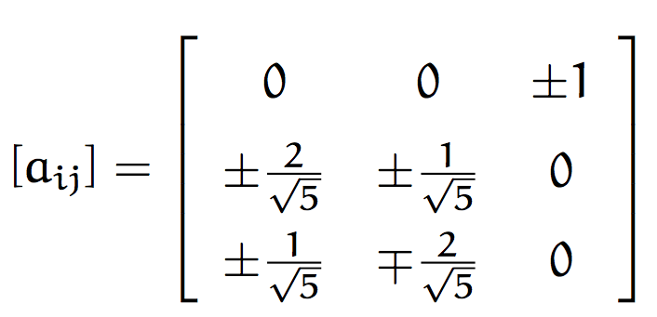
Let’s work through an example
Similarly, using λ₍₃₎= 1,
And the unit-vector criterion gives
and
So, the third eigenvector is: ( , 0)
And the
Transformation matrix
is:
Each row is an eigenvector

Slide 12
Let’s work through an example
The rows provide 2 sets of eigenvectors, depending on the upper/lower +/- choices.
How would you decide which set to use?
Suppose in a different problem, the 2nd and 3rd eigenvalues were equal. There will be some remaining ambiguity you won’t be able to find 3 eigenvectors in the same way.
What’s going on? What have you learned about the directions in which a_{ij}n_{j} points in the same direction as n_{j}?

