Slide 1
ESS 411/511 Geophysical Continuum Mechanics
Broad Outline for the Quarter
Continuum mechanics in 1-D
1-D models with springs, dashpots, sliding blocks
Attenuation
Mathematical tools – vectors, tensors, coordinate changes
Stress – principal values, Mohr’s circles for 3-D stress
Coulomb failure, pore pressure, crustal strength
Measuring stress in the Earth
Strain – Finite strain; infinitesimal strains
Moments – lithosphere bending; Earthquake moment magnitude
Conservation laws
Constitutive relations for elastic and viscous materials
Elastic waves; kinematic waves

Slide 2
ESS 411/511 Geophysical Continuum Mechanics Class #10
For Friday class
Please read Mase, Smelser, and Mase, Ch 3 through Section 3.6
Your short CR/NC Pre-class prep writing assignment (1 point) in Canvas
It will be due in Canvas at the start of class.
I will send another message when it is posted in Canvas.
Problem Sets
Problem Set #2 due in Canvas today
Problem Set #3 in Problem session tomorrow
ESS 511 Term Projects
For those of you taking this class as ESS 511, a reminder that in class on Friday, I will ask each of you for a 60-second outline of your ideas so far about your term topic.

Slide 3
ESS 411/511 Geophysical Continuum Mechanics Class #10
Warm-up (break-out rooms)
Vectors and tensors get more interesting when they vary with time t and with position x inside a body.
Explain in words what is meant by:
v(x,t) σ_{ij}(x,t)
v_{i} v_{i,i} v_{i,j} ε_{ijk}v_{k,j}
σ_{ij} σ_{ii,k} σ_{ij,k} σ_{ij,kk} σ_{ij,kl}
x_{i,j} = δ_{ij}
Class- prep questions
Choosing eigenvectors.

Slide 4
Derivatives of tensors
A tensor can vary smoothly in space and time, so it has derivatives.
= rate at which velocity vector is changing at a point.
= rate at which velocity vector is changing at a point.
There are 2 indices, so this is a 3x3 array.
Elements show how each vector component varies in each spatial direction.

Slide 5
Divergence
A tensor can vary smoothly in space and time, so it has derivatives.
Scalar - a scalar doesn’t have divergence ☹
Vector -
Tensor
Each row is the divergence of the corresponding column of T

Slide 6
Gradient
A tensor can vary smoothly in space and time, so it has derivatives.
Scalar
Vector
Tensor etc …

Slide 7
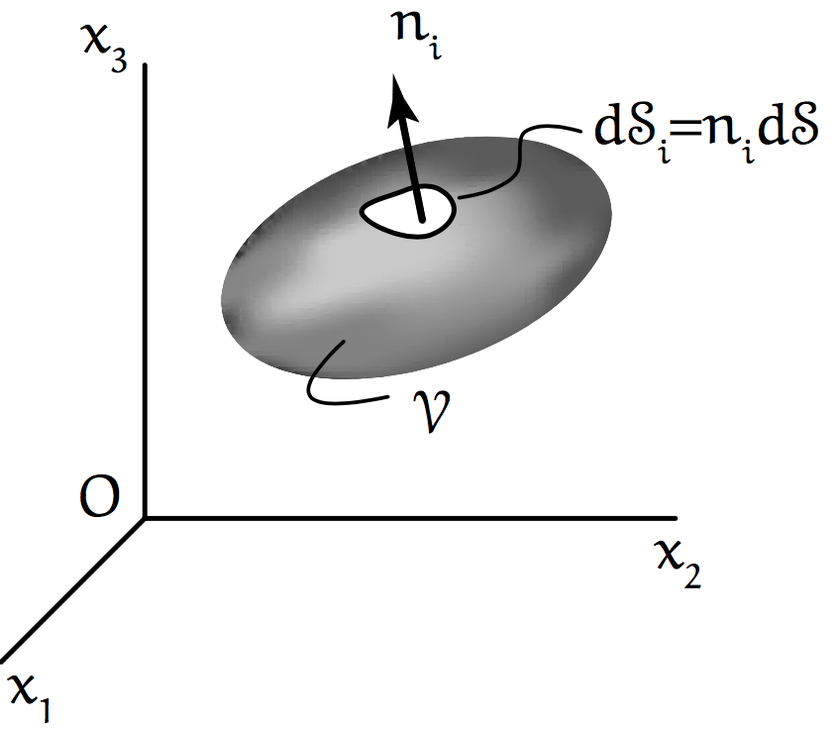
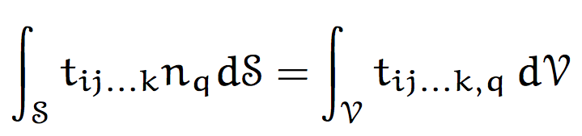
Integral theorems
We may want to know what is going on inside a body but have access only to its surface (or vice versa)
A volume V has surface S.
Each small patch dS on the surface is defined by its normal vector n_{i}.
Divergence theorem
The total amount of t_{ij…k} directed out across S is the same as the total amount of spreading (divergence) everywhere inside V.

Slide 8
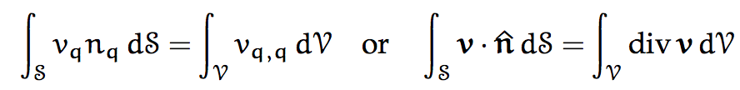
Special cases
Divergence theorem
If density ρ is uniform, the total amount of “stuff” flowing out across S with velocity v (the flux across S) is the same as the total amount of spreading (divergence) of that “stuff” everywhere inside V.

Slide 9
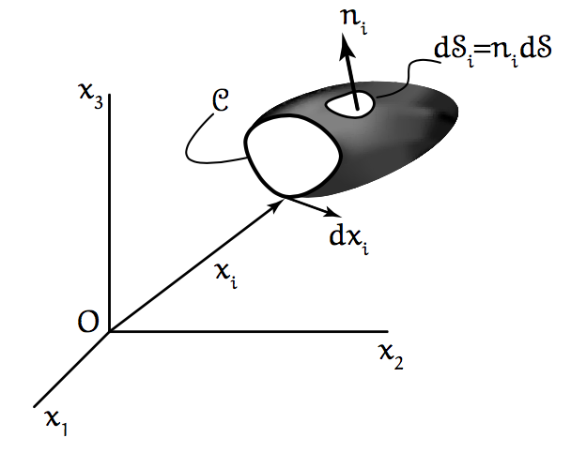
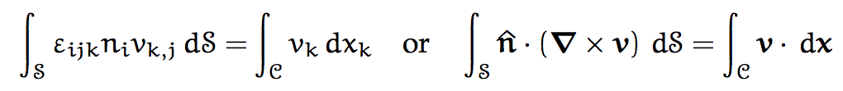
Stokes theorem
C is the perimeter of a cap on an open surface.
dx is the tangent to the perimeter C.
v is the material velocity.
If density ρ is uniform, the total circulation of “stuff” (curl) within the cap (“churning”) is equal to the net flow along the perimeter C (“the racetrack”).
(ε_{ijk}v_{j,k} is curl of v)

Slide 10


Definition of a tensor
In any rectangular coordinate system, a tensor is defined by 9 components that transform according to the rule
and where the basis vectors are related by

Slide 11
Forces in a continuum
Body forces b_{i} force per volume
Surface forces f_{i} force per area
(on exterior or interior surfaces)
Newton’s second law F = ma

