Slide 1
ESS 411/511 Geophysical Continuum Mechanics
Broad Outline for the Quarter
Continuum mechanics in 1-D
1-D models with springs, dashpots, sliding blocks
Attenuation
Mathematical tools – vectors, tensors, coordinate changes
Stress – principal values, Mohr’s circles for 3-D stress
Coulomb failure, pore pressure, crustal strength
Measuring stress in the Earth
Strain – Finite strain; infinitesimal strains
Moments – lithosphere bending; Earthquake moment magnitude
Conservation laws
Constitutive relations for elastic and viscous materials
Elastic waves; kinematic waves

Slide 2
ESS 411/511 Geophysical Continuum Mechanics Class #11
For Monday class
Please read Mase, Smelser, and Mase, Ch 3 through Section 3.8
Your short CR/NC Pre-class prep writing assignment (1 point) in Canvas
It will be due in Canvas at the start of class.
I will send another message when it is posted in Canvas.
I hope those among you who are US citizens are planning to vote.
There is information at uw.edu/studentlife/vote

Slide 3
One minute research project presentations from ESS 511 students

Slide 4
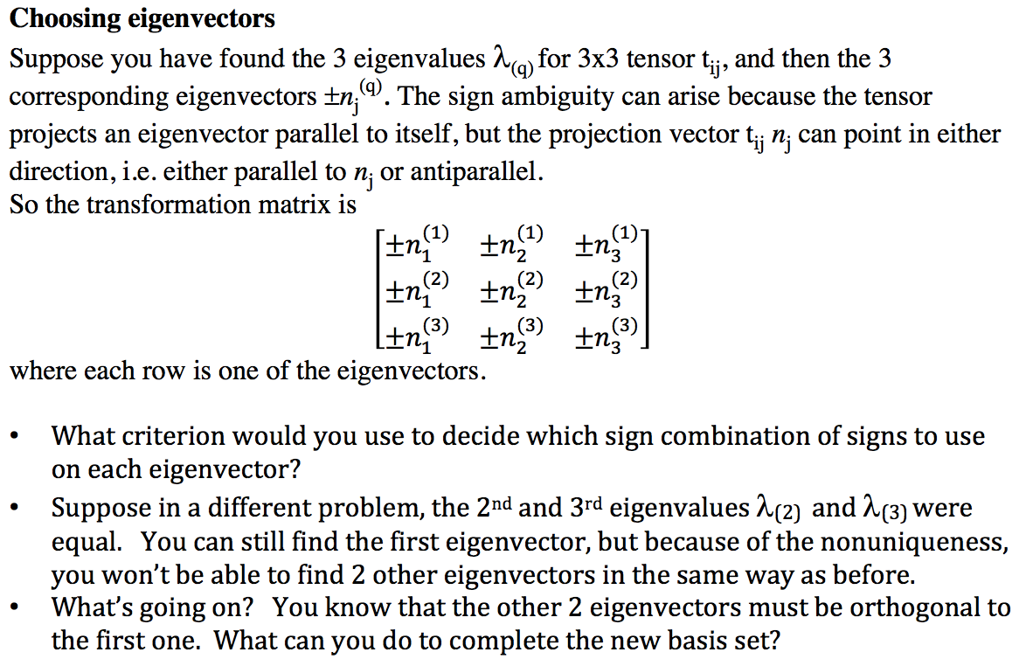
ESS 411/511 Geophysical Continuum Mechanics Class #11
Warm-up (break-out rooms)
Class-prep questions from Wednesday

Slide 5
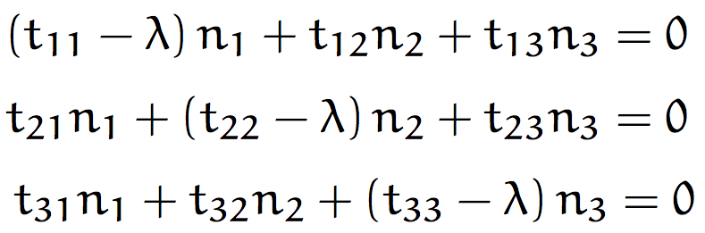
ESS 411/511 Geophysical Continuum Mechanics Class #11
Class-prep questions from Wednesday (break-out rooms)
If 2 eigenvalues are the same, either you will get 2 identlcal eigenvector solutions (not good because they must be orthogonal) or else there will be no clear solution. Then what?
Then you can choose any 2 orthogonal eigenvectors in the plane normal to the first eigenvector.
What if all 3 eigenvalues are the same?

Slide 6
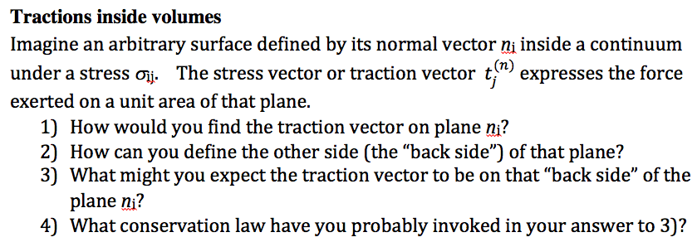
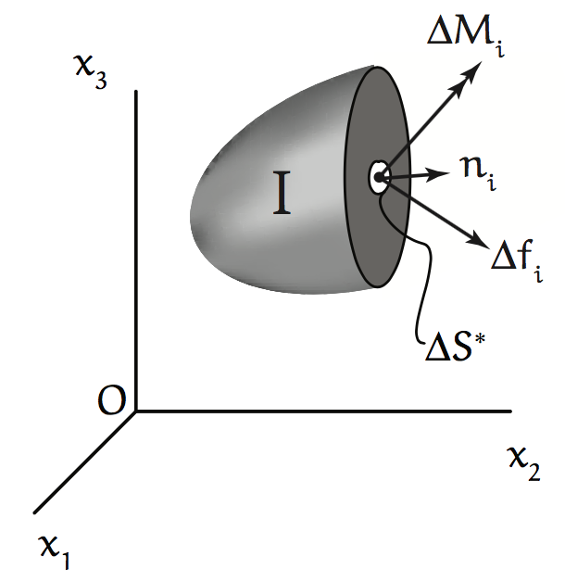
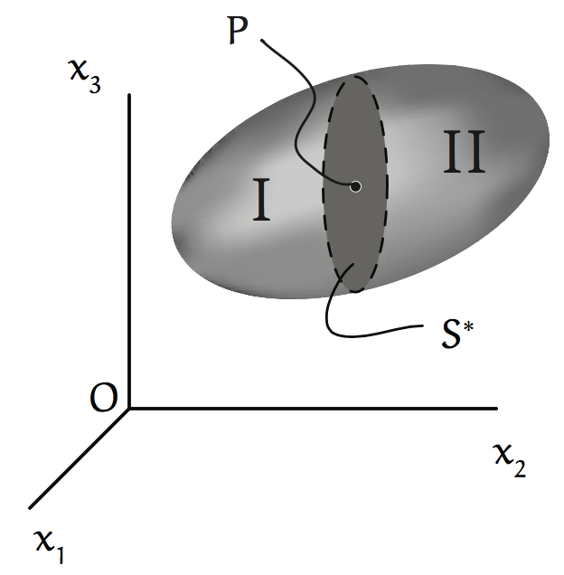
ESS 411/511 Geophysical Continuum Mechanics Class #11
Class-prep questions for today (break-out rooms)

Slide 7
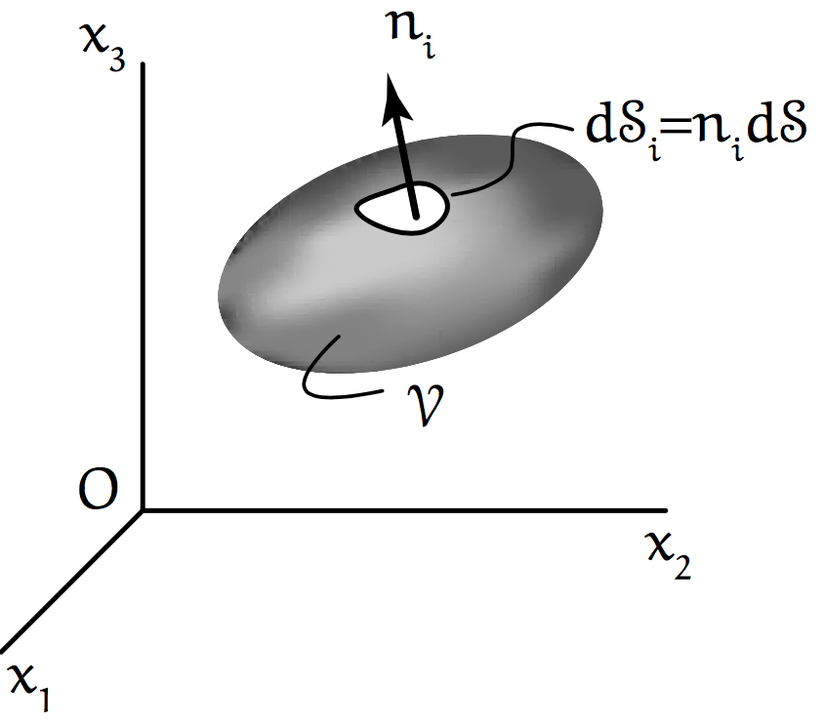
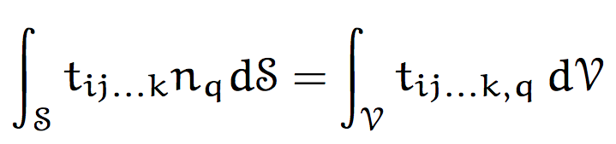
Integral theorems
We may want to know what is going on inside a body but have access only to its surface (or vice versa)
A volume V has surface S.
Each small patch dS on the surface is defined by its normal vector n_{i}.
Divergence theorem
The total amount of t_{ij…k} directed out across S is the same as the total amount of spreading (divergence) everywhere inside V.

Slide 8
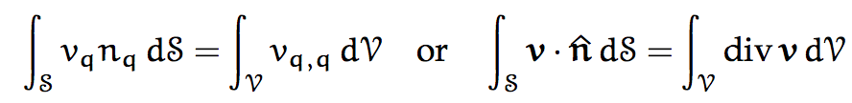
Special cases
Divergence theorem
If density ρ is uniform, the total amount of “stuff” flowing out across S with velocity v (the flux across S) is the same as the total amount of spreading (divergence) of that “stuff” everywhere inside V.

Slide 9
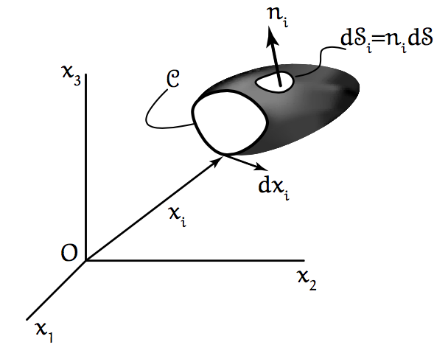
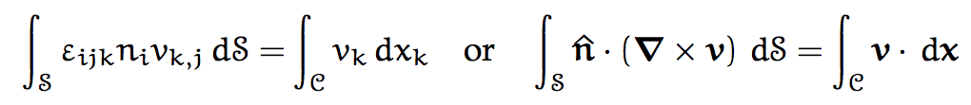
Stokes theorem
C is the perimeter of a cap on an open surface.
dx is the tangent to the perimeter C.
v is the material velocity.
If density ρ is uniform, the total circulation of “stuff” (curl) within the cap (“churning”) is equal to the net flow along the perimeter C (“the racetrack”).
(ε_{ijk}v_{j,k} is curl of v)

Slide 10


Definition of a tensor
In any rectangular coordinate system, a tensor is defined by 9 components that transform according to the rule
and where the basis vectors are related by

Slide 11
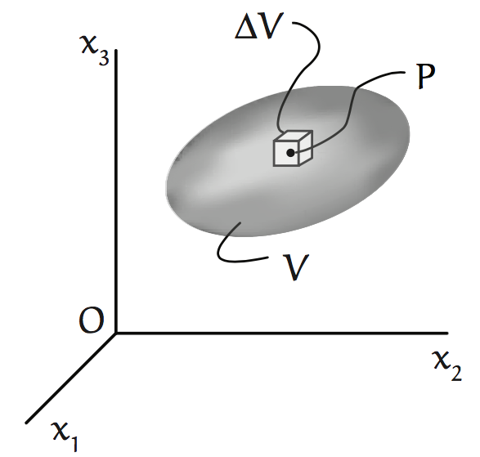

Density ρ in a continuum
Δm is the mass in a small volume ΔV around the point P.
ρ(x) = density (mass per unit volume)

Slide 12
Forces in a continuum
Body forces b_{i} force per volume
Surface forces t^{(n)}_{i} force per area or traction σ_{ji} n_{j}
(on exterior or interior surfaces)
Newton’s second law F = ma
In a continuum:

Slide 13
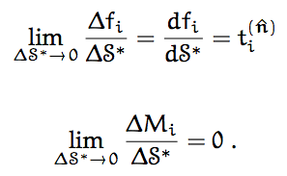
Traction and torque
f_{i} = force on ΔS*
M_{i} = moment or torque on ΔS*
(force x lever arm from center of ΔS*)

Slide 14
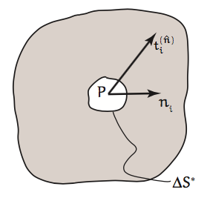
Traction
Traction vector acting at point P of plane element ΔS* whose normal vector is n_{i}.

Slide 15
Torque
Torque causes material to spin
M_{i} = moment or torque on ΔS* (force times lever arm from center of ΔS*)
M_{k} = r_{i} × F_{j}
F_{j}
Po
r_{i}
The torque or moment must go to zero because the lever arm must go to zero as ΔS* gets smaller.
If it did not, the material would be churned and ripped apart internally …
(This is also why the stress tensor must be symmetric.)

Slide 16
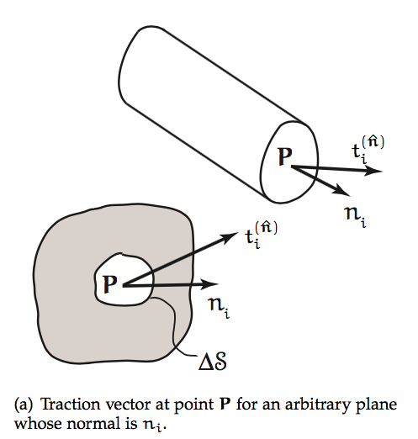
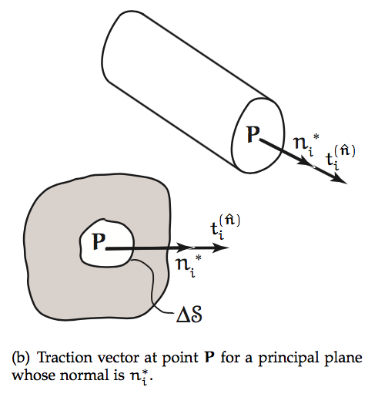
A stress tensor has principal coordinates in which the shear stress vanish, so that the traction vector on the principal planes is parallel to the normal vector

Slide 17
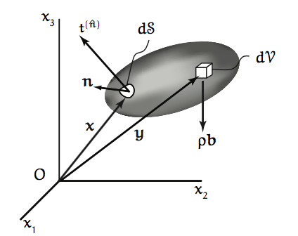
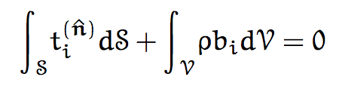
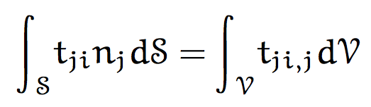
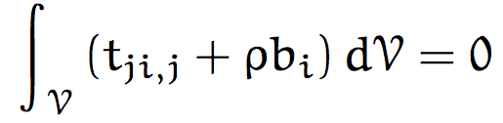

Momentum Conservation Equation
Force equilibrium
(1)
Divergence theorem for first term
Substitute in (1)
Volume V is arbitrary, so integrand must vanish for any V

