Slide 1
ESS 411/511 Geophysical Continuum Mechanics Class #12
Highlights from Class #11 – Zoe Krauss
Today’s highlights on Wednesday – Xinyu Wan
For Wednesday class
Please read Mase, Smelser, and Mase, Ch 3 through Section 3.8
Your short CR/NC Pre-class prep writing assignment (1 point) in Canvas
It will be due in Canvas at the start of class.
I will send another message when it is posted in Canvas.

Slide 2
ESS 411/511 Geophysical Continuum Mechanics
Broad Outline for the Quarter
Continuum mechanics in 1-D
1-D models with springs, dashpots, sliding blocks
Attenuation
Mathematical tools – vectors, tensors, coordinate changes
Stress – principal values, Mohr’s circles for 3-D stress
Coulomb failure, pore pressure, crustal strength
Measuring stress in the Earth
Strain – Finite strain; infinitesimal strains
Moments – lithosphere bending; Earthquake moment magnitude
Conservation laws
Constitutive relations for elastic and viscous materials
Elastic waves; kinematic waves

Slide 3
ESS 411/511 Geophysical Continuum Mechanics Class #12
Class-prep questions for today (break-out rooms)
Traction vectors on principal planes, Mohr’s circles
The traction vector tj(n) expresses the force per unit area of the plane defined by n_{i}. Section 3.7 explains how to resolve the traction vector into its components σ_{N} and σ_{S} normal and parallel to the plane respectively, and shows how to find the maximum and minimum values of σ_{N} and σ_{S}.
With respect to faults at km scales, or layered rocks such as shales at the meter describe how you think this might be useful.
Section 3.8 explains how to represent the state of stress at a point with Mohr’s circles.
How do you think the Mohr’s circle representation of stress t_{ij}in terms of σ_{N} and σ_{S} might give potentially more insight than just the stress tensor t_{ij} itself?

Slide 4


Definition of a tensor
In any rectangular coordinate system, a tensor is defined by 9 components that transform according to the rule
and where the basis vectors are related by
In Section 3.3 Equations (3.19) (-3.22) MSM show that stress transforms into new coordinate systems following this rule, and so stress is a tensor.

Slide 5
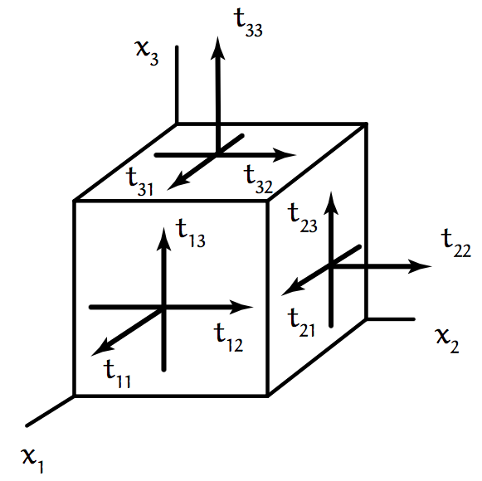
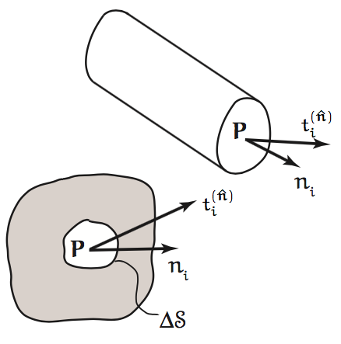
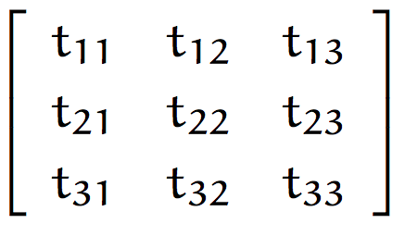
If a stress tensor is not expressed in its principal coordinates
the traction vectors on the coordinate planes may not be parallel to the coordinate vectors , and
off-diagonal elements of t_{ij} may be nonzero.

Slide 6
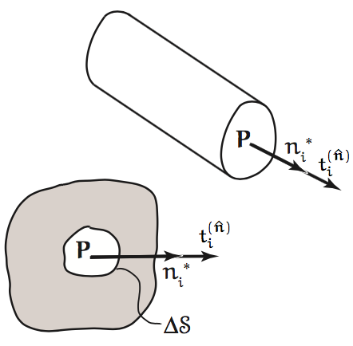
If a stress tensor is expressed in its principal coordinates
the traction vectors on the coordinate planes must be parallel to the coordinate vectors , and
off-diagonal elements t*_{ij} must be zero.

Slide 7
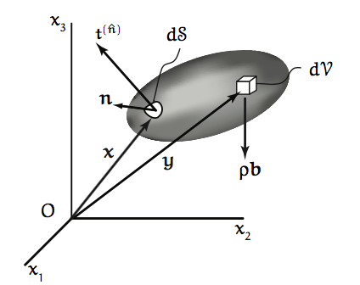
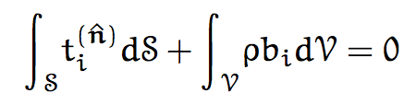
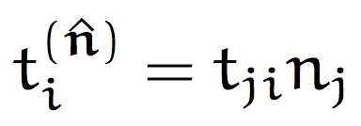
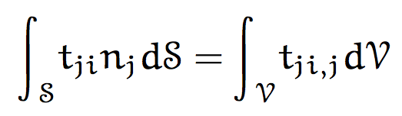
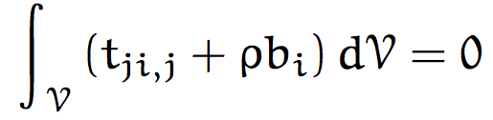

Momentum Conservation Equation
Force equilibrium
(1)
Replace traction vector with stress tensor
(2)
Apply Divergence Theorem (3) to change surface integral into volume integral
(3)
Collect volume terms
Volume V is arbitrary, so integrand must vanish for any V

Slide 8
Symmetry of stress tensor
As discussed in Class 11 on Friday, the stress tensor is symmetric because the moment on an infinitesimal surface element dS must go to zero.
The text derives this more rigorously in Section 3.4.
The message to remember is that for stress -
t_{ij} = t_{ji}
The stress tensor can be reflected across its diagonal without changing.

Slide 9
Transformation laws for stress tensor
Section 3.5 goes over how to express the stress tensor (t_{ij} or σ_{ij}) in different coordinate systems.
This is mainly a repeat of earlier ideas in Chapter 2 about transforming any tensor.
Section 3.6 goes over how to find the principal values (eigenvalues) of the stress tensor, how to find the principal directions (eigenvectors), and how to find the 3 scalar invariants of the stress tensor.
This is also mainly a repeat of earlier ideas in Chapter 2 about transforming any tensor.

Slide 10
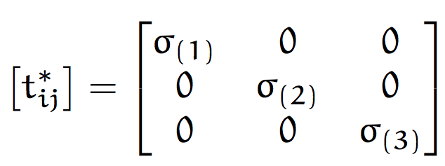
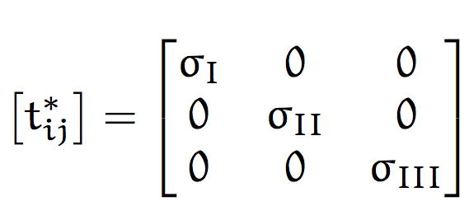
Notation
Principal stresses σ_{I} > σ_{II} > σ_{III}
or
Conventions:
Compressive stresses are negative
Principal stresses are numbered from largest (most positive) to smallest
Other conventions are also used in other texts and in research literature, but this convention is most versatile and correct in all situations

Slide 11
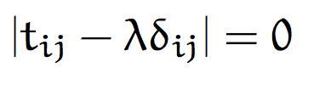
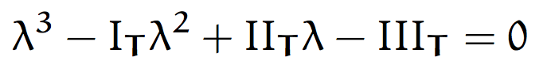
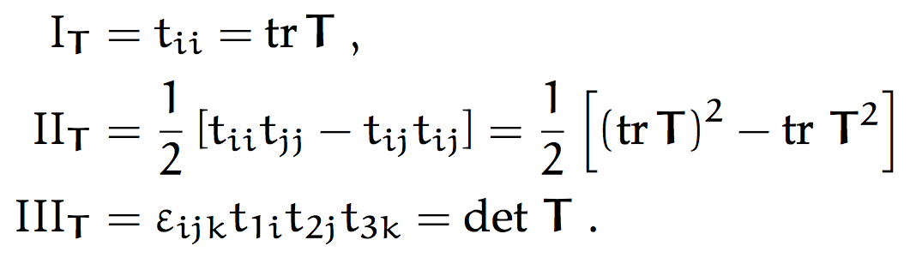
Notation
Scalar Invariants of the stress tensor
These are the coefficients in the cubic characteristic equation when solving for the eigenvalues
Trace
Second invariant
Determinant

Slide 12
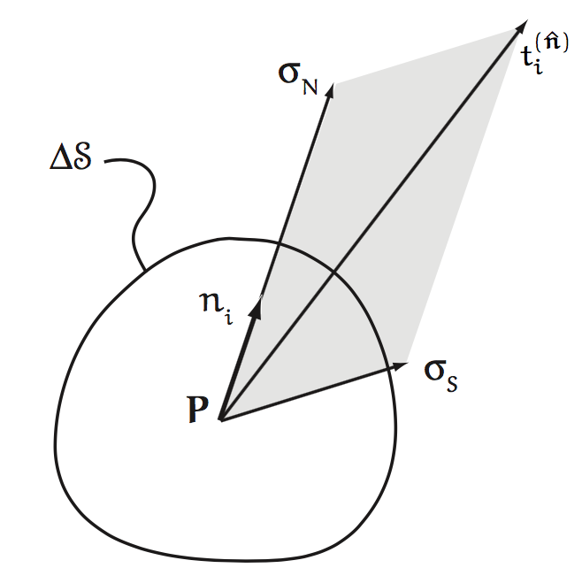

Section 3.7 – Normal and shear traction on a plane
On any of the infinite number of plane elements ΔS at P, the traction vector can be resolved into components σ_{N} normal to the plane, and σ_{S} in the plane.
(σ_{N} and σ_{S} are just scalar magnitudes.)
Take the dot product to find σ_{N} as the projection of onto n_{i}.
Then use the Pythagorean theorem to find σ_{S}

Slide 13
Section 3.7 – Minimum and maximum stress values
What are the largest and smallest values that σ_{N} and σ_{s} can take at P when considering all possible planes through P?
Take the dot product to find σ_{N}
Then use the Pythagorean theorem to find σ_{S}
Then find the directions n_{i} where σ_{N} and σ_{s} have extrema
for i=1,2,3
for i=1,2,3

Slide 14
Section 3.7 – Minimum and maximum stress values
σ_{N} and σ_{S} can vary dramatically depending on which plane the traction vector is resolved onto.
σ_{N}
σ_{N}
n_{i}
σ_{S}
n_{i}
P
σ_{S}
P

Slide 15
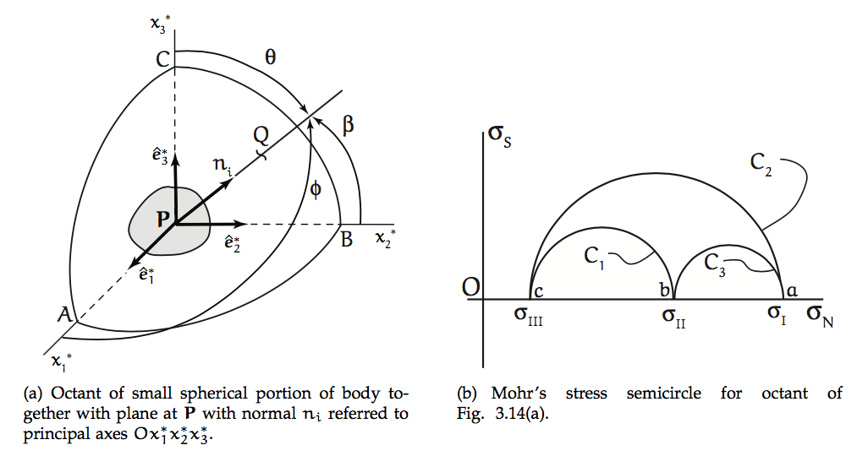
Cartesian Space vs Stress Space
are principal directions defining principal planes at P.
Lower-case letters in stress space correspond to upper-case letters in Cartesian space.
End point Q of unit vector n_{i} can fall anywhere on unit sphere centered at P.
φ, β, θ relate Q to coordinate axes.
The 3 circles correspond to Q lying in a principal plane.

Slide 16
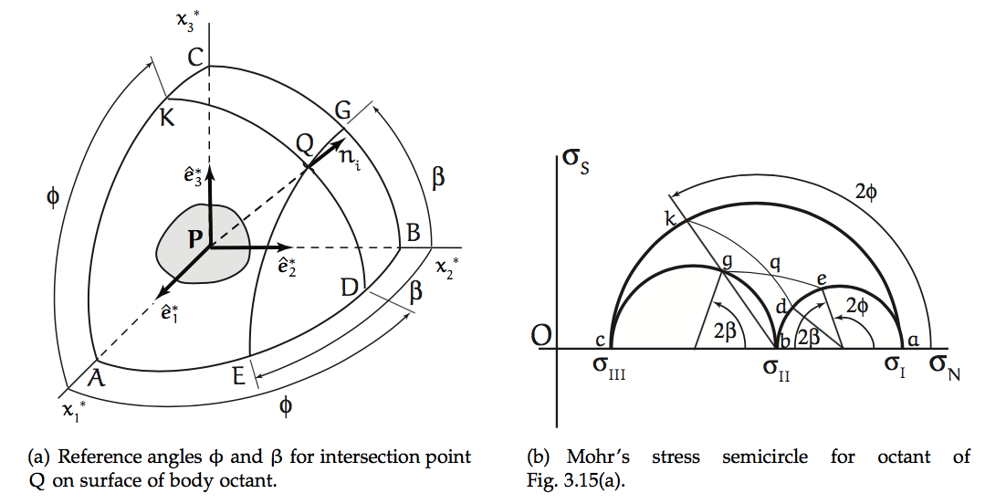
Cartesian Space vs Stress Space
are principal directions defining principal planes at P.
Small circles in Cartesian space (e.g. EQG) map onto circles (e.g. eqg) concentric with primary Mohr’s circles (e.g. akc).
Similarly, KQD maps onto kqd.
Intersection at q shows σ_{N} and σ_{s} on plane defined by normal vector n_{i} at Q.
(I have attempted to (sort of) correct the stress-plane figure below. ☺ )
q

