Slide 1
ESS 411/511 Geophysical Continuum Mechanics Class #13
Highlights from Class #12 – Xinyu Wan
Today’s highlights on Friday – Maleen Kidiwela
For Friday class
Please read Mase, Smelser, and Mase, Ch 3 through Section 3.8
Your short CR/NC Pre-class prep writing assignment (1 point) in Canvas
It will be due in Canvas at the start of class.
I will send another message when it is posted in Canvas.

Slide 2
ESS 411/511 Geophysical Continuum Mechanics
Broad Outline for the Quarter
Continuum mechanics in 1-D
1-D models with springs, dashpots, sliding blocks
Attenuation
Mathematical tools – vectors, tensors, coordinate changes
Stress – principal values, Mohr’s circles for 3-D stress
Coulomb failure, pore pressure, crustal strength
Measuring stress in the Earth
Strain – Finite strain; infinitesimal strains
Moments – lithosphere bending; Earthquake moment magnitude
Conservation laws
Constitutive relations for elastic and viscous materials
Elastic waves; kinematic waves

Slide 3
Class-prep questions for today (break-out rooms)
Mohr’s circles
Why are Mohr’s circles actually circles in stress space, and not some other shape, such as general ellipses for example?
For a given stress tensor t_{ij} in stress space, with principal stresses
σ_{I} > σ_{II} > σ_{III}
the normal and shear components of t_{ij}, σ_{N} and σ_{S} for all possible planes with normal vectors n_{i} plot in a restricted areas in stress space, and all other areas are “out of bounds”.
In which area do all the possible stress states (σ_{N}, σ_{S}) plot in the stress-space diagram?
Why do Mohr’s circles always seem to stop at σ_{S} = 0? Is a negative shear component impossible?

Slide 4
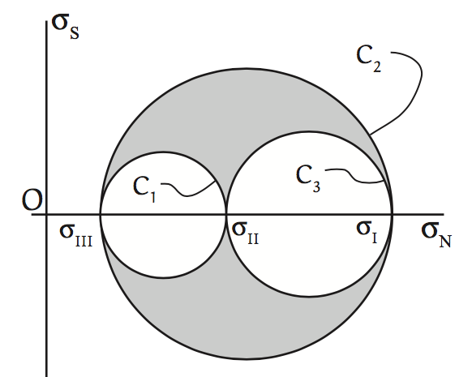
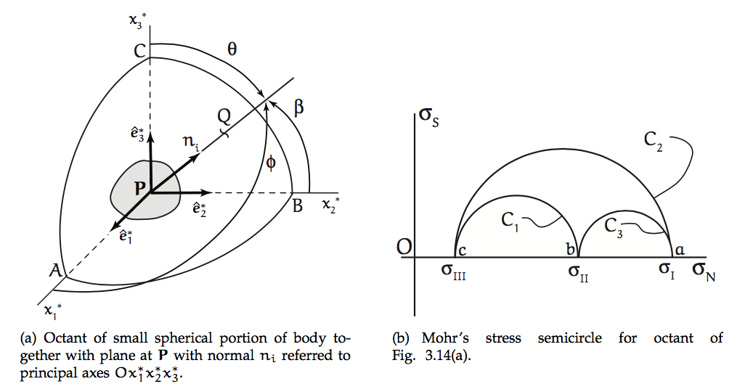
Mohr’s circles in 4th quadrant
σ_{N}
t^{(n)}
σ_{s}
-t^{(n)}
σ_{s}
Plane
σ_{N}
Normal vectors n_{j} defining a plane can point in either direction, e.g. into opposite octant in Cartesian space

Slide 5
Problem Set #1
Remember to include units when you evaluate expressions
Some of you interpreted 1(f) to be about shearing the lithosphere.
If you used the thickness of the asthenosphere (~200 km), you would have found that the strain rate fell below the minimum strain rate needed for failure.
Question 2 – viscosity of silly putty
Some of you are clearly theoreticians rather than experimentalists. You never told me how you would set up an experiment in your Lab.

Slide 6
Section 3.7 – Minimum and maximum stress values
σ_{N} and σ_{S} can vary dramatically depending on which plane the traction vector is resolved onto.
σ_{N}
σ_{N}
n_{i}
σ_{S}
n_{i}
P
σ_{S}
P

Slide 7
Cartesian Space vs Stress Space
are principal directions defining principal planes at P.
Lower-case letters in stress space correspond to upper-case letters in Cartesian space.
End point Q of unit vector n_{i} can fall anywhere on unit sphere centered at P.
φ, β, θ relate Q to coordinate axes.
The 3 circles correspond to Q lying in a principal plane.

Slide 8
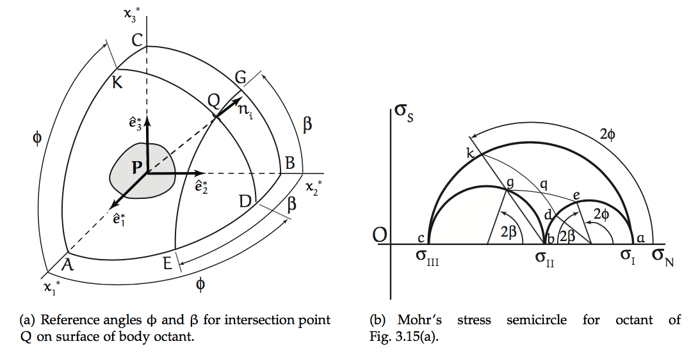
Cartesian Space vs Stress Space
are principal directions defining principal planes at P.
Small circles in Cartesian space (e.g. EQG) map onto circles (e.g. eqg) concentric with primary Mohr’s circles (e.g. akc).
Similarly, KQD maps onto kqd.
Intersection at q shows σ_{N} and σ_{s} on plane defined by normal vector n_{i} at Q.
(I have attempted to (sort of) correct the stress-plane figure below. ☺ )
q

Slide 9
Sliding friction
t^{(n)}
σ_{N}
σ_{s}
σ_{S}= - μ σ_{N} μ is coefficient of friction for sliding on a pre-existing break

Slide 10
Mohr-Coulomb Fracture
t^{(n)}
σ_{N}
σ_{s}
σ_{S}= - n σ_{N} n is cohesion, or internal friction
opposing rupture in unbroken material

