Slide 1
ESS 411/511 Geophysical Continuum Mechanics Class #14
Highlights from Class #13 – Maleen Kidiwela
Today’s highlights on Monday – Andrew Gregovich
Our text doesn’t cover our next topics very thoroughly, so we will use a few other sources, which are posted on the class web site under READING & NOTES. https://courses.washington.edu/ess511/NOTES/notes.shtml
For Monday class – Please read
Stein and Wysession 5.7.2
Stein and Wysession 5.7.3/4
Raymond notes on failure
Also see slides about upcoming topics
Failure and Mohr’s circles – slides
Your short CR/NC Pre-class prep writing assignment (1 point) in Canvas
It will be due in Canvas at the start of class.
I will send another message when it is posted in Canvas.

Slide 2
Sliding friction
Fracture
Pore pressure

Slide 3
ESS 411/511 Geophysical Continuum Mechanics
Broad Outline for the Quarter
Continuum mechanics in 1-D
1-D models with springs, dashpots, sliding blocks
Attenuation
Mathematical tools – vectors, tensors, coordinate changes
Stress – principal values, Mohr’s circles for 3-D stress
Coulomb failure, pore pressure, crustal strength
Measuring stress in the Earth
Strain – Finite strain; infinitesimal strains
Moments – lithosphere bending; Earthquake moment magnitude
Conservation laws
Constitutive relations for elastic and viscous materials
Elastic waves; kinematic waves

Slide 4
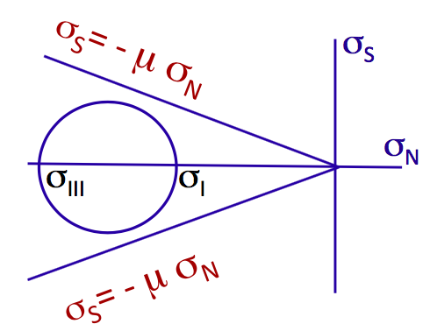
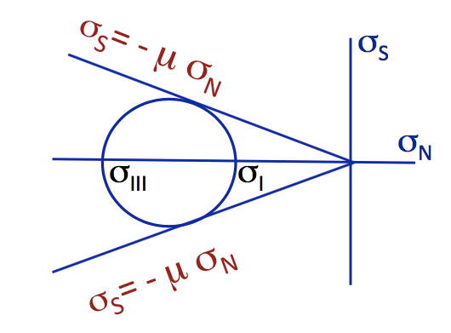
Class-prep questions for today (break-out rooms)
Failure of materials
Faults can slip when shear stress σ_{S} is large enough to overcome frictional resistance. Frictional resistance to failure can be modeled as increasing proportional to the normal traction σ_{N}.
In stress space, if a stress state σ_{N} and σ_{S} exists that intersects or touches the frictional line, then the plane represented at that point can fail.
In the diagrams, all principal stresses are negative.
Are they compressive or extensile?
In the first diagram, do any stress states exist outside the circle shown?
Can any faults fail in this stress field?
In the second diagram (below):
What has changed in the stress field?
Can any faults fail in this new stress field?
If yes, how many different faults can fail?
How could you identify the orientation(s) from the Mohr's circle?

Slide 5
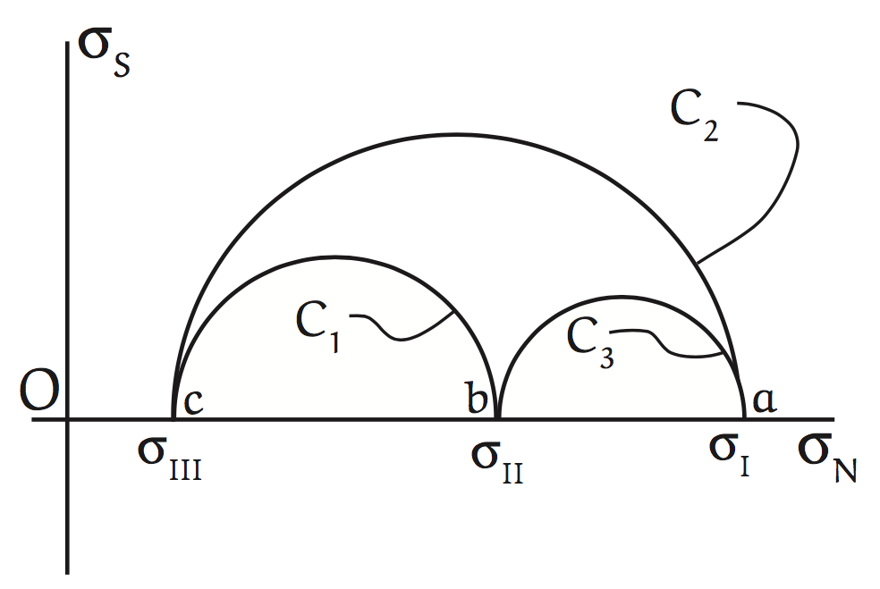
Mohr’s circle in 2-D view
Traction on n_{i}
n_{i}
2θ
θ
plane

Slide 6
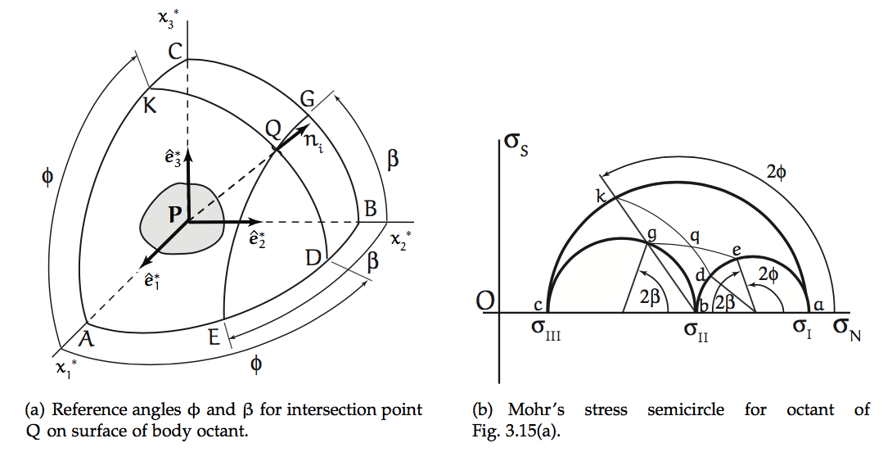
Cartesian Space vs Stress Space
are principal directions defining principal planes at P.
Small circles in Cartesian space (e.g. EQG) map onto circles (e.g. eqg) concentric with primary Mohr’s circles (e.g. akc).
Similarly, KQD maps onto kqd.
Intersection at q shows σ_{N} and σ_{s} on plane defined by normal vector n_{i} at Q.
(I have attempted to (sort of) correct the stress-plane figure below. ☺ )
q

Slide 7
Sliding friction
t^{(n)}
σ_{N}
σ_{s}
σ_{S}= - μ σ_{N} μ is coefficient of friction for sliding on a pre-existing break

Slide 8
Frictional sliding
σ_{S}= - μ σ_{N}
σ_{S}
(σ_{III} + σ_{I})/2
2θ
σ_{N}
σ_{III}
σ_{I}
σ_{S}= - μ σ_{N} μ is coefficient of friction for sliding on a pre-existing break

Slide 9
Differential stress σ_{III} - σ_{Ι}
σ_{S}= - μ σ_{N}
σ_{S}
σ_{N}
o
o
o
σ_{III}
σ_{II}
σ_{I}
But, if σ_{III} = σ_{Ι}, all 3 principal stresses are equal
What do the 3 Mohr’s circle look like?
Describe this state of stress inside the body.
Is frictional failure possible, if differential stress is zero?

Slide 10
Differential stress σ_{III} – σ_{Ι}
σ_{S}= - μ σ_{N}
σ_{S}
σ_{N}
o
o
o
σ_{III}
σ_{II}
σ_{I}
But, if σ_{III} = σ_{Ι}, all 3 principal stresses are equal
What do the 3 Mohr’s circle look like?
Describe this state of stress inside the body.
Is frictional failure possible, if differential stress is zero?

Slide 11
Mohr-Coulomb Fracture
t^{(n)}
σ_{N}
σ_{s}
σ_{S}= τ₀- n σ_{N} n is coefficient of internal friction for fracture on a new fault surface
τ₀ is cohesion of the material

Slide 12
Mohr-Coulomb Fracture
σ_{S}
σ_{S}= τ₀- n σ_{N}
τ₀
o
σ_{III}
σ_{I}
σ_{N}
σ_{S}= τ₀- n σ_{N} n is coefficient of internal friction for fracture on a new fault surface
τ₀ is cohesion of the material

