Slide 1
ESS 411/511 Geophysical Continuum Mechanics Class #15
Highlights from Class #14 – (Andrew Gregovich)
Today’s highlights on Wednesday – Andrew Gregovich
Our text doesn’t cover our next topics very thoroughly, so we will use a few other sources, which are posted on the class web site under READING & NOTES. https://courses.washington.edu/ess511/NOTES/notes.shtml
Stein and Wysession 5.7.2
Stein and Wysession 5.7.3/4
Raymond notes on failure
Also see slides about upcoming topics
Failure and Mohr’s circles – slides
Your short CR/NC Pre-class prep writing assignment (1 point) in Canvas
It will be due in Canvas at the start of class.
I will send another message when it is posted in Canvas.

Slide 2
ESS 411/511 Geophysical Continuum Mechanics
Broad Outline for the Quarter
Continuum mechanics in 1-D
1-D models with springs, dashpots, sliding blocks
Attenuation
Mathematical tools – vectors, tensors, coordinate changes
Stress – principal values, Mohr’s circles for 3-D stress
Coulomb failure, pore pressure, crustal strength
Measuring stress in the Earth
Strain – Finite strain; infinitesimal strains
Moments – lithosphere bending; Earthquake moment magnitude
Conservation laws
Constitutive relations for elastic and viscous materials
Elastic waves; kinematic waves

Slide 3
Warm-up questions – (break-out)
Explain what’s going on in each case.
σ_{S}
σ_{S}
(e)
σ_{S}
(a)
(c)
σ_{III}
σ_{II}=σ_{I}
σ_{N}
σ_{III}
σ_{II}
σ_{I}
σ_{N}
σ_{III}=σ_{II}=σ_{I}
σ_{N}
σ_{S}
σ_{S}
(b)
(d)
(f)
p = -σ_{ii} /3
What is p?
Why the minus sign?
σ_{III}
σ_{II}
σ_{I}
σ_{N}
σ_{III}
σ_{II}
σ_{I}
σ_{N}

Slide 4
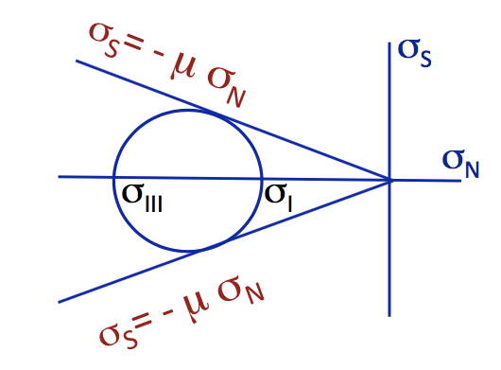
Class-prep questions for today (break-out rooms)
Failure of materials
Last class, we looked at frictional sliding on pre-existing fractures or faults with a coefficient of friction μ.
What physical characteristics of a surface cause friction?
Now we are going to actually break new rocks.
Mohr−Coulomb failure
σ_{S}= τ₀- n σ_{N}
n = coefficient of internal friction for fracture on a new fault surface
τ₀ = cohesion of the material
σ_{S}
Explain what you think n and τ₀ might mean in terms of micro-scale processes at the micro-crack, crystalline, or lattice scales.
Why do you think the failure envelope is rounded off at the right? Think about the sign of σ_{N} and the processes that might contribute to internal friction.
σ_{S}= τ₀- n σ_{N}
τ₀
σ_{N}
σ_{III}
σ_{I}

Slide 5
Sliding friction
t^{(n)}
σ_{N}
σ_{s}
σ_{S}= - μ σ_{N} μ is coefficient of friction for sliding on a pre-existing break

Slide 6
Frictional sliding
σ_{S}= - μ σ_{N}
σ_{S}
(σ_{III} + σ_{I})/2
2θ
σ_{N}
σ_{III}
σ_{I}
σ_{S}= - μ σ_{N} μ is coefficient of friction for sliding on a pre-existing break

Slide 7
Differential stress σ_{III} - σ_{Ι}
σ_{S}= - μ σ_{N}
σ_{S}
σ_{N}
o
o
o
σ_{III}
σ_{II}
σ_{I}
But, if σ_{III} = σ_{Ι}, all 3 principal stresses are equal
What do the 3 Mohr’s circle look like?
Describe this state of stress inside the body.
Is frictional failure possible, if differential stress is zero?

Slide 8
Differential stress σ_{III} – σ_{Ι}
σ_{S}= - μ σ_{N}
σ_{S}
σ_{N}
o
o
o
σ_{III}
σ_{II}
σ_{I}
But, if σ_{III} = σ_{Ι}, all 3 principal stresses are equal
What do the 3 Mohr’s circle look like?
Describe this state of stress inside the body.
Is frictional failure possible, if differential stress is zero?

Slide 9
Mohr-Coulomb Fracture
t^{(n)}
σ_{N}
σ_{s}
σ_{S}= τ₀- n σ_{N} n is coefficient of internal friction for fracture on a new fault surface
τ₀ is cohesion of the material

Slide 10
Mohr-Coulomb Fracture
σ_{S}
σ_{S}= τ₀- n σ_{N}
Now we are actually breaking rock …
τ₀
o
σ_{III}
σ_{I}
σ_{N}
σ_{S}= τ₀- n σ_{N} n is coefficient of internal friction for fracture on a new fault surface
τ₀ is cohesion of the material

Slide 11
Failure in shear
Why is failure is not on the plane with maximum shear stress?
Why are there 2 conjugate failure planes?
σ_{S}
σ_{III}
θ
2θ
n_{i}
σ_{III}
σ_{I}
σ_{N}
σ_{I}

Slide 13
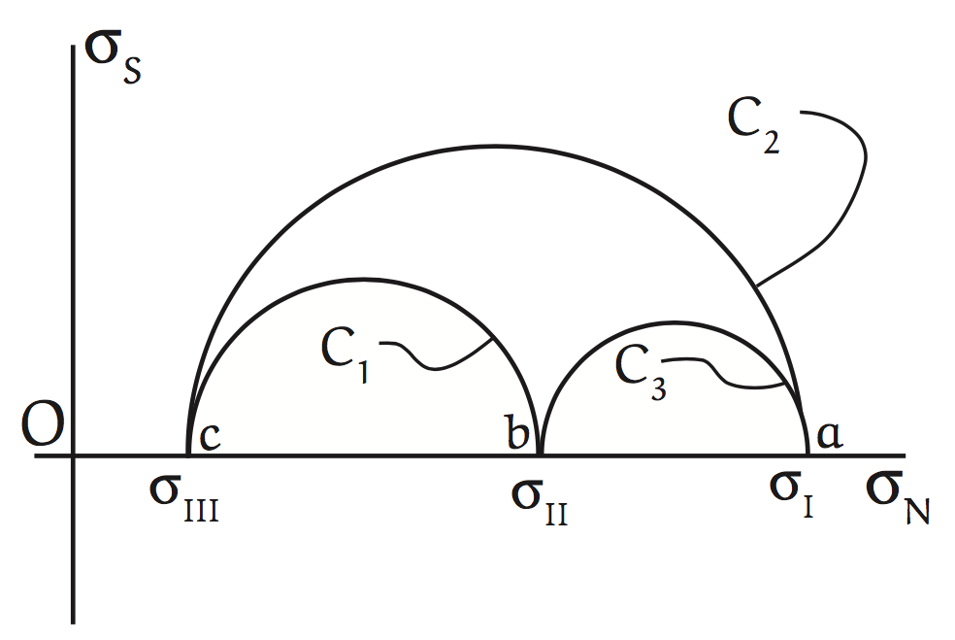
Mohr’s circle in 2-D view
Traction on n_{i}
n_{i}
2θ
θ
plane

Slide 14
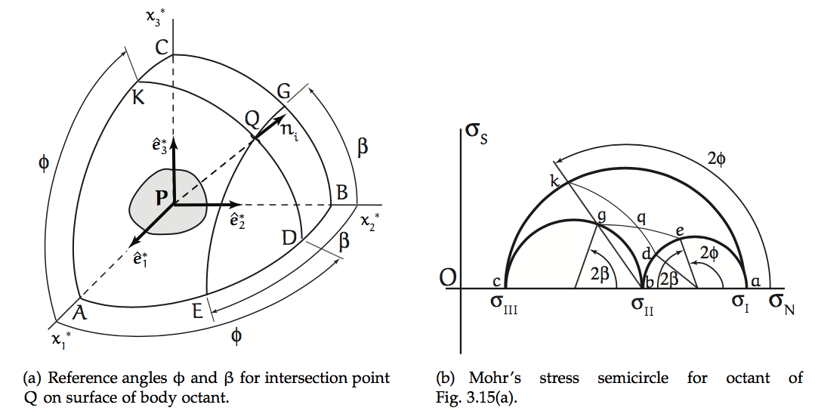
Cartesian Space vs Stress Space
are principal directions defining principal planes at P.
Small circles in Cartesian space (e.g. EQG) map onto circles (e.g. eqg) concentric with primary Mohr’s circles (e.g. akc).
Similarly, KQD maps onto kqd.
Intersection at q shows σ_{N} and σ_{s} on plane defined by normal vector n_{i} at Q.
(I have attempted to (sort of) correct the stress-plane figure below. ☺ )
q

