Slide 1
ESS 411/511 Geophysical Continuum Mechanics Class #16
Highlights from Class #15 – Andrew Gregovich
Today’s highlights on Friday – Madie Mamer
Our text doesn’t cover our next topics very thoroughly, so we will use a few other sources, which are posted on the class web site under READING & NOTES. https://courses.washington.edu/ess511/NOTES/notes.shtml
Stein and Wysession 5.7.2
Stein and Wysession 5.7.3/4
Raymond notes on failure
Also see slides about upcoming topics
Failure and Mohr’s circles – slides
Your short CR/NC Pre-class prep writing assignment (1 point) in Canvas
It will be due in Canvas at the start of class.
I will send another message when it is posted in Canvas.

Slide 2
ESS 411/511 Geophysical Continuum Mechanics
Broad Outline for the Quarter
Continuum mechanics in 1-D
1-D models with springs, dashpots, sliding blocks
Attenuation
Mathematical tools – vectors, tensors, coordinate changes
Stress – principal values, Mohr’s circles for 3-D stress
Coulomb failure, pore pressure, crustal strength
Measuring stress in the Earth
Strain – Finite strain; infinitesimal strains
Moments – lithosphere bending; Earthquake moment magnitude
Conservation laws
Constitutive relations for elastic and viscous materials
Elastic waves; kinematic waves

Slide 3
Homework #3 – Question #1
Rotation axis
The coordinate axes look like a tripod, and the rotation axis was vertical
Some of you drew a left-handed coordinate system, so the unprimed axes mapped onto the wrong primed axes.
That screwed up your transformation matrix a_{ij} matrix because
120º
120º
120º
After transforming the axes
T’ = A T A^{T} should still have 9 entries which are just a re-arrangement of the original t_{ij}.
Because T is isotropic, you now have 9 relations equating 2 different elements t_{ij}.
The second rotation gives another 9 relations.
Then the only way to satisfy all those relations is by T = λ I
Good news
even with a left-handed rotation, you should still get the same result ☺

Slide 4
Homework #3 – Question #2
Show that δ_{ij} and ε_{ijk} are unchanged in new coordinate systems
There was a lot of abuse of index notation. For example -
More than 2 “i” or “j” indices in a term e.g. a_{ij} a_{ij} a_{ij} ε_{ijk}
det(A) = a_{ij} a_{kl} a_{mn} LHS is a scalar, but RHS is a 6th order tensor
A correct expression is ε_{qmn} det(A) = ε_{ijk} a_{iq} a_{jm} a_{kn}

Slide 5
Homework #3 – Question #3
Determine the principal values of the matrix
and show that the principal axes Ox₁*x₂*x₃* are obtained from Ox₁x₂x₃ by a rotation of 60º about the x₁ axis.
Most people got the 3 eigenvalues (4,8,12) .
There were two approaches to showing that a 60º rotation around x₁ put K_{ij} into its principal coordinates.
Find the eigenvectors and show that thei x*₂ and x*₃ unit vectors have been rotated 60º from the initial coordinate axes.
Find the transformation matrix a_{ij} and then express K’_{ij} in the rotated coordinates : K’_{ij} = a_{im}a_{jn}K_{mn}
I saw a lot of incorrect transformation matrices, where the off-diagonal elements had the wrong signs, so the rotation went in the wrong direction
Remember that
If K’_{ij} is going to be in principal coordinates, it had better be in diagonal form, with diagonal elements 4,8,12 (!)

Slide 6
4 Conventions in Stress Polarity
Engineering/Mathematical convention:
Criterion 1: Positive σ_{ii} * signifies extension
Criterion 2: Order σ_{I} > σ_{II} > σ_{III} (Mase & Mase)
or
σ_{I} < σ_{II} < σ_{III} (Stein & Wysession)
Geologic/Tectonic/Rock Mechanics convention:
Criterion 1: Positive σ_{ii} * signifies compression
(not a tensor!! Why not?)
Criterion 2: Order σ_{I} > σ_{II} > σ_{III} (Twiss & Moores)
or
σ_{I} < σ_{II} < σ_{III} (?)
_{* No sum implied}

Slide 7
Class-prep questions for today (break-out rooms)
Greatest shear stress is on planes …….. with normal vectors n_{i} at 45º to σ_{III}. But failure actually happens on planes – – – – at an angle θ>45º between n_{i} and σ_{III}
Why is failure not on the plane with maximum shear stress?
Think of the role of σ_{N} in preventing slip.
Can you relate this to the tangent to the top of the Mohr’s circle?
All surfaces are roughs at some scale. Relate this failure angle to how one rough surface slides over another rough surface.
Failure planes – – – are defined by their normal vectors n_{i}.
Why are there 2 conjugate failure planes?
Relate this to the Mohr’s circle.
σ_{III}
σ_{III}
σ_{S}
2θ
n_{i}
45^{ο}
n_{i}
σ_{I}
θ
σ_{I}
σ_{III}
σ_{I}
σ_{N}
Stress space
Cartesian space

Slide 8
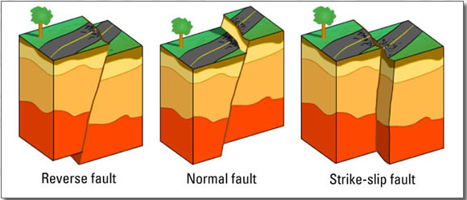
Types of faults
The Earth’s surface is traction-free, so one of the principal directions is generally vertical
What are the orientations of the principal axes of stress , ,
in each case?
σ_{S}= - μ σ_{N}
σ_{S}
(σ_{III} + σ_{I})/2
2θ
σ_{N}
σ_{III}
o
σ_{I}

Slide 9
Sliding friction
t^{(n)}
σ_{N}
σ_{s}
σ_{S}= - μ σ_{N} μ is coefficient of friction for sliding on a pre-existing break

Slide 10
Frictional sliding
σ_{S}= - μ σ_{N}
σ_{S}
(σ_{III} + σ_{I})/2
2θ
σ_{N}
σ_{III}
σ_{I}
σ_{S}= - μ σ_{N} μ is coefficient of friction for sliding on a pre-existing break

Slide 11
Differential stress σ_{I} – σ_{III}
σ_{S}= - μ σ_{N}
σ_{S}
σ_{N}
o
o
o
σ_{III}
σ_{II}
σ_{I}
But, if σ_{III} = σ_{Ι}, all 3 principal stresses are equal
What do the 3 Mohr’s circle look like?
Describe this state of stress inside the body.
Is frictional failure possible, if differential stress is zero?

Slide 12
Differential stress σ_{I} – σ_{III}
σ_{S}= - μ σ_{N}
σ_{S}
σ_{N}
So differential stress is essential in order to have failure
o
o
o
σ_{III}
σ_{II}
σ_{I}
How could we change the stress state in order to cause failure?
Hold σ_{I} make σ_{III} more negative (squeeze harder in x₃)
Hold σ_{III}, make σ_{I} less negative (don’t squeeze as hard in x₁)

Slide 13
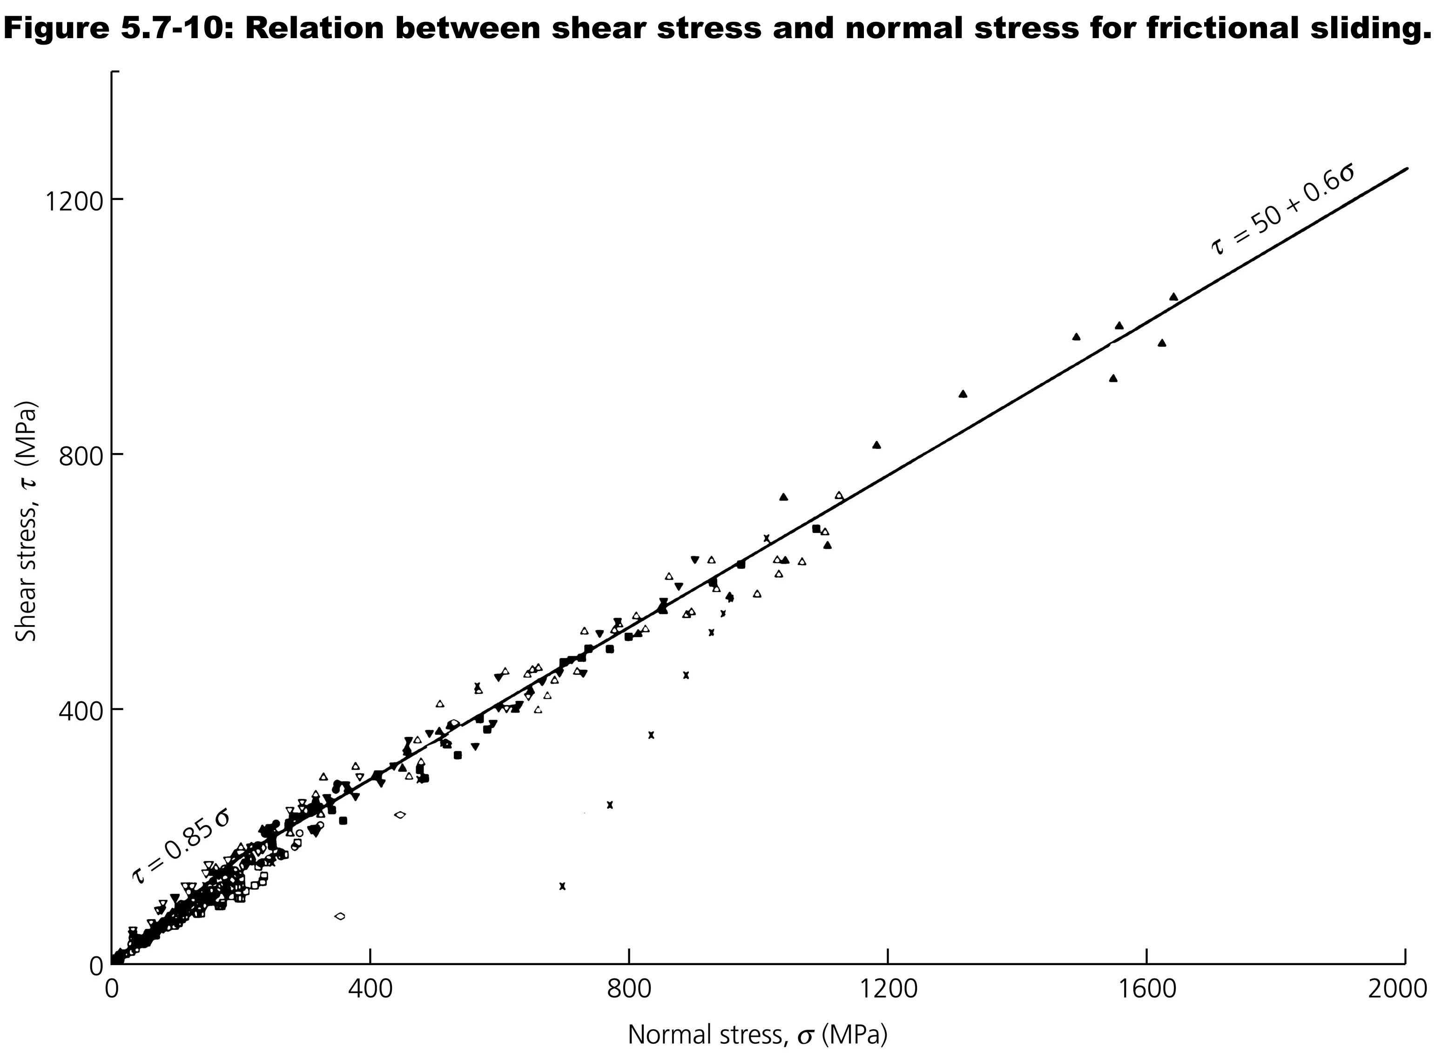
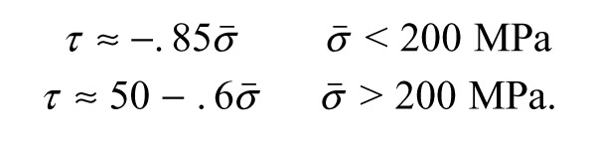
Experimental result for frictional sliding:
“Byerlee’s law”
This figure uses convention that compression is positive ☹
Lab experiments show a linear relation between the maximum shear stress that rocks can support at any given normal stress. This is called Byerlee’s Law.

Slide 14
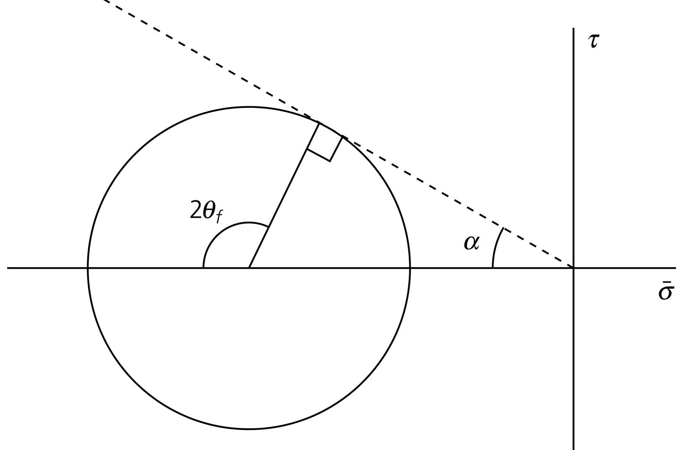
Sliding line has slope μ
compression -
This figure uses convention that compression is positive ☹
compression +
Byerlee’s law
Two regions

Slide 15
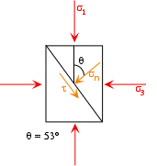
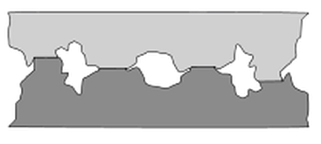
Coulomb stress
Notion of friction:
More shear stress τ needed to overcome increase in normal stress σ and cause fault to slip – Byerlee’s law is an example
Coulomb stress
σ_{S} = τ – μ ( σ_{Ν} - p )
where μ is intrinsic coefficient of friction, p is pore pressure
(not the mean stress p=-σ_{ii}/3, need to be careful of context)
Basis is that real area of contact (much smaller than apparent area) is controlled by normal stress
deformation of asperities in response to normal stress
harder to over-ride asperities at higher normal stress
σ₃
σ
σ
τ
σ₁

Slide 16
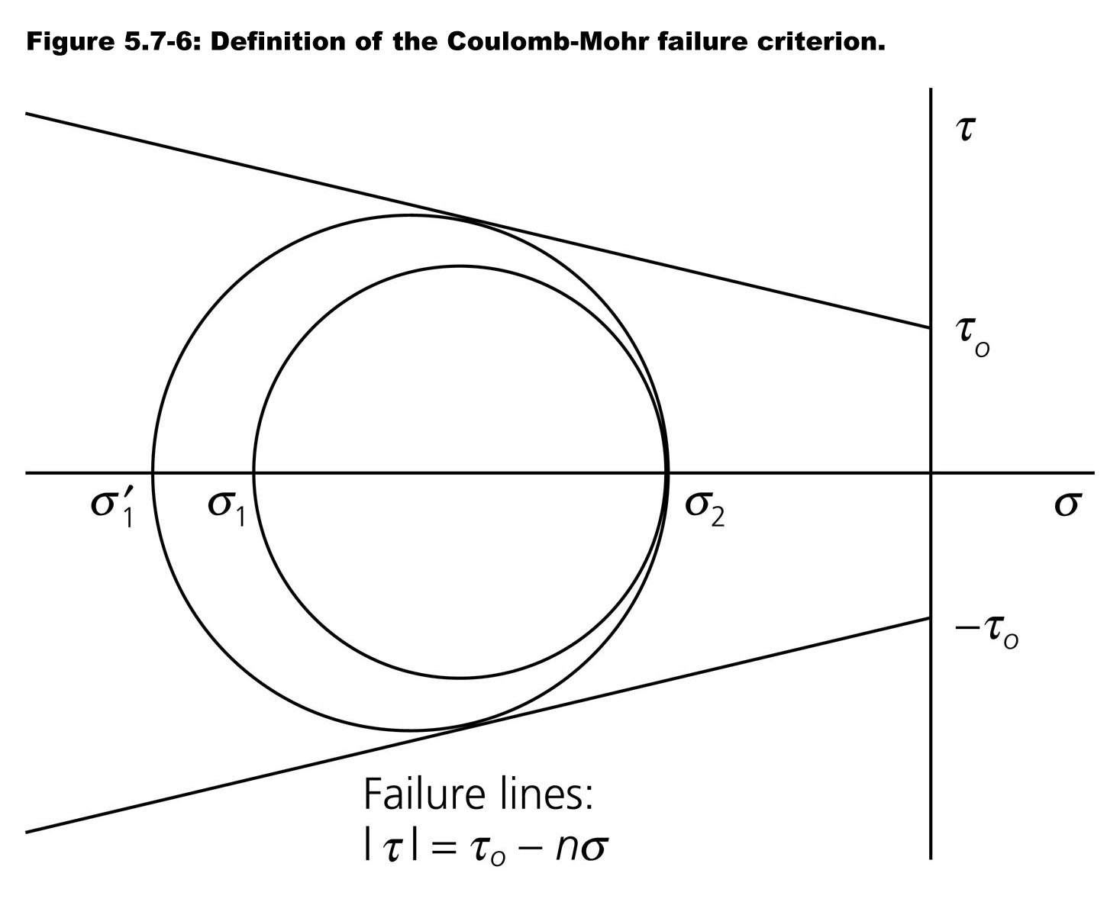
Fracture occurs when critical combination of shear and normal stress exceeded
= σ_{S}
σ₃’
σ₃
σ₁
=σ_{N}
Notes:
Stress may increase, circle may expand with time

Slide 17
Mohr-Coulomb Fracture
σ_{N}
t^{(n)}
σ_{S}
σ_{S}= τ₀- n σ_{N} n is coefficient of internal friction for fracture on a new fault surface
τ₀ is cohesion of the material in absence of any confining stress σ_{N}

Slide 18
Mohr-Coulomb Fracture
σ_{S}
σ_{S}= τ₀- n σ_{N}
τ₀
Now we are actually breaking rock …
σ_{III}
o
σ_{I}
σ_{N}
σ_{S}= τ₀- n σ_{N} n is coefficient of internal friction for fracture on a new fault surface
τ₀ is cohesion of the material in absence of any confining stress σ_{N}

Slide 19
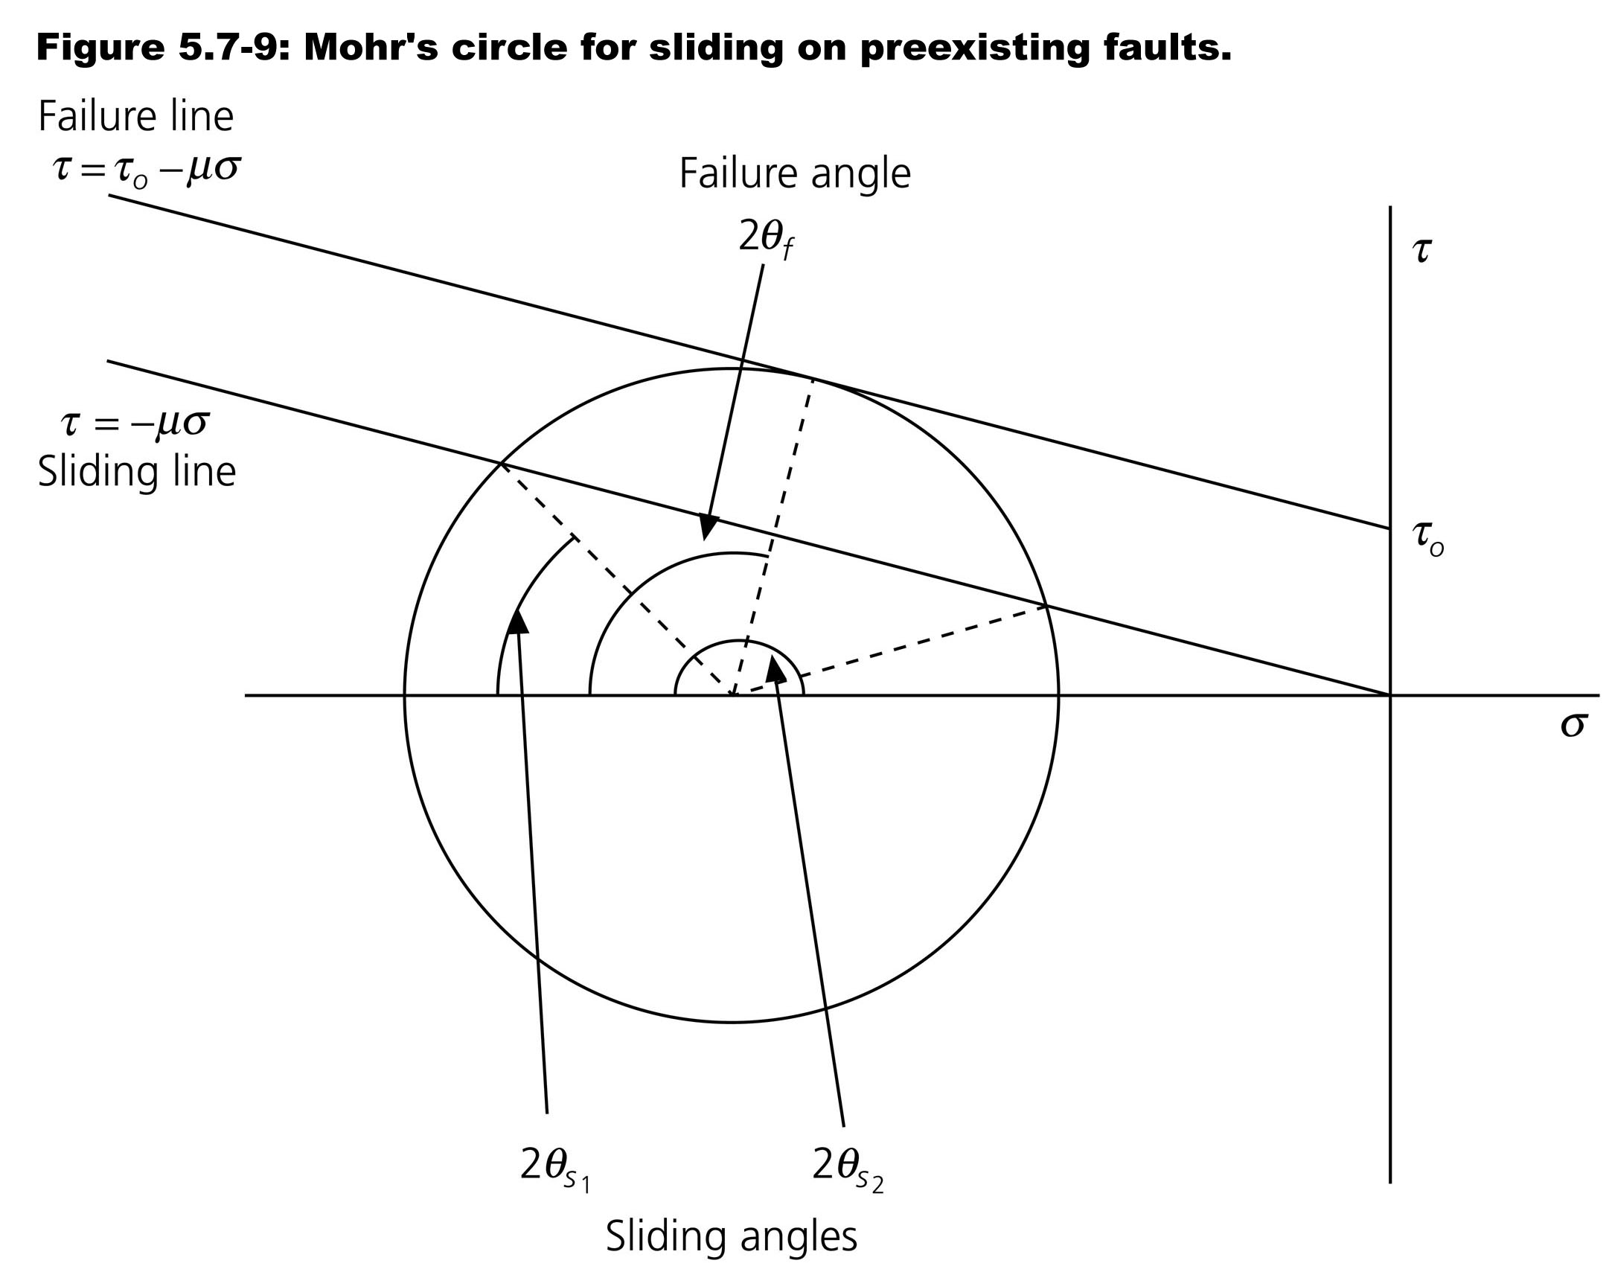
n
= σ_{N}
Controversial -
estimates range
from 0.8 to 0.03
σ_{III}
σ_{I}
Faults have negligible cohesion
If there are pre-existing faults whose normals have angles to σ₁ between θ_{S1} and θ_{S2}
those faults will slide before new fracture can occur.

Slide 20
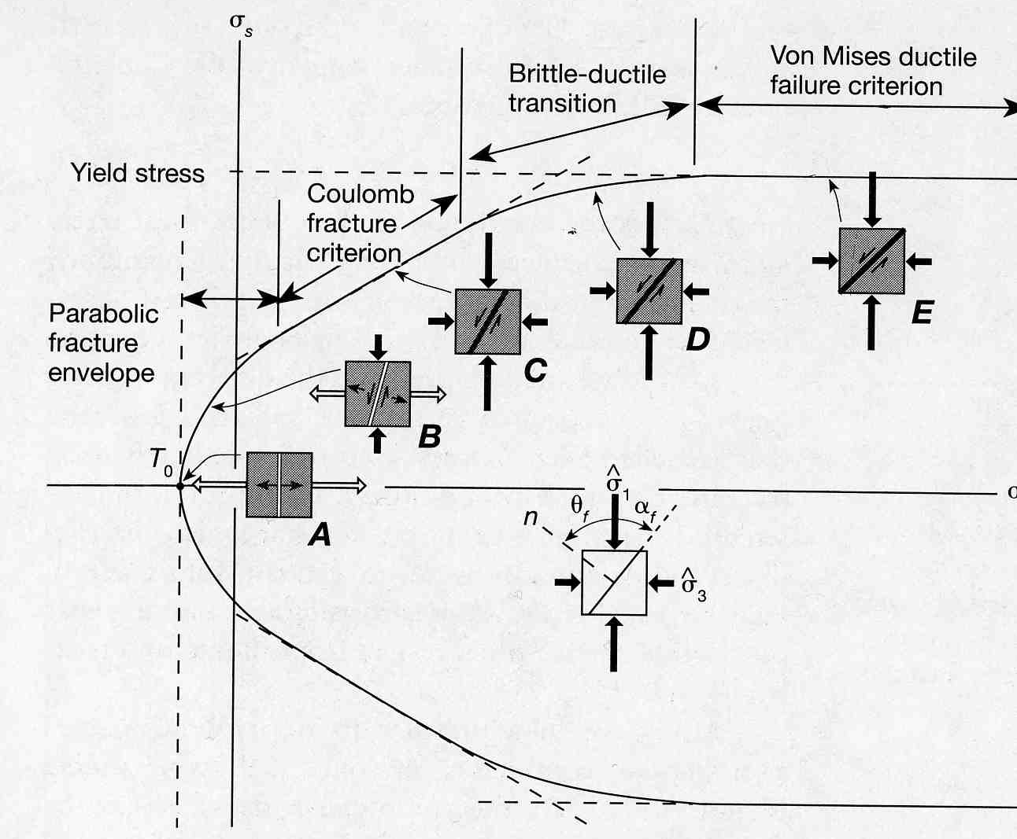
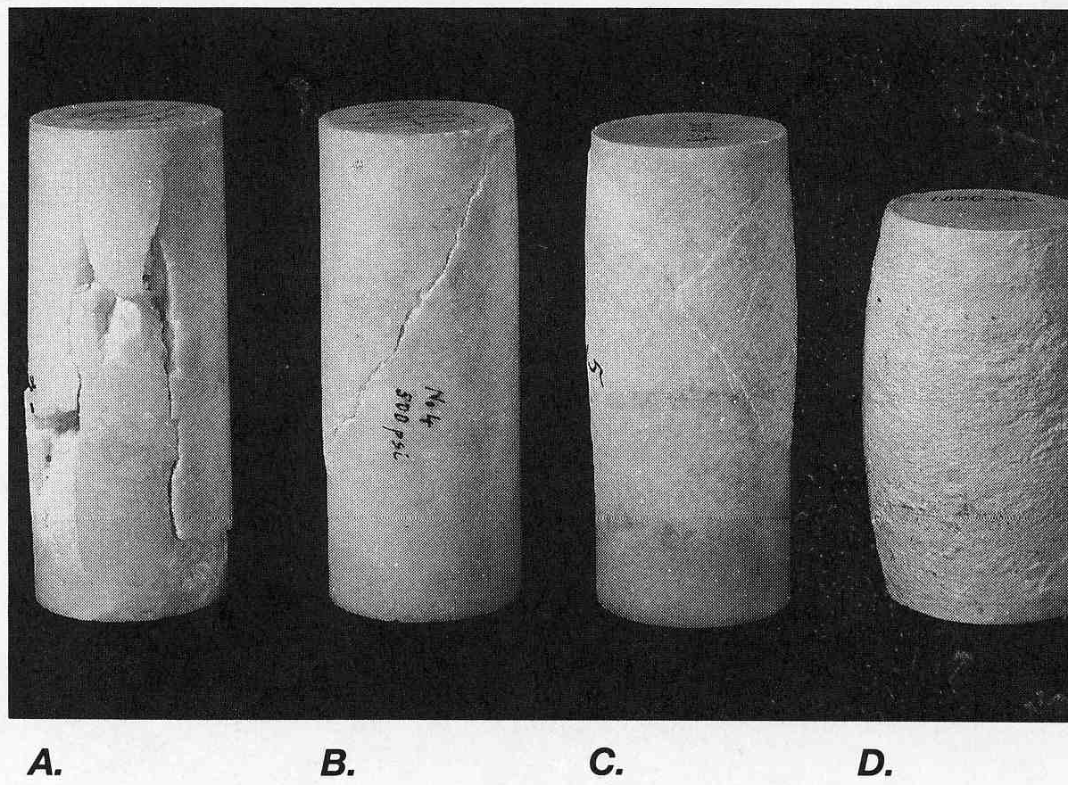
Compression
i.e., geologic convention
A B C D

