Slide 1
ESS 411/511 Geophysical Continuum Mechanics Class #19
Highlights from Class #18 – Chloe Mcburney
Today’s highlights on Monday – Alexandria Vasquez-Hernandez
Check out these websites about measuring stress in the Earth:
https://www.eoas.ubc.ca/courses/eosc433/lecture-material/L7-InSituStress.pdf
http://www.hydrofrac.com/hfo_home.html
Also see slides on class web site about Measuring Stress in the Earth
https://courses.washington.edu/ess511/NOTES/SLIDE_SHOWS/PDF/stress_class_show_2017_all.pdf
Your short CR/NC Pre-class prep writing assignment (1 point) in Canvas
It will be due in Canvas at the start of class.
I will send another message when it is posted in Canvas.

Slide 2
Mid-course class evaluations
Did you get a notice?
Your comments will be helpful for me
Thanks!
Midterm take-at-home
Any concerns?
ESS 511 term-project reports
Can you upload reports to Canvas now?

Slide 3
ESS 411/511 Geophysical Continuum Mechanics
Broad Outline for the Quarter
Continuum mechanics in 1-D
1-D models with springs, dashpots, sliding blocks
Attenuation
Mathematical tools – vectors, tensors, coordinate changes
Stress – principal values, Mohr’s circles for 3-D stress
Coulomb failure, pore pressure, crustal strength
Measuring stress in the Earth
Strain – Finite strain; infinitesimal strains
Moments – lithosphere bending; Earthquake moment magnitude
Conservation laws
Constitutive relations for elastic and viscous materials
Elastic waves; kinematic waves

Slide 4
Measuring Stress in the Earth
I - Stress boundary conditions
What happens to stress when 2 continua are stuck together?

Slide 5
How do stresses vary across material boundaries?
e₃
e₁
e₂
Material 1
t⁽¹⁾
Material 2
Let’s choose a coordinate system
with e₁ and e₂ in the interface
now calculate all the forces on the little box
Let the thickness of the box go to zero
t⁽²⁾

Slide 6
How do stresses vary across material boundaries?
Material 1
ρ⁽¹⁾,
n⁽¹⁾
t⁽¹⁾
e₃
A
e₁
L
e₂
Material 2
ρ⁽²⁾,
Let’s choose a coordinate system
with e₁ and e₂ in the interface, and e₃ normal to the interface
Now add up all the forces on the surface of the little box
n⁽²⁾ = -n⁽¹⁾
t⁽²⁾
For equilibrium, Σf_{j} = 0
Let the thickness L of the box go to zero, so the areas of the sides go to zero
The only remaining nonzero forces are:

Slide 7
How do stresses vary across material boundaries?
Material 1
ρ⁽¹⁾,
e₃
n⁽¹⁾
t⁽¹⁾
e₁
e₂
A
L
Material 2
ρ⁽²⁾,
n⁽²⁾
t⁽²⁾

Slide 8
How do stresses vary across material boundaries?
Material 1
ρ⁽¹⁾,
e₃
n⁽¹⁾
t⁽¹⁾
e₁
e₂
A
L
Material 2
ρ⁽²⁾,
n⁽²⁾
t⁽²⁾
So σ₁₃, σ₂₃, and σ₃₃ must be continuous across the interface.
σ₃₁ and σ₃₂ are also continuous, since σ_{ij} is symmetric
There are no restrictions on σ₁₁, σ₁₂, σ₂₁, or σ₂₂.
They act only within their own material.
This is the principle of stress guides

Slide 9
How do stresses vary across material boundaries?
So σ₁₃, σ₂₃, and σ₃₃ must be continuous across the interface.
σ₃₁ and σ₃₂ are also continuous, since σ_{ij} is symmetric
brick
There are no restrictions on σ₁₁, σ₁₂, σ₂₁, or σ₂₂.
They act only within their own material.
This is the principle of stress guides
e₂
e₃
e₁
Is σ₂₂ continuous across the jello/steel interface?
What about σ₃₃ ?
steel
jello

Slide 10
Why do we care about stresses in the Earth?

Slide 11
Measuring stress around an excavation
Mine shaft
Tunnel
Well
Others?
Let’s take a break for some flatjacks with syrup ...

Slide 12
Class-prep questions (Break-out rooms)
For Class #19 (Friday Nov 13). Due before class.
Check out these websites about measuring stress in the Earth:
https://www.eoas.ubc.ca/courses/eosc433/lecture-material/L7-InSituStress.pdf
http://www.hydrofrac.com/hfo_home.html
https://courses.washington.edu/ess511/NOTES/SLIDE_SHOWS/PDF/stress_class_show_2017_all.pdf
Assignment:
What is a flatjack?
How can a flatjack be used to measure stress?

Slide 13
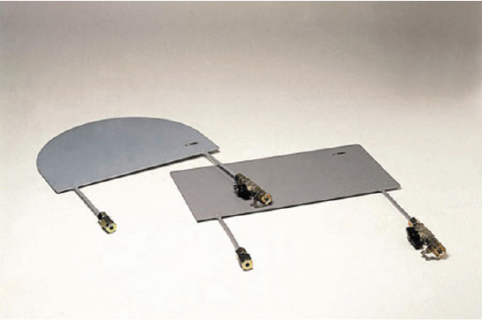
Flatjack Tests
What do you think the test might measure?
http://www.walterpmoore.com/

Slide 14
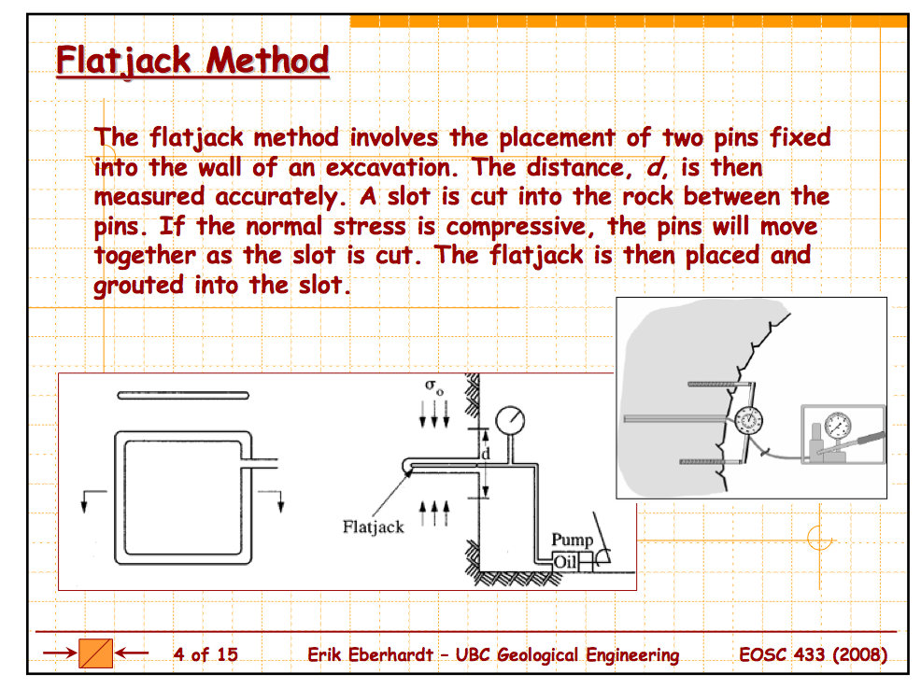

Slide 15
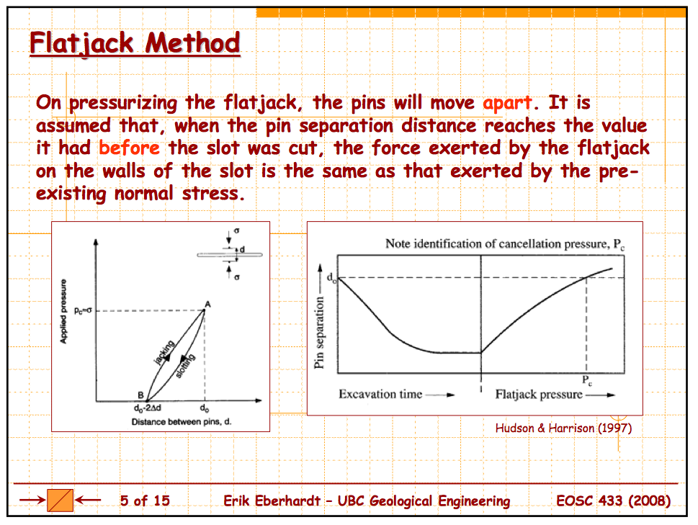

Slide 16
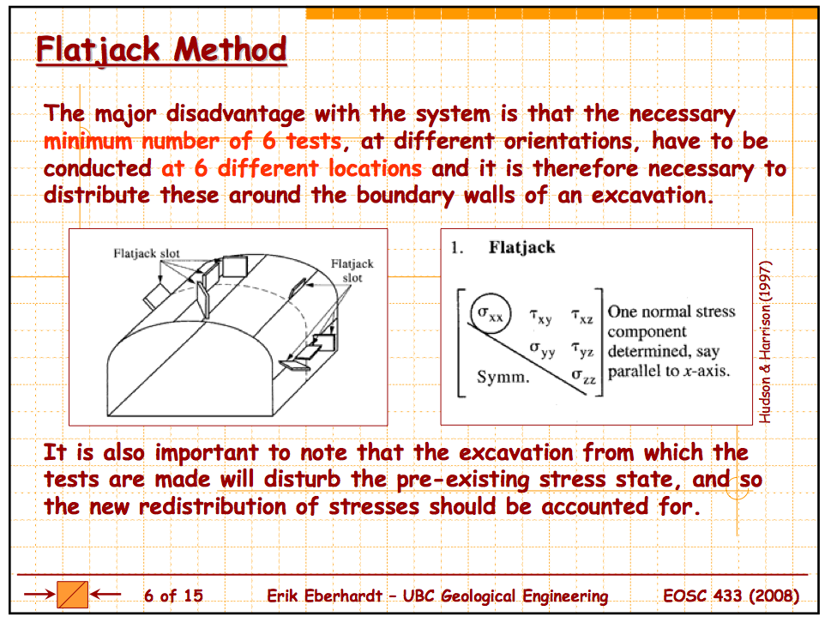

Slide 17
Over-coring

Slide 18
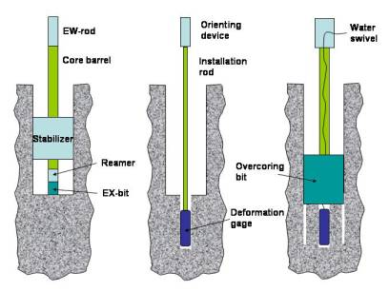
Overcoring – the operation
http://www.hydrofrac.com/hfo_home.html

Slide 19
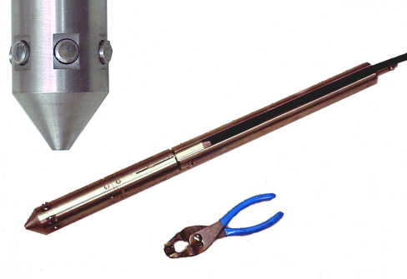
Overcoring – the tool
http://www.hydrofrac.com/hfo_home.html

Slide 20
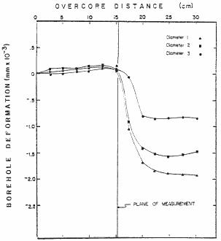
Overcoring – the data
Three channels of diametral deformations logged continuously as the deformation gage is overcored. As the overcoring bit passes through the plane of measurements, the stresses are relieved and the results are shown as diametral deformations.
http://www.hydrofrac.com/hfo_home.html
Notes:
http://www.hydrofrac.com/hfo_home.html
Three channels of diametral deformations logged continuously as the deformation gage is overcored. As the overcoring bit passes through the plane of measurements the stresses are relieved and the results are shown as diametral deformations (After Fisher, 1982).

Slide 21
Why 3 sensors at 120º?
Why not 2 sensors at 90º?
The hole will deform into an ellipse.
Many ellipses can fit 2 diameters.
How many parameters are needed to describe an ellipse?
θ
Major axis a
minor axis b
orientation angle θ
a
b
With 3 diameters, there is a unique ellipse solution

Slide 22
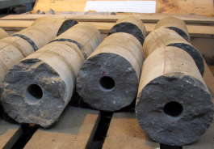
Overcoring - calibration
Now we know the deformation of the hole, but not the stress in the surrounding rock.
What’s next?
Rheological properties
Pressure tests and tri-axial tests on the recovered cores to relate measured strain to relieved stress.
http://www.hydrofrac.com/hfo_home.html

Slide 23
Modes of fracture

Slide 24
Modes of Cracking
Coulomb model represents failure in shear.
The 2 sides of a crack slide past each other without opening large gaps.
Mode II or Mode III in
fracture mechanics
But materials can also fail in another mode.
The 2 sides of a crack do not slide past each other
Large gaps can open.
Mode I

Slide 25
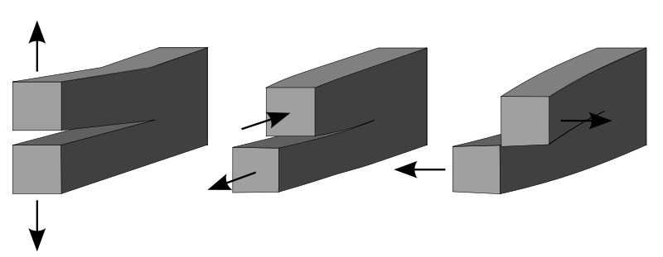
Modes of Cracking
Mode I:
Opening
Mode II:
In-plane shear
Mode III:
Out-of-plane shear
Crack
propagation
Crack
propagation
Crack
propagation

Slide 26
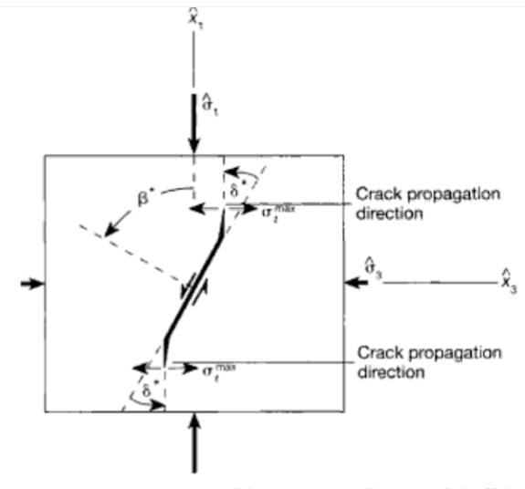
How shear cracks grow – not in own plane
wing cracks
Shear cracks (Modes II or III) need “process zone” to grow.
Wing cracks are part of that process zone.
Notes:
Fig 9.20 of Twiss and Moores. Orientation of the most critically stressed Griffith crack under applied confined compression.
The crack is closed, and the orientation of the most critically stress crack falls in the range 45 <= beta < 90.
A local tensile stress concentration develops near, but not at, the crack tips and is a maximum at angle delta > 0.The local tensile stress maximum sigma_sub_l max is oriented
such that the crack grows progressively toward parallelism with sigma 1.
Crack growth must be acccomodated by frictional sliding on the closed part of the crack surface.

Slide 27
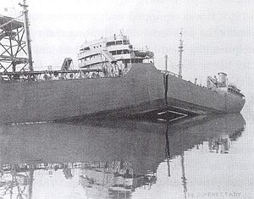
S.S. Schenectady
Portland OR, 16 January, 1943

Slide 28
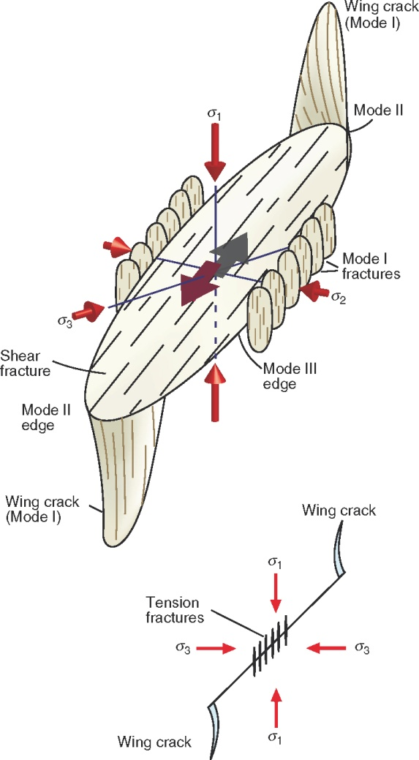
Fracture growth and wing cracks
new
A shear crack cannot propagate in its own plane
A shear crack has Mode II and Mode III edges
On the Mode II edges, Mode I wing cracks form
On the Mode III edges, arrays of Mode I cracks form

Slide 29
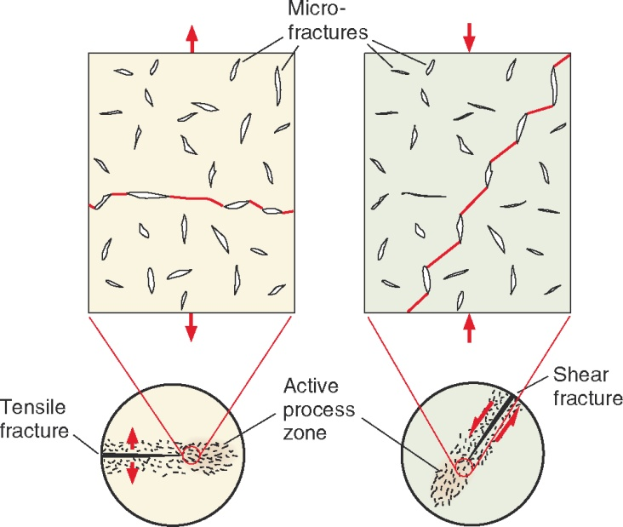
Growth and propagation of extension and shear fracture
Linkage of tensile microcracks (flaws)
Notes:
Circled figures are cm scale views, rectangles illustrate microscale structures

Slide 30
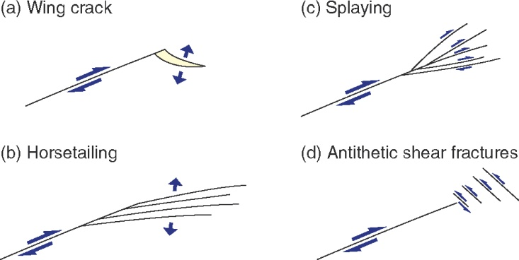
Minor fractures at the termination of shear fractures
Also see numerous fracture patterns in Kim, Peacock, Sanderson,
J. Structural Geology (2004).

Slide 31
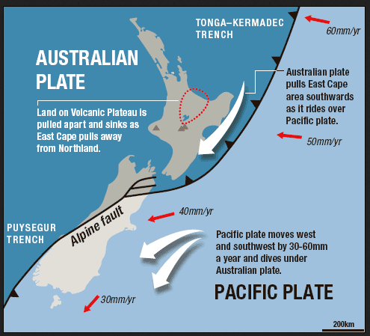
https://theextinctionprotocol.wordpress.com/2015/03/25/new-zealand-community-told-to-prepare-for-major-quake-along-dangerous-alpine-fault/

Slide 32
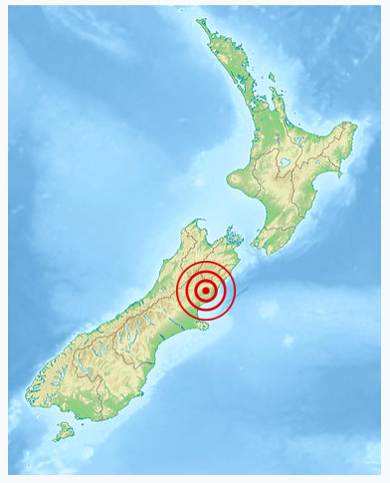
Kaikoura 14 November 2016 7.8 M_{W}

Slide 33
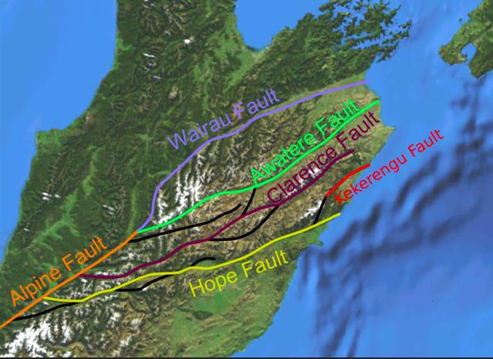
Splaying faults NZ South Island
By Mikenorton - Own work, CC BY-SA 3.0,
https://commons.wikimedia.org/w/index.php?curid=10742220

Slide 34
Let’s talk about fluid pressure …
Recall discussion of fracking (hydrofracturing) in Problem session yesterday
Shut-in pressure ⇒ horizontal stress state?
Breakdown pressure ⇒ horizontal stress state?
x₂
σ_{V}
x₃
x₁
Pump on
off
on
off
p_{f}
σ_{h}
σ_{H}
p_{f}
break-down
σ_{h}
σ_{H}
shut-in
borehole
σ_{V}
time

