Slide 1
ESS 411/511 Geophysical Continuum Mechanics Class #21
Highlights from Class #20 – Brandon Lomahoynaya
Today’s highlights on Friday – Xinyu Wan
For Friday, please read MSM Chapter 4.1 through 4.6
Kinematics of Deformation and Motion
The Problem Set this week is about kinematics and strain.
We will get back to stress and moments (torques) later. When we do, keep in mind these websites about measuring stress in the Earth:
https://www.eoas.ubc.ca/courses/eosc433/lecture-material/L7-InSituStress.pdf
http://www.hydrofrac.com/hfo_home.html
Also see slides on class web site about Measuring Stress in the Earth
https://courses.washington.edu/ess511/NOTES/SLIDE_SHOWS/PDF/stress_class_show_2017_all.pdf

Slide 2
Mid-term course evaluation
Due to major changes resulting from Covid-19, the UW has set up an option for mid-term course evaluations in addition to the traditional end-of-Quarter evaluations.
I hope will all be able to give me feedback. Thanks!
This evaluation will close on Nov 20, (Friday) at 11:59pm.
ESS 411 A & ESS 511 A - Geophysical Continuum Mechanics
https://uw.iasystem.org/survey/230856
(This evaluation link is only for the courses listed above.
It can only be accessed by students enrolled in the courses.)

Slide 3
Problem Set #4
I’m working on it ☺
Mid-term
I’m working on it next …

Slide 4
ESS 411/511 Geophysical Continuum Mechanics
Broad Outline for the Quarter
Continuum mechanics in 1-D
1-D models with springs, dashpots, sliding blocks
Attenuation
Mathematical tools – vectors, tensors, coordinate changes
Stress – principal values, Mohr’s circles for 3-D stress
Coulomb failure, pore pressure, crustal strength
Measuring stress in the Earth
Strain – Finite strain; infinitesimal strains
Moments – lithosphere bending; Earthquake moment magnitude
Conservation laws
Constitutive relations for elastic and viscous materials
Elastic waves; kinematic waves

Slide 5
Kinematics
Description without reference to forces
Concept of particle in a continuum
Just an infinitesimal point in the material, labeled with a vector field X
Displacement
Vector mapping of an object from initial X to final configuration x
Deformation
Change of shape described by a displacement field
Rigid-body rotation and translation
No deformation, but displacement can differ from point to point
Strain or distortion
Elongation or shear
Homogeneous deformation
Initially straight material lines stay straight
Finite strain
Material lines can become curved

Slide 6
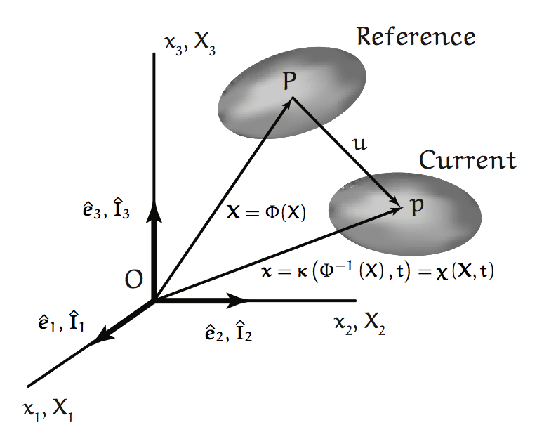
Initial and Final Configurations

Slide 7










Material and Spatial Coordinates
Position
Velocity and Acceleration

Slide 8


Material and Spatial Coordinates
Reversible mapping or strain

Slide 9
Class-prep for Wednesday Two ESS411/511 students observe I-5 traffic
ρ(x,t₀)
NE 45th
x
2 km
x
I-5
Units of traffic density: [ρ(x,t₀)] = [cars/km]
v
ρ(x)
The only cars on I-5 are in the 2-km-long ρ(x,t) packet.
All the cars are moving at the same speed v, so the density packet maintains its shape as it moves along I-5.
ρ(x,t) = = ρ₀ f(x-vt)
Describe in words the history of traffic density as seen by the observer on the overpass.
Describe the history of traffic density as seen by the observer in the car.
Sketch out ρ(x,t) on a graph with x horizontal, and t on the vertical axis.
e.g., you can show the density profile ρ(x,t_{j}) at several different times t_{j}.
Then add the paths of the 2 observers through x and t.

Slide 10
Slope
Lagrangian observer moving at v sees constant ρ(X)
time t
Eulerian observer at fixed x₀ sees ρ(x₀,t)
x₀
location x

Slide 11
Translation, Rotation, and Strain ESS 411/511

Slide 12
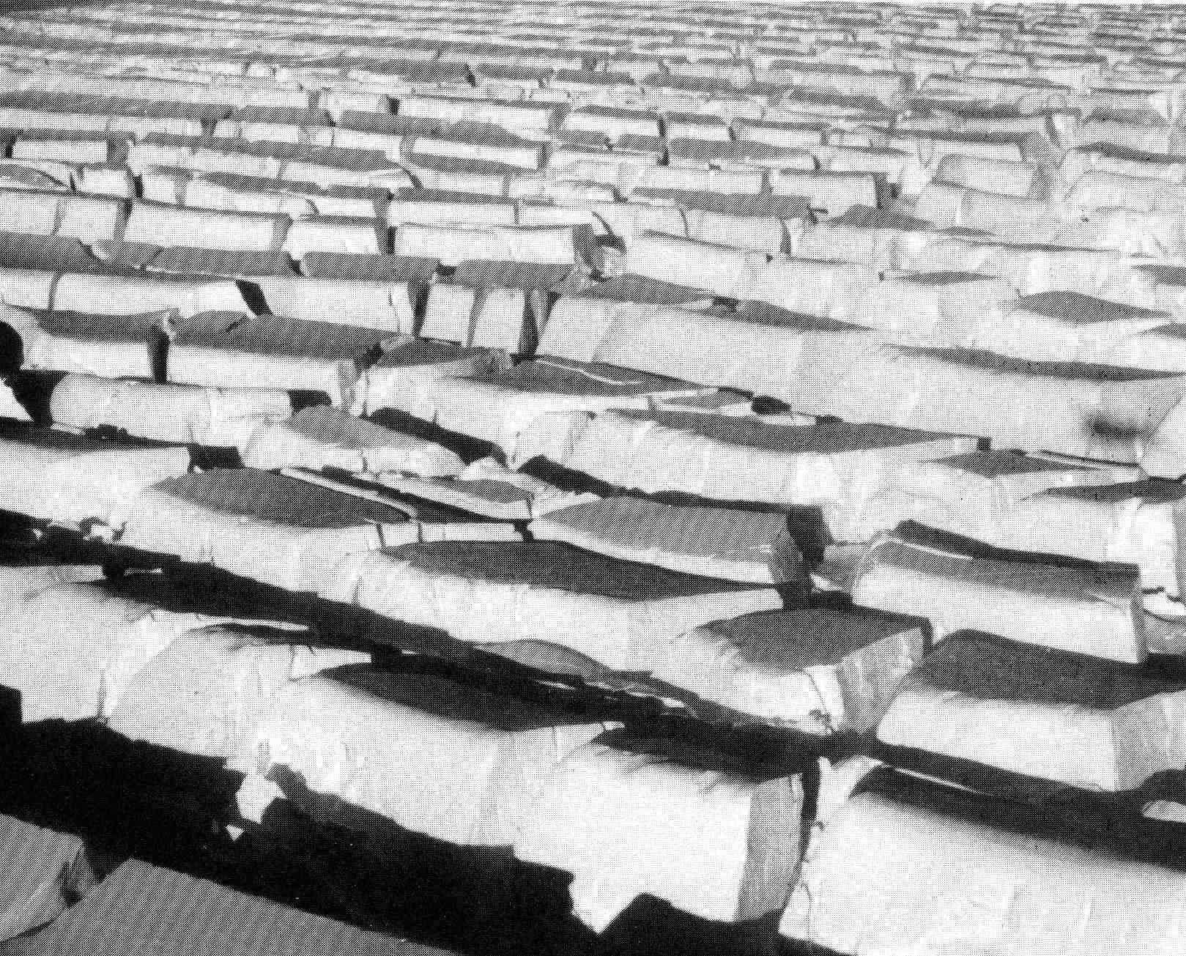
Glacier sped up through Transantarctic Mountains, then spread sideways as it entered Ross Ice Shelf
Qualitatively describe the history of strain and the mode of failure
Flow
Notes:
R.P .Sharp, Living Ice, 1988. Fig 2.14, p.41. Un-named Glacier (in 1988) between Nimrod and Byrd Glaciers, Transantarctic Mtns.
Ice flows from upper right to lower left.
Crevasse set A oriented from lower right to upper left formed upstream in region of extending flow.
Crevasse set B oriented from upper right to lower left formed later, when glacier spread laterally when emerging from relatively narrow valley.
Short length of B crevasses indicatespre-existing A crevasses limited rupture length.
More-rounded and weathered lips of A serac blocks also indicate older age.

Slide 13
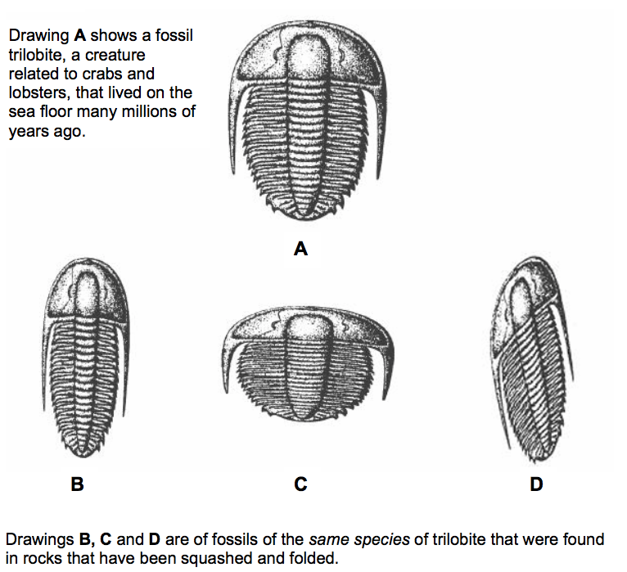
Trilobites as strain gauges
Notes:
https://www.geolsoc.org.uk/ks3/webdav/site/GSL/shared/pdfs/education%20and%20careers/RockCycle/Deformed%20Fossils%20Experiment.pdf

Slide 15
What happened?

Slide 16
Translation

Slide 17
What happened?

Slide 18
Homogeneous strain in x
(stretching)

Slide 19
What happened?

Slide 20
Translation in both x and y

Slide 21
Inhomogeneous shear strain

Slide 22
What happened?

Slide 23
Homogeneous strain in x
(stretching)

Slide 24
What happened?

Slide 25
Rigid body rotation about (0,0)

Slide 26
Initial and final configurations

Slide 27
Particle trajectories

Slide 28
Particle trajectories

Slide 29
Particle trajectories

Slide 30
Particle trajectories

Slide 31
Particle trajectories

Slide 32
Particle trajectories

Slide 33
Translation, rotation, and strain

