Slide 1
ESS 411/511 Geophysical Continuum Mechanics Class #22
Highlights from Class #21 – Xinyu Wan
Today’s highlights on Monday – Barrett Johnson
Kinematics of Deformation and Motion
For Monday, please read MSM Chapter 4.7 and 4.8
Infinitesimal strain
Strain compatibility
Also check out 4.11 and 4.12
Velocity gradient and strain rate
Material derivatives of lines are, and volumes

Slide 2
Mid-term course evaluation
Due to major changes in teaching and learning resulting from Covid-19, the UW has set up an option for mid-term course evaluations in addition to the traditional end-of-Quarter evaluations.
I hope will all be able to give me feedback. Thanks!
Over half of you have responded so far, which is great. I hope that others among you to will also be able to give me feedback and suggestions.
The evaluation window will close tonight (Friday) at 11:59pm.
Here’s the link (only you who are enrolled in the class can use it).
https://uw.iasystem.org/survey/230856

Slide 3
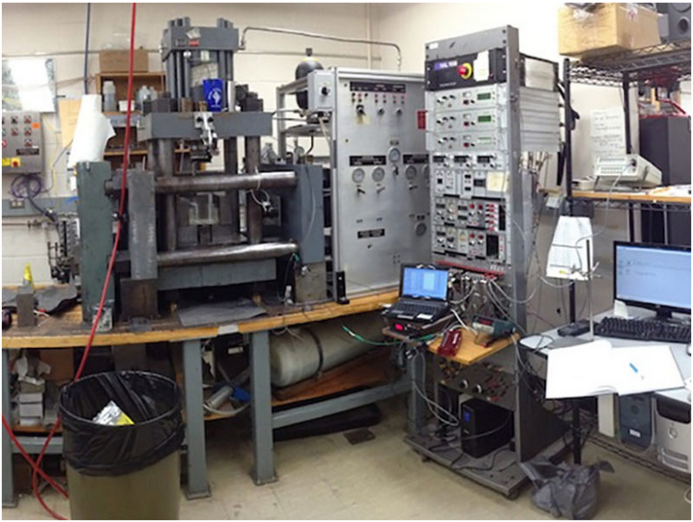
Indoor Icequakes
I just received this week’s edition of Eos Buzz from AGU, in which staff reporters publish highlights about papers coming out in AGU journals, such as
Journal of Geophysical Research (JGR)
Geophysical Research Letters (GRL)
https://eos.org/research-spotlights
Researchers at Penn State have reproduced stick/slip failure between ice and bedrock with
σ_{N} = 500 MPa, like under a 500m thick glacier.
The peer-reviewed paper is in GRL, and is titled
Application of Constitutive Friction Laws to Glacier Seismicity
Here’s the link:
https://doi.org/10.1029/2020GL088964

Slide 4
Problem Set #4
I’m still working on it ☺
Mid-term
I’m working on it next …

Slide 5
ESS 411/511 Geophysical Continuum Mechanics
Broad Outline for the Quarter
Continuum mechanics in 1-D
1-D models with springs, dashpots, sliding blocks
Attenuation
Mathematical tools – vectors, tensors, coordinate changes
Stress – principal values, Mohr’s circles for 3-D stress
Coulomb failure, pore pressure, crustal strength
Measuring stress in the Earth
Strain – Finite strain; infinitesimal strains
Moments – lithosphere bending; Earthquake moment magnitude
Conservation laws
Constitutive relations for elastic and viscous materials
Elastic waves; kinematic waves

Slide 6
Kinematics
Description without reference to forces
Concept of particle in a continuum
Just an infinitesimal point in the material, labeled with a vector field X
Displacement
Vector mapping of an object from initial X to final configuration x
Deformation
Change of shape described by a displacement field
Rigid-body rotation and translation
No deformation, but displacement can differ from point to point
Strain or distortion
Elongation or shear
Homogeneous deformation
Initially straight material lines stay straight
Finite strain
Material lines can become curved

Slide 7
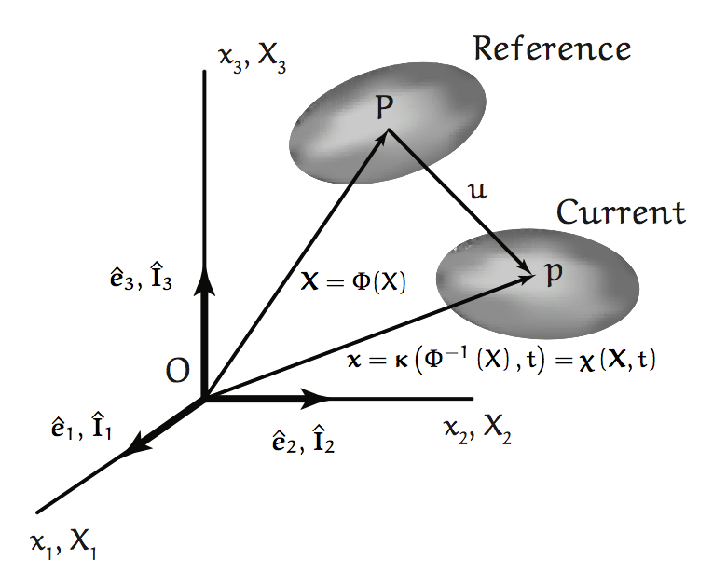
Initial and Final Configurations

Slide 8
Rates of change in a continuum
When the material is being tracked through time, it is convenient to use two sets of coordinates
Material
The material coordinates X_{A} are the initial positions of a material particle X in a coordinate system I_{A}
Although particle X may move over time, the place X_{A} where it started from doesn’t ever change.
The coordinates X_{A} act as a label identifying particle X, wherever it goes.
Spatial
The spatial coordinates x_{i}(X,t) mark the current position of a material particle X in a coordinate system
Conversely, X(x_{i} ,t) indicates which particle X is occupying location x_{i} at time t.

Slide 9
Temporal Derivatives
As we saw with the traffic on I-5, there are two types of temporal derivatives of some quantity φ in a continuum.
Rate of change of any property φ(x_{i} ,t) at a fixed point x_{i} in space,
can be written as
(1)
The partial derivative symbol indicates that position x_{i} is held constant.
Rate of change of φ(X_{A},t) for a particle X_{A} in the moving material,
can be written as or
(2)
where “D” or “d” indicate a “total” or “material-following” derivative.
The identity A of a particle isn’t changing through time
(Calvin and Hobbs transmogrification isn’t allowed),
So (2) is a function of a single variable t, and

Slide 10
Material Derivatives
In the material coordinate system I_{A}, rate of change of φ for particle X_{A} as it moves along its trajectory is relatively simple:
However, it gets uglier if we want to express the material-following derivative in the fixed coordinate system
The rate of change of φ for the particle currently at x_{i} as it moves along its trajectory depends on two things:
1. The rate of change of φ seen by an observer at position x_{i}
2. The rate of change at which the flow v carries gradients of φ past position x_{i} , even though φ may not be changing on the particles
,

Slide 11
Ways to change φ at a point x_{i}
No motion
e.g. material warming in place
Motion uniform and constant
e.g. a seamount carried by ocean plate
v=0
v=v₀
t=3
φ
φ
t=1
t=2
t=3
t=2
t=1
x_{i}
x_{i}
,

Slide 12
Putting it all together
However, it gets uglier if we want to express the material-following derivative in the fixed coordinate system
In the spatial coordinate system , rate of change of φ for a particle X_{A} as it passes through x_{i} :
Rate of change seen at x_{i}
Correction for changes carried in by flow, without φ actually changing on the particles
For example, for the seamount, the two terms must cancel each other, because we know that φ, the topography of the seamount, is not changing.
Other situations can be more complicated … ☺

Slide 13
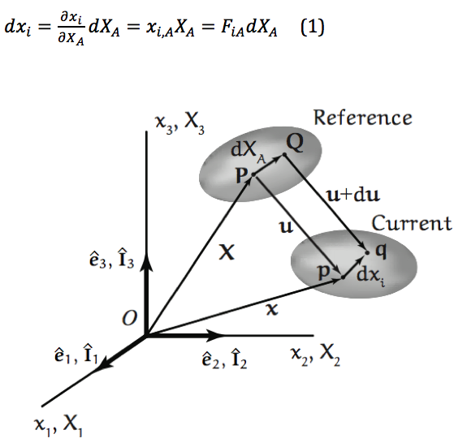
Displacement and Finite Strain
Any two nearby points P and Q in the initial configuration are moved to p and q in the final configuration.
The displacement of point P is u_{P} = p – P
The displacement of point Q is u_{Q} = q – Q Or in general, u = x – X
Because Q is close to P, u can be expanded as a Taylor series around the point P. Here are the first-order terms:
This can be arranged to find du
The small line element dX_{A} in the initial configuration also gets deformed into a different line element dx_{i}.

Slide 14
Displacement and Finite Strain
The small line element dX_{A} in the initial configuration also gets deformed into a different line element dx_{i}, which can also be expressed by the first-order terms of a Taylor series
The derivatives form the deformation gradient tensor F_{iA}
The deformation is reversible, so F_{iA} has an inverse

Slide 15
Class-prep: deformation tensor F_{iA} (Break-out rooms)
Figure 4.2 in text MSM shows that an initial small line element dX_{A} between points P and Q in a body becomes a small line element dx_{i} between points p and q after deformation.
The deformation gradient tensor F_{iA} characterizes the deformation in the vicinity of P and Q by relating dx_{i} to dX_{A}, e.g. as expressed in Equation 4.39
Assignment
Write the general form of the tensor F_{iA} in the equation above as a 3x3 matrix.
Find the 3x3 matrix F_{iA} for the particular deformation field defined by
x₁ = X₁
x₂ = 2 X₃
x₃ = -1/2 X₂
Find the vector dx_{i} resulting from deformation of the column vector
dX_{A} = [1,1,1]^{T}
and comment on the results in terms of rotation and stretching.

Slide 16
Reference line element dX_{A}
Mapping
Deformation gradient tensor
Finding current line element dx_{i}
Luckily for us, there is no change in the X₁ direction ☺
dX = (1,1,1)
Q
u+du
x₃
P
u
p
q
dx = (1,2,-1/2)
x₂

Slide 17
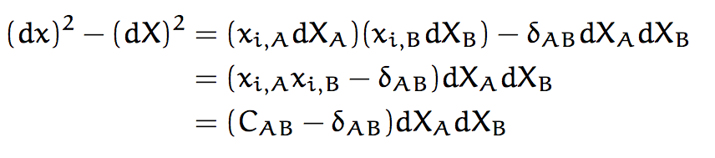

A measure for strain (dx)² – (dX)²
Green’s deformation tensor
Lagrangian finite strain tensor

Slide 18
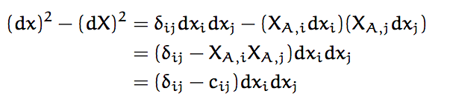
A measure for strain (dx)² – (dX)²
Cauchy deformation tensor
Eulerian finite strain tensor

Slide 19


In terms of displacements u_{i} = (x_{i} – X_{i})

