Slide 1
ESS 411/511 Geophysical Continuum Mechanics Class #23
Highlights from Class #22 – Barrett Johnson
Today’s highlights on Wednesday – Madeleine Lucas
Kinematics of Deformation and Motion
For Wednesday, please read MSM Chapter 4.11 and 4.12
Velocity gradient and strain rate
Material derivatives of lines areas, and volumes

Slide 2
Problem Set #4
I’m still working on it ☺
Mid-term
I’m working on it next …

Slide 3
ESS 411/511 Geophysical Continuum Mechanics
Broad Outline for the Quarter
Continuum mechanics in 1-D
1-D models with springs, dashpots, sliding blocks
Attenuation
Mathematical tools – vectors, tensors, coordinate changes
Stress – principal values, Mohr’s circles for 3-D stress
Coulomb failure, pore pressure, crustal strength
Measuring stress in the Earth
Strain – Finite strain; infinitesimal strains
Moments – lithosphere bending; Earthquake moment magnitude
Conservation laws
Constitutive relations for elastic and viscous materials
Elastic waves; kinematic waves

Slide 4
Kinematics
Description without reference to forces
Concept of particle in a continuum
Just an infinitesimal point in the material, labeled with a vector field X
Displacement
Vector mapping of an object from initial X to final configuration x
Deformation
Change of shape described by a displacement field
Rigid-body rotation and translation
No deformation, but displacement can differ from point to point
Strain or distortion
Elongation or shear
Homogeneous deformation
Initially straight material lines stay straight
Finite strain
Material lines can become curved

Slide 5
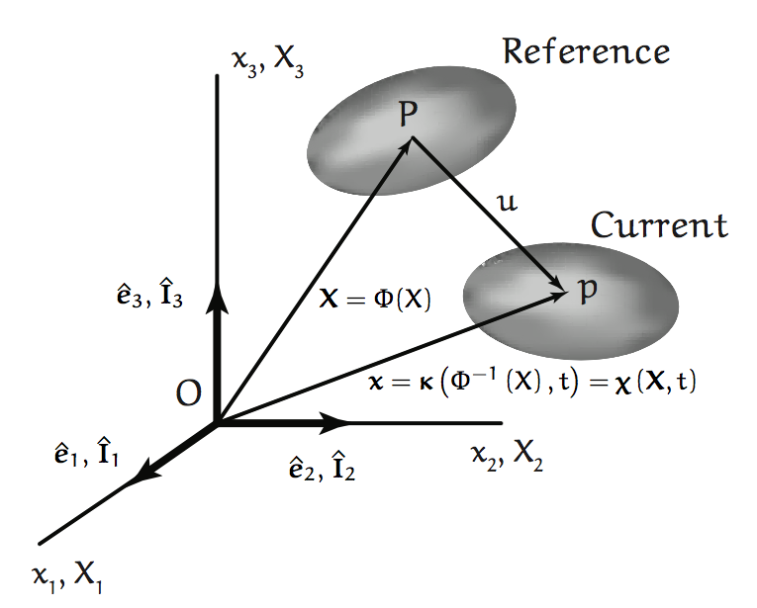
Initial and Final Configurations

Slide 6


Class-prep: Strain Compatibility (Break-out rooms)
For small strains, the strain is defined (Equation 4.62) as
where u_{i} =x_{i} – X_{A} d_{iA} is displacement, the difference between current and initial positions. (The Kroenecker delta just makes it clear how to relate the “A” subscripts in the initial coordinate system to the “i” subscripts in the current coordinate system.)
Section 4.8 describes strain compatibility, and the 81 strain-compatibility equations that relate the various second derivatives.
Assignment
81 equations– that’s a lot of equations!
Why are only 6 of them needed in practice?
Compatibility with what? What would strain incompatibility look like?
On page 129 – “It may be shown that the compatibility equations, either Eq 4.90 or Eq 4.91, are both necessary and sufficient for a single-valued displacement field of a body occupying a simply connected domain.”
How would you paraphrase this sentence into simple concepts?

Slide 7
Finite Strain in 1-D
−ΔL
We typically first see strain expressed as
and when there is shortening, ΔL< 0
L₀
L₀+ΔL
But this approach is not accurate for large strains e.g. when -ΔL is large fraction of L₀. For example,
−ΔL = L₀ /2
L₀
L₀
−ΔL = L₀ /4
L₀ /2
L₀ /4
In both steps the height was halved, so the incremental strain should be the same …

Slide 8
Finite Strain in 1-D
We can address large strains by adding up a whole series of small strains e.g. when -ΔL is large fraction of L₀.
We have to reset L₀ at each step and call it l
−ΔL
L₀
L₀+ΔL
?
(remembering that ΔL<0)
Now recall the Taylor series for ln(1+x) when -1< x < 1
With x= (ΔL / L_{O}),
The first term looks familiar …
The second term corrects for the changing l as strain proceeds

Slide 9
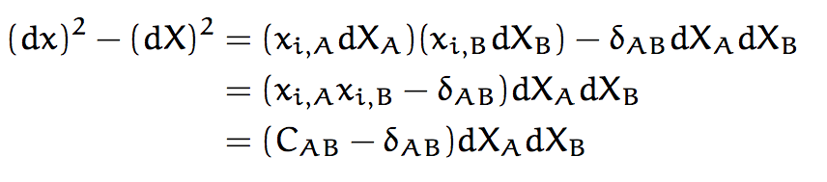

A measure for strain (dx)² – (dX)²
Green’s deformation tensor
Lagrangian finite strain tensor

Slide 10
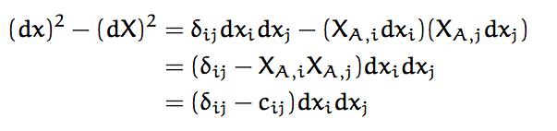
A measure for strain (dx)² – (dX)²
Cauchy deformation tensor
Eulerian finite strain tensor

Slide 11


In terms of displacements u_{i} = (x_{i} – X_{i})

Slide 12
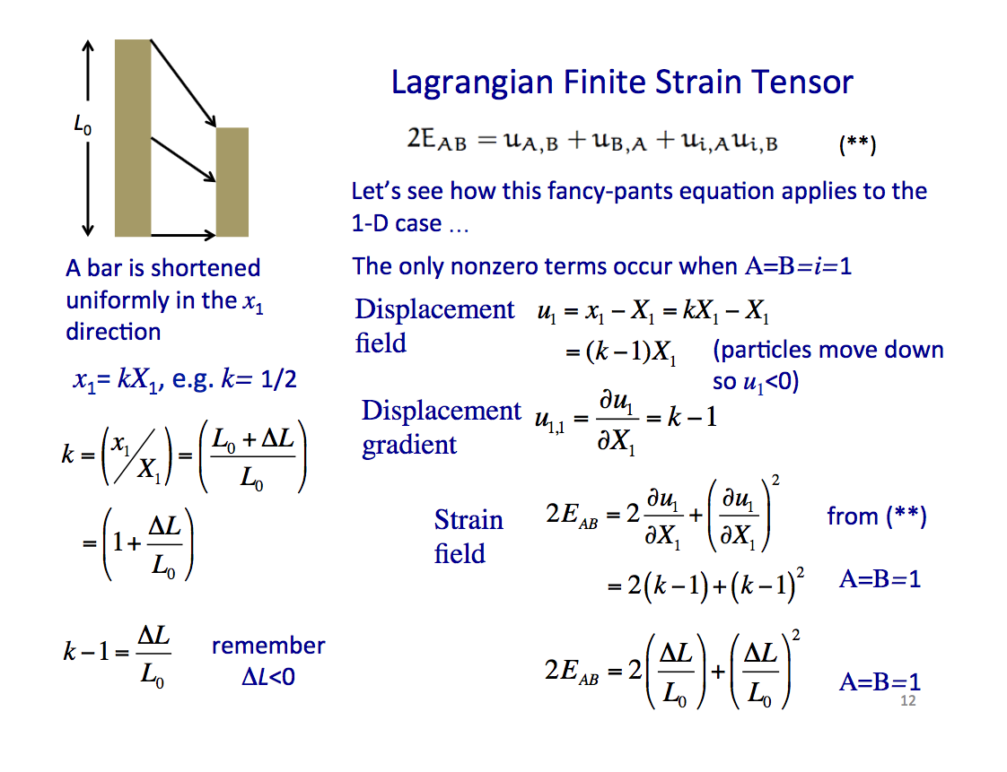

Slide 13

Eulerian Finite Strain Tensor
(**)
L₀
Let’s see how this fancy-pants equation applies in 1-D …
The only nonzero terms occur when i=j=A=1
Displacement field
A bar is shortened uniformly in the x₁ direction
(particles move down so u₁<0)
x₁= kX₁, (e.g. k=½)
Displacement gradient
Strain field
from (**)
A=B=1
A=B=1

Slide 14
Eulerian Finite Strain Tensor
L₀
(**)
Displacement field
(i=j=A=1)
(particles move down so u₁<0)
A bar is shortened uniformly in the x₁ direction
Strain field
x₁= kX₁, e.g. k= 1/2
from (**)

Slide 15
Eulerian Finite Strain Tensor
x₁= kX₁
(**)
L₀
Since
Let’s simplify the notation a bit by setting :
r = ΔL/L₀
Now

Slide 16
Eulerian Finite Strain Tensor
x₁= kX₁
(**)
L₀
Since
Let’s simplify the notation a bit by setting :
r = ΔL/L₀
Now

Slide 17
Lagrangian Finite Strain Tensor
L₀
Let’s see how this fancy-pants equation applies to the 1-D case …
A bar is shortened in the x₁ direction
x₁= kX₁, e.g. k= ½
Strain is homogeneous since k is a constant
A=B=1
Strain tensor

Slide 19
Lagrangian Finite Strain Tensor
L₀
(**)
Let’s see how this fancy-pants equation applies to the 1-D case …
A bar is shortened uniformly in the x₁ direction
The only nonzero terms occur when A=B=i=1
Displacement field
(particles move down so u₁<0)
x₁= kX₁, e.g. k= 1/2
Displacement gradient
Strain field
from (**)
A=B=1
remember ΔL<0
A=B=1

