Slide 1
ESS 411/511 Geophysical Continuum Mechanics Class #24
Highlights from Class #23 – Madeleine Lucas
Today’s highlights on Monday – Maleen Kidiwela

Slide 2
For Monday November 30
Rock Failures
Please review the slides at:
http://courses.washington.edu/ess511/CLASS_MATERIALS/LECTURES/CLASS_25/Class_25_prep_slides.pdf
and watch these two short videos
Rockbursts in Olmos tunnel, Peru
http://www.youtube.com/watch?feature=player_detailpage&v=RtzNhss2h4w
Exfoliating granite dome, Sierra Nevada CA
https://www.youtube.com/watch?v=yAZ1V_DJKV8

Slide 3
ESS 411/511 Geophysical Continuum Mechanics
Broad Outline for the Quarter
Continuum mechanics in 1-D
1-D models with springs, dashpots, sliding blocks
Attenuation
Mathematical tools – vectors, tensors, coordinate changes
Stress – principal values, Mohr’s circles for 3-D stress
Coulomb failure, pore pressure, crustal strength
Measuring stress in the Earth
Strain – Finite strain; infinitesimal strains
Moments – lithosphere bending; Earthquake moment magnitude
Conservation laws
Constitutive relations for elastic and viscous materials
Elastic waves; kinematic waves

Slide 4
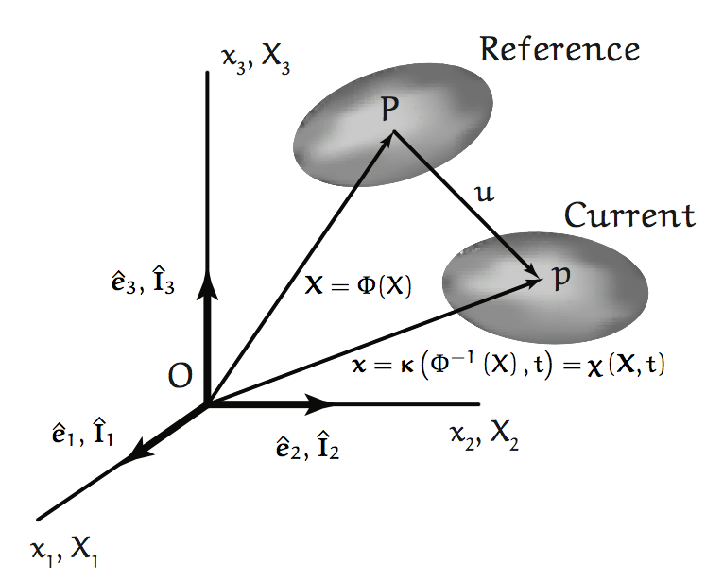
Initial and Final Configurations

Slide 5
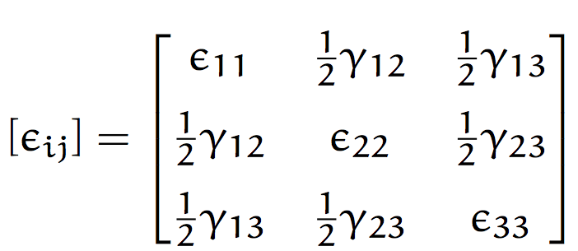
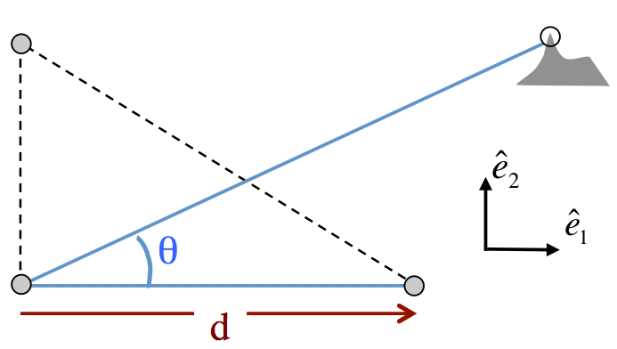
Class-prep: Moving Magma (Break-out rooms)
For small displacements and strains, the strain tensor can be written as (Eq. 4.72)
Magma is on the move at Mt Baker ski area
You are a surveyor with a “total station” (theodolite and EDM) to measure angles and distances.
Stress τ_{ij} is related to strain ε_{ij} by τ_{ij} = k ε_{ij} (k is an elastic-strength parameter)
you have 3 benchmarks (survey stations) arranged as a right-angled triangle.
Assignment
Understanding the strain tensor
Physical meaning of the diagonal entries?
Physical meaning of the off-diagonal entries?
(2) The strain tensor and the stress tensor
You have 1 month to determine the strain rate and stress in the ground from multiple surveys using your 3 survey benchmarks and the mountain peak.
What measurements will you plan to make over the one-month period, to derive the strain tensor from your data?
How will you calculate the stress tensor?
How will you determine the orientation of a potential fissure?

Slide 6
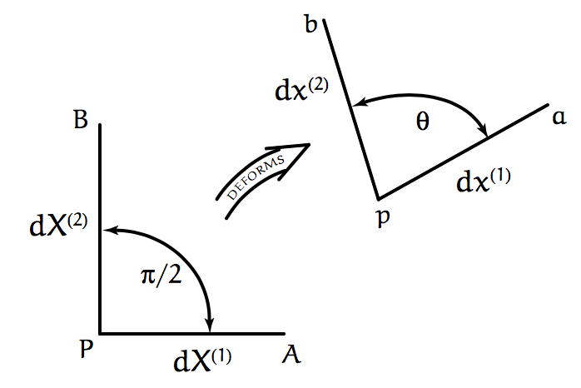

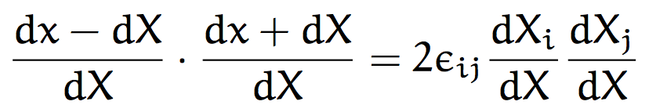







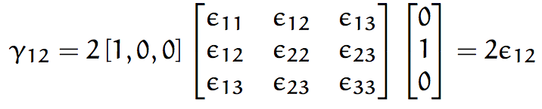
Small strain entries
γ
a unit vector in the direction of dX
change in length per unit original length for the element in the direction of N, called longitudinal strain.
If , then
If we set

Slide 7
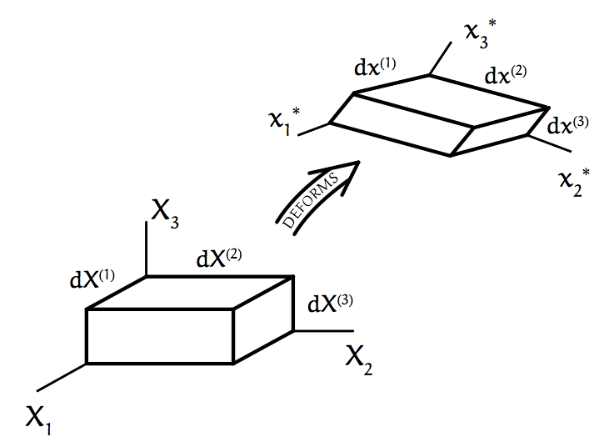
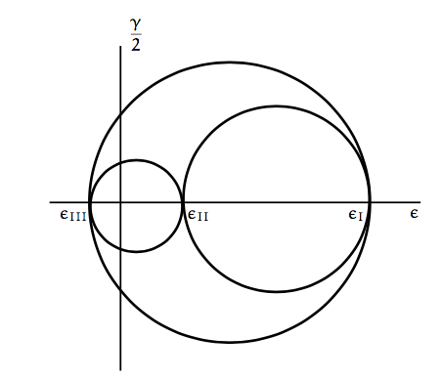

Slide 8
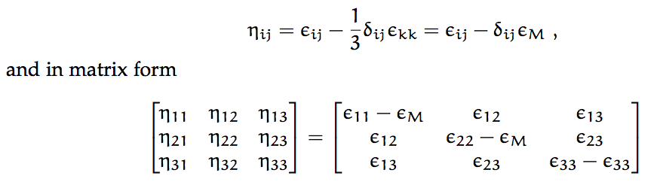
Deviator strain
Just like deviatoric stress …

Slide 9
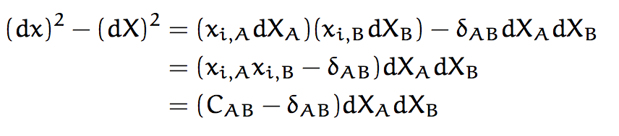

A measure for strain (dx)² – (dX)²
Green’s deformation tensor
Lagrangian finite strain tensor

Slide 10
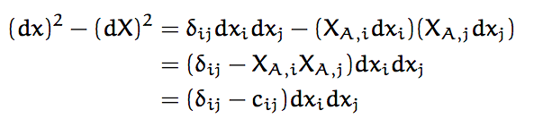
A measure for strain (dx)² – (dX)²
Cauchy deformation tensor
Eulerian finite strain tensor

Slide 11



Strain tensors in terms of displacements u_{i} = (x_{i} – X_{i})
Lagrangian view
so
(Let’s check it out in breakout rooms)
Eulerianian view
so
(Let’s check it out in breakout rooms)

