Slide 1
ESS 411/511 Geophysical Continuum Mechanics Class #26
Highlights from Class #25 – Andrew Gregovich
Today’s highlights on Friday – Madie Mamer
Problem Set #7
is posted. We will do just the first 2 questions.
Midterm
Has been marked, and I will return annotated versions to you later today.
We can discuss results on Thursday.
For Friday
Read (https://courses.washington.edu/ess511/NOTES/)
Ed’s note on volume elements
Ed’s note on conservation laws
Ed’s note on constitutive relations
ESS 511 60-second project updates on Friday

Slide 2
ESS 411/511 Geophysical Continuum Mechanics Class #26
For Problems Lab tomorrow
Read (https://courses.washington.edu/ess511/NOTES/)
Raymond notes on stress and moments
Turcotte and Schubert Section 3.9
For Friday class
Read (https://courses.washington.edu/ess511/NOTES/)
Ed’s note on volume elements
Ed’s note on conservation laws
Ed’s note on constitutive relations

Slide 3
ESS 411/511 Geophysical Continuum Mechanics
Broad Outline for the Quarter
Continuum mechanics in 1-D
1-D models with springs, dashpots, sliding blocks
Attenuation
Mathematical tools – vectors, tensors, coordinate changes
Stress – principal values, Mohr’s circles for 3-D stress
Coulomb failure, pore pressure, crustal strength
Measuring stress in the Earth
Strain – Finite strain; infinitesimal strains
Moments – lithosphere bending; Earthquake moment magnitude
Conservation laws
Constitutive relations for elastic and viscous materials
Elastic waves; kinematic waves

Slide 4
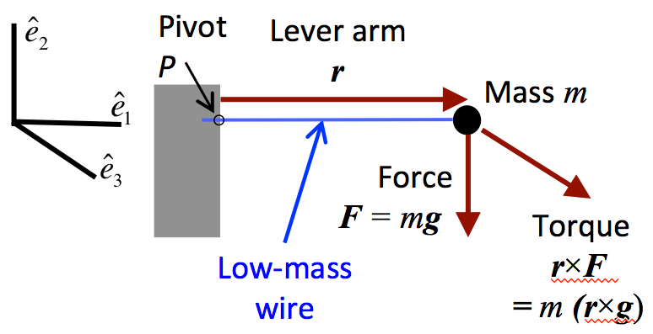
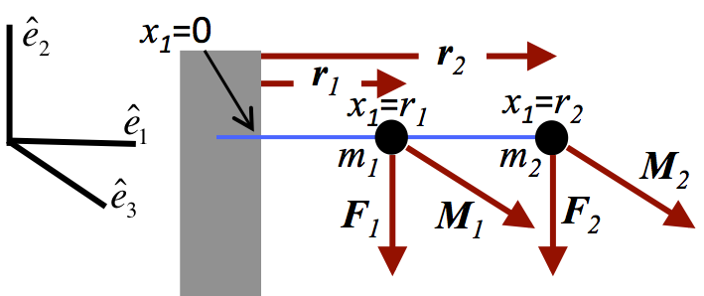
Class-prep: Please give me a moment …
Please Read Raymond notes on Stress and Moments on class web site
https://courses.washington.edu/ess511/NOTES/CFR_CHAPTERS/CFR_stress_notes.pdf
“Moment” and torque” are often used interchangeably, although technically a moment is a static concept, and torque applies to a rotation motion. Both involve a vector cross product between a force and a lever arm (or moment arm), so the units are Newton meters (N m). The first figure illustrates the moment exerted around the point P by a point mass m on the end of a stiff low-weight wire and subjected to gravity.
Now let’s put a second mass on the wire, and see how the moments work.
Assignment
What is the moment exerted by mass m₁ at point x₁=0?
What is the moment exerted by mass m₂ at point x₁=0?
What is the total moment exerted by both masses m₁ and m₂ at point x₁=0?
What is the moment exerted by mass m₂ at point x₁= r₁?
Suppose that we keep adding more discrete masses on the wire until we effectively have a solid steel bar. In a couple of sentences, explain how you could still find the net moment exerted at any particular point, such as x₁=0. (Consider that integral calculus could help.)

Slide 5
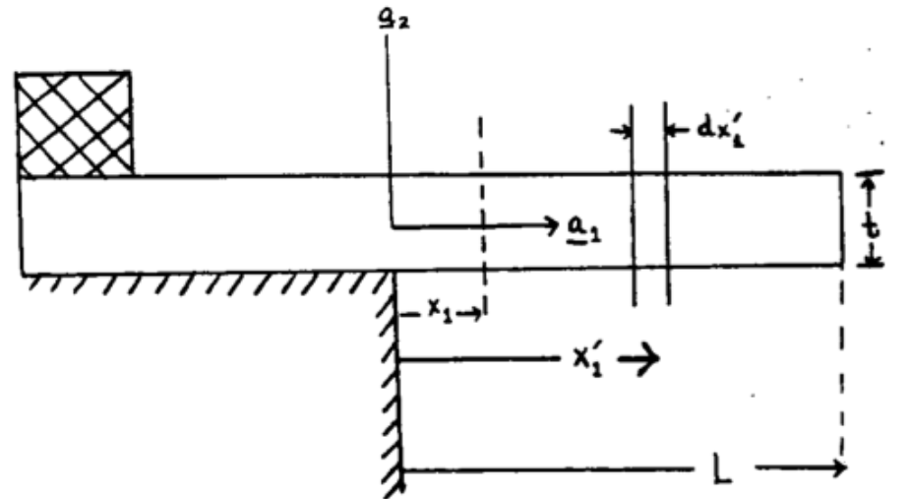
A hanging plate

Slide 6
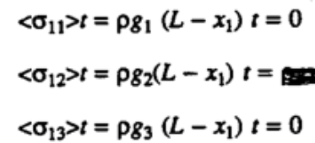
Average stress across the beam (per unit width)
Plane at x₁ must support the weight of all material to the right.
e.g. <σ₁₂>t is vertically directed force per unit width in x₃
Although <σ₁₁>=0, there must be
tension (σ₁₁>0) in the upper part and
compression (σ₁₁<0) in the lower part,
in order to prevent the material to the right from falling down.
0
σ₁₁
tension
compression
x₁

Slide 7
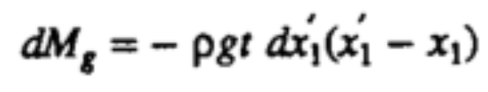
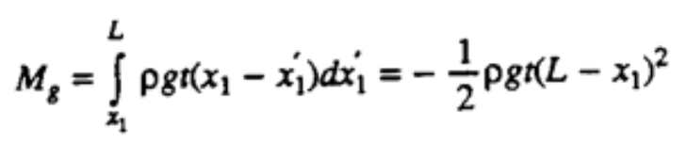
Incremental moment at x₁ due to outboard weight
Incremental moment at x₁ exerted by thin slice dx₁’ of slab at x₁’
e.g. <σ₁₂>t is vertically directed force per unit width in x₃
Now add up the incremental moments at x₁ due to all thin slices dx₁’ to the right of x₁
The force per unit width: ρg t dx₁’
The lever arm: (x₁ - x₁’)

Slide 8
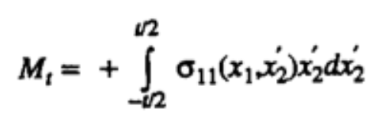
Incremental moment at x₁ due to stress in the beam
M_{g} must be balanced by an equal and opposite moment M_{t} at x₁ exerted by the stress state there.
σ₁₁
The force per unit width: σ₁₁ (x₁, x₂’) dx₂’
The lever arm: x₂’
tension
compression
x₁
Shear stresses at x₁ don’t contribute because they have no moment arm around x₁
σ₁₁ is assumed to be linear, but it is a very good assumption.

Slide 9
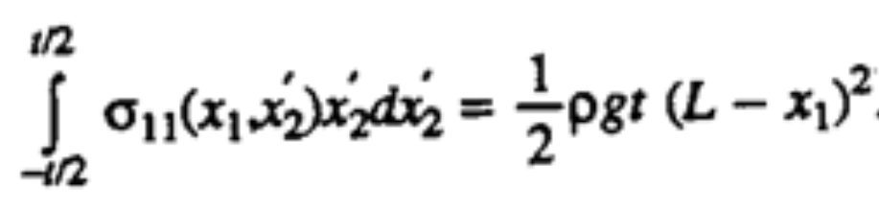
Putting it together -
M_{t} + M_{g} = 0

Slide 10
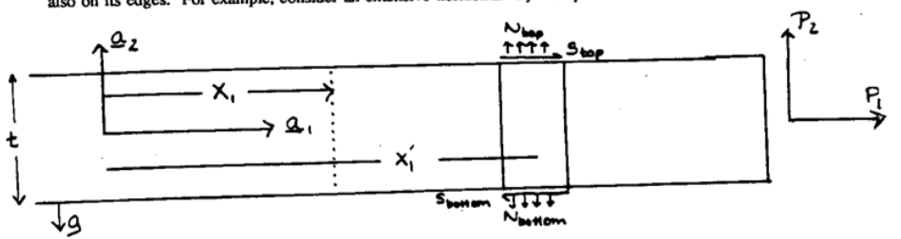
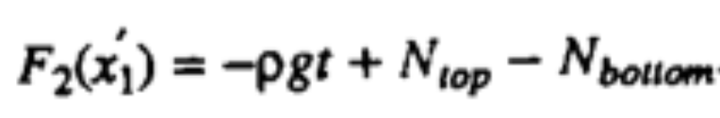
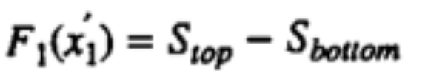
Now include tractions on the top and bottom
Putting it together

Slide 11
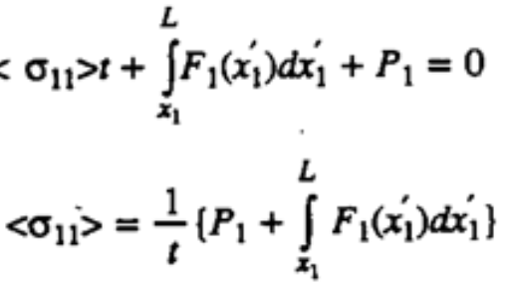
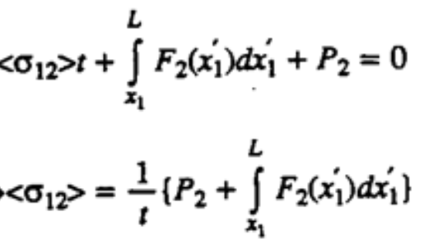
Now include tractions on the top and bottom
Putting it together

Slide 12
