Slide 1
ESS 411/511 Geophysical Continuum Mechanics Class #27
Highlights from Class #26 – Madie Mamer
Today’s highlights on Monday – Abigail Thienes
Today
ESS 511 60-second project updates today
For Monday please read
Ed’s note on constitutive relations (on right sidebar at)
https://courses.washington.edu/ess511/NOTES/)
For Problems Lab next week
Study Questions for take-at-home Final exam will be posted this weekend.

Slide 2
ESS 411/511 Geophysical Continuum Mechanics
Broad Outline for the Quarter
Continuum mechanics in 1-D
1-D models with springs, dashpots, sliding blocks
Attenuation
Mathematical tools – vectors, tensors, coordinate changes
Stress – principal values, Mohr’s circles for 3-D stress
Coulomb failure, pore pressure, crustal strength
Measuring stress in the Earth
Strain – Finite strain; infinitesimal strains
Moments – lithosphere bending; Earthquake moment magnitude
Conservation laws
Constitutive relations for elastic and viscous materials
Elastic waves; kinematic waves

Slide 3
Warm-up (break-out rooms)
What exactly are conservation laws?
Why are they useful?
What are some examples?

Slide 4
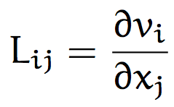

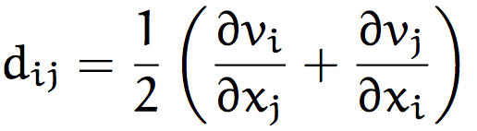
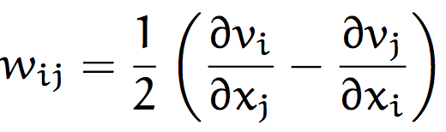
Some key ideas about rates of change
Velocity is rate of change of position or displacement
for particle X_{A}
Spatial velocity-gradient tensor
Symmetric and skew-symmetric decomposition
Deformation-rate tensor or strain-rate tensor
Vorticity or spin tensor

Slide 5



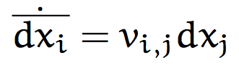
Rate of change of line elements MSM Section 4.12
A line element
is the deformation-gradient tensor
Rate of change
or

Slide 6
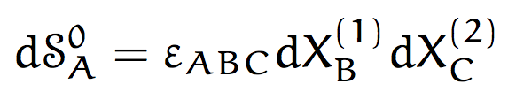

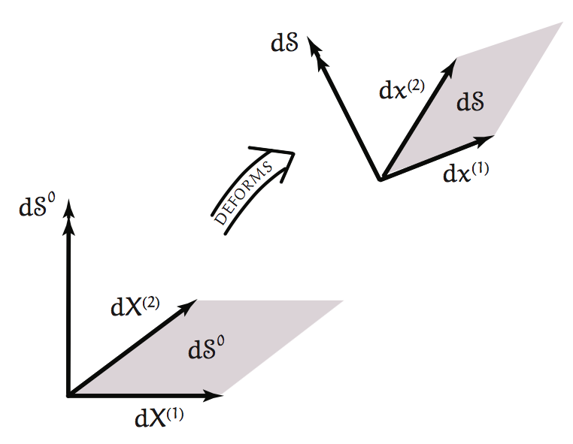
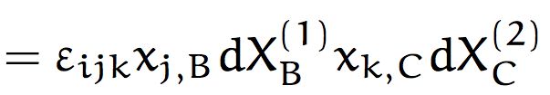

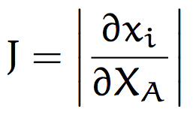

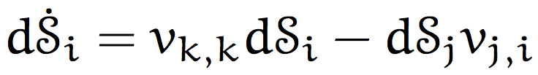
Rate of change of area elements MSM Section 4.12
After using
= det(F_{iA})
Now take time derivative
or

Slide 7
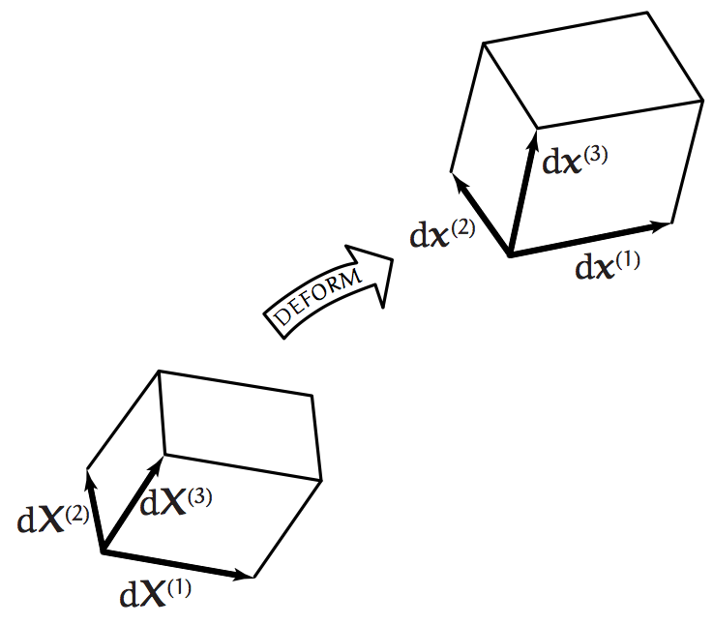








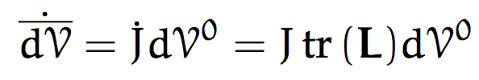

Rate of change of volume elements MSM Section 4.12
Now take time derivative

Slide 8
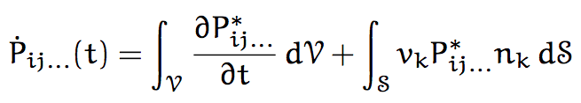
Class-prep: Conservation Laws
Please read
MSM Section 5.1 Material Derivatives of Line, Surface and Volume Integrals
Also
Ed’s notes on volume elements
Ed’s notes on Conservation Laws
Both are on the class web site at
https://courses.washington.edu/ess511/NOTES/notes.html
Assignment
Please identify each term or factor in the equation (MSM 5.3).
Explain in words what the equation does, and why it is useful.

Slide 9
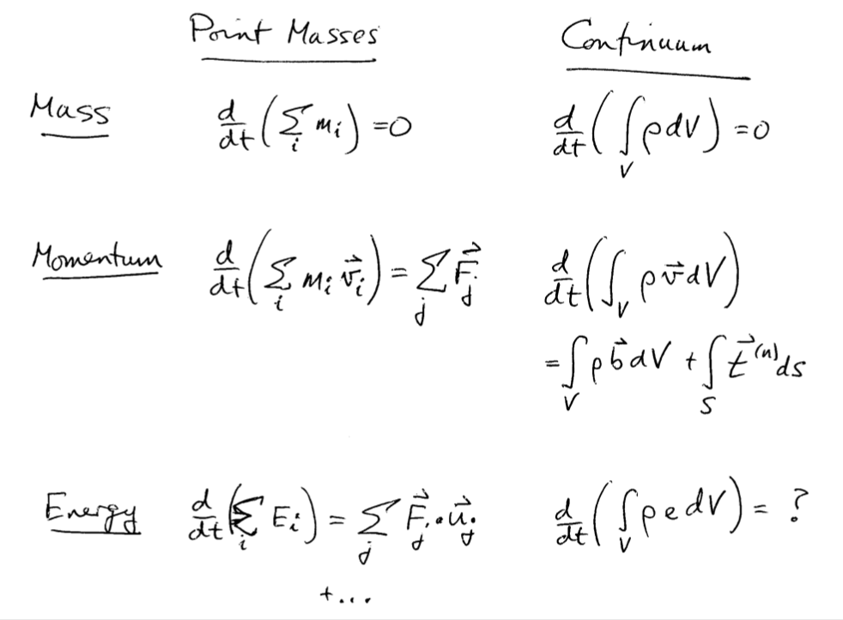
Discrete vs Continuum Conservation Laws

Slide 10
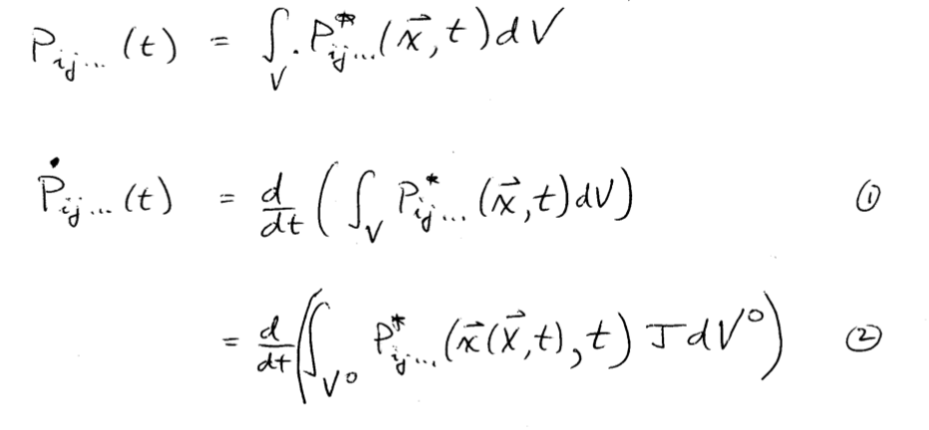
How do integrated quantities change through time?

Slide 11
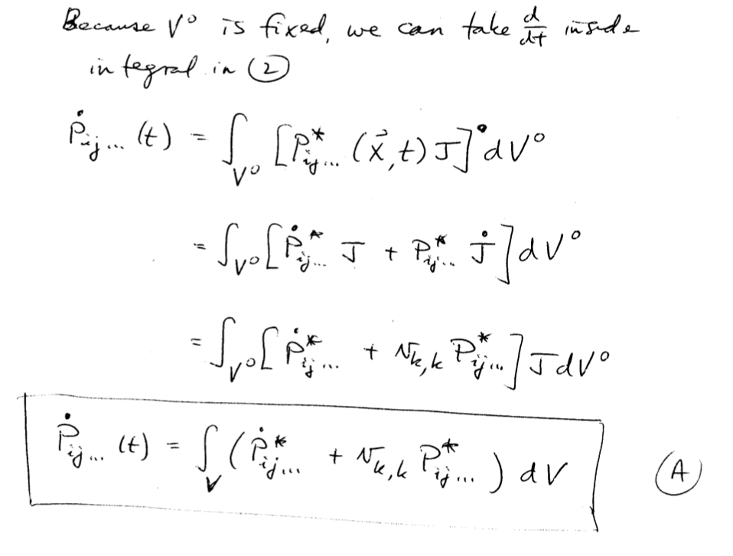

Slide 12
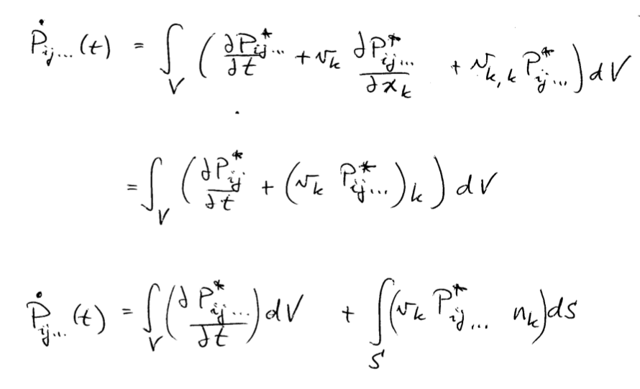

Slide 13
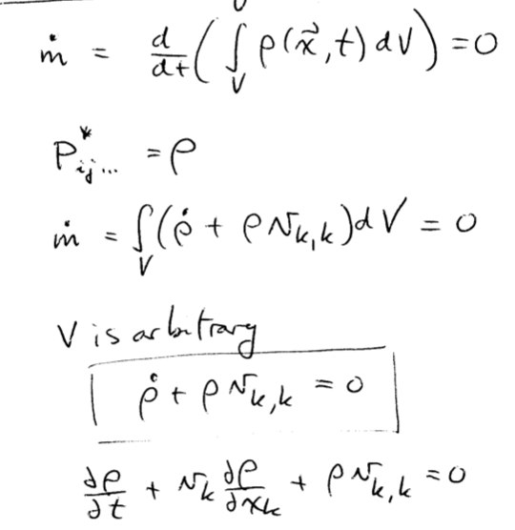

Conservation of Mass

Slide 14
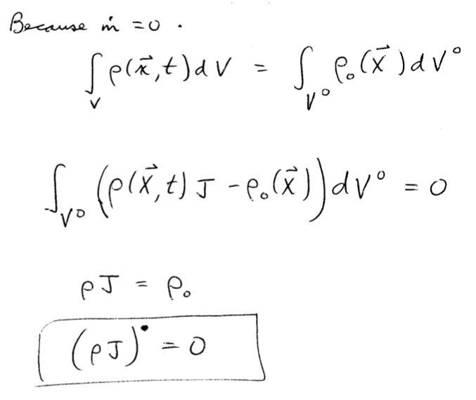

Slide 15
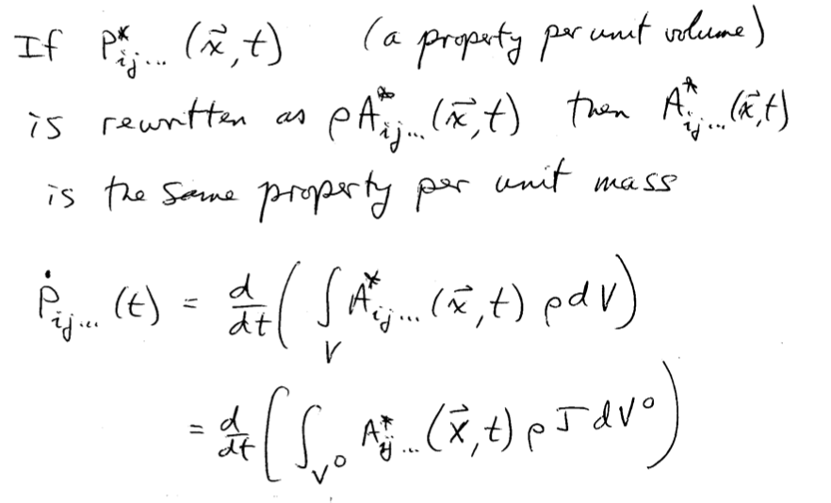
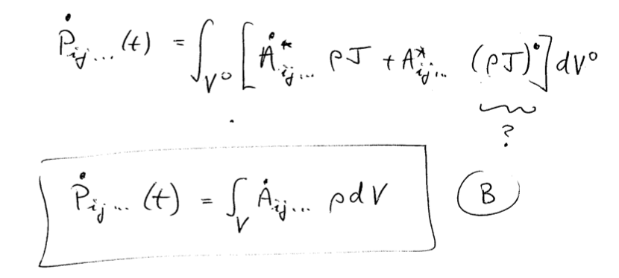

Slide 16
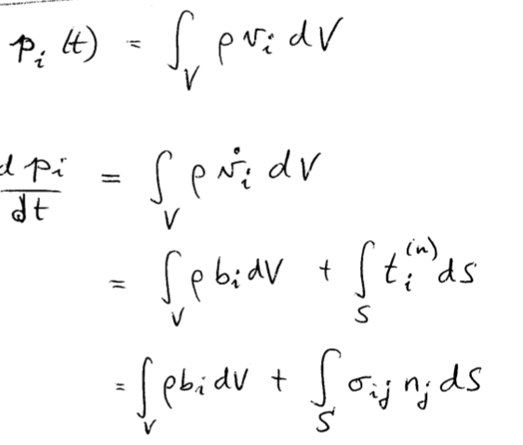
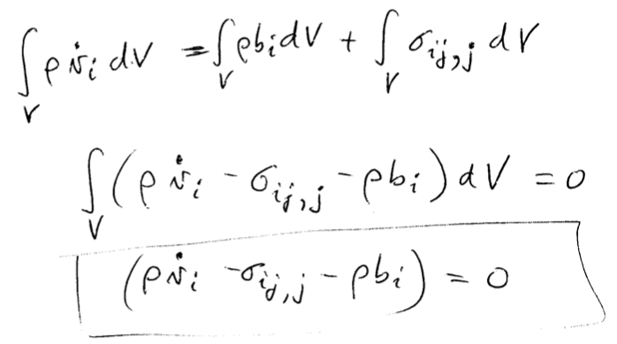
Conservation of Linear Momentum

Slide 17
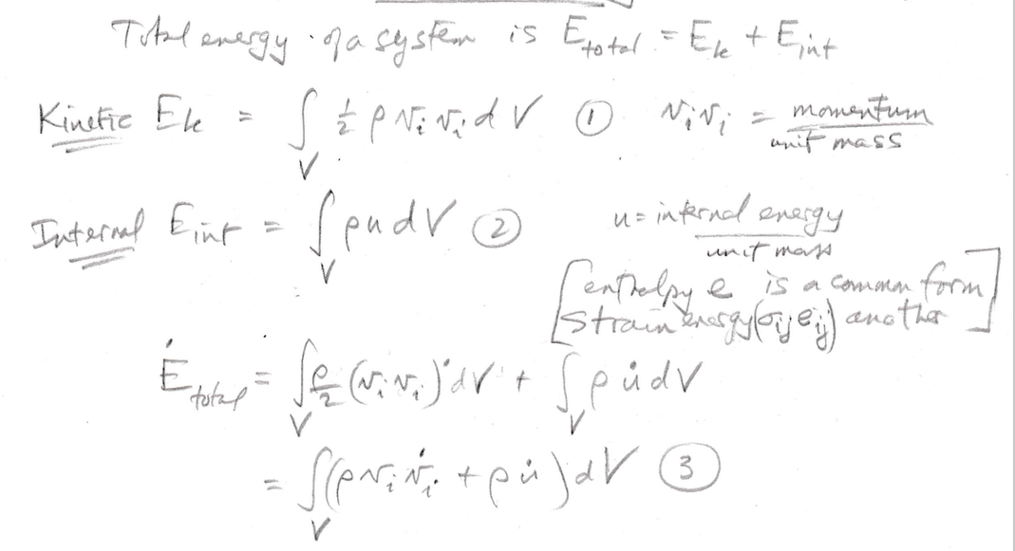
Conservation of Energy

Slide 18
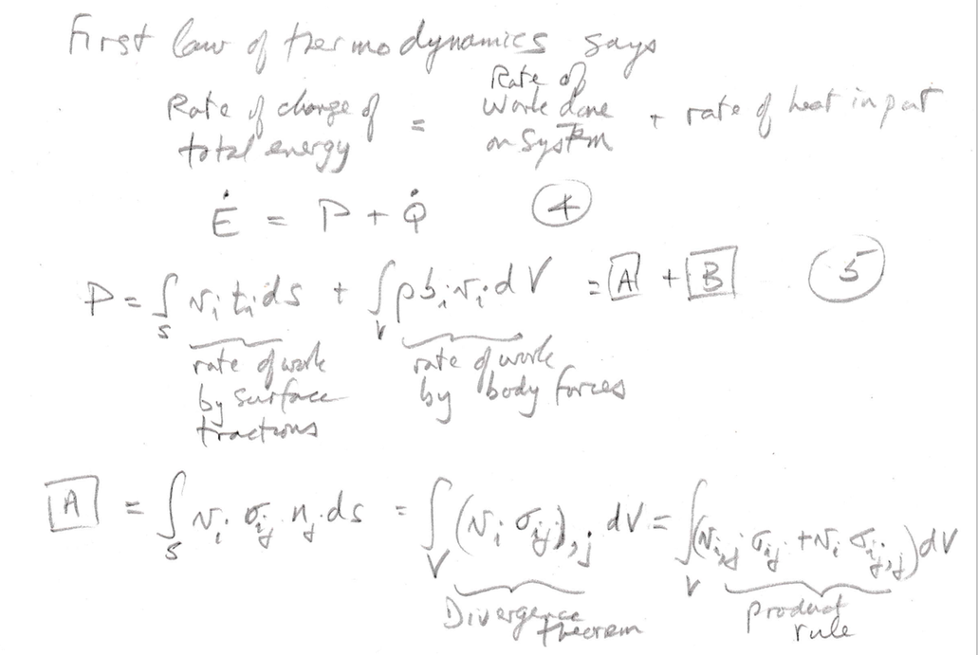

Slide 19
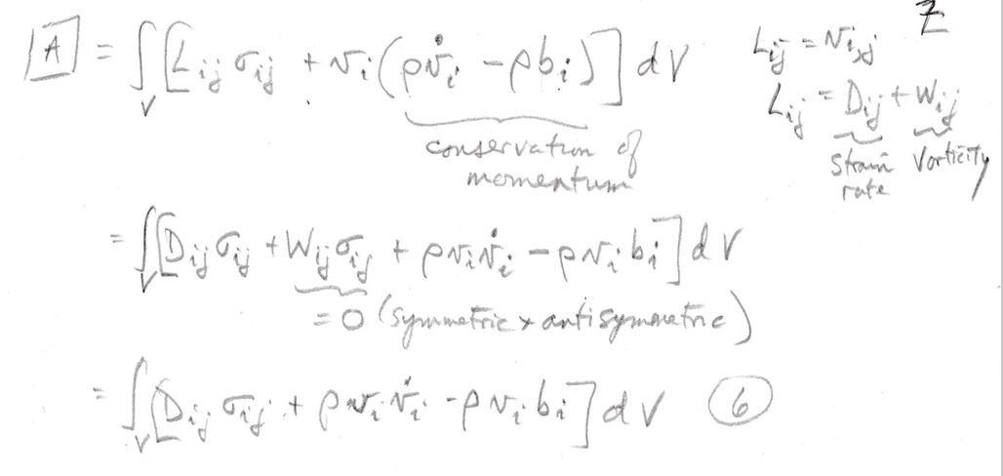

Slide 20
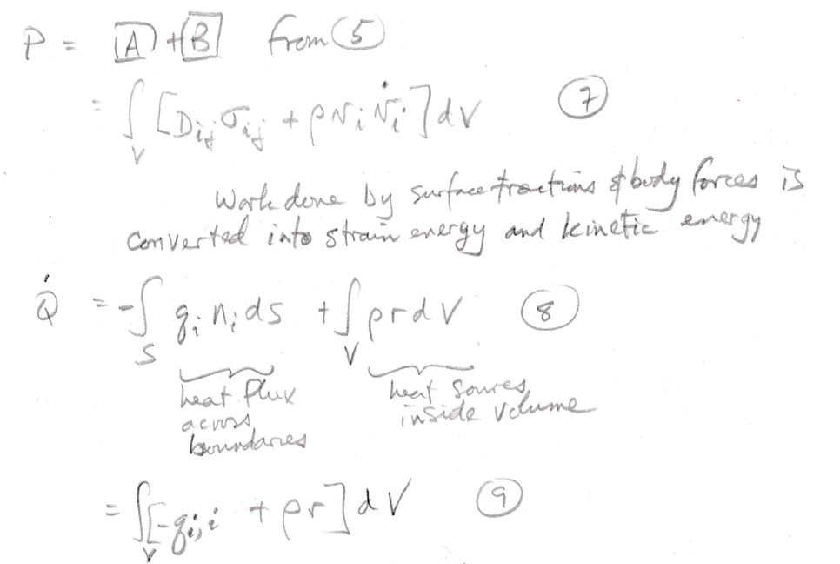

Slide 21
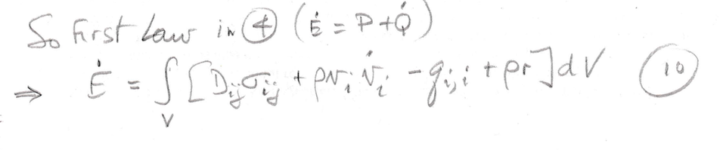

Slide 22
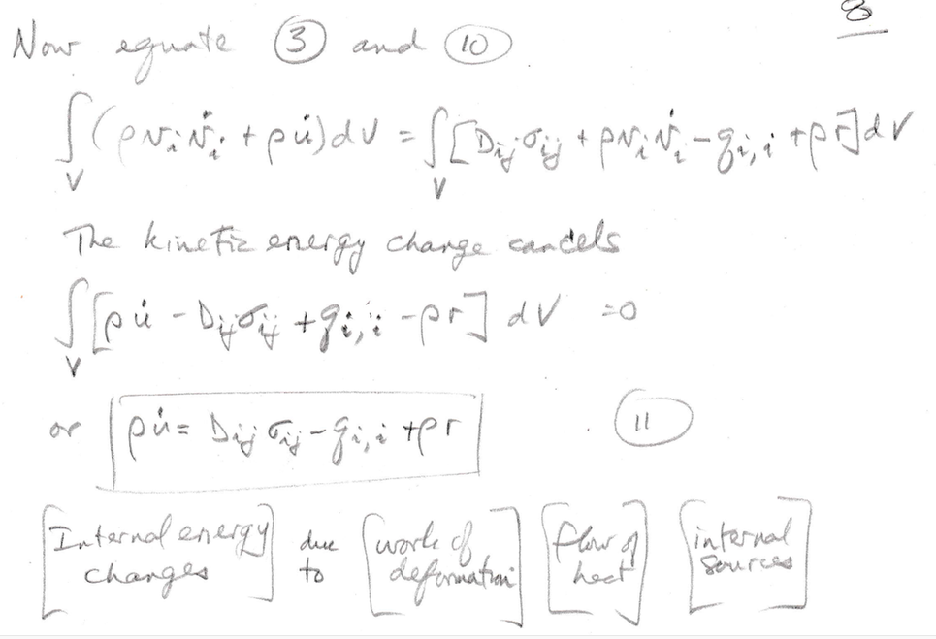

Slide 23
