Slide 1
ESS 411/511 Geophysical Continuum Mechanics Class #28
Highlights from Class #27 – Abigail Thienes
Today’s highlights on Wednesday – Zoe Krauss
Today
More on Moments
Constitutive Relations
For Wednesday and Friday please read
Ed’s notes on Seismic Moment
Ed’s notes on constitutive relations
Ed’s notes on classical fluids
Ed’s notes on elastic waves
(on right sidebar at)
https://courses.washington.edu/ess511/NOTES/)

Slide 2
Problem Sets
Problem Set #5 has been graded
Results are on Canvas
I will return annotated paper late today
Problem Set #6
Coming back soon …
For Problems Lab on Thursday
Study Questions for take-at-home Final exam have been posted.
I plan to prepare some notes about the issues encountered on the Mid-term and on Problem Sets #4 and #5

Slide 3
ESS 411/511 Geophysical Continuum Mechanics
Broad Outline for the Quarter
Continuum mechanics in 1-D
1-D models with springs, dashpots, sliding blocks
Attenuation
Mathematical tools – vectors, tensors, coordinate changes
Stress – principal values, Mohr’s circles for 3-D stress
Coulomb failure, pore pressure, crustal strength
Measuring stress in the Earth
Strain – Finite strain; infinitesimal strains
Moments – lithosphere bending; Earthquake moment magnitude
Conservation laws
Constitutive relations for elastic and viscous materials
Elastic waves; kinematic waves

Slide 4
Warm-up (break-out rooms)
What exactly are constitutive relations?
Why are they useful?
What are some examples?

Slide 5
Class-prep: Constitutive relations
Please read
Raymond notes on stress and moments
Ed’s notes on constitutive relations
Both are on the class web site at
https://courses.washington.edu/ess511/NOTES/notes.html
Assignment
In general, a linear relation between two second-order tensors f_{ij} and g_{ij} requires a fourth-order tensor coefficient c_{ijkm} with 81 components.
f_{ij} = c_{ijkm} g_{km}
However, stress σ_{ij} and strain ε_{km} can be related with just 2 scalar coefficients λ and μ (the Lamé constants) in Hooke’s Law for linear elasticity.
σ_{ij} = λδ_{ij} ε_{kk} + 2μ ε_{ij}
In a paragraph, outline
the properties of stress and strain tensors that allow much of this simplification,
the conservation laws that are invoked,
and any additional assumptions.
What do the Lamé constants represent, and what are their units?

Slide 6
Moments of interest in the Earth
Rock overhangs
Snow cornices
Length scale of support by bending lithosphere
Earthquake moment magnitude

Slide 7
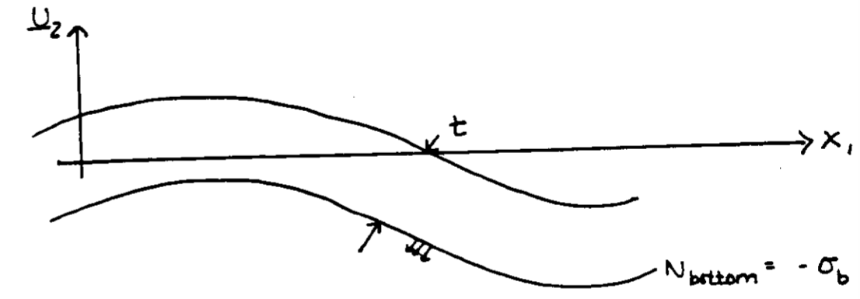

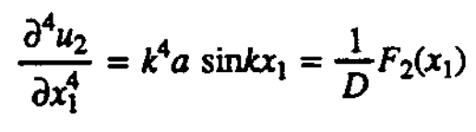
Warped lithosphere
Suppose lithosphere is flat in relaxed state
Now lithosphere is warped into a sinusoid
e.g. by loading with a big ice sheet
Far from any edge, P₁ = P₂ = 0
N_{top} = 0
N_{bot} = σ_{b}
σ_{b} results from 2 effects
weight of the overlying lithosphere
bending stresses in the lithosphere, which tries to relax
pull the lithosphere up and away from the mantle in the hollows,
push down on the mantle under the crests.

Slide 8


Suppose lithosphere is flat in relaxed state
Now lithosphere is warped into a sinusoid
e.g. by loading with a big ice sheet
(1)
Far from any edge, P₁ = P₂ = 0
N_{top} = 0
N_{bot} = σ_{b}
so
(3)
(2)
σ_{b} varies with x₁ and results from 2 effects
weight of the overlying lithosphere
bending stresses in the lithosphere, which tries to relax and flatten
pull the lithosphere up from the mantle in the hollows,
push down on the mantle under the crests.
From (2) and (3)
(4)

Slide 9
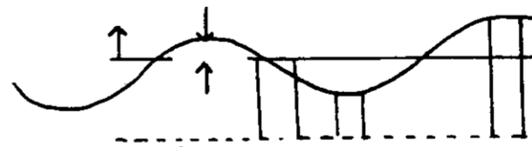

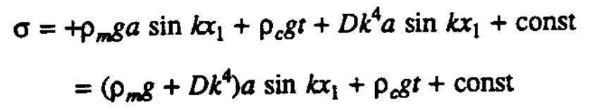
Wavelength λ
a = Amplitude of lithosphere “wave”
a
a << λ = 2π/k
Top of asthenosphere
Reference level in asthenosphere
Ρ_{m} Mantle density
At the reference level, first account for
weight of the mantle “bumps”: ρ_{m}g a sin(kx₁)
weight of the lithosphere with thickness t: ρ_{c}g t
Now account for the bending moments trying to flatten the lithophere
At the reference level, there are no horizontal stress gradients (why?)

Slide 10
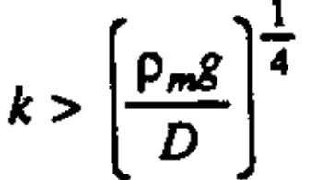
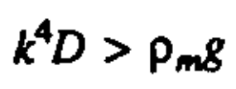
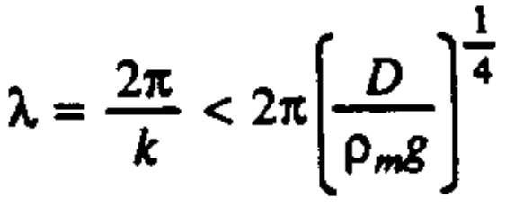
Wavelength λ
a
a << λ = 2π/k
Top of asthenosphere
The flexural rigidity of the lithosphere adds a restoring force additional to the force coming from the topography
Reference level
ρ_{m} mantle density
Bending stresses in the lithosphere become dominant or
In terms of the wavelength λ,
Short wavelengths can be supported, but long wavelength waves just sag into the mantle based on their weight
At the reference level in the asthenosphere, there are no horizontal stress gradients (why?)

Slide 11


Supportable wavelengths
Wavelength λ
a
a << λ = 2π/k
Top of asthenosphere
Reference level
ρ_{m} mantle density
Bending stresses in the lithosphere
become dominant or
Flexural rigidity
Elastic modulus
10¹⁰ Pa
ρ_{m} g ~0.3× 10⁵ Pa m-1, and with t = 100 km, D = 10²⁴ Pa m³
So bending stresses become important for λ<500 km
At the reference level in the asthenosphere, there are no horizontal stress gradients (why?)

Slide 12
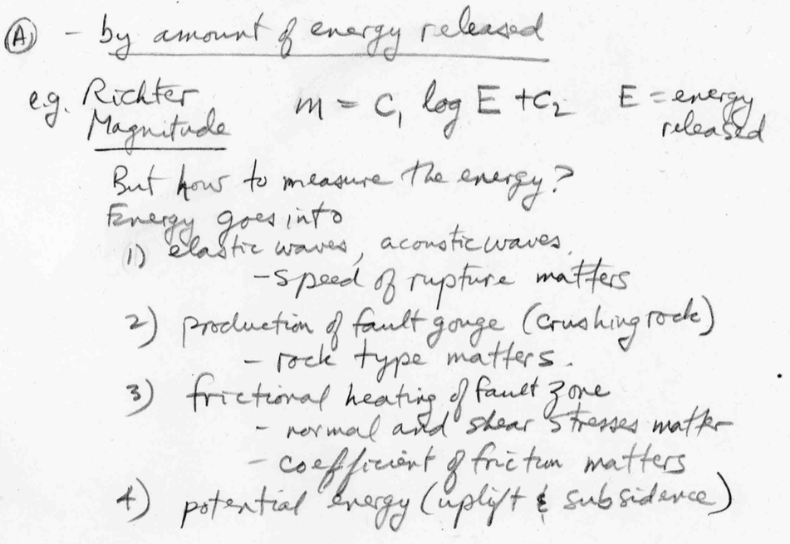
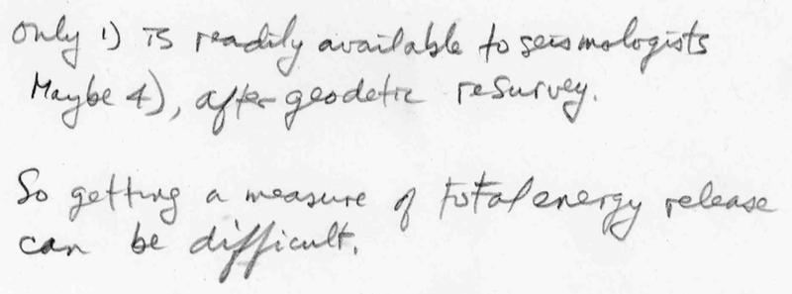
How to measure earthquake size?

Slide 13
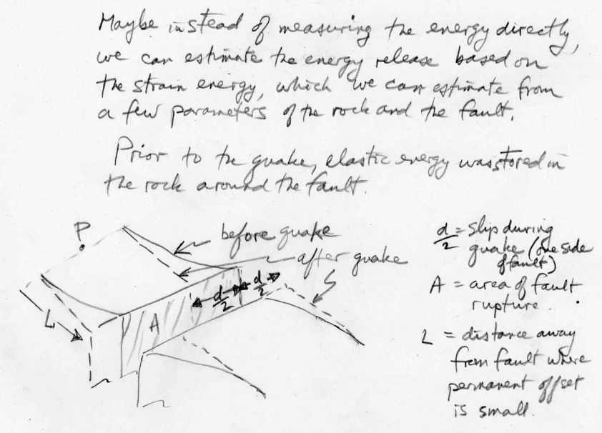
Estimate strain energy released?

Slide 14
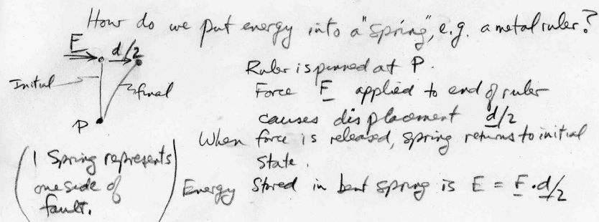
Estimate strain energy in a spring?

Slide 15
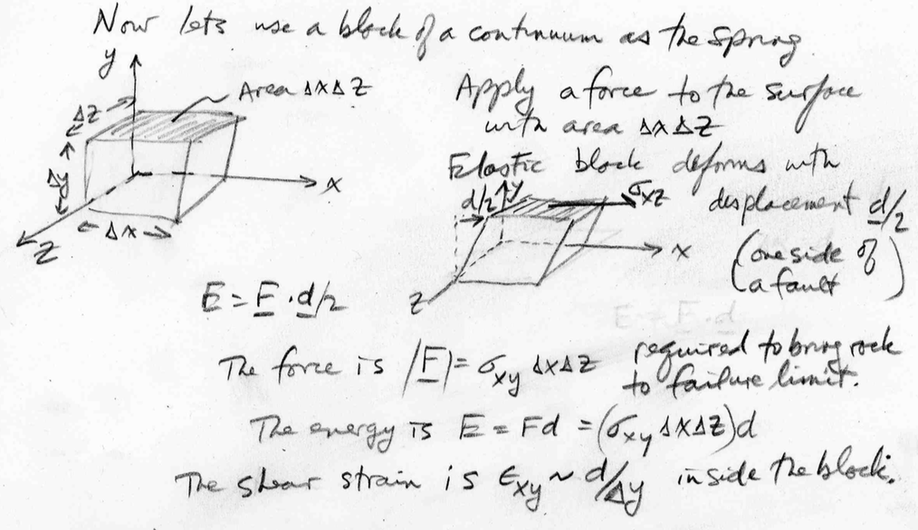
Energy released by a spring

Slide 16
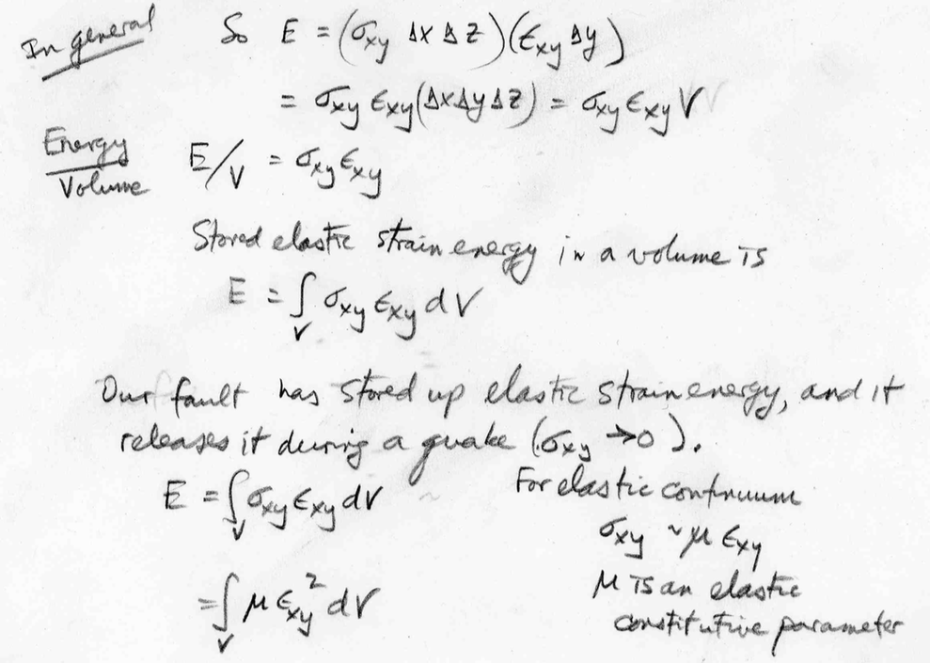
Energy per unit volume

Slide 17
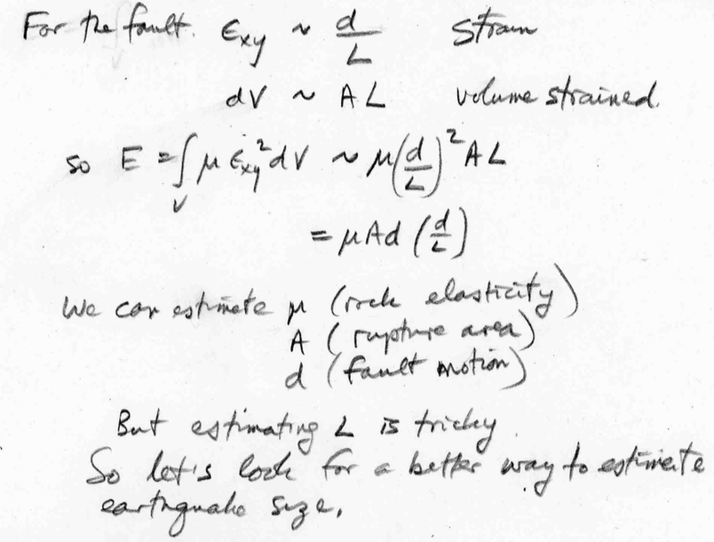
Simple, but not maybe simple enough …

Slide 18
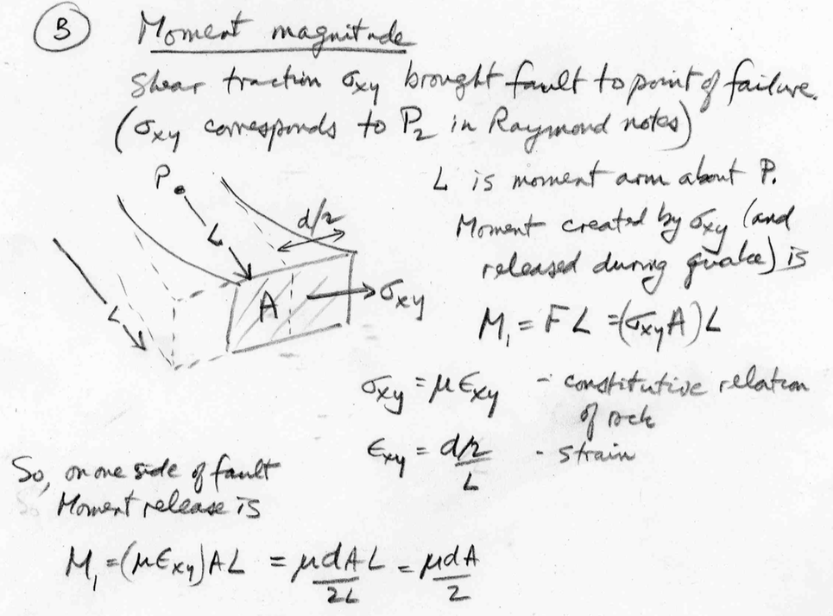
(B) Moment Magnitude

Slide 19
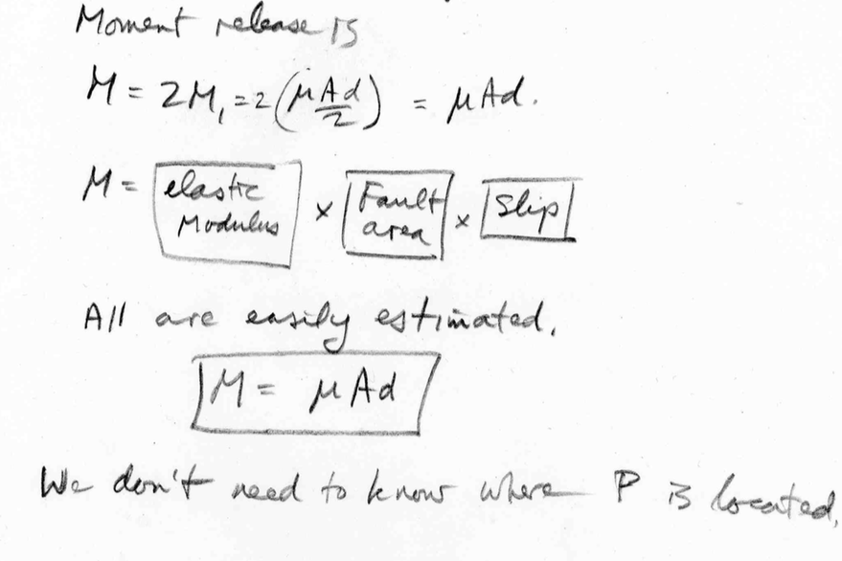
Both sides of the fault release moment

