Slide 1
ESS 411/511 Geophysical Continuum Mechanics Class #29
Highlights from Class #28 – Zoe Krauss
Today’s highlights on Friday – Chloe Mcburney
Today
Constitutive Relations, viscous fluids, elastic plane waves
For Friday please read
Ed’s notes on elastic waves
Ed’s notes on kinematic waves
(on right sidebar at)
https://courses.washington.edu/ess511/NOTES/)

Slide 2
Problem Sets
Problem Set #6 has also been graded
Results are on Canvas
I will return annotated paper later today
Problem Set #7
Due on sunday …
For Problems Lab on Thursday
Study Questions for take-at-home Final exam have been posted.
I am preparing some notes about the issues that you encountered on the Mid-term and on Problem Sets #4, #5, and #6

Slide 3
ESS 411/511 Geophysical Continuum Mechanics
Broad Outline for the Quarter
Continuum mechanics in 1-D
1-D models with springs, dashpots, sliding blocks
Attenuation
Mathematical tools – vectors, tensors, coordinate changes
Stress – principal values, Mohr’s circles for 3-D stress
Coulomb failure, pore pressure, crustal strength
Measuring stress in the Earth
Strain – Finite strain; infinitesimal strains
Moments – lithosphere bending; Earthquake moment magnitude
Conservation laws
Constitutive relations for elastic and viscous materials
Elastic waves; kinematic waves

Slide 4
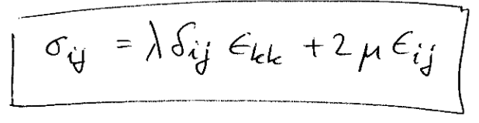
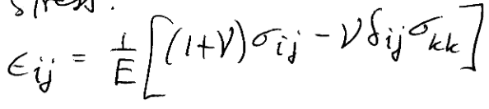
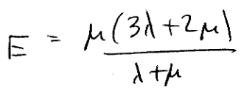

Elastic solid
σ_{zz}
Stress in terms of strain
L
Strain in terms of stress
σ_{zz}
σ_{zz}
Young’s modulus
L
L+ΔL
(Relates normal stresses and strains)
Poisson’s ratio
Δz
(Ratio of strains in direction of stress and normal to stress)
Δx

Slide 5
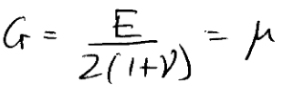
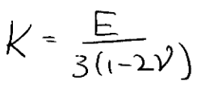
Other combinations of elastic parameters are possible
Young’s modulus
Shear modulus
(Relates shear stress to shear strain)
Poisson’s ratio
Bulk modulus
(Ratio of volumetric stress to volumetric strain)

Slide 6
Warm-up (break-out rooms)
1) What is the value of Poisson’s ratio for an incompressible material?
Hint:
volumetric stress σ_{ii}/3
volumetric strain e_{ii} = 0
Bulk modulus
(Ratio of volumetric stress to volumetric strain)
2) Can shear stress exist in a fluid?

Slide 7
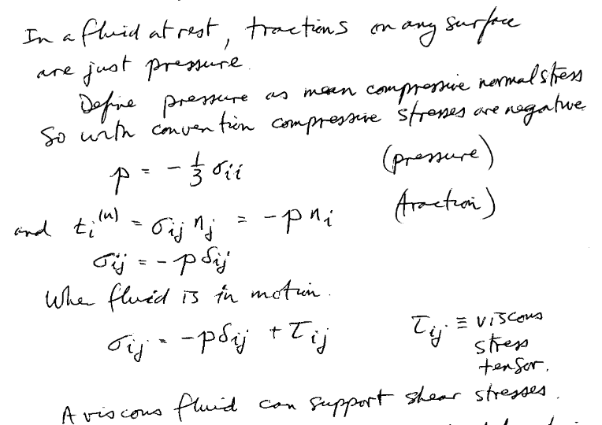
Classical (Newtonian) Fluids

Slide 8
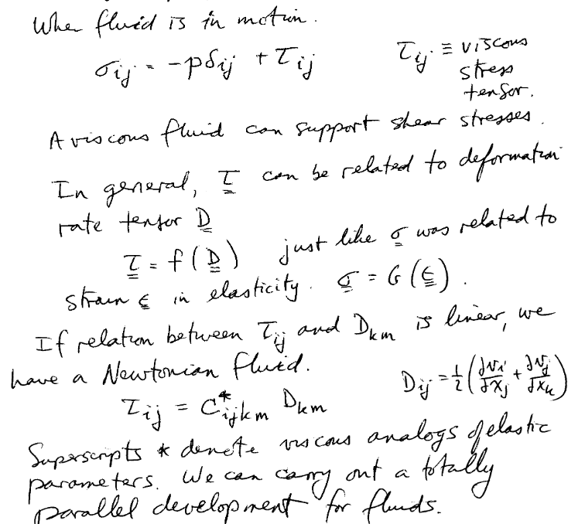
Fluid in motion

Slide 9
Class-prep: Constitutive relations
Please read
Ed’s notes on classical fluids
Ed’s notes on elastic waves
Both are available on the class web site at
https://courses.washington.edu/ess511/NOTES/notes.html
In a classical isotropic linear fluid, the deviatoric stress tensor τ_{ij} can be related to the deformation-rate tensor D_{ij} with just 2 scalar coefficients λ* and μ* (analogs to the elastic Lamé constants λ and μ)
τ_{ij} = λ* δ_{ij} D_{kk} + 2μ* D_{ij}
Assignment
Write out the relation between σ_{ij} and τ_{ij} and describe their difference in prose.
Define ε_{ij} and D_{ij} and describe their difference in prose.
What do the Lamé analog constants λ* and μ* represent, and what are their units?

Slide 10
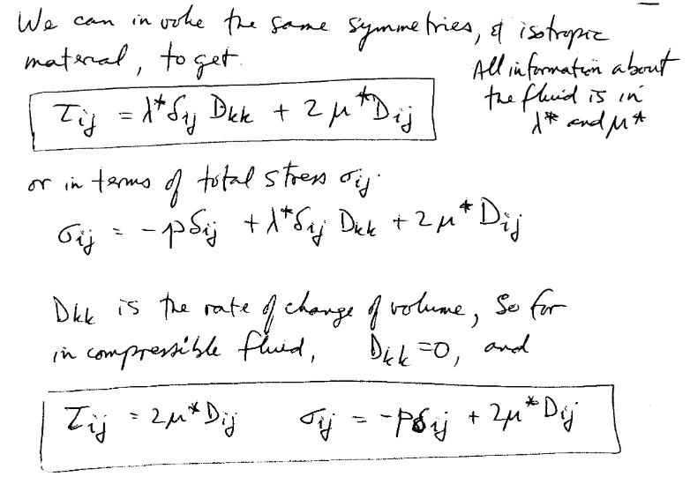
A constitutive relation

Slide 11



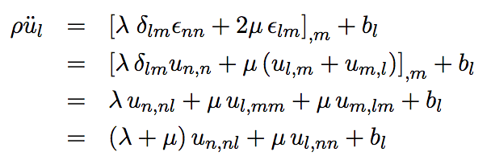
Elastic waves
Equations of motion
ρ is density
u_{l} is displacement
b_{l} is body force
Stress
Strain
Putting it together

Slide 12





Elastic waves
Putting it together
Lets look for plane-wave solutions
(1)
In index notation, (1) is written as
(2)

Slide 13

Elastic waves
Equations of motion
In absence of body forces, set b_{l}=0
Put (2) into equations of motion
(2)
After a bunch of algebra (in the notes),
When A and k are parallel, we get compressional waves (p waves)
When A and k are orthogonal, we get shear waves (s waves)

Slide 14
Elastic waves
Equations of motion
In absence of body forces, set b_{l}=0
Put (2) into equations of motion
(2)
After a bunch of algebra (in the notes),
When A and k are parallel, we get compressional waves (p waves)
When A and k are orthogonal, we get shear waves (s waves)

Slide 15


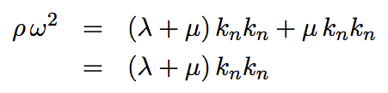
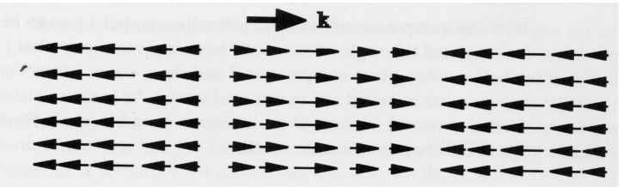
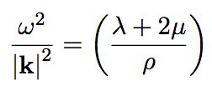
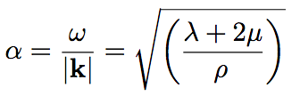
When A and k are parallel, we get compressional waves (p waves)
Phase velocity of p wave

Slide 16


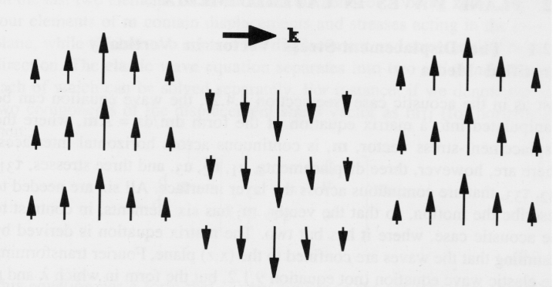

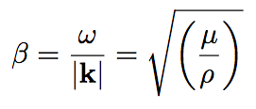
When A and k are orthogonal, we get shear waves (s waves)

