Slide 1
ESS 411/511 Geophysical Continuum Mechanics Class #30
Highlights from Class #29 – Chloe Mcburney
Today’s highlights on Monday – Alexandria Vasquez-Hernandez
(at ESS 511 term-project reports)
Today
Elastic plane waves
Kinematic waves
Based on notes on right sidebar at
https://courses.washington.edu/ess511/NOTES/
Ed’s notes on elastic waves
Ed’s notes on kinematic waves

Slide 2
ESS 411/511 Geophysical Continuum Mechanics Class #30
ESS 511 term-project reports
Monday 8:30-10:20 a.m. (which would have been our final-exam slot)
5 reports
10 minutes to present
5 minutes for questions, discussions, and transition
Do we need to start at 8:30?

Slide 3
Problem Sets
Problem Set #7
Due on Sunday …
I am preparing some brief notes about issues that you encountered on the Mid-term and on Problem Sets #4, #5, and #6

Slide 4
ESS 411/511 Geophysical Continuum Mechanics
Broad Outline for the Quarter
Continuum mechanics in 1-D
1-D models with springs, dashpots, sliding blocks
Attenuation
Mathematical tools – vectors, tensors, coordinate changes
Stress – principal values, Mohr’s circles for 3-D stress
Coulomb failure, pore pressure, crustal strength
Measuring stress in the Earth
Strain – Finite strain; infinitesimal strains
Moments – lithosphere bending; Earthquake moment magnitude
Conservation laws
Constitutive relations for elastic and viscous materials
Elastic waves; kinematic waves

Slide 5

Adapting to classes on Zoom

Slide 6
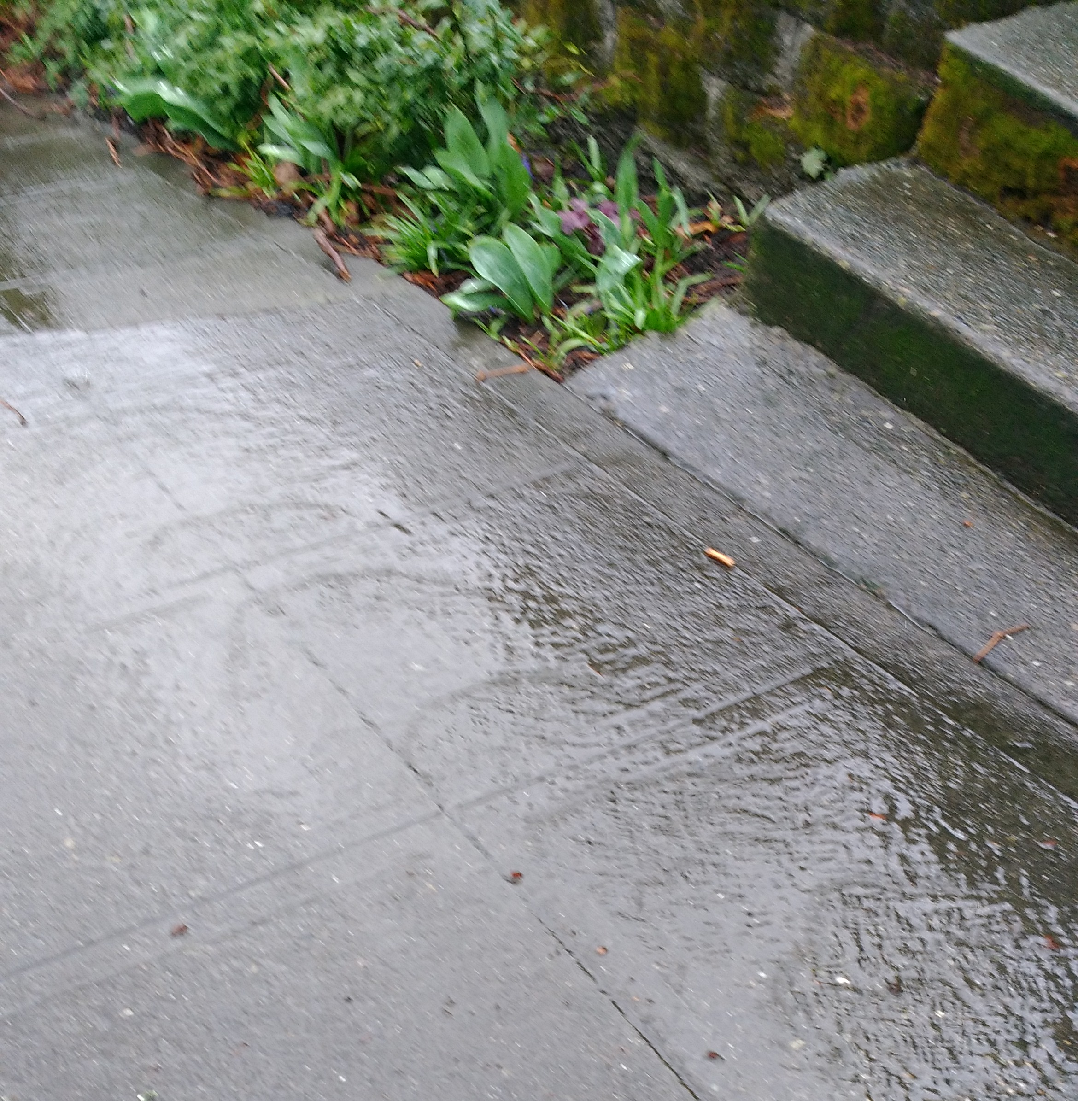
Warm-up – (break-out rooms)
Roll waves on a Seattle sidewalk
(Yes, it occasionally rains here … ☺ )
Are these kinematic waves, or dynamic waves?
Where is the water the deepest?
Which is moving faster, the water or the wave?

Slide 7



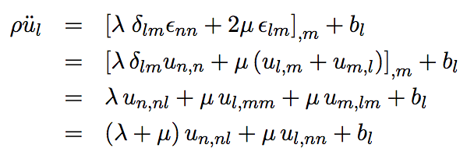
Elastic waves
Equations of motion
ρ is density
u_{l} is displacement
b_{l} is body force
Stress
Strain
Putting it together

Slide 8





Elastic waves
Putting it together
Lets look for plane-wave solutions
(1)
In index notation, (1) is written as
(2)

Slide 9

Elastic waves
Equations of motion
In absence of body forces, set b_{l}=0
Put (2) into equations of motion
(2)
After a bunch of algebra (in the notes),
When A and k are parallel, we get compressional waves (p waves)
When A and k are orthogonal, we get shear waves (s waves)

Slide 10
Elastic waves
Equations of motion
In absence of body forces, set b_{l}=0
Put (2) into equations of motion
(2)
After a bunch of algebra (in the notes),
When A and k are parallel, we get compressional waves (p waves)
When A and k are orthogonal, we get shear waves (s waves)

Slide 11


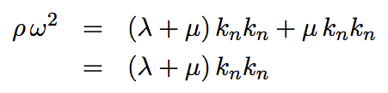
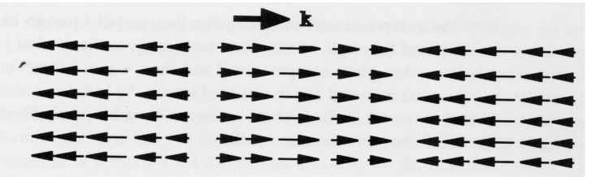
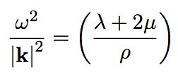
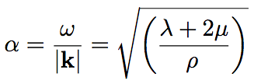
When A and k are parallel, we get compressional waves (p waves)
Phase velocity of p wave

Slide 12


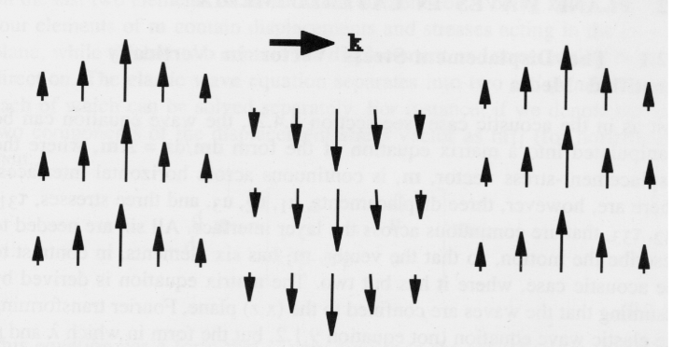

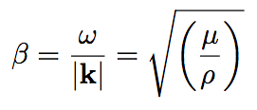
When A and k are orthogonal, we get shear waves (s waves)

Slide 13
Let’s look at some waves
https://courses.washington.edu/ess511/NOTES/EDS_NOTES/roll_waves_2019_12_20_FV_Ave_E.mp4

Slide 14
Dynamic and kinematic waves in 1-D
Dynamic wave in 1-D
Solutions
Initial condition
Boundary conditions
infinite domain
c is a wave velocity
Waves can travel in both directions at velocity c
Kinematic wave in 1-D
Solutions
Initial condition
Boundary conditions
infinite domain
Waves can travel in only one direction at velocity c
c is a wave velocity

Slide 15




Kinematic waves – from a continuity equation
Continuity equation
is density
q is flux
Flux gradient
Wave speed c
Key question how does v depend on ρ?

Slide 16
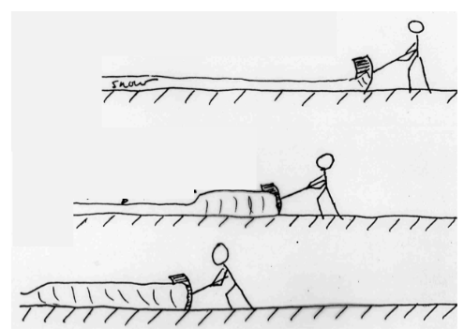
dv/dρ >0

Slide 17
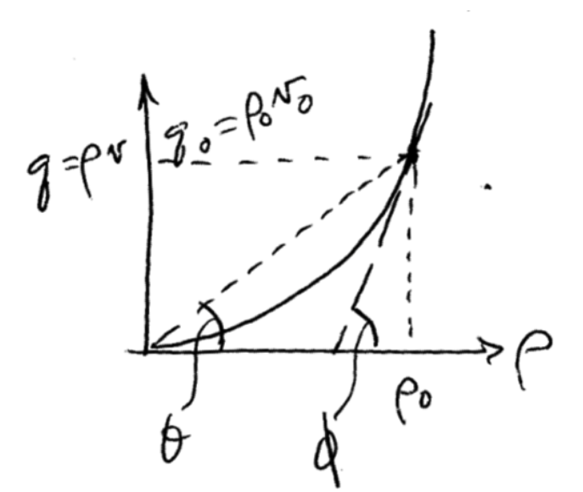
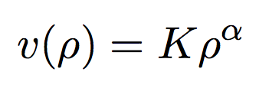
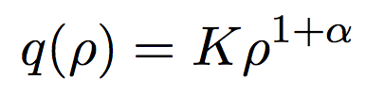
Flood waves

Slide 18
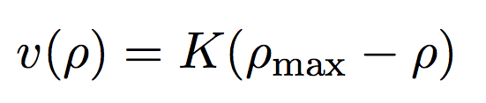
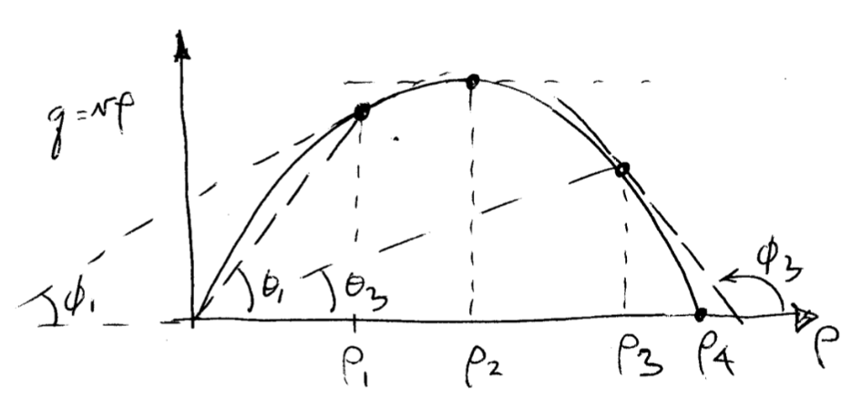
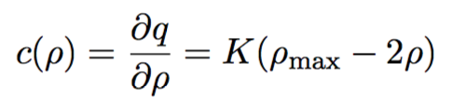


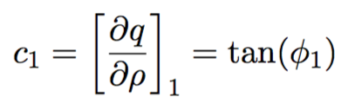

Traffic waves

