Slide 1
ESS 411/511 Geophysical Continuum Mechanics Class #26
For Problems Lab tomorrow
Read (https://courses.washington.edu/ess511/NOTES/)
Raymond notes on stress and moments
Turcotte and Schubert Section 3.9
For Friday class
Read (https://courses.washington.edu/ess511/NOTES/)
Ed’s note on volume elements
Ed’s note on conservation laws
Ed’s note on constitutive relations

Slide 2
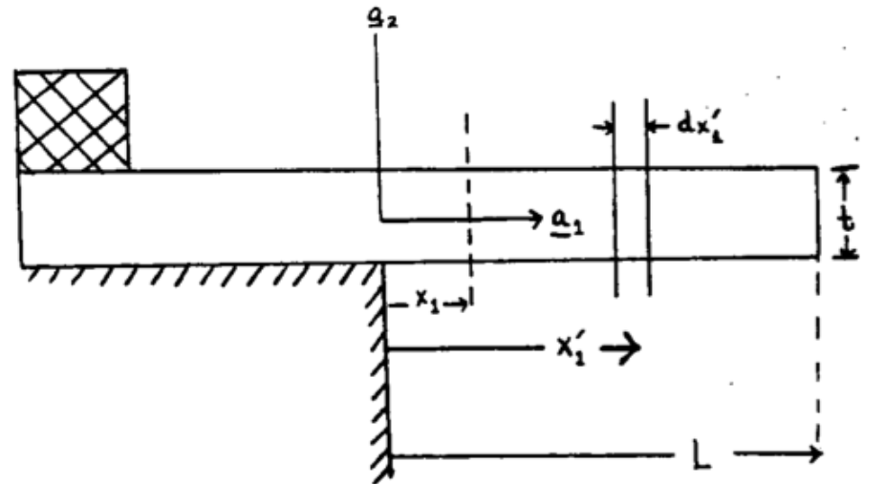
A hanging plate

Slide 3
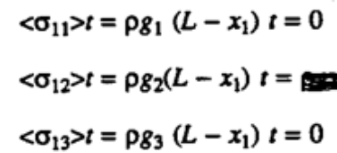
Average stress across the beam (per unit width)
Plane at x₁ must support the weight of all material to the right.
e.g. <σ₁₂>t is vertically directed force per unit width in x₃
Although <σ₁₁>=0, there must be
tension (σ₁₁>0) in the upper part and
compression (σ₁₁<0) in the lower part,
in order to prevent the material to the right from falling down.
0
σ₁₁
tension
compression
x₁

Slide 4
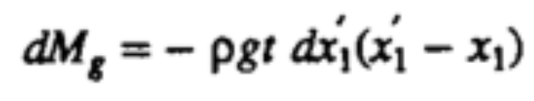
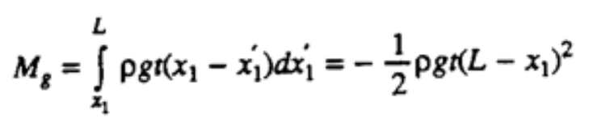
Incremental moment at x₁ due to outboard weight
Incremental moment at x₁ exerted by thin slice dx₁’ of slab at x₁’
e.g. <σ₁₂>t is vertically directed force per unit width in x₃
Now add up the incremental moments at x₁ due to all thin slices dx₁’ to the right of x₁
The force per unit width: ρg t dx₁’
The lever arm: (x₁ - x₁’)

Slide 5
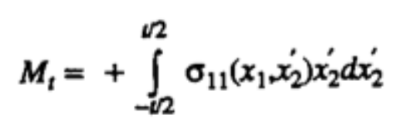
Incremental moment at x₁ due to stress in the beam
M_{g} must be balanced by an equal and opposite moment M_{t} at x₁ exerted by the stress state there.
σ₁₁
The force per unit width: σ₁₁ (x₁, x₂’) dx₂’
The lever arm: x₂’
tension
compression
x₁
Shear stresses at x₁ don’t contribute because they have no moment arm around x₁
σ₁₁ is assumed to be linear, but it is a very good assumption.

Slide 6
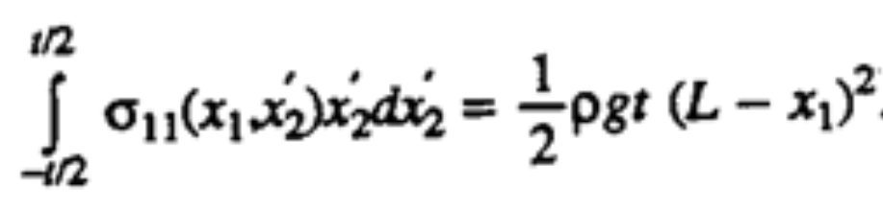
Putting it together -
M_{t} + M_{g} = 0

Slide 7
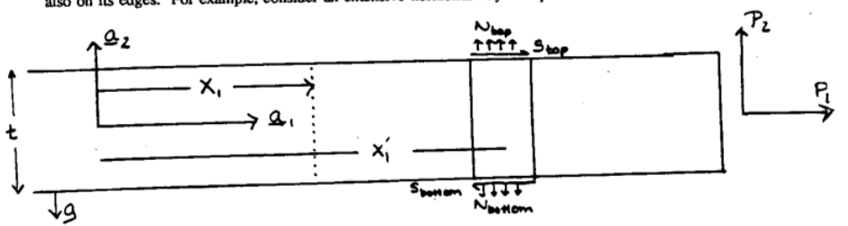
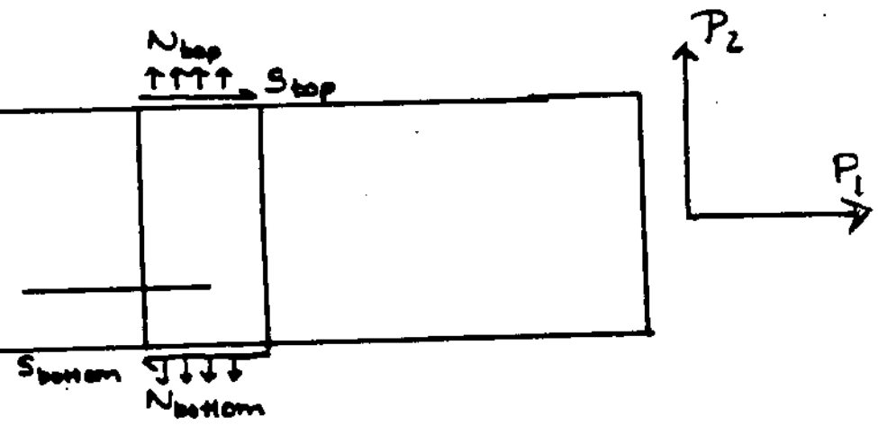
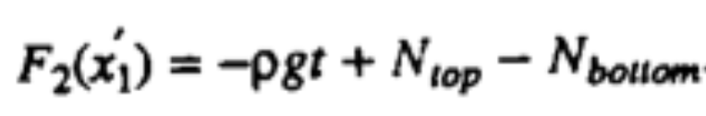
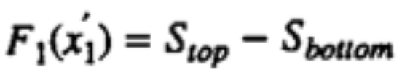
Now include tractions on the top and bottom
Horizontal forces
Vertical forces

Slide 8
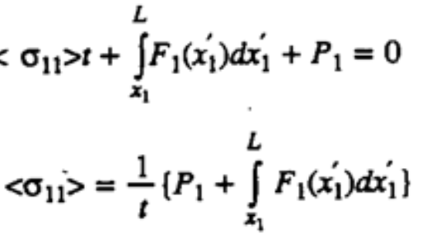
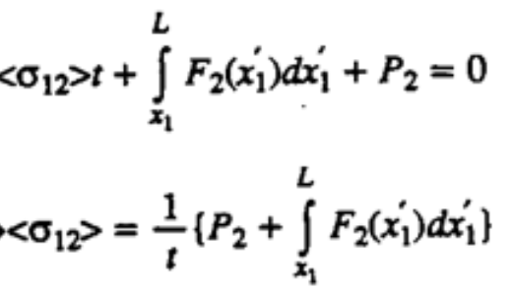
Balanced forces
Zero net force in a₁ direction
Zero net force in a₂ direction

Slide 9
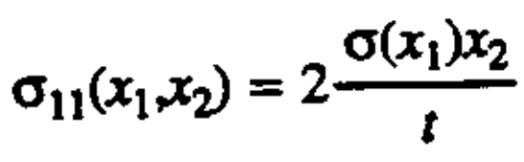
Finding stress σ₁₁ in beam
σ(x₁’)
σ(x₁”)
t/2
σ₁₁(x₁,x₂)
-t/2
x₁’
x₁”
σ₁₁ is assumed to be linear, but it is a very good assumption.
σ(x₁) gives the magnitude of the stress at the upper surface.
x₂/(t/2) gives the normalized shape from bottom (x₂= -t/2) to top (x₂= t/2)
x₁

Slide 10
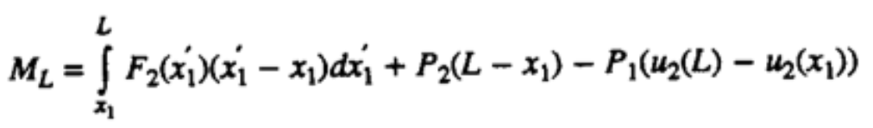

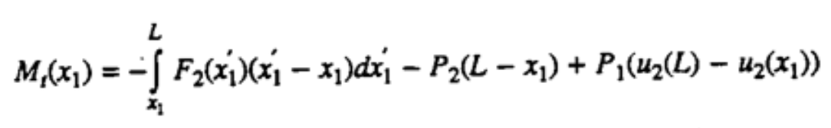
Balance of Moments
Moment due to weight outboard from x₁
Moment due to stress in plane at x₁
Recall
Zero net moment
Calculate M_{t}(x₁) from known geometry and forces

Slide 11
With deflection
u₂(x₁)
u₂ = 0
u₂(L)
P₂
x₁
P₁
L
Calculate M_{t}(x₁) from known geometry and forces

Slide 12
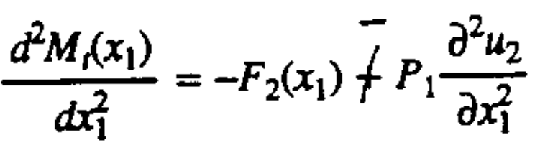
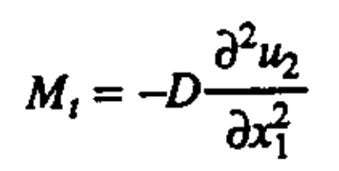
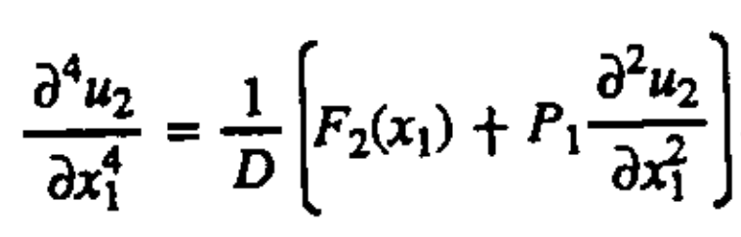
Integral equations are messy …
So we can differentiate it twice with respect to x₁
-
Then we use the idea of flexural rigidity D, which relates the bending curvature to the force moment.
(D is a property of the geometry and the material.)
To get an equation for the shape u₂(x₁)

