Slide 1
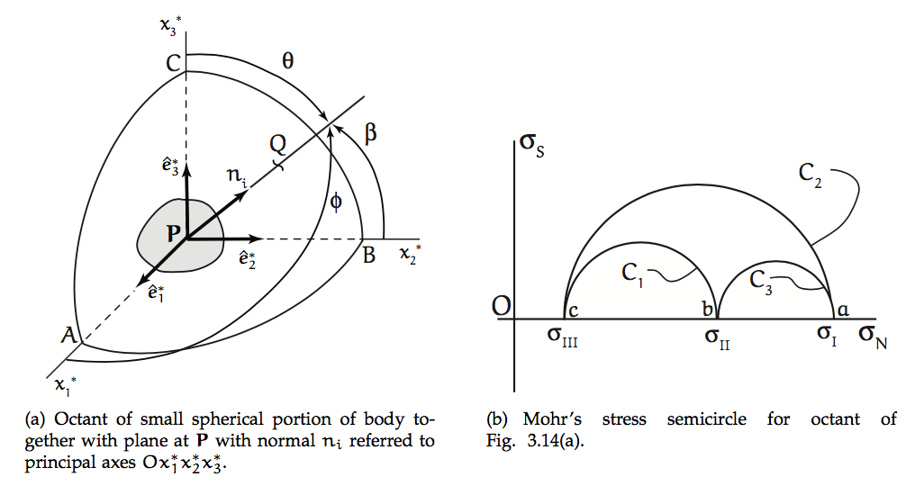
Cartesian Space vs Stress Space
are principal directions defining principal planes at P.
Lower-case letters in stress space correspond to upper-case letters in Cartesian space.
End point Q of unit vector n_{i} can fall anywhere on unit sphere centered at P.
φ, β, θ relate Q to coordinate axes.
The 3 circles correspond to Q lying in a principal plane.

Slide 2
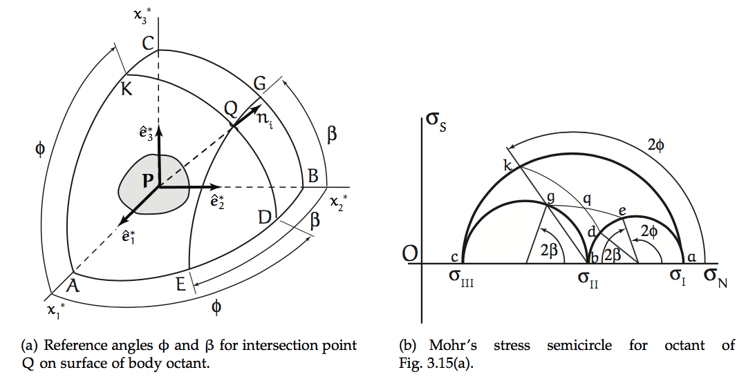
Cartesian Space vs Stress Space
are principal directions defining principal planes at P.
Small circles in Cartesian space (e.g. EQG) map onto circles (e.g. eqg) concentric with primary Mohr’s circles (e.g. akc).
Similarly, KQD maps onto kqd.
Intersection at q shows σ_{N} and σ_{s} on plane defined by normal vector n_{i} at Q.
(I have attempted to (sort of) correct the stress-plane figure below. ☺ )
q

