Slide 1
ESS 411/511 Geophysical Continuum Mechanics
Broad Outline for the Quarter
Continuum mechanics in 1-D
1-D models with springs, dashpots, sliding blocks
Attenuation
Mathematical tools – vectors, tensors, coordinate changes
Stress – principal values, Mohr’s circles for 3-D stress
Coulomb failure, pore pressure, crustal strength
Measuring stress in the Earth
Strain – Finite strain; infinitesimal strains
Moments – lithosphere bending; Earthquake moment magnitude
Conservation laws
Constitutive relations for elastic and viscous materials
Elastic waves; kinematic waves

Slide 2
ESS 511 Term projects
This Friday Nov 5:
60 second updates
Next Friday Nov 12:
1-page reports (outline, refs, …)
The following Friday Nov19:
60 second updates

Slide 3
Class-prep questions
Check out these websites about measuring stress in the Earth:
https://www.eoas.ubc.ca/courses/eosc433/lecture-material/L7-InSituStress.pdf
http://www.hydrofrac.com/hfo_home.html
https://courses.washington.edu/ess511/NOTES/SLIDE_SHOWS/PDF/stress_class_show_2017_all.pdf
Assignment:
What is a flatjack?
How can a flatjack be used to measure stress?

Slide 4
How do stresses vary across material boundaries?
e₃
e₁
e₂
Material 1
t⁽¹⁾
Material 2
Let’s choose a coordinate system
with e₁ and e₂ in the interface
now calculate all the forces on the little box
Let the thickness of the box go to zero
t⁽²⁾

Slide 5
How do stresses vary across material boundaries?
Material 1
ρ⁽¹⁾,
n⁽¹⁾
t⁽¹⁾
e₃
A
e₁
L
e₂
Material 2
ρ⁽²⁾,
Let’s choose a coordinate system
with e₁ and e₂ in the interface, and e₃ normal to the interface
Now add up all the forces on the surface of the little box
n⁽²⁾ = -n⁽¹⁾
t⁽²⁾
For equilibrium, Σf_{j} = 0
Let the thickness L of the box go to zero, so the areas of the sides go to zero
The only remaining nonzero forces are:

Slide 6
How do stresses vary across material boundaries?
Material 1
ρ⁽¹⁾,
e₃
n⁽¹⁾
t⁽¹⁾
e₁
e₂
A
L
Material 2
ρ⁽²⁾,
n⁽²⁾
t⁽²⁾

Slide 7
How do stresses vary across material boundaries?
Material 1
ρ⁽¹⁾,
e₃
n⁽¹⁾
t⁽¹⁾
e₁
e₂
A
L
Material 2
ρ⁽²⁾,
n⁽²⁾
t⁽²⁾
So σ₁₃, σ₂₃, and σ₃₃ must be continuous across the interface.
σ₃₁ and σ₃₂ are also continuous, since σ_{ij} is symmetric
There are no restrictions on σ₁₁, σ₁₂, σ₂₁, or σ₂₂.
They act only within their own material.
This is the principle of stress guides

Slide 8
How do stresses vary across material boundaries?
So σ₁₃, σ₂₃, and σ₃₃ must be continuous across the interface.
σ₃₁ and σ₃₂ are also continuous, since σ_{ij} is symmetric
brick
There are no restrictions on σ₁₁, σ₁₂, σ₂₁, or σ₂₂.
They act only within their own material.
This is the principle of stress guides
e₂
e₃
e₁
Is σ₂₂ continuous across the jello/steel interface?
What about σ₃₃ ?
steel
jello

Slide 9
Why do we care about stresses in the Earth?

Slide 10
Measuring stress around an excavation
Mine shaft
Tunnel
Well
Others?
Let’s take a break for some flatjacks with syrup ...

Slide 11
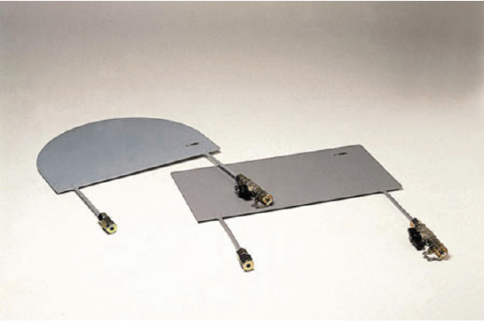
Flatjack Tests
What do you think the test might measure?
http://www.walterpmoore.com/

Slide 12
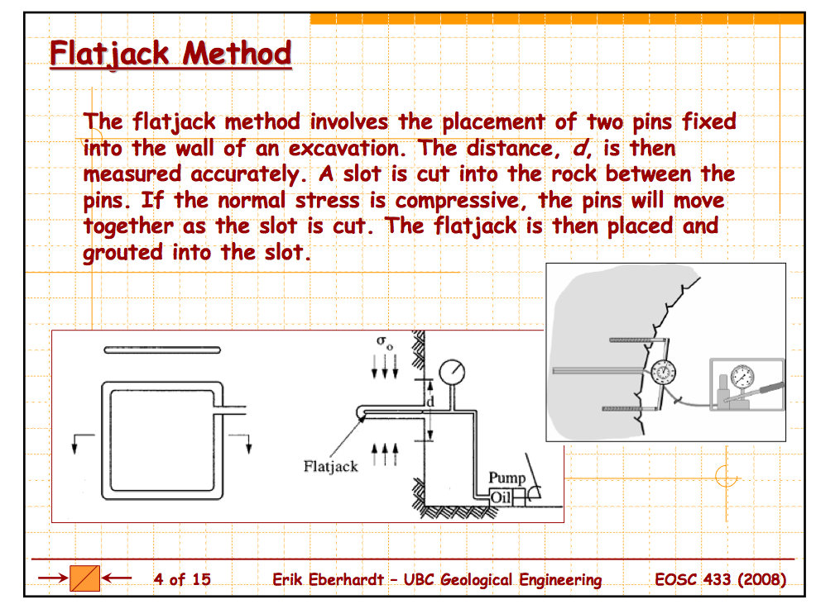

Slide 13
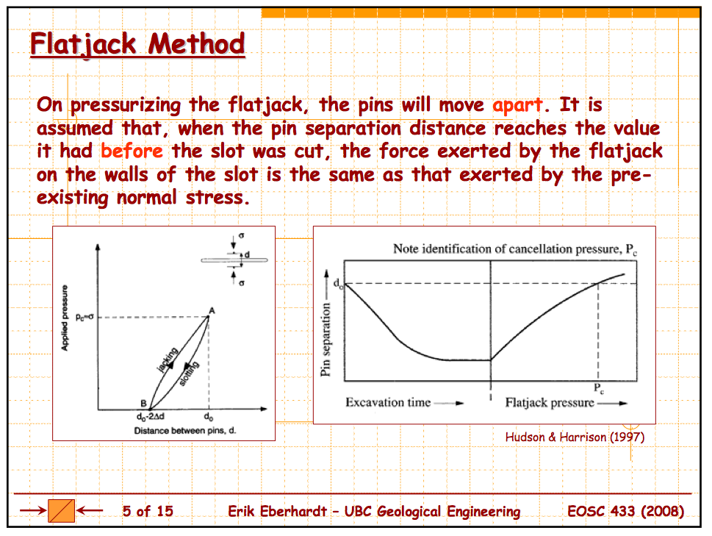

Slide 14
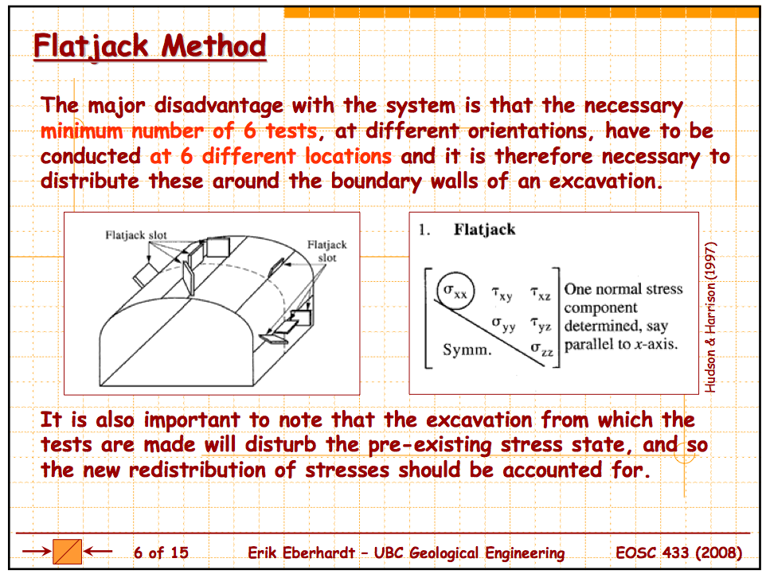

Slide 15
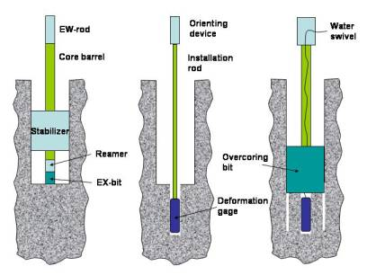
Overcoring – the operation
http://www.hydrofrac.com/hfo_home.html

Slide 16
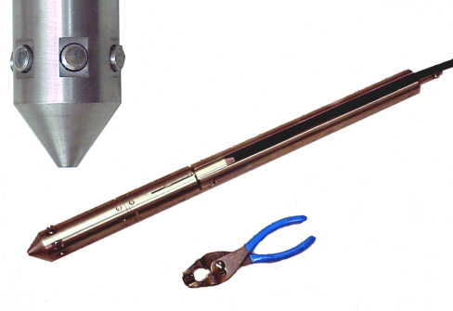
Overcoring – the tool
http://www.hydrofrac.com/hfo_home.html

Slide 17
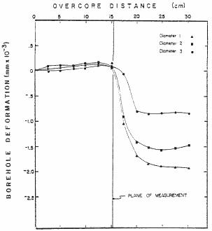
Overcoring – the data
Three channels of diametral deformations logged continuously as the deformation gage is overcored. As the overcoring bit passes through the plane of measurements, the stresses are relieved and the results are shown as diametral deformations.
http://www.hydrofrac.com/hfo_home.html
Notes:
http://www.hydrofrac.com/hfo_home.html
Three channels of diametral deformations logged continuously as the deformation gage is overcored. As the overcoring bit passes through the plane of measurements the stresses are relieved and the results are shown as diametral deformations (After Fisher, 1982).

Slide 18
Why 3 sensors at 120º?
Why not 2 sensors at 90º?
The hole will deform into an ellipse.
Many ellipses can fit 2 diameters.
How many parameters are needed to describe an ellipse?
θ
Major axis a
minor axis b
orientation angle θ
a
b
With 3 diameters, there is a unique ellipse solution

Slide 19
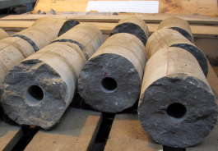
Overcoring - calibration
Now we know the deformation of the hole, but not the stress in the surrounding rock.
What’s next?
Rheological properties
Pressure tests and tri-axial tests on the recovered cores to relate measured strain to relieved stress.
http://www.hydrofrac.com/hfo_home.html

Slide 20
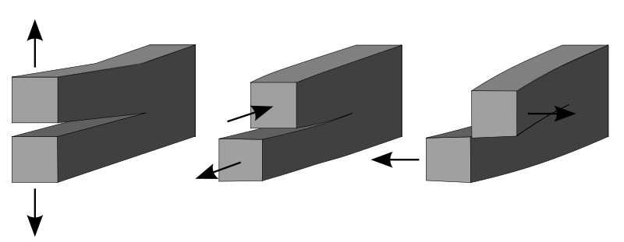
Modes of Cracking
Mode I:
Opening
Mode II:
In-plane shear
Mode III:
Out-of-plane shear
Crack
propagation
Crack
propagation
Crack
propagation

