Slide 1
ESS 411/511 Geophysical Continuum Mechanics Class #21
Highlights from Class #20 – John-Morgan Manos
Today’s highlights on Friday – Alysa Fintel
Kinematics of Deformation and Motion
For Friday, please read MSM Chapter 4.11 and 4.12
Velocity gradient and strain rate
Material derivatives of lines areas, and volumes

Slide 2
Problem Set #4
Brad is working on it ☺
Mid-term
I’m working on it …

Slide 3
ESS 411/511 Geophysical Continuum Mechanics
Broad Outline for the Quarter
Continuum mechanics in 1-D
1-D models with springs, dashpots, sliding blocks
Attenuation
Mathematical tools – vectors, tensors, coordinate changes
Stress – principal values, Mohr’s circles for 3-D stress
Coulomb failure, pore pressure, crustal strength
Measuring stress in the Earth
Strain – Finite strain; infinitesimal strains
Moments – lithosphere bending; Earthquake moment magnitude
Conservation laws
Constitutive relations for elastic and viscous materials
Elastic waves; kinematic waves

Slide 4


Class-prep for Class 22 on Friday: Strain Compatibility
For small strains, the strain is defined (Equation 4.62) as
where u_{i} =x_{i} – X_{A} δ_{iA} is displacement, the difference between current and initial positions. (The Kroenecker delta δ_{iA} just makes it clear how to relate the “A” subscripts in the initial coordinate system to the “i” subscripts in the current coordinate system.)
Section 4.8 describes strain compatibility, and the 81 strain-compatibility equations that relate the various second derivatives.
Assignment
81 equations– that’s a lot of equations!
Why are only 6 of them needed in practice?
Compatibility with what? What would strain incompatibility look like?
On page 129 – “It may be shown that the compatibility equations, either Eq 4.90 or Eq 4.91, are both necessary and sufficient for a single-valued displacement field of a body occupying a simply connected domain.”
How would you paraphrase this sentence into simple concepts?

Slide 5
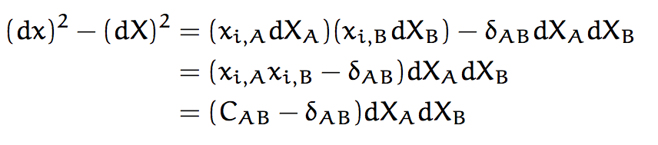

A Lagrangian measure for strain (dx)² – (dX)²
Green’s deformation tensor
Lagrangian finite strain tensor
Is C_{AB} symmetric?
Is E_{AB} symmetric?

Slide 6
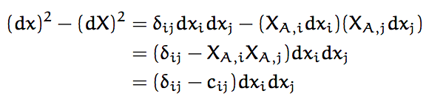
An Eulerian measure for strain (dx)² – (dX)²
Cauchy deformation tensor
Eulerian finite strain tensor
Is c_{ij} symmetric?
Is e_{ij} symmetric?

Slide 7


In terms of displacements u_{i} = (x_{i} – X_{i})

Slide 8
Finite Strain in 1-D
−ΔL
We typically first see strain expressed as
and when there is shortening, ΔL< 0
L₀
L₀+ΔL
But this approach is not accurate for large strains e.g. when -ΔL is large fraction of L₀. For example, break a big change into 2 smaller changes:
Step 1
Step 2
−ΔL = L₀ /2
L₀
L₀
−ΔL = L₀ /4
L₀ /2
L₀ /4
But in both steps the height was halved, so the incremental strain should be the same …

Slide 9
Finite Strain in 1-D
when -ΔL is large fraction of L₀, and L is the final length, we can address large strains by adding up a whole series of small strains.
We have to reset L₀ at each step and call it l
−ΔL
L₀
L₀+ΔL
?
(remembering that ΔL<0)
Now recall the Taylor series for ln(1+x) when -1< x < 1
With x= (ΔL / L_{O}),
The first term looks familiar …
The second term corrects for the changing l as strain proceeds

Slide 10

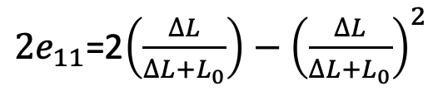
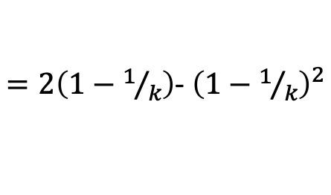
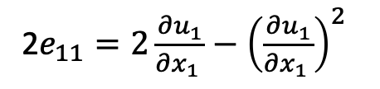
Eulerian Finite Strain Tensor
L₀
(**)
Displacement field
(i=j=A=1)
(particles move down so u₁<0)
A bar is shortened uniformly in the x₁ direction
Strain field
2$e_{11}=2\frac{∂u_{1}}{∂x_{1} }−{\left(\frac{∂u_{1}}{∂x_{1} }\right)}^{2}$
x₁= kX₁, e.g. k= 1/2
from (**)
$=2\left(1−1/k\right)$- ${\left(1−1/k\right)}^{2}$
and
so
$2e_{11}$=2$\left(\frac{∆L}{{∆L+L}_{0}}\right)−{\left(\frac{∆L}{{∆L+L}_{0}}\right)}^{2}$

Slide 11
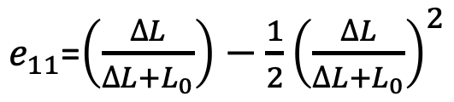
Let’s compare …
Traditional 1-D logarithmic finite strain
Eulerian finite strain tensor in 1-D
$e_{11}$=$\left(\frac{∆L}{{∆L+L}_{0}}\right)−{\frac{1}{2}\left(\frac{∆L}{{∆L+L}_{0}}\right)}^{2}$
They are clearly very similar for small ΔL
Both show a quadratic correction for larger strains

Slide 12
Example of a strain – is it small?
When an s-wave from a major Kamchatka quake arrives at Seattle, the ground is strained by the passing wave. To estimate the strain, we need to estimate
Displacement amplitude
Wavelength (think about frequency of vibration and typical wave propagation speed)
What is your estimate for the strain?
Would you need finite strain theory to analyze this?

Slide 13
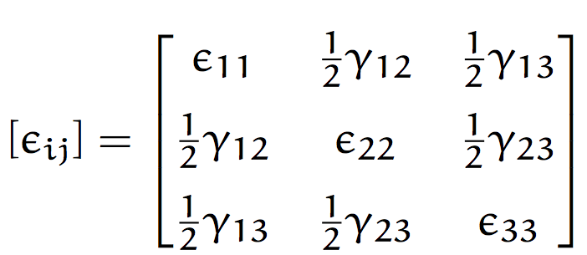
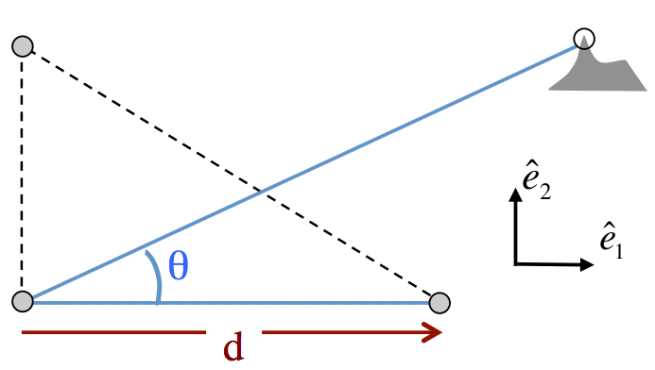
Class-prep: Moving Magma (Break-outs)
For small displacements and strains, the strain tensor can be written as (Eq. 4.72)
Magma is on the move at Mt Baker ski area
You are a surveyor with a “total station” (theodolite and EDM) to measure angles and distances.
Stress τ_{ij} is related to strain ε_{ij} by τ_{ij} = k ε_{ij} (k is an elastic-strength parameter)
you have 3 benchmarks (survey stations) arranged as a right-angled triangle.
Assignment
Understanding the strain tensor
Physical meaning of the diagonal entries?
Physical meaning of the off-diagonal entries?
(2) The strain tensor and the stress tensor
You have 1 month to determine the strain rate and stress in the ground from multiple surveys using your 3 survey benchmarks and the mountain peak.
What measurements will you plan to make over the one-month period, to derive the strain tensor from your data?
How will you calculate the stress tensor?
How will you determine the orientation of a potential fissure?

Slide 14
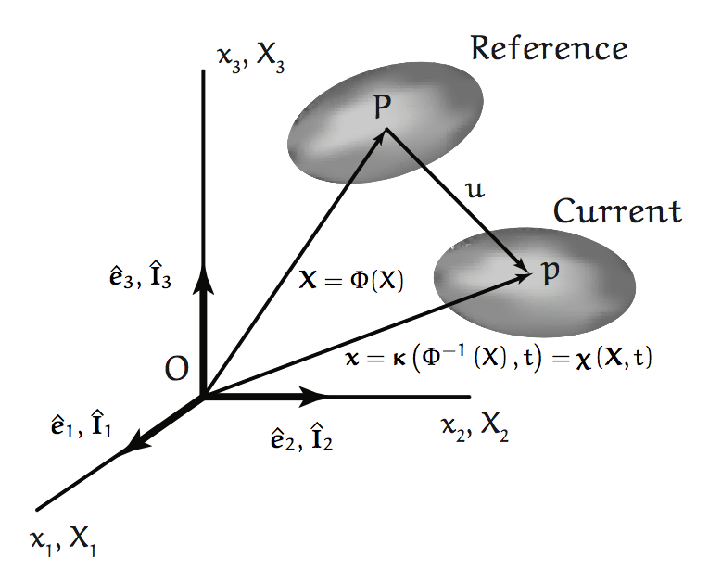
Initial and Final Configurations

Slide 15
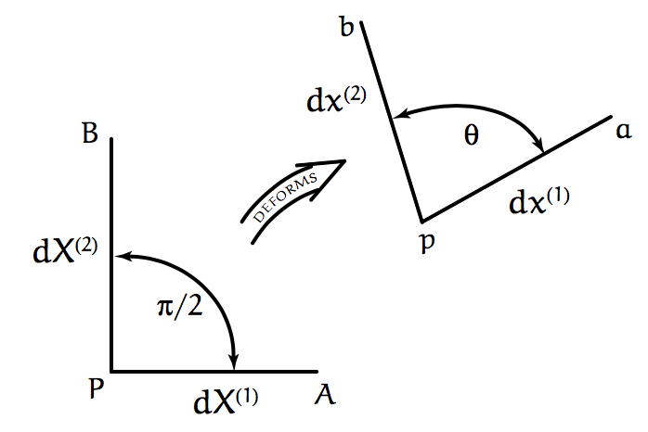

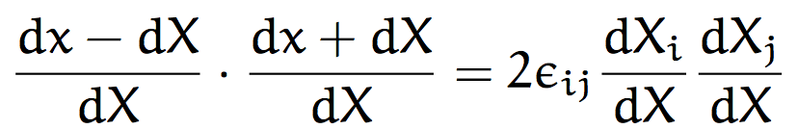







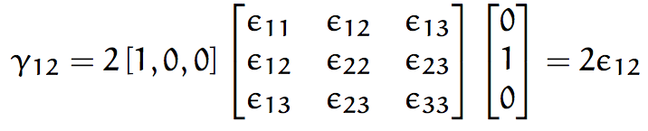
Small strain entries
γ
a unit vector in the direction of dX
change in length per unit original length for the element in the direction of N, called longitudinal strain.
If , then
If we set

Slide 16
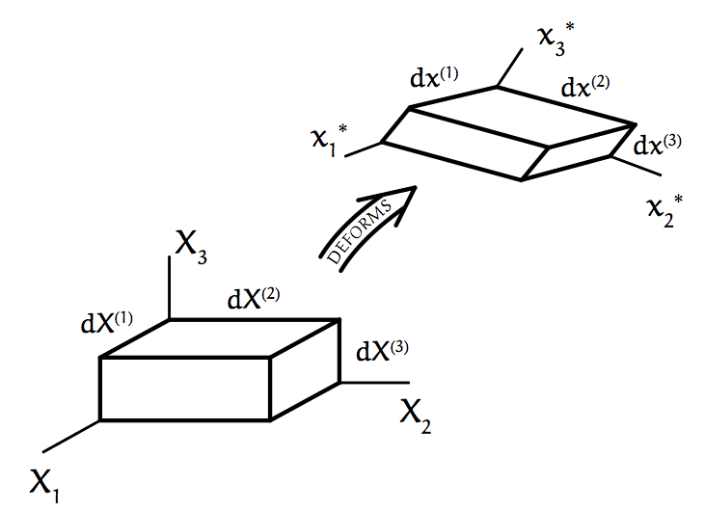
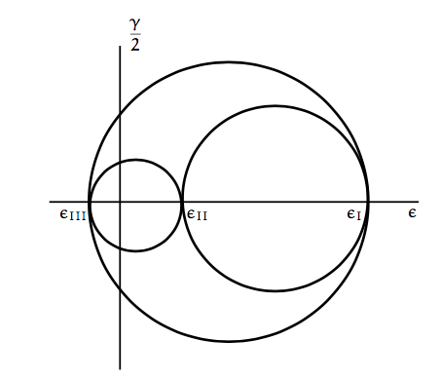

Slide 17

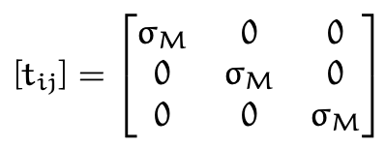

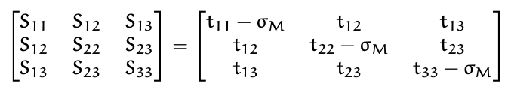
Deviatoric stress
Mean stress …
(How is this related to pressure?)
Spherical stress …
(Where might you find a state of stress like this?)
Decomposition …
Deviatoric stress …
What sort of materials would best be described by deviatoric stress?

Slide 18
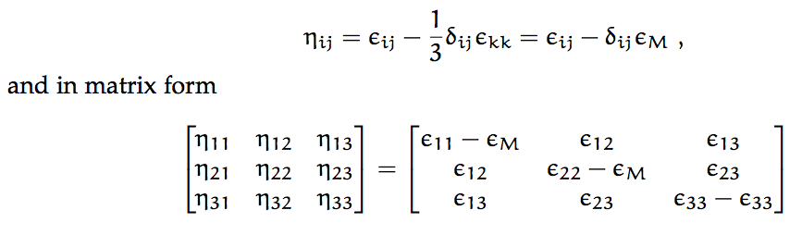
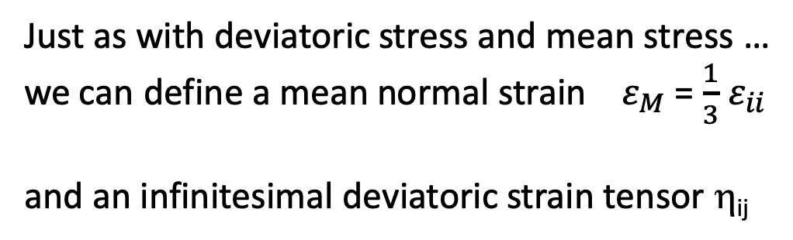
Deviatoric strain
Just as with deviatoric stress and mean stress …
we can define a mean normal strain $ε_{M}$ = $\frac{1}{3}$ $ε_{ii}$
and an infinitesimal deviatoric strain tensor η_{ij}
Where would deviatoric stress be a useful concept?

